Slide 1
College of Social Sciences and International Studies

Slide 2
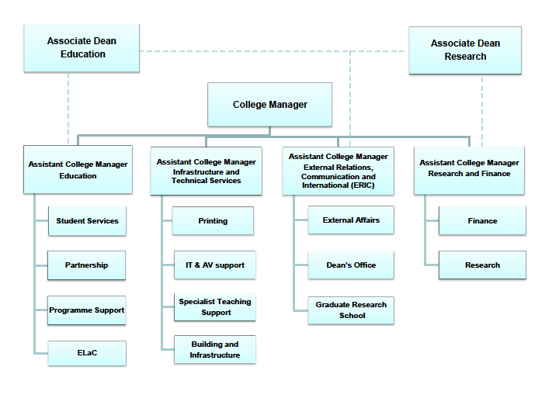
Professional Services Structure

Slide 3
Education
Assistant College Manager (Education)
Elaine Davies
Student Services
College Student Centre Manager
Tim Rushforth
Tremough
ASU
Streatham
College Student
Centre Manager
Tim Rushforth
St Luke’s
College Student Centre
Campus oversight: Lisa Fripp (Partnership Team)
Partnership
Partnership Director
Jos Sumner
Programme Support
(UG/PGT)
Academic /Programme Support Managers
Sally Slater
Rebecca Pace 0.6
(based primarily at St Luke’s)
Senior Administrator
Julia Southcott 0.5
- Team Leader and QA Support
Education
Academic/Programme
Support Manager
Rebecca Pace 0.6
Law
Senior Administrator
Tom Begbie
IAIS
Programme Manager
Jane Clark
Politics
Senior Administrator
Julia Southcott 0.5
Sociology &
Philosophy
Administrator
Dave Morning
ELaC
ELaC Manager
Mike Jeffries
Partnership
Co-ordinators
Rachel Ware
Lynda King
ITE Programme Manager
Lisa Fripp
Administrator
Lucy Brigden
Administrative Assistants
Alana Mitchell
Debbie Mitchell
Administrators
Audrey Cowlard
Lillian Bunni
Carole Lewis 0.8
Administrative Assistant
Catherine Allen 0.8
Administrator
Sam Phillips 0.6
Administrative Assistants
Tom Allen 0.8
Carole Miller 0.6
Sam Chalmers
Administrator
Sarah Roberts
Tremough
Administrator
Irene Christophers
Tremough
Administrator
Linds Langstaff0.6
Administrators
Jenny Wlasak 0.6
Susan Margetts
Computing Development Officers
Rich Osborne
Jeremy Miller
Technician
Richard Holding
Administrative Assistants
Jemma Allard
Tracey Hooper
Suzanne Seaton 0.8
Race Equality Resource Officer
Sara Bennett 0.2

Slide 4
Research & Finance
Assistant College Manager
0.5 Joanna Lunnon
1.0 Hannah Pike
Finance Manager
Vacant 0.8
(at a later date)
Senior Finance Administrator
Mike Phillips 0.5 *
Research & Finance Administrator
Caroline Sandford 0.6 *
Research Manager
Karan Ogden 0.8
Roz Davis 0.8
Senior Research Administrator
Fiona Raffael 0.4 *
Marilyn Stephens 0.2 *
Jane Clark 0.8
Finance Administrator
Sally Seedhouse0.6 *
Jean Wyatt 0.6 *
Claire Greener 0.6 (contract)
Lucy Smith 0.2 *
Research Administrator
Jess Barrett 0.66
Caroline Sandford 0.4*
Tamara Snell 0.6
Jo Moncur 0.5
Lucy Smith 0.2 *
Grant Funded
Cheryl Sutton 1.0
Claire Packman 1.0
Laura Dobb 1.0
Ginny Russell 0.1
Marilyn Stephen 0.8 *
Fiona Raffael 0.6 *
Robert Mason 0.5
Sarah Heeks0.5
Beata Faracik 0.4
Laura Newbury 1.0
Nichola Vickers 0.6
Research Assistant
Lucy Smith 0.2 *
Other jobs
Timetabling
Mike Phillips 0.5 *
Workload model
Sally Seedhouse 0.29 *
Admin Support
Jean Wyatt 0.2 *
Lucy Smith 0.2 *
Jane Clark 0.2 * (building and admin support)
* indicates job combined with
another post on this sheet

Slide 5
Senior Administrator
(Dean’s Office)
Andrea Schoefbeck 1.0
External Relations,
Communication and International
Assistant College Manager
Hannah Rundle 1.0
Elisenda McCutchion (maternity cover)
Dean’s Office
External Affairs
Team
Graduate Research
School
Administrator
(Dean’s Office)
Hanan Price 1.0
Administrator
(Dean’s Office)
Julia Rice0.8
Marketing + Communications Manager
Emma Reeve 1.0
Employability + Work Placements Officer
Julia Paci 1.0
Alumni Relations Officer
Stephen Gibson 0.5
Web Content + Marketing Officer
Anna Howell 1.0
Admissions + Marketing Officer
Eleanor Monger 1.0
Student Development
+ Policy Officer
Chris Longman 0.8
Senior Administrator
(Graduate Research School)
Sarmi Ghosh 1.0
Roos Zandstra – maternity cover
Administrative Assistant (Graduate Research School)
Melissa Mitcheson
0.5 term time only
Admissions + Scholarships Assistant
(Graduate Research School)
Liz Hull 1.0
Administrator
(Graduate Research School)
Jenny Andrews1.0
Modern Apprentice
Amy Rager 1.0

Slide 6
Infrastructure and Technical Services
Assistant College Manager
Joanna Lunnon 0.5
Buildings, IT & AV Support
Nigel Weaver 1.0
Printing
IT and AV support
Specialist Teaching Support
Buildings and Infrastructure
St Luke's Print Unit
Tina Otton 0.82
Jenny Wise 0.74
Andy Cutler 1.0
Paul Howell 1.0
Debs Bristow 0.9
Steve Lunn 1.0
Doug Allen 1.0
Chris Smith 0.74
Jenny Weaver 1.0
H&S support St Luke's
included in specialist teaching support
Doug Allen
H&S support Amory
tbc
building related matters St Luke's
included in specialist teaching support
Jenny Weaver
building related matters IAIS
included in Education
Jane Clark 0.2
Administrative Support
vacant post 0.2
building related matters Amory
included in Education
Audrey Cowlard 0.2
IT Support
Quaisar Iskander 1.0
Richard King 0.5
This diagram does not indicate the reporting structure of the Infrastructure and Technical Services Team.

