Slide 1

The Grammar of School-Age Writing:
What do we Already
(Think we Maybe (Don't))
Know?
Mark Brenchley

Slide 2
The Grammatical Basis of
Writing Development
“Exeter” approach → L1 grammar approached not as an abstract system, but as something deployed in actual pieces of writing
How is grammar actually deployed?
How is it deployed developmentally?

Slide 3
One time ago there was a king called King James the First. And the Catholics did not like him. And there was a bad man called Guy Fawkes. He wanted to blow the Houses of Parliament. He wanted to kill the king too, as well as the Catholics. He hid 36 barrels of gun powder and he hid it. Robert Catesby sent a letter to the king.
Year 2 (6-7 yrs)
I am writing to express my opposition to the article regarding “teenage tearaways” which was recently published in your newspaper. I could not help but notice the considerable bias in the article but I read on, only to witness your reporter put words into your readers’ mouths sentence, after sentence, after sentence.
Year 11 (15-16 yrs)

Slide 4
Repetition
One time ago there was a king called King James the First. And the Catholics did not like him. And there was a bad man called Guy Fawkes. He wanted to blow the Houses of Parliament. He wanted to kill the king too, as well as the Catholics. He hid 36 barrels of gun powder and he hid it. Robert Catesby sent a letter to the king.
Year 2 (6-7 yrs)
I am writing to express my opposition to the article regarding “teenage tearaways” which was recently published in your newspaper. I could not help but notice the considerable bias in the article but I read on, only to witness your reporter put words into your readers’ mouths sentence, after sentence, after sentence.
Year 11 (15-16 yrs)

Slide 5
Lexis
One time ago there was a king called King James the First. And the Catholics did not like him. And there was a bad man called Guy Fawkes. He wanted to blow the Houses of Parliament. He wanted to kill the king too, as well as the Catholics. He hid 36 barrels of gun powder and he hid it. Robert Catesby sent a letter to the king.
Year 2 (6-7 yrs)
I am writing to express my opposition to the article regarding “teenage tearaways” which was recently published in your newspaper. I could not help but notice the considerable bias in the article but I read on, only to witness your reporter put words into your readers’ mouths sentence, after sentence, after sentence.
Year 11 (15-16 yrs)

Slide 6
One time ago there was a king called King James the First. And the Catholics did not like him. And there was a bad man called Guy Fawkes. He wanted to blow the Houses of Parliament. He wanted to kill the king too, as well as the Catholics. He hid 36 barrels of gun powder and he hid it. Robert Catesby sent a letter to the king.
Year 2 (6-7 yrs)
I am writing to express my opposition to the article regarding “teenage tearaways” which was recently published in your newspaper. I could not help but notice the considerable bias in the article but I read on, only to witness your reporter put words into your readers’ mouths sentence, after sentence, after sentence.
Year 11 (15-16 yrs)

Slide 7
Mapping the Terrain
Systematic literature review
8,058 initial texts
468 final texts
658 “supplementary” texts
Not quite complete but general picture clear
(Not simply that doing a review is a total pain)

Slide 8
Mapping the Terrain
PLENTY OF INDIVIDUAL FINDINGS
Phrase Level
    NP Structure (type and # of modifications)
AGE ⬆ (Crossley et al. 2011; Ravid & Berman, 2010)
QUAL ⬆ (Olinghouse & Wilson, 2013)

Slide 9
Mapping the Terrain
PLENTY OF INDIVIDUAL FINDINGS
Clause Level
    # Coordinated Clauses
AGE ⬇ (Veal, 1974)
    # Relative Clauses
QUAL ⬆ (G&F, 1970)

Slide 10
Mapping the Terrain
PLENTY OF INDIVIDUAL FINDINGS
Discourse “Flow”
    Subject Opening
QUAL ⬇ (Myhill, 2008)
    Non-Finite Adverbial Clause Opening
QUAL ⬆ (Myhill, 2008)
    Subject-Verb Inversions
QUAL ⬆ (Myhill, 2008)

Slide 11
Mapping the Terrain
PIECES OF A PUZZLE #1
Variation not necessarily continuous
“Continuous”:
AGE ⬆ - Passives (Hunt, 1965)
QUAL ⬇ - Coordinated Clauses (Myhill, 2008)

Slide 12
Mapping the Terrain
PIECES OF A PUZZLE #1
Variation not necessarily continuous
“Pick ups”
NP Modification: postgrads > 11 > 7 = 4 (R&B, 2010)
Participial Adjectives: high > medium = low (G&F, 1970)
“Drop Offs”
Adverbial Clauses: 7 = 5 > 3 (O’Donnell et al, 1967)
Relative Clauses: high = medium > low (G&F, 1970)

Slide 13
Mapping the Terrain
PIECES OF A PUZZLE #2
Shifts of Grammatical Attention
NP LENGTH: postgrads > 11 = 7 = 4
NP MODIFICATION: postgrads > 11 > 7 = 4
NP ABSTRACTION: postgrads > 11 > 7 > 4
(Ravid & Berman, 2010)

Slide 14
Mapping the Terrain
PIECES OF A PUZZLE #3
Two Developmental Strands: “AGE” + “QUALITY”
Sometimes align
Relative Clauses
    QUALITY ⬆, AGE ⬆ (Golub & Frederick, 1970)
Modals
    QUALITY ⬆, AGE ⬆ (Golub & Frederick, 1970)

Slide 15
Mapping the Terrain
PIECES OF A PUZZLE #3
Sometimes don’t
Sentences with Adverbial Opening
    QUALITY: Good = Average = Weak
    AGExQUALITY: Good > Average > Weak @ 8
    Good = Average = Weak @ 10
    (Myhill, 2008)

Slide 16
Mapping the Terrain
PIECES OF A PUZZLE #3
Sometimes don’t
Sentences with Non-Finite Adverbial Clause Opening
    AGExQUALITY: Good = Average = Weak @ 8
    Good > Average > Weak @ 10
    (Myhill, 2008)

Slide 17
Mapping the Terrain
PIECES OF A PUZZLE #4
Importance of the Wider Diatypic Context
Genre:
  T-Unit Length: A > D > N (Crowhurst & Piché, 1979)
Audience:
  Clause Length: Teacher > Friend (Crowhurst & Piché, 1979)

Slide 18
Mapping the Terrain
PIECES OF A PUZZLE #4
Genre:
  T-Unit Length:
  AGE @10: A > D > N
  @6: A > N, A = D, D = N
  QUAL @ARG: Positive Relationship
  @NAR: Negative Relationship
  (Crowhurst, 1980; Crowhurst & Piché, 1979)

Slide 19
Mapping the Terrain
PIECES OF A PUZZLE #4
Genre:
  T-Unit Length:
  AGE @10: A > D > N
  @6: A > N, A = D, D = N
  QUAL @ARG: Positive Relationship
  @NAR: Negative Relationship
  AGExQUAL @12: ARG: Positive Relationship
  NAR: Negative Relationship
  @6: ARG: No Relationship
  NAR: No Relationship

Slide 20
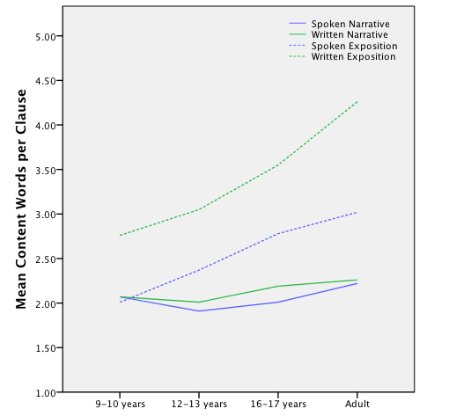
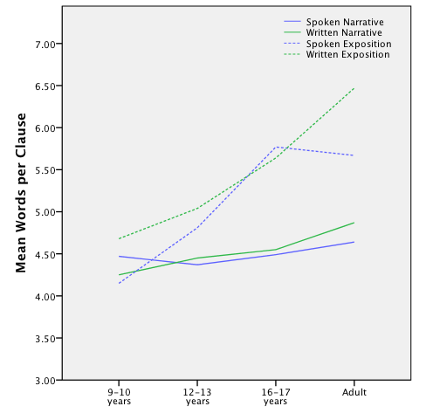
Mapping the Terrain
Words per Clause
(Berman & Ravid, 2009)
Content Words per Clause
(Berman & Ravid, 2009)

Slide 21
Mapping the Terrain
PIECES OF A PUZZLE #5
Systematicity?
Not just about individual bits of grammar, but how they are interrelated

Slide 22
Mapping the Terrain
PIECES OF A PUZZLE #5
Dean & Quinlan (2010)
    US Essay Writing (Descriptive, Persuasive)
    @ 4th, 6th, 8th, 10th, 12th grade
    e.g. “Spoken Style”: mental state/conversation verbs (+ve)
    first person singular pronouns (+ve)
              noun/verb ratio (-ve)
          attributive adjectives (-ve)
    AGE: @4/6/8/10/12: Negative Association
    QUALITY: @Persuasive: Negative Association
          @Descriptive: Positive Association

Slide 23
Mapping the Terrain
Fragmentary evidence base, but pieces of underlying puzzle
Problematic educationally – how can we support teachers and students in putting all these pieces together more comprehensively?
Value of a multi-dimensional approach, grounded in the work of Douglas Biber (1988)
Language use can be modeled as a set of core communicative functions that cut across specific instances of language use
Each function associated with specific clusters of grammatical features
Writing development as students “attaining” and then “better deploying” the appropriate sets of grammatical features for expressing these underlying communicative functions in particular writing contexts

Slide 24
References
Berman, R. A. & Ravid, D. (2009). Becoming a Literate Language User: Oral and Written Text Construction across Adolescence. In D. R. Olson & N. Torrance (eds.) Cambridge Handbook of Literacy (92-111). Cambridge: Cambridge University Press.
Biber, D. (1988). Variation across speech and writing. Cambridge: Cambridge University Press.
Crossley, S. A. et al. (2011). The development of writing proficiency as a function of grade level: A linguistic analysis. Written Communication 28(3), 282-311.
Crowhurst, M. (1980). Syntactic complexity and teachers’ quality ratings of narrations and arguments. Research in the Teaching of English 14(3), 223-213.
Crowhurst, M. & Piché, G. L. (1979). Audience and mode of discourse effects on syntactic complexity in writing at two grade levels. Research in the Teaching of English 13(2),101-109.
Dean, P. & Quinlan, T. (2010). What automated analyses of corpora can tell us about students’ writing skills. Journal of Writing Research 2(2), 151-177.
Golub, L. S. & Frederick, W. C. (1970). An analysis of children's writing under different stimulus conditions. Research in the Teaching of English 4(2), 168-180.

Slide 25
References
Loban, W. (1976). Language development: Kindergarten through grade twelve. Urbana, IL: NCTE.
Myhill, D. A. (2008). Towards a linguistic model of sentence development in writing. Language and education 22(5), 271-288.
O’Donnell, R. C. et al. (1967). A transformational analysis of oral and written grammatical structures in the language of children in grades three, five, and seven. The Journal of Educational Research 61(1), 35-39.
Olinghouse, N. G. & Wilson, W. (2013). The relationship between vocabulary and writing quality in three genres. Reading & Writing 26(1), 45-65.
Ravid, D. & Berman, R. A. (2010). Developing noun phrase complexity at school: A text- embedded cross-linguistic analysis. First Language 30(1), 3-26.
Veal, L. R. (1974). Syntactic measures and rated quality in the writing of young children. Studies in Language Education, Report 8. Athens, GA: University of Georgia.
Harpin, W. (1976). The Second 'R': Writing Development in the Junior School. London: Allen & Unwin.
Hunt, K. W. (1965). Grammatical Structures Written at Three Grade Levels. Champaign, IL: NCTE.

