Slide 1
Using nouns to establish genre and setting

Slide 2
LEAD Principles
PRINCIPLE | EXPLANATION | RATIONALE
LINKS | Make a link between the grammar being introduced and how it works in the writing being taught | To establish a purposeful learning reason for addressing grammar, and connect grammar with meaning and rhetorical effect
EXAMPLES | Explain the grammar through examples, not lengthy explanations | To avoid writing lessons becoming mini-grammar lessons, and to allow access to the structure even if the grammar concept is not fully understood
AUTHENTIC TEXTS | Use authentic texts as models to link writers to the broader community of writers | To integrate reading and writing and show how ‘real’ writers make language choices
DISCUSSION | Build in high-quality discussion about grammar and its effects | To promote deep metalinguistic learning about why a particular choice works, and to develop independence rather than compliance
Notes:
These are the key pedagogical principles which underpin the teaching. In the slides which follow, where the teaching is using these principles, they are shown in cream text boxes.
If you are not familiar with the principles you might like to listen to the PPT with audio which explains them.

Slide 3
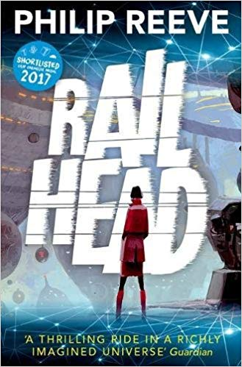
Genre and Setting
What genre is this story?
What might the setting be like for this story?
What might be the names of places and objects in the story?
What might the writer want to do for the reader in naming these places and objects?
Authentic text
Discussion
Notes:
Screenshot quotation is from Philip Reeve’s website: https://www.philip-reeve.com/railhead/
Railhead is the first volume of his science fiction trilogy (the others are Black Light Express and Station Zero), stories set in high-tech future societies.
The author explains the origin of some of the place and character names in the novel on this website:
http://www.philip-reeve.com/category/railhead-a-z/
Examples of place names: The Network Empire; the Great Network; the Datasea; Spindlebridge; the K-Bahn; Jangala
Examples of people’s names: the Guardians; Station Angels; Hive Monks; Zen Starling
You can bring out in discussion that names in science fiction are often altered versions of recognisable ones, which helps the reader imagine an invented world by comparing it to our own, while at the same time signalling its differences. For example, in the world of Railhead, ‘Jangala’ is a jungle-like tropical resort for important guests; “The Datasea is composed of the interlinked internets of every planet in the empire. It’s not just used by people; it’s home to all sorts of artificial intelligences, ranging from the godlike Guardians to all kinds of bots, data entities and semi-intelligent viruses, which make it a fairly dangerous sea to surf: people can get lost in there…”
On the next slide, Philip Reeve explains the ‘work’ that names do in what he calls ‘worldbuilding’ - establishing the reader’s view of a sci-fi world and the people in it.

Slide 4
Choosing names for science fiction
“Getting the names right is half the battle – you can do a lot of worldbuilding simply by deciding what people and places are called. When I started writing the story which became Railhead I tried to make sure the names sounded different. I called my central characters Zen and Nova because those were the sorts of names I remember from futuristic stories and TV shows that were around when I was a child – they’re sci-fi names. I knew that in German-speaking cities there are often railway lines called the U-bahn and the S-bahn. My interstellar empire would be linked by the K-bahn, whose trains would go through K-gates and flash across a dimension called K-space to reach their far destinations.”
Philip Reeve

Slide 5
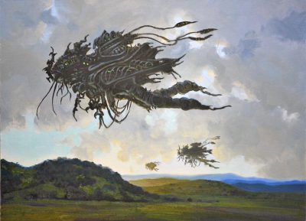
Choosing a science-fiction name: your turn!
What if… robots were in control of the world? What do you think this robot’s job might be? What name would you give it that suggests its role?
Notes:
Invite students to suggest suitable Proper Nouns and encourage explanations of choices that emphasise the connection between the name and the robot’s role in a futuristic world. Border patrollers? Law enforcers? Spies? As with Philip Reeve’s examples, you can stress how sci-fi names often combine the familiar and the invented, and, like Datasea, might take the form of a compound noun.
Some suggestions: Robopatroller; Turbo Guardian; Enemyblaster; I-Spies; Buzzbugs; Motorclones.

Slide 6
Using Proper Nouns to describe a science fiction setting
Links
Zen’s hometown was a sheer-sided ditch of a place. Cleave’s houses and factories were packed like shelved crates up each wall of a mile-deep canyon on a one-gate world called Angkat whose surface was scoured by constant storms. Space was scarce, so the buildings huddled into every available scrap of terracing, and clung to cliff faces, and crowded on the bridges which stretched across the gulf between the canyon walls – a gulf which was filled with sagging cables, dangling neon signage, smog, dirty rain, and the fluttering rotors of air taxis, ferries and corporate transports. Between the steep-stacked buildings a thousand waterfalls went foaming down to join the river far below, adding their own roar to the various dins from the industrial zone. The local name for Cleave was Thunder City.
From Railhead by Philip Reeve
Examples
What impression of this place do you get? Would you want to live there?
What more do the highlighted place names tell you?
Discussion
Notes:
Description of the city setting in Railhead, home to the main character, Zen Starling. Read once and discuss reactions to the description: what impression of this place do we form? What would it be like to live there?
In a second reading, focus on the highlighted Proper Nouns – ask what further impression of the setting we get from these names – what more do they tell us about life in this place?
Students may well not know the word ‘cleave’ – ask if the sound of the word and the context provide clues (e.g. ‘mile-deep canyon’), or explore linked words – cleaver, cleaving, cloven (hoof) – before going to a dictionary. ‘Cleave’ is a good example of a word that can be both verb (to cut, splice or cling to) and noun: a geographical feature which is like a gorge. Here, the choice of ‘Cleave’ emphasises the unnatural, artificial, harsh and ugly nature of the city. Angkat might be a portmanteau word from Angkor Wat temple complex in Cambodia – a place of ancient walls and towers and the seat of the once-powerful Khmer Empire. Philip Reeve says he uses a lot of Asian-sounding names in Railhead because he sees Asia as a future leading power, more so than the ‘tired Western world’. Here, might it also be used because it sounds exotic, unusual, from another world?
Does Thunder City suggest anything other than noise? Do we infer that this is a powerful place? A dangerous place? Try word substitution to emphasise the effect of this particular choice i.e. how would our view be different if it was called ‘Whisper City’?

Slide 7
Using concrete nouns to describe a science fiction setting
Zen’s hometown was a sheer-sided ditch of a place. Cleave’s houses and factories were packed like shelved crates up each wall of a mile-deep canyon on a one-gate world called Angkat whose surface was scoured by constant storms. Space was scarce, so the buildings huddled into every available scrap of terracing, and clung to cliff faces, and crowded on the bridges which stretched across the gulf between the canyon walls – a gulf which was filled with sagging cables, dangling neon signage, smog, dirty rain, and the fluttering rotors of air taxis, ferries and corporate transports. Between the steep-stacked buildings a thousand waterfalls went foaming down to join the river far below, adding their own roar to the various dins from the industrial zone. The local name for Cleave was Thunder City.
Why do you think there are so many objects listed in this description?
What things are familiar to you? What things are more unusual?
Would you want to live in this place? Why, or why not?
Notes:
Read the extract again, this time focusing on the highlighted concrete nouns. Note how much of the description is formed by essentially providing a list of concrete nouns, adding to the crowded, chaotic impression of the place.
Prompt students to focus on the writer’s choice of objects and how they are juxtaposed e.g. by asking them to group and label the objects. Headings might be:
natural v. manufactured (e.g. ditch, canyon, river, cliff faces, waterfalls/buildings, cables, neon signage, rotors, industrial zone)
weather-related (e.g. smog, rain, storms)
familiar/unfamiliar (e.g. buildings, factories, houses/rotors of air taxis, corporate transports)
heights/depths (e.g. canyon, gulf, ditch, terracing, cliff faces, canyon walls
repeated nouns (e.g. canyon, gulf, buildings, wall)
Other suggested prompts for discussion and close reading:
Focus on sensory description that helps us imagine Zen’s hometown, sketching the scene if helpful, e.g:
Imagine standing at the top of the one-mile deep canyon looking down: What would you see? What would you hear? Imagine standing at the bottom of the canyon looking up: What would you see? What would you hear? You could ask students to use the highlighted nouns to quickly sketch the scene, then compare with another pair’s drawing. What could they easily see/draw; what was trickier? Note that a picture of this place (from Philip Reeve’s website) is provided on the next slide, so you could project this and ask if it’s a good representation of what they have imagined.
If appropriate, you could focus on the writer’s use of juxtaposition and irony. For example, the choice of ‘hometown’ is interesting, suggesting a cosiness and comfort that isn’t reflected in the description. Philip Reeve describes Cleave as ‘a dump’ which provides a reason for Zen to leave and look for a better life elsewhere. Perhaps the choice of ‘hometown’ suggests a slight unwillingness in having to do so? Much of the description hinges on the contrast between natural, potentially beautiful features, and their unnatural- and precarious - colonisation by humans.
As noted previously about science fiction, ordinary objects are often skewed slightly to become futuristic – hence ‘taxis’ become ‘air taxis’ and buildings are stacked like crates, highlighting both lack of available building space/overcrowding but also loss of personal/human identity – reminds us of battery chickens perhaps?

Slide 8
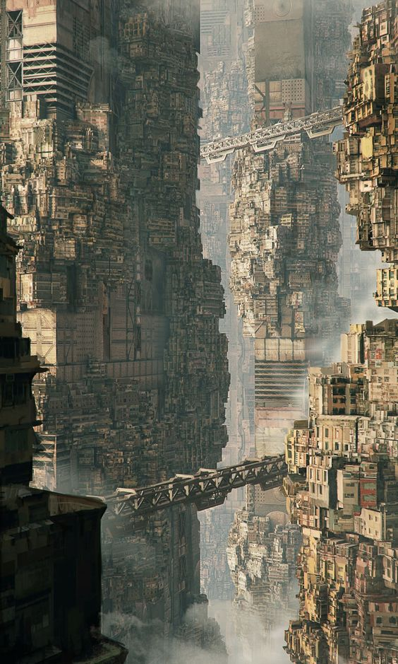
How well does the image match the description?
Cleave’s houses and factories were packed like shelved crates up each wall of a mile-deep canyon on a one-gate world called Angkat whose surface was scoured by constant storms. Space was scarce, so the buildings huddled into every available scrap of terracing, and clung to cliff faces, and crowded on the bridges which stretched across the gulf between the canyon walls – a gulf which was filled with sagging cables, dangling neon signage, smog, dirty rain, and the fluttering rotors of air taxis, ferries and corporate transports.

Slide 9
Verbalising the Grammar-Writing Link
A crucial element of the LEAD principles is helping writers to think explicitly (metalinguistically) about the choices they make. As a teacher, you need to support this by being crystal clear yourself about how you verbalise the link between a grammar choice and its effect in a particular text/context. Then express this in student-friendly language, as below.
Verbalisation to share with students:
When you are writing narrative, you can help your reader to understand the genre of your story and to visualise important settings within it.
Choose your Proper and concrete nouns carefully! Ask yourself what you want your reader to see, think and feel about the setting that you’re describing.
Notes:
This is key: our research shows that teachers need to ‘practise’ verbalising the link for themselves; and then share it with students (and discuss it in the context of the students’ own writing).

Slide 10
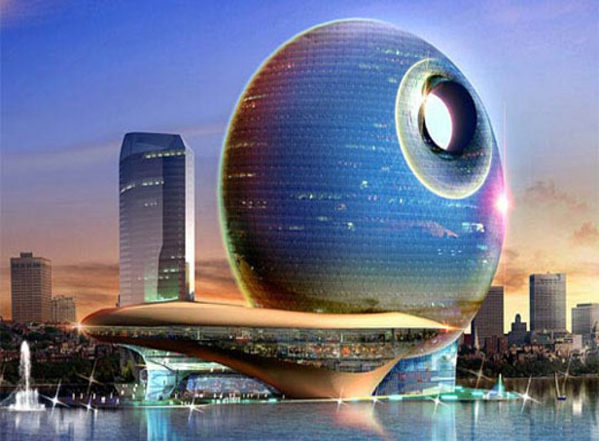
Imagine this is the setting for a science fiction story. Choose Proper Nouns to name the city and/or buildings in it and concrete nouns to list some of the things you might see or hear. Your aim is to use nouns that help your reader to imagine what it would be like to live in this place. Focus on noun choice as you write the opening sentences to the story.
Notes:
You might want to use this slide to consolidate learning.
If helpful, students might imagine this as the city base from which the robot patrols (slide 5) operate.
Encourage students to explain what they want their name to suggest e.g. Blue Sky City might suggest a go-ahead ambitious place; The name Geometron might hint at the geometric design of the city’s buildings (compare with London’s The Shard), its transport systems (metro) and a digital or mechanised world (metronome).
For the opening sentence(s), you can use the extract from Railhead as a model e.g. using the technique of listing objects:
An example:
Geometron was a vast grid-like space filled with triangular towers, glitterball spheres, curving glass bridges and motorised walkways on stilts. Every hour, on the hour, silent drone patrols streamed from the eye of the mighty Neodome, bound for the Borderlands, as workers criss-crossed the city streets. No-one paused or looked up.

