Slide 1
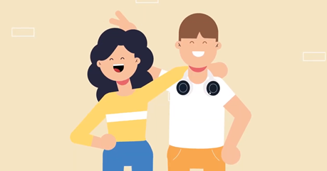
Working out relationships – LESSON 2
Learning Objectives:
To learn about healthy and unhealthy one-to-one intimate relationships and strategies to build healthy lasting relationships
Notes:
This lesson builds on Lesson 1 which looked at recognising an unhealthy relationship. Here the focus is on recognising a healthy relationship: what are the key attributes of such relationships and what are the skills and strategies needed to build healthy lasting relationships?
RUN THROUGH the learning objectives on the slide.

Slide 2
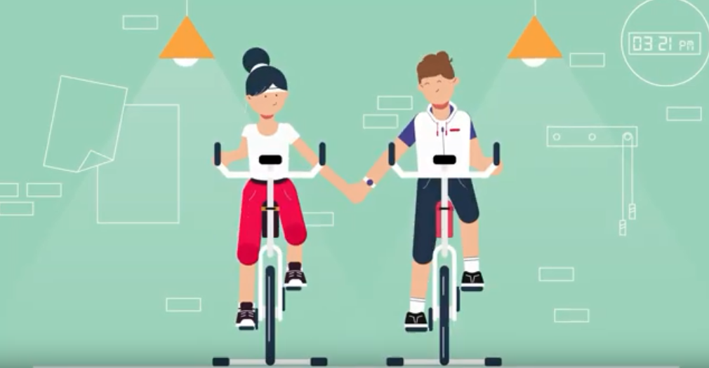
Working out relationships – LESSON 2
Learning Outcomes
Pupils will be able to:
Evaluate whether a relationship is healthy or unhealthy
Identify strategies to build a healthy lasting relationship
Define a healthy relationship
Notes:
This lesson builds on Lesson 1 which looked at recognising an unhealthy relationship. Here the focus is on recognising a healthy relationship: what are the key attributes of such relationships and what are the skills and strategies needed to build healthy lasting relationships?
RUN THROUGH the learning outcomes on the slide.

Slide 3
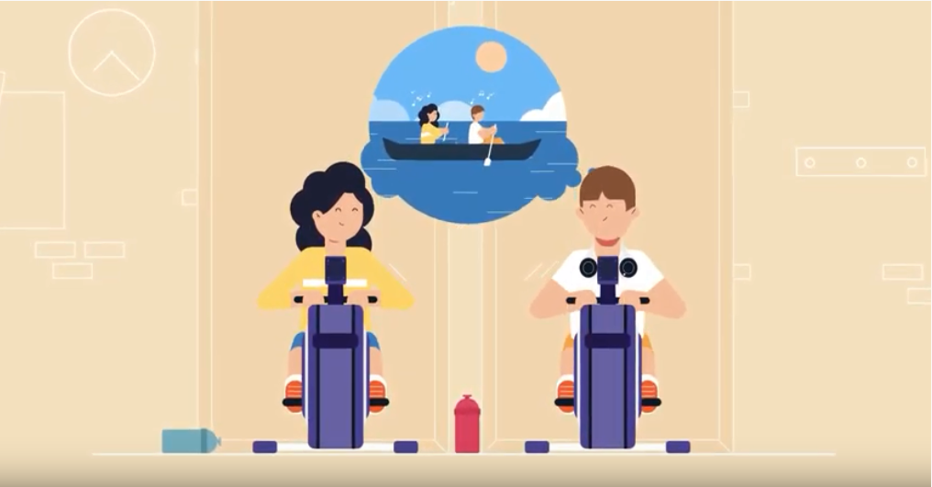
Working out relationships
To what extent do you agree that ‘if a relationship is good, it shouldn’t be hard work.’
Notes:
Ask the whole class to think about the extent to which they agree that ‘If a relationship is good, it shouldn’t be hard work’. The focus of this lesson is on be normalising that relationships take effort to keep them vibrant.

Slide 4
Working out relationships
Task
Read this relationship scenario.
Jess and Ethan aren’t looking for a serious relationship yet but what is it about their relationship that makes it healthy?
Jess and Ethan are both 16. They met at their school drama club 6 months ago. They chatted for a month or so before Ethan plucked up the courage to ask Jess out. Ethan likes that Jess is confident and that they can talk about silly things and serious things for hours. Jess thinks that Ethan is funny and kind. Jess and Ethan enjoy drama club and hanging out watching box-sets together. Ethan is mad about football and plays three times a week. Jess isn’t into football but she likes to go to watch Ethan play sometimes. When he is at football she goes out with her friends or catches up on school work. Ethan used to get a bit upset that Jess didn’t come to watch him play more often but they had a chat and Jess explained that she really wants to do well at school this year so she has to work hard. Ethan likes that Jess is ambitious and so is now ok about her not coming to watch him play often.
Notes:
This slide introduces pupils to the Jess and Ethan scenario. This baseline activity tests what pupils of all abilities recognise as healthy relationship traits. Stress that this couple are not looking for a serious relationship. The emphasis here is on recognising whether a relationship has the necessary foundations to be healthy long term.
ASK: What is it about their relationship that makes it healthy? Pupils should mention things like:
They like each other/ have fun together/have lots in common/ are equals/ respect and see the best in each other
They don’t expect to spend all their time together or the relationship to be perfect
Dealt well with Jess not always attending football
They have a healthy balance between time together and time apart with friends

Slide 5
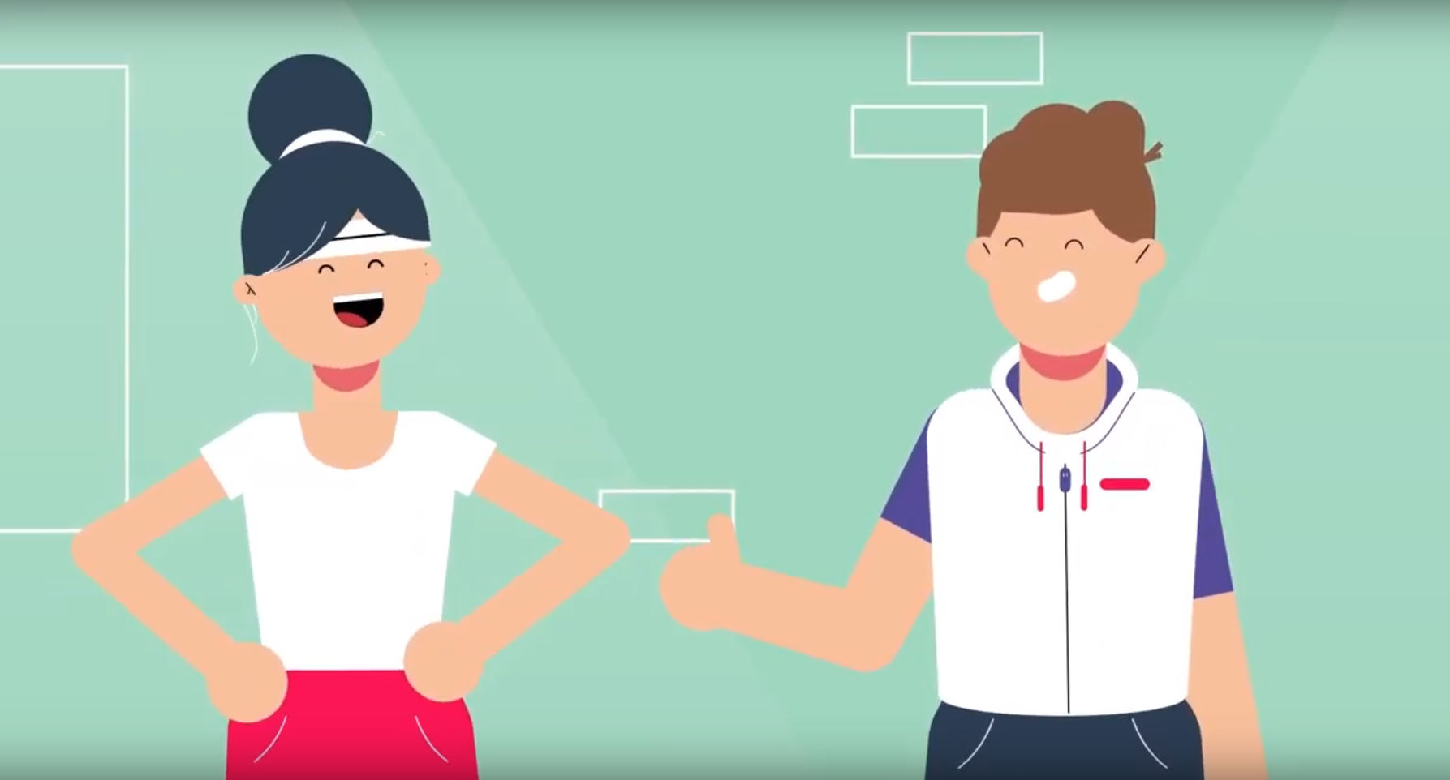
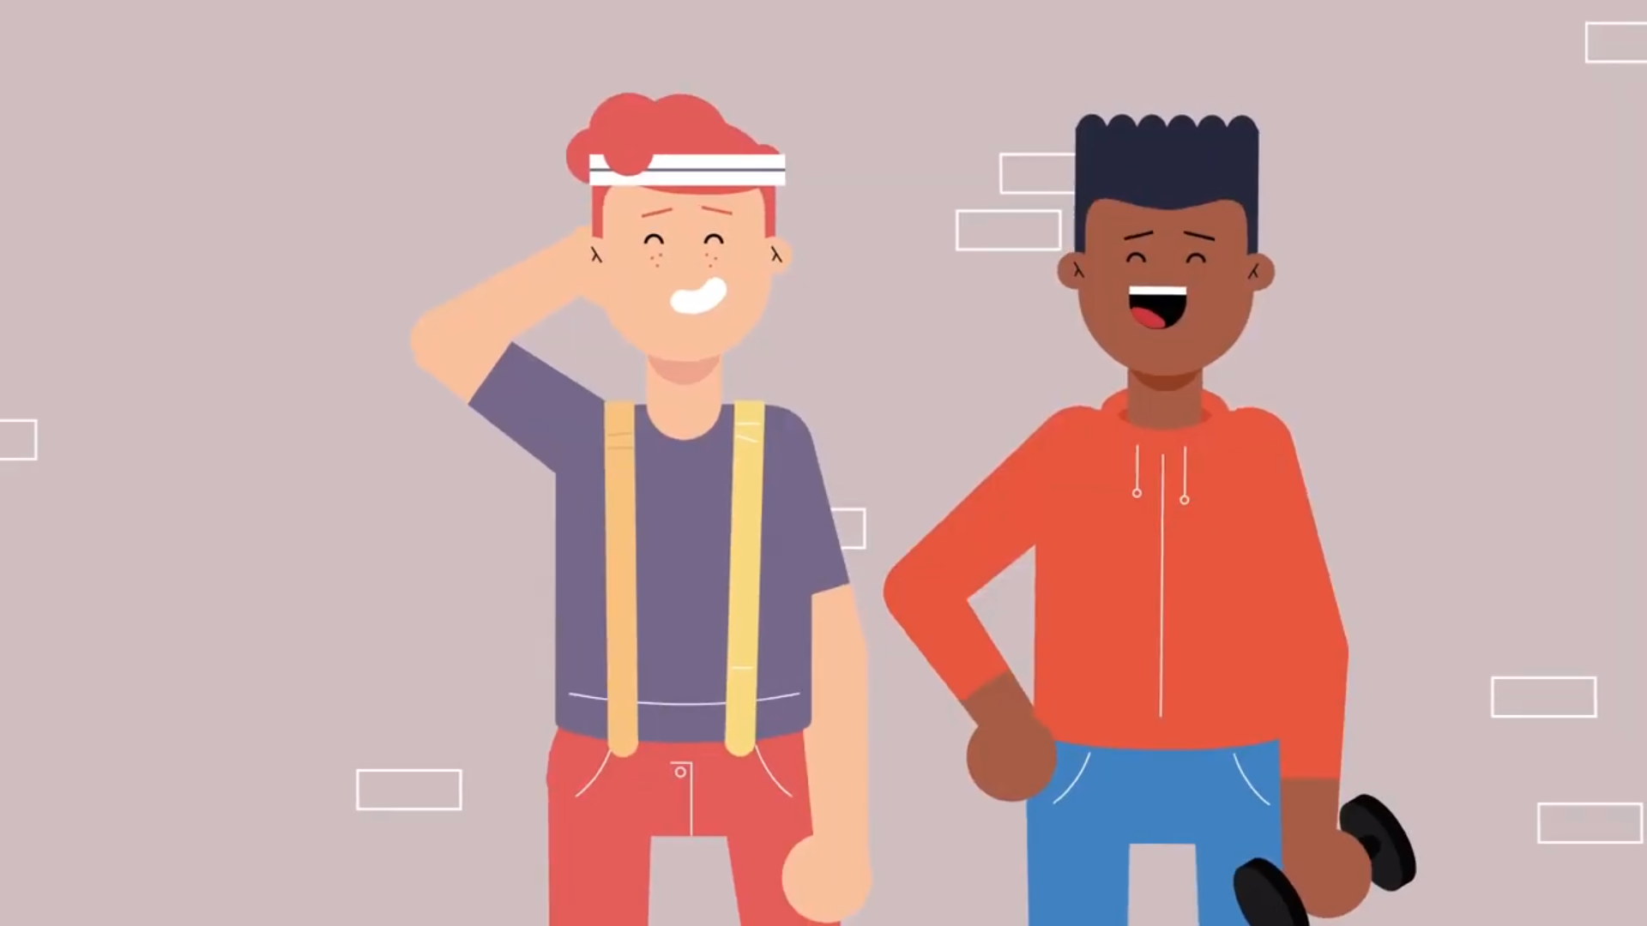
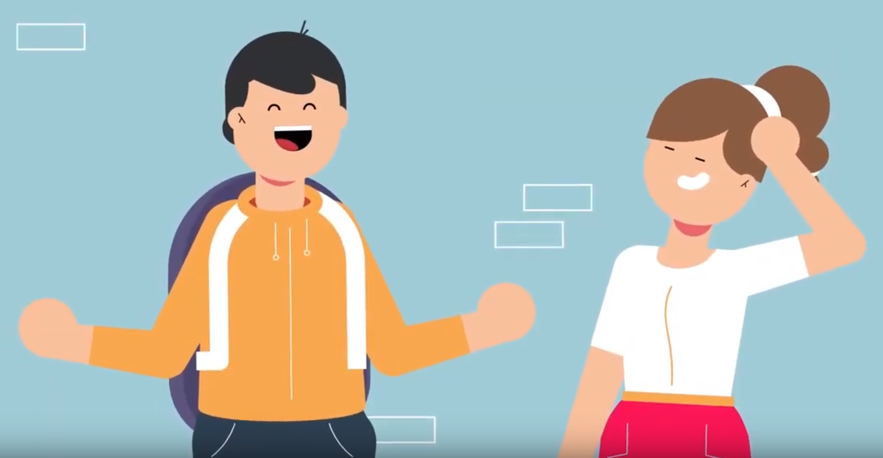
Working out relationships – video
As you watch this video make a note of whether Jess and Ethan’s relationship displays the four things that it suggests are needed to keep a relationship strong.
Working Out Relationships?
Notes:
Lesson 1 introduced this video on the key components of healthy, lasting relationships drawn from the Shackleton Relationships project findings. To consolidate learning pupils will watch the video again (1 minute 13 seconds)- press control, click on the ‘Working Out Relationships’ link to play video. In lesson 1 pupils were asked to note key characteristics of a healthy relationship. Here, they apply and feedback the characteristics identified to a fictious healthy relationship scenario.

Slide 6
WHICH OF THE BELOW DOES THE relationship HAVE NOW? WHICH ARE FOR THE FUTURE?
Are they a ‘good fit’? (Can they work well as a team? Do they have similar values and outlook on life?)
Do they have a strong basis of friendship? (Do they have fun together? Share interests and humour? Appreciate each other?)
Do they want the same things in their relationship and out of life? (Do they each feel that they can jointly agree a plan for their lives together? Can they negotiate?)
Are their expectations realistic? (Do they accept there will be ups and downs? Understand the need to make an effort?)
Do they generally see the best in each other? (Can they accept each other’s flaws? Respect their differences?)
Do they both work at keeping their relationship vibrant? (Do they make time to spend together and time apart? Each show the other that they care?)
Do they both feel they can discuss things freely and raise issues with each other? (Do they deal with issues promptly and constructively? Enjoy talking and listening to each other?)
Are they both committed to working through hard times? (Do they both ‘give and take’? Work on themselves? Look to a positive future together?)
When they face stressful circumstances would they pull together to get through it? (Can they each adapt well to change? Would they seek professional help if needed?)
Do they each have supportive others around us? (Do they each have a good support network they can turn to or call on for help if needed?)
Notes:
GIVE THE PUPILS 5 MINUTES ON THEIR TABLES TO CONSIDER: Which of the ten attributes of healthy relationships do Jess and Ethan’s relationship display now? Which apply to longer term relationships?
ANSWER: The relationship is in its early days and the couple are young but they seem to have the basis of a good relationship. They display: 1, 2, 4, 5, 6, 7 and 10. They have dealt well with the potential issue over Jess watching Ethan play football but have not had any major challenges. 3, 8 and 9 are more for the future.

Slide 7
Working out relationships
Below are an example of a ‘harsh’ start-up and a ‘soft’ start-up to Ethan and Jess’s conversation about Jess watching Ethan playing football.
On your tables suggest how Jess might reply and what Ethan says next.
Ethan: Why do you never come to watch me play football? All the other lads’ girlfriends come to watch them play. Maybe that’s because they like their boyfriends more than you like me.
Jess: That’s not fair! I do come sometimes. You know I have to work hard if I’m going to get into 6th form – not that you care about that.
Ethan: I’m sick of hearing about how hard you are working. I’m working hard too you know!
Ethan: I wish you could come to watch me play football more often. I like it when you come to watch me play.
Jess: I like it too. But I’ve got to keep up the hard work if I’m going to get into 6th form.
Ethan: I know, and I really want you to do well. Pretty and hard-working – no wonder I fell for you!
Notes:
This Activity gets pupils to practise a strategy for effective communication. By practising a ‘harsh’ and a ‘soft start–up to a potentially difficult conversation, pupils will learn how the choice of words at the beginning of the conversation may determine what follows. By clicking through in slideshow mode responses to each start-up are suggested.
As an extension exercise, pupils could be asked to repeat the exercise but with a ‘harsh’ and a ‘soft’ start up from Jess, e.g.
Harsh: “Urgh, I’m really stuck on how to do this maths homework. Not that you’d care, all you ever think about is football.”
Soft: “Urgh, I’m really stuck on how to do this maths homework. After football practice, please would you explain it to me? You seemed to get in class better than I did.”
Suggested responses are in the TGs at page 9-10.

Slide 8
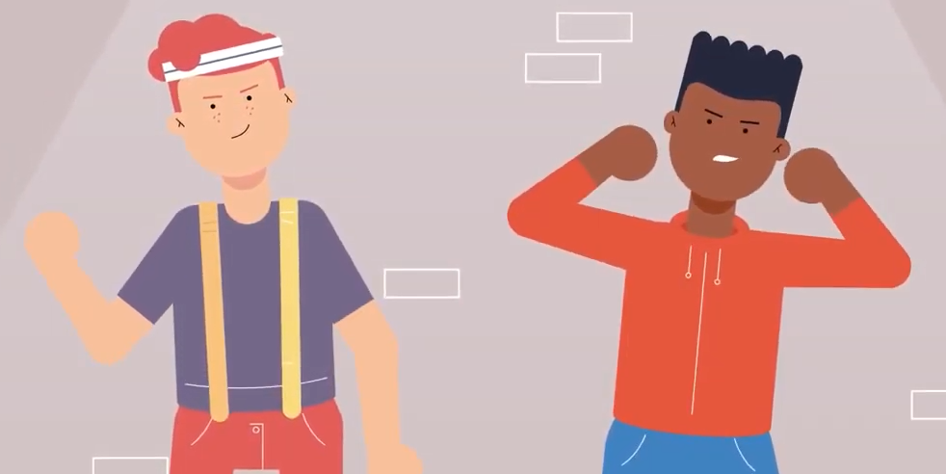
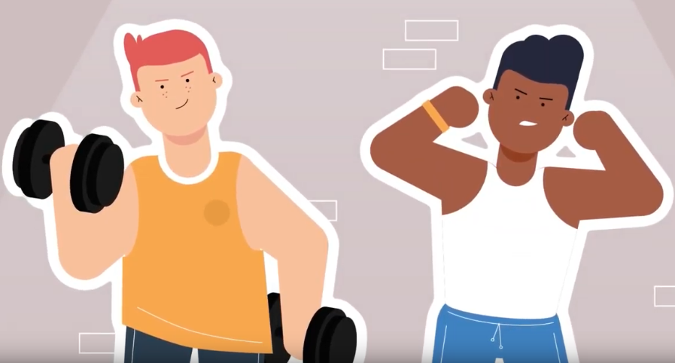
Working out relationships – MEDIA/ SOCIAL MEDIA
Consider:
How the media might influence young people’s expectations of relationships
The way in which relationships are portrayed in the media
How peers might influence one another by posting about their relationships on social media
Notes:
Activity 5 asks the pupils to consider the influence that the media and social media has on the way that relationships are portrayed and therefore young people’s expectations around relationships. Using the three bullet points on the slide to guide discussion give the pupils 5 minutes to consider these issues.

Slide 9
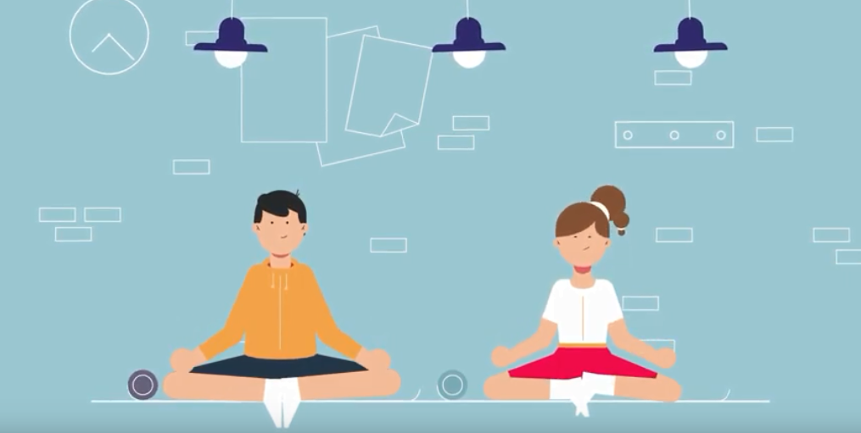
Working out relationships
On the next two slides there are some ‘quick fire statements’ to:
Identify the key signs of healthy relationships
Identify skills and strategies for building lasting healthy relationships
Notes:
To consolidate knowledge and reflect on learning conclude with two ‘quick fire’ exercises that the whole class answer the first on the signs of healthy relationships to ensure that pupils can identify key signs of healthy and unhealthy relationships (SLIDE10) and the second on building lasting relationships so that pupils can identify clearly the skills and strategies needed to build lasting, vibrant relationships. (SLIDE 11).

Slide 10
SIGNS OF healthy relationships
1. UNHEALTHY: Attraction is important but friendship is crucial
2. UNHEALTHY: All relationships go through ups and downs
3. HEALTHY: Respectfully dealing with issues as they arise keeps relationships on track
The relationship is built mostly on friendship and fun
Expect perfection – if it’s anything less move on
Partners feel able to talk openly to each other and deal with conflict at an early stage
If it’s the ‘right’ relationship you only need each other
HEALTHY: Attraction is important, but friendship is fundamental
UNHEALTHY: All relationships go through ups and downs
HEALTHY: Good communication and respectfully dealing with issues as they arise is healthy
UNHEALTHY: Time apart and time together is healthy
1. Relationship built mostly on FRIENDSHIP 2. BOTH PARTNERS SHOULD EXPECT IT TO BE PERFECT – IF IT’S NOT MOVE ON 3. CONFLICT DEALT WITH AT AN EARLY STAGE 4.
Notes:
ASK the class to feedback as a whole on the four statements.
In slideshow mode each statement in the left hand box is followed by a statement in the right hand box indicating whether this is a sign of a healthy or an unhealthy relationship.

Slide 11
Building lasting relationships
1. UNHEALTHY: Attraction is important but friendship is crucial
2. UNHEALTHY: All relationships go through ups and downs
3. HEALTHY: Respectfully dealing with issues as they arise keeps relationships on track
Know yourself and work out if you’d make a good team
Put work in to develop a good relationship
Work to change yourself to be the person your partner wants
Work at problems as they arise to reach a compromise
Work through hard times with help from family and friends
YES: Strong relationships are built on friendship and teamwork
YES: Good relationships require time, work and commitment
NO: Partners should respect and accept each other as they are
YES: Dealing with issues as they crop up is healthy
YES: When we face tough times, good support is vital
1. Relationship built mostly on FRIENDSHIP 2. BOTH PARTNERS SHOULD EXPECT IT TO BE PERFECT – IF IT’S NOT MOVE ON 3. CONFLICT DEALT WITH AT AN EARLY STAGE 4.
Notes:
Ask the class to feedback as a whole on the five statements in the left hand box which draw on the ‘working out’ theme.
In slideshow mode each statement in the left hand box is followed by a statement in the right hand box indicating whether this is a strategy to build a lasting healthy relationship.

Slide 12
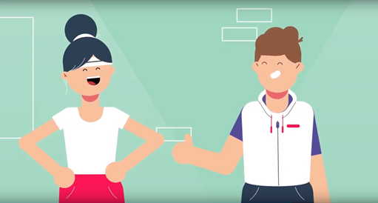
Working out relationships
Task
Define a ‘healthy relationship’ in 30 words or fewer.
Notes:
ON THEIR TABLES GIVE PUPILS 5 MINUTES to define a ‘healthy relationship’ in 30 words or fewer.
A possible answer would be: Healthy relationships are fun and mutually supportive. Partners are open, honest and deal with problems constructively. They don’t expect perfection but
work at keeping things good, with support where needed.
If pupils are struggling, there is a support task on p12 of the TG which suggests that you get pupils to at least list some key attributes of healthy relationships: friendship, good teamwork, dealing with conflict constructively, supportiveness, trust, honesty, realistic expectations, having good support around you.

Slide 13
Working out relationships
Consider again, to what extent do you agree that ‘if a relationship is good, it shouldn’t be hard work.’
Notes:
Ask the whole class to consider once again about the extent to which they agree that ‘If a relationship is good, it shouldn’t be hard work.’ Try to draw out the difference between relationships being ‘hard work’ and the need to ‘work hard’ to ensure that relationships remain positive and strong. You may wish to use the ‘gym analogy’ from the video to emphasise that, like keeping fit, keeping a relationship healthy requires effort.

Slide 14
Working out relationships: HOMEWORK TASK
Before your next PSHE lesson:
Create a poster aimed at your year group setting out the key attributes of a healthy relationship
Your poster can contain the key attributes discussed and/or some others that you think are needed in healthy relationships
Notes:
HOMEWORK TASK: To finish, ask pupils to create a poster aimed at their year group setting out the key attributes of a healthy relationship. This can include the attributes discussed in the lesson but encourage pupils to think of and include additional attributes that they think are important. They should bring this to their next PSHE lesson.

