Slide 1
Modern Families:
Learning the legal consequences of different family forms
Lesson 2: Legal Rights When Relationships End
Notes:
This is the second of two lessons, ‘Modern Families’. Lesson 1 introduces pupils to three couples in three different relationship forms. In considering these couples, pupils will learn about the key regulations on formalising relationships. In lesson 2 pupils consider the rights and protections provided within legally recognised marriages and civil partnerships and the legal status of other long-term relationships such as cohabitation. In particular, the ‘common law marriage myth’ - the mistaken belief that unmarried couples who live together for some time have a ‘common law marriage’ which gives them the same legal rights as married couples.
The legal position of the different family forms considered is correct as of 26.10.22.

Slide 2
TEACHER slide- preparing to teach
Preparing to teach and using these slides:
The slides headed ‘teacher slides’ assist the teacher in setting up and running the lesson.
Slide 8 onwards are for the pupil facing lesson.
Please read the Lesson Plan 2 Teacher Guidance for ‘Modern Families’ before teaching.
Have slides in presenter mode – notes are available under each slide to aid teaching.
Support: and extension: activities are suggested where appropriate (icons on bottom right corner of slides).
Resources:
Sticky notes.
An ‘ask-it-basket’/ question box for pupils to ask questions confidentially.
Handout for ‘Baseline activity’ (Resource A) if using.
Grid and flashcards (Resources B and C).
Information recording sheet (Resource D and slides 16-20).
Timing:
The lesson is designed to be taught over
55 minutes.
Notes:
This two-part lesson plan has been devised for Key Stage 4 and Key Stage 5 pupils. This teaching is aimed at PSHE teaching.
This slide gives an overview of the lesson. It should be read in conjunction with the Teacher Guidance for ‘Modern Families’ Lesson 2. Teachers are reminded to review and address any questions submitted in the anonymous ask-it-basket’/ question box, to ensure they are answering all pupils’ questions.
Before the lesson begins, print out Resources A (if using), B and C with enough copies for one per table. Print out Resource D with enough copies for pupils to work in pairs. Print out slides 16 to 20 and stick them around the room.

Slide 3
TEACHER slide- DFE GUIDANCE
This two-part lesson plan for Key Stage 4 and Key Stage 5 PSHE aims:
in lesson 1 to help pupils learn ‘the characteristics and benefits of strong, positive relationships, including mutual support, trust, respect and equality’ (Programme of Study 2020-2021 KS4, R1).
in lessons 1 and 2, to help pupils learn about ‘the importance of stable, committed relationships, including the rights and protections provided within legally recognised marriages and civil partnerships and the legal status of other long-term relationships’ (Programme of Study 2020-2021 KS4, R4 – see also KS5, R1-3).
DfE Guidance on RSE states that RSE teaching should:
equip pupils with ‘knowledge that will enable them to make informed decisions about their… relationships’ (para. 1).
be based on knowledge of pupils and their circumstances… [with] no stigmatisation of children based on their home circumstances (para. 59).
teach pupils what marriage is, including their legal status e.g. that marriage carries legal rights and protections not available to couples who are cohabiting or who have married, for example, in an unregistered religious ceremony (para. 81).
Notes:
This two-part lesson plan for Key Stage 4 and Key Stage 5 PSHE aims to meet the requirements of The Programme of Study for PSHE Education 2020-2021 for Key Stage 4 and Key Stage 5.
At Key Stage 4, pupils should learn ‘about the importance of stable, committed relationships, including the rights and protections provided within legally recognised marriages and civil partnerships and the legal status of other long-term relationships’ (R4).
At Key Stage 5 pupils should learn:
R1. how to articulate their relationship values and to apply them in different types of relationships.
R2. to recognise and challenge prejudice and discrimination and understand rights and responsibilities with regard to inclusion.
R3. to recognise, respect and, if appropriate, challenge the ways different faith or cultural views influence relationships.
The primary purpose of the lessons is to equip pupils with knowledge that will enable them to make informed decisions about their relationships in the future by helping pupils to understand the key legal rights of different family forms see DfE Guidance on RSE (paras. 1 and 81).

Slide 4
TEACHER SLIDE – the law on marriage Formation
The principles governing current marriage law date from 1836. It tightly regulates how and where weddings can take place. This differs depending on the type of wedding. At present, couples have to make a choice between a religious or a civil wedding, with no option for a wedding reflecting other beliefs.
Couples having an Anglican wedding can give notice to the church; all other couples must give notice at the register office.
Until June 2021, couples could not marry or hold a civil partnership ceremony outdoors. Now civil weddings and civil partnerships can be held outdoors provided the venue is licensed.
If a couple do not comply with the legal requirements, which may happen with some religious ceremonies, their marriage may not be legally recognised. This means the parties have no legal status or protection. People often only discover their lack of legal status at the time of relationship breakdown.
Notes:
The current law closely regulates matters such as notice requirements, venue and content of marriage and civil partnership ceremonies. If couples fail to comply with the regulations, then the relationship will not be legally binding. The current law is viewed by many as archaic and too prescriptive.
The Law Commission, the independent body that conducts research and consultations to make recommendations, issued a report on 19th July 2022. The report concluded that the current system of weddings law is too complicated and restrictive. Currently, couples must choose between a civil wedding and a religious wedding. Religious weddings are further divided by the law into different types: Anglican, Jewish, Quaker, and any other religious group. Each of these categories are subject to different sets of rules. The law also restricts how couples are permitted to celebrate their weddings so that many couples are unable to hold a ceremony that is meaningful to them.
The Law Commission makes two key recommendations:
1. There should be a universal set of rules for all weddings.
2. Regulation of weddings should be based on the person who ‘officiates’ the ceremony, rather than on the building in which the wedding can take place.
If these changes are adopted, the Law Commission argues that this would simplify the process, give couples greater flexibility over the form their wedding ceremonies will take and help ensure that fewer weddings conducted according to religious rites result in a marriage that the law does not recognise at all.
It is important to note that these are only recommendations. The current law will continue unless and until Parliament passes or amends an Act to change the law.
Additionally, the rules about outdoor ceremonies were relaxed in June 2021, initially in response to the Covid pandemic, but the changes were made permanent in March 2022. Now civil weddings and civil partnerships can be held outdoors provided the venue is licensed. The changes in the rules do not apply to religious weddings.
For further information see: https://www.nuffieldfoundation.org/wp-content/uploads/2020/11/when_is_a_wedding_not_a_marriage_-_exploring_non-legally_binding_ceremonies_-_final_report.pdf.

Slide 5
TEACHER SLIDE – non-QUALIFYING ceremonies
Myth: A religious wedding only, e.g. an Islamic nikah, will give the couple rights if one person dies or the couple separate.
In fact: If a couple has a religious-only ceremony in England and Wales this is not legally binding. It is sometimes referred to as a ‘non-qualifying ceremony’. The couple do not have any automatic rights against each other on separation or death, unlike a couple in a valid marriage. The law treats couples who had a non-qualifying ceremony in England and Wales as if they were cohabitants. This can lead to significant inequalities between the couple on separation, with women often most disadvantaged because they may have reduced their hours or stopped working when they became parents. This is a particular problem in the Muslim community where one or both parties may enter a nikah (the religious ceremony) without knowing that it is not a legal marriage. But any religious-only ceremony may result in a non-qualifying ceremony. Similarly, ceremonies led by Humanist or independent celebrants have no legal recognition under the current law.
Notes:
This slide sets out the legal consequences of a non-qualifying ceremony. Whilst this is an issue particularly in the Muslim community in England and Wales where couples may have a nikah not realising that this does not constitute a legal marriage, it is important to note that the term ‘non-qualifying ceremony’ applies to any ceremony that does not constitute a legal marriage.
In lesson 1, pupils will consider the requirements for forming a relationship that would be considered to be legally binding in England and Wales. In lesson 2, pupils consider the legal rights of couples, including on death or separation depending on their family form.
For further information on religious only marriages see: https://researchbriefings.files.parliament.uk/documents/CBP-8747/CBP-8747.pdf.

Slide 6
TEACHER SLIDE – the common law marriage Myth
Myth: After a certain period together/if you have a child together, cohabiting couples have the same rights as married couples: the 'common law marriage myth'.
In fact: unlike married or civil partners, cohabiting partners are not entitled to claim financial support from their former partner for themselves if they separate (although both parents must financially support their children).
Cohabitation is the fastest growing family form in England. However, many cohabitants do not realise that they do not have the same legal rights as married couples or civil partners. Parents must financially support children, but not each other. Rights to the couple’s home are based on property law which, unlike family law, does not take into account contributions towards the family life leaving many ‘stay at home’ or part-time working mothers financially disadvantaged. In 2018, research by the University of Exeter showed that 47% believed that cohabiting couples form a ‘common law marriage’ when this is not the case, the so-called ‘common law marriage myth’.
Notes:
In lesson 2, pupils will consider the legal differences between marriage/civil partnership and cohabitation on death or separation. To set this up, in lesson 1 pupils will consider the ‘common law marriage myth’, that is, the mistaken belief that unmarried couples who live together for some time have a ‘common law marriage’ which gives them the same legal rights as married couples.
For further details see: https://researchandinnovation.co.uk/1981-2/.

Slide 7
TEACHER SLIDE – LESSON OUTLINE AND TIMINGS
Activity | Description | Suggested timing
Introduction | Ground rules, learning objectives and outcomes. | 3 minutes
Baseline activity | Pupils will consider what rights they think couples who live together should have. | 5 minutes
Rights and protections | Pupils will complete a grid by choosing from a set of flashcards the rights and protections given to three different family forms. | 10 minutes
Differences in rights and protections | Pupils will learn about the differences in rights and protections that married couples or couples in a civil partnership have compared to cohabitants or couples who had a non-qualifying ceremony and steps that couples can take to protect their rights. Pupils will apply the learning to a set of scenarios. | 15 minutes
Lawmaker for a day | Pupils will be asked to imagine that they have been given the responsibility to draft a new law for cohabitants – what would it include and when would it apply? | 15 minutes
Endpoint assessment | Pupils will complete an exit slip that will show whether their views have changed from the baseline activity. | 5 minutes
Homework/extension | Wrap up and setting homework (or extension) task. | 2 minutes
Notes:
The above outlines the suggested timing for the lesson’s activities.
The timings given are the minimum time required to deliver the activities. If some activities are generating lots of discussion and you feel students are making good progress towards achieving the learning outcomes, you may wish to spend longer on some activities and extend the lesson plans across multiple lessons.

Slide 8
GROUND RULES
We will:
keep anything that others say confidential
talk about ‘someone I know…’ rather than using a person’s name
comment on what is said, not who has said it
have the right to pass
ensure that comments or views expressed are respectful of different family forms, cultures and beliefs
seek help in school/encourage friends to seek help if needed.
We will not:
disclose personal information about ourselves or others
judge others
put anyone on the spot
ask personal questions or try to embarrass someone.
Notes:
Pupils will be discussing different family forms which has the potential to be distressing for some (if, for example, their parents have separated, or home life is difficult). Teachers should refer to the Handling complex issues safely in the PSHE Classroom guide before teaching. It is important that ground rules are established to minimise the potential for distress to any pupil. If a teacher already has established ‘class ground rules’ then these can be substituted. Pupils can also be asked to add to the ground rules as appropriate.
Teachers should also:
have an ‘ask-it-basket’/ question box for pupils to ask questions confidentially
review and address any questions submitted in the anonymous ‘ask-it-basket’/ question box
work within the school’s policies on safeguarding and confidentiality
link PSHE education into the whole school approach to support pupil wellbeing
make pupils aware of sources of support, both inside and outside the school
explain to pupils that while confidentiality is important, if something is said or a behaviour causes concern, teachers may speak to another member of staff
ensure that language used is always inclusive.

Slide 9
MODERN FAMILIES – LESSON 2
Learning Objective: -
To learn about key differences in legal rights between couples who are legally married or in a civil partnership and couples in a non-legally binding relationships, and why it is important to know these differences.
Notes:
Explain that today’s lesson will explore key differences in legal rights across the life stages for different family forms and how misconceptions about those legal rights can lead to unintended outcomes.
Learning Objective:
Run through the learning objectives:
To learn about key differences in legal rights between couples who are legally married or in a civil partnership and couples in a non-legally binding relationships, and why it is important to know these differences.

Slide 10
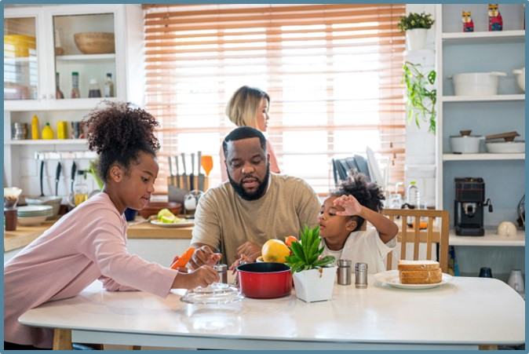
MODERN FAMILIES – LESSON 2
Learning Outcomes - Pupils will be able to:
Describe the legal rights of couples who are legally married or in a civil partnership.
Analyse the reasons why a couple may or may not choose to marry or have a civil partnership.
Explain the consequences of not having a legally binding relationship.
Notes:
Run through the Learning Outcomes - After the lesson pupils will be able to:
Describe the legal rights of couples who are legally married or in a civil partnership.
Analyse the reasons why a couple may or may not choose to marry or have a civil partnership.
Explain the consequences of not having a legally binding relationship.

Slide 11
BASELINE ACTIVITY: Who should have rights?
Statement | strongly disagree | disagree | neither agree nor disagree | agree | strongly agree
1. Couples who marry are more committed than couples who live together without marrying.
2. Couples can choose to marry or have a civil partnership so there is no need for rights for couples who live together.
3. All couples who live together should have the same rights as couples who marry or have a civil partnership.
4. Couples who live together should have the same rights as couples who marry or have a civil partnership but only after they have lived together for at least two years.
5. Couples who live together should have the same rights as couples who marry or have a civil partnership but only if they have a child together.
Notes:
Check that pupils understand/recall from the last lesson what a civil partnership is.
Ask pupils, without conferring, to complete the table above to gauge their views on what rights couples who live together (cohabitants) should have. To ensure that all pupils participate, either provide a handout for pupils to complete (a handout is at the end of the slides – Resource A) or ask them to write their responses to the five questions (strongly disagree, disagree etc. ) on a blank piece of paper.
Note: Do not give further hints or tips, even if pupils ask questions. They should not share their ideas with classmates during the activity. This will allow you to see pupils’ beliefs and ideas before the lesson begins.
Circulate the room as pupils complete the scale in Resource A to gauge what pupils think/feel/believe concerning the topic. After pupils have had three to four minutes or so to complete their responses, ask for all class feedback (using a show of hands for each question’s options). Ask pupils not to change their answers during class feedback and to put these to one side as they complete an exit slip based on these questions at the end of the lesson.

Slide 12
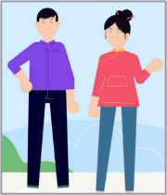
Rent a house
Have a child together (own or by adoption)
Buy a house
Couple separates
What happens if one of them dies without a will?
Civil partners
Religious and civil wedding
Cohabitants
Notes:
Handout to each table the grid template found at the end of the pupil-facing slides at slides 27 (Resource B), with cards at slides 28-29 (Resource C). The cards list the legal position on each of the events listed e.g., the position regarding parental responsibility depending on whether a couple is in a civil partnership, married or cohabiting.
Before the lesson, print (with enough for a set for each table) Resource B and the two slides for Resource C, which will need to be printed, two-sided (with the printer set to ‘flip on the short edge’) and cut up.
Remind pupils of the brief scenarios: the same-sex couple, John and Jake, are in a civil partnership, the second couple, Emad and Saira, have had a religious wedding followed by a civil wedding that complied with the legal regulations (so they are legally married) and the third couple, Henry and Mary, are cohabitants.
Ask pupils to place the cards on the grid (Resource B) according to which solution they believe applies to each couple for each life stage e.g., renting a house, having a child etc.

Slide 13
Rent a house | The couple both have a right to occupy the home, regardless of in whose name the tenancy is held. | The couple both have a right to occupy the home, regardless of in whose name the tenancy is held. | The couple both have a right to occupy the home if the tenancy is held in joint names. If the tenancy is in one person’s name the other can occupy only if that person agrees.
Have a child together (own or by adoption or surrogacy) | Parents share rights and responsibilities for the child equally. | Parents share rights and responsibilities for the child equally. | Fathers in mixed-sex relationships share rights and responsibilities for the child equally with the mother if the father is registered on the birth certificate.
Buy a house | The couple both have a right to occupy and a share, regardless of in whose name the property is held. | The couple both have a right to occupy and a share, regardless of in whose name the property is held. | Rights to occupy and to a share depend on in whose name the property is held, and the financial contributions made.
Couple separates | Assets and income divided according to needs. | Assets and income divided according to needs. | Assets divided according to legal ownership unless contributions establish an interest. No right to income.
What happens if one of them dies without a will? | Survivor gets all the assets if no children or first £270,000 + half of what’s left if children. | Survivor gets all the assets if no children or first £270,000 + half of what’s left if children. | Survivor has no automatic right to the assets owned by the person who has died.
Civil partners
Religious and civil wedding
Cohabitants
Rent a house
Rent a house
Rent a house
Have a child
Have a child
Have a child
Buy a house
Buy a house
Buy a house
Couple separates
Couple separates
Couple separates
What would happen if one dies?
What would happen if one dies?
What would happen if one dies?
Notes:
In slideshow mode on a click, each box is revealed to show the legal position for each couple per event. Check that pupils have placed the cards in the correct boxes. Answer any queries from pupils who placed a card in the incorrect box/ explain why the cards have been placed in a particular box if there have been any issues.
Ask: What do you notice about the rights of each family form?
Answer: The same-sex couple in a civil partnership and the married mixed-sex couple have exactly the same rights, whereas the cohabiting couple has significantly fewer rights, especially if the couple separates or one dies.
Next, ask pupils to remove the cards and then put the relevant cards in the column for Emad and Saira only that indicate what the position would have been on the occurrence of each event. This time, they should assume that the couple had a non-qualifying ceremony by way of a nikah ceremony in England.
The answer is that the position for couples with a non-qualifying ceremony is the same as cohabitants. The pupils should have placed the cards they used in the previous exercise for the cohabitants in Emad and Saira’s column.
The key point to draw out is that the position of civil partners and couples with a legally binding marriage is the same but that where there has been a non-qualifying ceremony in England and Wales, this is treated as if the couple is not married. The couple’s rights are the same as if they were cohabitants.
As a support activity For the first exercise (i.e., Emad and Saira in a valid marriage), consider giving pupils the template with the first column for John and Jake completed leaving the pupils with two cards per row, each with a different solution, for the pupils to complete the remaining boxes.
As an extension activity consider asking pupils to discuss which outcomes feel unfair to them. For example, does it feel fair that:
Henry and Mary, as cohabitants, have far fewer rights than if they were married?
couples in a civil partnership have the same rights as married couples?
if Emad and Saira had had a religious-only ceremony in England and Wales, this would be treated as a ‘non-qualifying ceremony’, and they would be treated the same as cohabitants?
The differences are considered in more detail in slides 16 to 20 below.

Slide 14
Rent a house | Rent a house | Rent a house | Rent a house
Have a child together (own or by adoption or surrogacy) | Have a child | Have a child | Have a child
Buy a house | Buy a house | Buy a house | Buy a house
Couple separates | Couple separates | Couple separates | Couple separates
What happens if one of them dies without a will? | What would happen if one dies without a will? | What would happen if one dies without a will? | What would happen if one dies without a will?
Notes:
This and the next slide are there to create the animation on slide 13 and will be hidden when in slideshow mode.

Slide 15
Rent a house | The couple both have a right to occupy the home, regardless of in whose name the tenancy is held. | The couple both have a right to occupy the home, regardless of in whose name the tenancy is held. | The couple both have a right to occupy the home if the tenancy is held in joint names. If the tenancy is in one person’s name the other can occupy only if that person agrees.
Have a child together (own or by adoption or surrogacy) | Parents share rights and responsibilities for the child equally. | Parents share rights and responsibilities for the child equally. | Fathers in mixed-sex relationships share rights and responsibilities for the child equally with the mother if the father is registered on the birth certificate.
Buy a house | The couple both have a right to occupy and a share, regardless of in whose name the property is held. | The couple both have a right to occupy and a share, regardless of in whose name the property is held.. | Rights to occupy and to a share depend on in whose name the property is held, and the financial contributions made.
Couple separates | Assets and income divided according to needs. | Assets and income divided according to needs | Assets divided according to legal ownership unless contributions establish an interest. No right to income.
What happens if one of them dies without a will? | Survivor gets all the assets if no children or first £270,000 + half of what’s left if children. | Survivor gets all the assets if no children or first £270,000 + half of what’s left if children. | Survivor has no automatic right to the assets owned by the deceased.

Slide 16
Renting A HOME
Married couples and civil partners:
Have ‘home rights’ so are entitled to stay in the home while they are married or in a civil partnership – even if the tenancy is in the spouse or partner’s name only.
Cohabitants and couples with a non-qualifying ceremony:
Have no automatic right to stay in the home if the tenancy is in the partner’s name only.
What should couples do?
Cohabitants should agree with their landlord to put the tenancy in both their names if they can, and make sure they each understand their rights and obligations as tenants.
Notes:
To consolidate learning and underscore the significant difference between the rights of married couples/civil partners and couples who live together (cohabitants) or have a non-qualifying ceremony, this and the next four slides consider a range of typical life stages and how the risks associated with the different family form in each scenario might be mitigated. The key thing to get across in this and the next four slides is that:
Couples who have a non-qualifying ceremony are treated in law as if they are cohabitants, not a married couple.
The rights of cohabitants and couples who had a non-qualifying ceremony are significantly less than those of couples married or in a civil partnership.
To enable all students to achieve the same learning outcomes in the lesson and ensure that all students actively participate and engage with the content, hand out Resource D. Working in pairs, ask pupils to consider the five scenarios presented in Resource D and give them two to three minutes to circulate the room, considering the information presented on each of the five slides (stuck around the room before the start of the lesson) to determine the steps the person referred to should take in each of the given scenarios. Ask 5 pupils to give their responses to a question. Then, briefly run through the slides to clarify answers and consolidate learning.
Run through the slide highlighting the differences between the different family forms and the possible remedies when renting a home. Check whether pupils have any questions.

Slide 17
HAVING A CHILD
Married couples and civil partners:
The child’s father and mother share parental responsibility if they are married or in a civil partnership, as do most same-sex couples if they are married or in a civil partnership, provided the child was conceived via a clinic.
Married or CP step-parents can acquire PR if the parent who is not their partner/spouse agrees.
Same-sex fathers married or in a CP may acquire PR through adoption or surrogacy.
Cohabitants and couples who had a non-qualifying ceremony:
All mothers have PR but fathers in opposite sex couples do not have automatic rights – although most have PR as fathers who are registered on the birth certificate have PR
Same-sex fathers may acquire PR through adoption or surrogacy.
What should couples do?
Cohabitants and couples who had a non-qualifying ceremony should register the birth jointly.
Notes:
Run through the slide highlighting the differences between the different family forms and the possible remedies when having a child.
Point out that while all mothers automatically have PR for their children, not all fathers have it. However, provided the father is named on the birth certificate, which most fathers are, they will share PR equally with the mother. As a higher-level teaching point or if the class is particularly interested, unmarried fathers who are not on the birth certificate can also acquire PR by entering a PR agreement with the mother or court order).
Check whether pupils have any questions.

Slide 18
BUYING A HOME
Married couples and civil partners:
Have ‘home rights’ so are entitled to stay in the home while they are married or in a civil partnership – even if the tenancy is in the spouse or partner’s name only.
Cohabitants and couples who had a non-qualifying ceremony:
Have no automatic right to occupy if the house is in the partner’s name only. They need to prove that they have an interest because they contributed to the purchase or made some other financial contribution.
What should couples do?
Register home rights if married or in a civil partnership.
All couples should sign a legal document known as a Declaration of Trust when buying the house which lists each person’s contribution and what share they will each have in the house.
Why might someone contribute towards purchasing a property but agree to it being bought in the partner’s name only?
Notes:
Run through the slide highlighting the differences between the different family forms and the possible remedies.
Ask: Why might someone contribute towards purchasing a property but agree to it being bought in the partner’s name only? (In slideshow mode this question will appear on a click).
They may not think about the consequences of the house being in the partner’s name only in the excitement of buying a home together.
They may not realise that they have no automatic rights to the home if they were to separate.
It may have seemed easier to put the house in one person’s name or may have been a requirement of the mortgage, especially if that person was the higher earner.
It may feel unromantic or as if they do not trust their partner if the person were to say that it did not feel fair to buy the home in one person’s name.
It may seem irrelevant as the person does not think they will ever separate from their partner.
Check whether pupils have any questions.

Slide 19
SPLITTING UP
Married couples and civil partners:
The starting point for dividing the assets is 50/50.
One person can be awarded more if required e.g. to meet their housing needs.
One person may have to make monthly payments to the other if needed.
Cohabitants and couples who had a non-qualifying ceremony:
The starting point for dividing the assets is each person keeps any assets in their own name and they share joint assets equally.
A person will only get a share of asset in the other person’s name if they contributed to the purchase price.
There is no right to income from the other person other than to meet the expenses of caring for a child.
What should couples do?
Before the couple marry or enter a civil partnership, they should consider having a pre-nuptial agreement.
Cohabitants should consider a cohabitation agreement before living together.
What is a pre-nuptial agreement?
A voluntary agreement the couple signs before the marriage/CP which may be binding if fair.
Notes:
Run through the slide highlighting the differences between the different family forms and possible remedies when a couple splits up. The key point to get across is that the rights of cohabitants – to assets in the other person’s sole name or to income for themselves - are far more restrictive than the rights of married or CP couples.
Explain that the law is complicated but the main difference between married couples/couples in a CP and cohabitants/couples who had a non-qualifying ceremony is that:
Unless the couple are extremely wealthy, mostly the court won't take into account whose name the assets are held with married couples/couples in a CP. They will divide the assets according to need and often the parent who the children will spend most time with will need more than half of the assets to provide a home for themselves and the children.
With cohabitants and couples with a non-qualifying ceremony, the starting point is that they each keep assets in their own name and share joint assets equally. If one person wants to make a claim for share of an asset in the other person’s name (often the family home) they will need to show, for example, that they contributed towards the purchase price. Where there are children, the court can delay the sale of the family home until the children finish education.
Parents must contribute towards the upbringing of their children, whether or not they are married. Either the couple can agree the payment between themselves or make an application to the Child Maintenance Service. However, only married couples and couples in a CP can be ordered to pay monthly payments to the other spouse/CP – cohabitants have no such rights.
Ask: What is a pre-nuptial agreement? (In slideshow mode this question will appear on a click, followed by an abbreviated version of the answer below to help students to complete Resource D.)
Answer: an agreement signed by the couple before the marriage or civil partnership ceremony which sets out how the couple’s assets and income will be divided if they separate. Pre-nuptial agreements are not legally binding in England and Wales. However, the court will usually uphold them if they have been freely entered into, with full appreciation of the facts (usually because each person has provided details of their assets and income to the other and the terms of the agreement have been explained to each person by their lawyer) and the agreement is fair. Entering a prenuptial agreement is voluntary.
Explain that a cohabitation agreement is agreed and signed by a couple who intend to live together or are living together. It deals primarily with who owns (and owes) what at the time of the agreement, and in what proportions; what financial arrangements the couple has decided to make while they are living together, and how property, assets and income should be divided if they should split up.
Check whether pupils have any questions.

Slide 20
One person dying WITHOUT A WILL
Married couples and civil partners:
If there are no children, the surviving spouse/civil partner gets all the assets.
If there are children, the surviving spouse/civil partner gets the first £270,000 plus half of what is left.
If the survivor is under the state retirement age, a Bereavement Support Payment is payable of up to £3500 then £350pm for 18 months.
Cohabitants and couples who had a non-qualifying ceremony:
The surviving partner has no automatic right to the assets owned by the person who has died.
If the survivor is under the state retirement age, a Bereavement Support Payment is payable of up to £3500 then £350pm for 18 months.
What should couples do?
Each person should make a will setting out who will inherit their assets if they die.
Notes:
The key point to get across is that cohabitants and couples who had a non-qualifying ceremony have no automatic right to assets owned by the other person on that person’s death.
Explain that a will sets out who will inherit a person’s assets on death. Provided a will is valid, the assets of the person who has died will be divided following the will, so a surviving partner or spouse would inherit the share left to them, regardless of whether the couple was married. However, if a person dies without making a will, then the rules are very different depending on whether the couple was married/ in a civil partnership.
Run through the slide highlighting the differences between the different family forms and the possible remedies if one person from the couple was to die.
The rights a survivor may have largely depend on the person who has died taking proactive steps in their lifetime to protect the survivor, for example by:
Owning an asset jointly or signing a Declaration of Trust setting out what proportion of the asset the survivor will have on the death of the owner of the asset.
Nominating the survivor to receive for example a share of a life insurance policy or their pension.
Each person should therefore make a will setting out who will inherit their assets if they die.
Point out that since 2018 bereavement support payments have been payable to cohabitants as well as married couples or civil partners.
As a higher-level teaching point pupils may be interested to know that If one person dies without a legal will expressing their wishes, the surviving spouse or civil partner pays no inheritance tax on assets they inherit whereas cohabitants or couples who had a non-qualifying ceremony have to pay any inheritance tax due. (Inheritance is payable if the deceased persons assets exceed £325,000).
Check whether pupils have any questions.

Slide 21
lawmaker FOR A DAY!
You have been given the responsibility to draft a new law for cohabitants. List:
The key rights that you would grant to cohabitants (if any).
When cohabitants should start to have these rights.
Why might some cohabitants be opposed to marriage or civil partnership?
Should people be allowed to opt out of any automatic rights for cohabitants that might be introduced? Why/why not?
Notes:
Collect the Resource C cards from each table to ensure that pupils are not just copying these for this exercise. Tell pupils to imagine that they have been given the responsibility to draft a new law for cohabitants. Working on their tables, ask pupils to make a list of:
The key rights that they would grant to cohabitants (if any). (Tell them that they can use the Resource B grid to make sure that they cover rights on the occurrence of the events listed.)
When they think cohabitants should start to have these rights (e.g. immediately upon moving in together; after a certain period of living together (if so, what); if they have a child together etc.)
Ask pupils to reflect on why they think that the law (if any) that they have proposed is appropriate. What responsibilities do they feel that cohabitants might have towards their partner, or their families? Why should cohabitants have these responsibilities?
Ask pupils for feedback on their answers and their reasoning. Thinking about responsibilities (as well as rights) will help to emphasise that regardless of the legal status of the relationship, those in relationships are expected to maintain healthy relationship behaviours towards one another.
Note that in slideshow mode the following two questions then appear on a click:
Ask why might some cohabitants be opposed to marriage or civil partnership?
Answers might include:
They see any formal regulation of their relationship as an infringement of their freedom of choice.
They see both marriage and civil partnership as outdated institutions.
They do not want to have any legal responsibility towards their partners.
Ask: Should people be allowed to opt out of any automatic rights for cohabitants that might be introduced? Why/why not?
Answers might include:
They should be able to because they may have chosen to cohabit specifically because they did not want to be bound by the rules of the institutions of marriage or civil partnership therefore it would be unfair to then make them bound by the rules of a new law regarding cohabitation.
They should not be able to because they should be responsible for their partner and any children of the relationship. Particularly because one partner may have been financially disadvantaged by the decisions that the couple made during the marriage (eg one partner’s employment prospects might have worsened if they have worked part time after having children – this impacts especially on women). There is also a possibility, if the relationship is controlling in any way, that the decision to live together without marrying has not been agreed upon freely by both parties. Even if the relationship is not controlling, if one person does not want to marry but the other does, it means that the financially more vulnerable one is 'stuck' with significantly less rights than if they were married, which can lead to unfair outcomes if the relationship breaks down.
The key thing to get pupils to be thinking about here is that allowing one person the 'right' to choose to be free of any responsibility towards their partner means that if the relationship ends, the partner's 'right' not to be financially disadvantaged by the decisions the couple made during the relationship is curtailed. The question then becomes one of fairness. Is it fair that this should be the outcome? Should there be a safety net of rights for partners who are not married? If so, when should this operate? After a certain period of time together? If the couple have a child?
This discussion will help pupils to consider the responsibilities that people have within their relationships as well as rights.
As a support activity consider giving pupils the Resource C cards so that they can choose which outcome, for each event, they think should apply to cohabitants if they were made a lawmaker for a day.
As an extension activity consider telling the pupils that Henry and Mary are considering entering into a cohabitation agreement that would set out how they would divide their assets and time with their daughter Lily aged two in the event of their separation. Ask pupils to bullet point the things that should be covered in the cohabitation agreement. This might include:
How they will divide their household bills during the cohabitation.
On separation, how they will divide:
any assets they owned before they began to cohabit
any assets they acquired during the time they lived together
any debts they may have
time with Lily and
how much one parent will pay the other each month (if anything) towards the cost of Lily’s upkeep.

Slide 22
ENDPOINT ASSESSMENT ACTIVITY
Complete an exit slip stating who you think should have rights if a relationship breaks down. Have your views changed during the lesson?
What would you say to someone who says, “getting married is the best option for all couples!”?
“getting married is the best option for all couples!”
Notes:
Ask pupils to complete an exit slip focusing on their beliefs about who should acquire rights if a relationship breaks down and whether these have changed during the lesson.
Ask them to respond to the following question: What would you say to someone who says, “getting married is the best option for all couples!”?
Pupils should write their responses in their PSHE exercise book or on an ‘exit slip’ or sticky note, which they should hand to the teacher before leaving the classroom.

Slide 23
HOMEWORK OR EXTENSION TASK
Before the next lesson
Produce a poster setting out considerations people should think about if they are wondering whether to get married/form a civil partnership.
Notes:
HOMEWORK OR EXTENSION TASK
Ask pupils to produce and bring a poster setting out considerations people should think about if they are wondering whether to get married/form a civil partnership.

Slide 24
Further help and support
For further help and support in school contact:
Your form teacher/ PSHE teacher
Your Head of Year
The pastoral support team
For further help and support outside of school:
ChildLine: https://www.childline.org.uk
Muslim Youth helpline: https://myh.org.uk/
National Youth Advocacy Service: https://NYAS.net
Citizen’s Advice: https://www.citizensadvice.org.uk
AdviceNow: https://www.advicenow.org.uk/
Notes:
Remind pupils who they can talk to in school, e.g. teacher or head of year, or the pastoral support team (you may wish to personalise this slide with names of contact staff) or outside of school.
ChildLine can assist if the child is having any problems in their home and family life.
Muslim Youth helpline may be helpful given the culturally sensitive issues raised.
National Youth Advocacy Service (NYAS) provides a range of rights based services for children and young people through a network of qualified advocates. Advocates ensure that the views of children and young people are listened to, particularly in decisions which are made about them. This may be helpful for any pupil whose parents have separated.
Citizen’s Advice and AdviceNow have lots of information on some of the issues the pupils have been discussing such as cohabitants rights.
Remind pupils to use the ‘ask it basket’ for any questions they may have.

Slide 25
Resource A: Grid for baseline activity;
Resource B: Grid for core activity and
Resource C: Flashcards for printing (front and back)
Resource D: Information recording sheet

Slide 26
BASELINE ACTIVITY: Who should have rights?
Statement | strongly disagree | disagree | neither agree nor disagree | agree | strongly agree
1. Couples who marry are more committed than couples who live together without marrying.
2. Couples can choose to marry or have a civil partnership so there is no need for rights for couples who live together.
3. All couples who live together should have the same rights as couples who marry or have a civil partnership.
4. Couples who live together should have the same rights as couples who marry or have a civil partnership but only after they have lived together for at least two years.
5. Couples who live together should have the same rights as couples who marry or have a civil partnership but only if they have a child together.
Notes:
Resource A.

Slide 27
Rent a house
Have a child together (own or by adoption)
Buy a house
Couple separates
What happens if one of them dies without a will?
Religious and civil wedding
Notes:
Resource B.

Slide 28
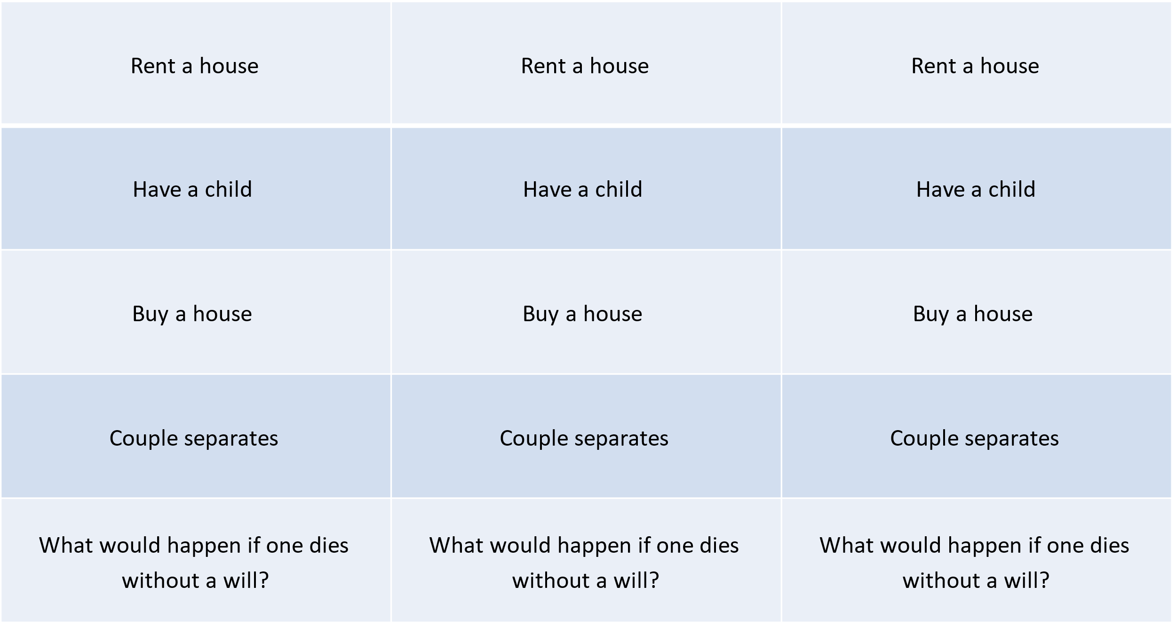
Notes:
Resource C – front.

Slide 29
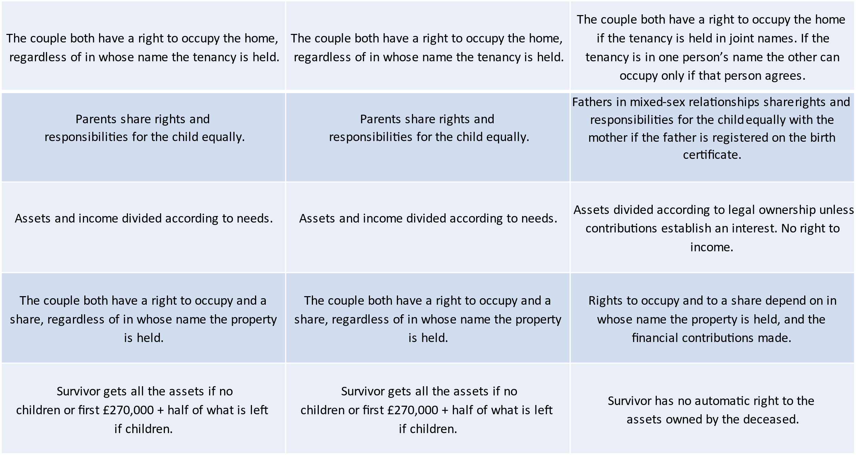
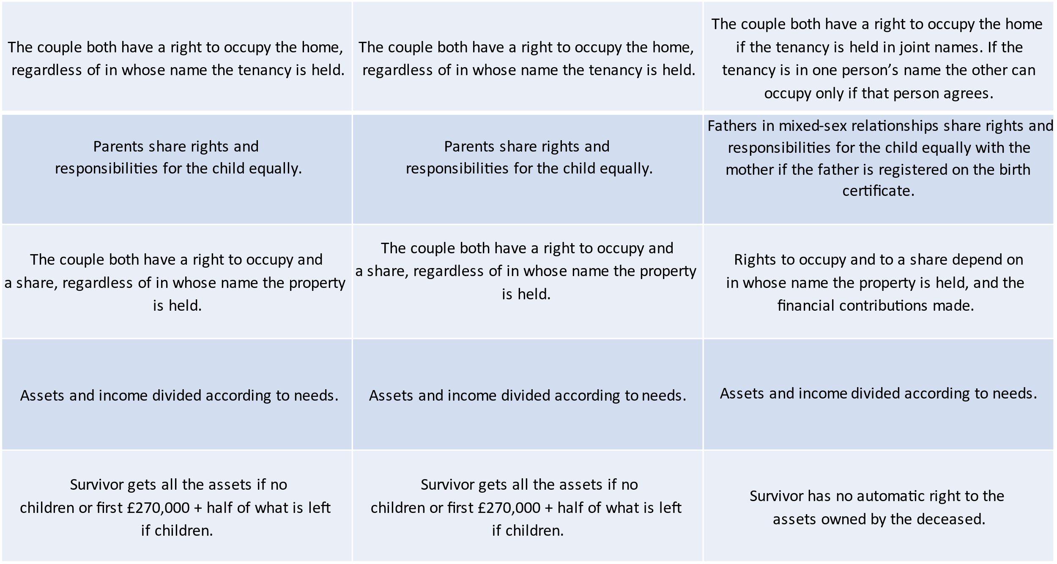
The couple both have a right to occupy the home, regardless of in whose name the tenancy is held.​ | The couple both have a right to occupy the home, regardless of in whose name the tenancy is held.​ | The couple both have a right to occupy the home ​ if the tenancy is held in joint names. If the ​ tenancy is in one person’s name the other can occupy only if that person agrees.​
Parents share rights and ​ responsibilities for the child equally.​ ​ | Parents share rights and ​ responsibilities for the child equally.​ ​ | Parents share rights and ​ responsibilities for the child equally.​ ​
Assets and income divided according to needs.​ ​ | Assets and income divided according to needs.​ ​ | Assets and income divided according to needs.​ ​
The couple both have a right to occupy and a share, regardless of in whose name the property ​ is held.​ | The couple both have a right to occupy and a share, regardless of in whose name the property ​ is held.​ | Rights to occupy and to a share depend on in whose name the property is held, and the ​ financial contributions made.​
Survivor gets all the assets if no ​ children or first £270,000 + half of what is left ​ if children.​ | Survivor gets all the assets if no ​ children or first £270,000 + half of what is left ​ if children.​ | Survivor has no automatic right to the ​ assets owned by the deceased.​
Notes:
Resource C – back.

Slide 30
Legal rights
I don't feel ready to get married, but I want to move in with my partner. What would happen if we later split up?
I am expecting a baby with my male partner, but we aren’t married. Do we need to do anything to make sure we both have parental responsibility?
My best friend has agreed to buy a house with their partner, but only in the partner's name even though she is paying some of the deposit. Is there anything she can do to protect her deposit in case they ever split up?
My older brother and his partner are getting married soon, and they keep talking about arranging a “pre-nuptial agreement”. What is that? Is it something you have to do before you get married?
My elderly neighbours got married last month so that they would be looked after if either of them died, but wouldn’t their money have gone to each other even if they weren’t married? They’ve been together for 40 years!
Notes:
Resource D: Information recording sheet

