Slide 1
Rosie’s story: What happens if families change?
Lesson 1
Notes:
This is the first of two lessons, ‘Rosie's Story: What happens if families change?’ Lesson 1 introduces pupils to Rosie, aged 9 and the people who make up her family or are important to her. They learn that families come in all shapes and sizes and sometimes families change when parents separate. They will learn about the range of emotions that young people go through when parents separate and discuss what children can do to help to support a friend whose parents have separated.
In lesson 2 pupils consider their right to have their voices heard and their views taken into account in the decision-making when parents separate under The United Nations Convention on the Rights of the Child, article 12. They will consider the processes available to help parents to reach an agreement (including mediation and court) and the help and support available to young people at this time.

Slide 2
TEACHER SLIDE – PREPARING TO TEACH
Preparing to teach and using these slides:
The slides headed ‘teacher slides’ assist the teacher in setting up and running the lesson
Slide 5 onwards are for the pupil-facing lesson
Please read the Lesson Plan 1 Teacher Guide for ‘Rosie's Story’ before teaching
Have slides in presenter mode – notes are available under each slide to aid teaching
Support: and extension:
activities are suggested where appropriate (icons on bottom right corner of slides)
Resources:
Post-it notes
An ‘ask-it-basket’/ question box for pupils to ask questions confidentially
Save for the above, no additional teaching resources are needed to teach this lesson
Timing:
The lesson is designed to be taught
over 45 minutes
Notes:
This two-part lesson plan for PSHE lessons has been devised for upper Key Stage 2 pupils.
This slide gives an overview of the lesson. It should be read in conjunction with the Teacher Guide for ‘Rosie's Story’ lesson 1. Teachers are reminded to review and address any questions submitted in the anonymous ask-it-basket’/ question box, to ensure they are answering all pupils’ questions.

Slide 3
TEACHER SLIDE – PREPARING TO TEACH
This two-part lesson plan for Key Stage 2 PSHE aims:
in lesson 1, to outline different family forms, what family members do to show they care and the range of emotions children may go through when parents separate (Programme of Study 2020 KS2: R5-R9, H20, L4)
in lesson 2, to outline the processes involved in divorce and separation, children’s rights to have their voices heard in the process and how this can be achieved. Pupils learn about the help and support available to young people at this time (R9, H23, L2)
DfE Guidance on RE states that RE in primary school teaching should:
focus… on teaching the fundamental… characteristics of positive relationships, with particular reference to… family relationships (para 54)
be based on knowledge of pupils and their circumstances… [with] no stigmatisation of children based on their home circumstances and recognising that families of many forms provide a nurturing environment for children (para 59)
creates an opportunity to enable pupils to be taught about positive emotional and mental wellbeing (para 61)
Notes:
For PSHE, the teaching in this two-part lesson plan is aimed to meet the requirements of The Programme of Study for PSHE Education 2020 for Key Stage 2 which states that children pupils should learn:
that people who love and care for each other can be in a committed relationship (e.g. marriage), living together, but may also live apart (R5)
that a feature of positive family life is caring relationships [and] about the different ways in which people care for one another (R6)
to recognise and respect that there are different types of family structure (including single parents, same-sex parents, step-parents, blended families, foster parents); that families of all types can give family members love, security and stability (R7)
to recognise other shared characteristics of healthy family life, including commitment, care, spending time together; being there for each other in times of difficulty (R8)
how to recognise if family relationships are making them feel unhappy or unsafe, and how to seek help or advice (R9)
to recognise there are human rights, that are there to protect everyone (L2)
the importance of having compassion towards others; shared responsibilities we all have for caring for other people… [and] how to show care and concern for others (L4)
The lesson centres on a young child, Rosie age 9 and her family. By exploring the changes in Rosie's family when her parents separated a year ago the themes outlined above are explored.
In line with the DfE Guidance on RE in primary schools the teaching should be based on knowledge of pupils and their circumstances… [with] no stigmatisation of children based on their home circumstances and recognising that families of many forms provide a nurturing environment for children. (Families can include for example, single parent families, LGBT parents, families headed by grandparents, adoptive parents, foster parents/carers amongst other structures) (para. 59).
N.B. the DfE Guidance on RSE in secondary schools provides that the lessons should assist teachers’ awareness of common ‘adverse childhood experiences’ (such as family breakdown…) and understanding of when and how these may be affecting any of their pupils and so may be influencing how they experience these subjects. Teachers should understand that pupils who have experienced problems at home may depend more on schools for support. (para 102). Given the prevalence of family breakdown amongst primary aged children, teachers should have the same considerations in mind when teaching KS2 pupils.

Slide 4
TEACHER SLIDE – LESSON OUTLINE AND TIMINGS
Activity | Description | Suggested timing
Introduction | Ground rules, learning objectives and outcomes | 5 minutes
Baseline activity | Pupils will suggest key words associated with ‘family’ and the different people who can be part of a family | 8 minutes
What do families do for one another? | Pupils will discuss on their tables what family members, or people that are special to them, do to make them feel loved and cared for | 7 minutes
Introducing Rosie | Pupils will be introduced to Rosie; her home, school friend, teacher and hobby | 2 minutes
Who is in Rosie’s family? | In pairs, pupils will be asked to consider the people and groups that are important to Rosie and decide which are part of her family | 6 minutes
Rosie’s feelings | Pupils will consider how Rosie might have been feeling after her parents separate and how Rosie’s friend Billy could support Rosie | 10 minutes
Endpoint assessment | Pupils will revisit and revise the baseline answers as appropriate | 5 minutes
Further support | Pupils will consider the further support available in school and online | 2 minutes
Notes:
The lesson is designed to be taught over 45 minutes. Should you have time for a 60-minute lesson we suggest adding time to the following activities so that the revised times are:
Introduction (no change)
Baseline activity - 10 minutes
What do families do for one another? - 10 minutes
Introducing Rosie - 3 minutes
Who is in Rosie’s family? - 7 minutes
Rosie’s feelings - 15 minutes
Endpoint assessment - 6 minutes
Further support - 4 minutes

Slide 5
GROUND RULES
We will:
not talk about anything personal about ourselves or others
not talk about anything personal that others say in the lesson to anyone else
we will listen to other’s views and opinions respectfully, without judging them
not ask anyone to answer a question if they don’t want to, and we don’t have to answer either
talk about ‘someone I know…’ rather than using a person’s name
comment on what is said, not who has said it
not ask personal questions or try to embarrass someone
seek help in school/encourage friends to seek help if needed
Notes:
Pupils will be discussing the experiences of a young child, Rosie aged 9 whose parents separated a year ago. The subjects raised have the potential to be distressing for some if their own parents have separated, or they do not live with either parent. Teachers should refer to the Handling complex issues safely in the PSHE Classroom guide (available at: https://pshe-association.org.uk/system/files/2018%20-%20Handling%20complex%20issues%20safely%20in%20the%20PSHE%20classroom.pdf) before teaching. It is important that ground rules are established to minimise the potential for distress to any pupil. Teachers may modify or explain ground rules as needed and if a teacher already has established ‘class ground rules’ then these can be substituted. Pupils can also be asked to add to the ground rules as appropriate.
Teachers should also:
have an ‘ask-it-basket’/ question box for pupils to ask questions confidentially
review and address any questions submitted in the anonymous ‘ask-it-basket’/ question box
work within the school’s policies on safeguarding and confidentiality
link PSHE education into the whole school approach to support pupil wellbeing
make pupils aware of sources of support, both inside and outside the school
explain to pupils that while confidentiality is important, if something is said or a behaviour causes concern, teachers may speak to another member of staff.

Slide 6
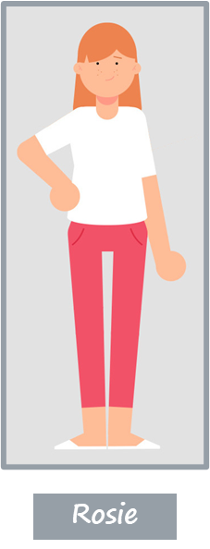
Rosie’s story: What happens if families change? LESSON 1
Learning Objectives Pupils will learn:
about different types of families and how they can change
Notes:
Run through the Learning Objectives:
Pupils will learn:
about different types of families and how they can change. (R5, R7, H6)
Explain that most parents stay together but some don‘t and that the pupils will be introduced to Rosie aged 9 and the changes in her family when her parents separate.

Slide 7
Rosie’s story: What happens if families change? LESSON 1
Learning Outcomes: Pupils will be able to:
describe the different ways in which people can be a family
explain some of the ways that families show that they care for each other
describe the range of emotions that young people may feel when parents separate and what friends can do to support them at that time
Notes:
Run through the Learning Outcomes: Pupils will be able to:
Describe the different ways in which people can be a family (R5, R7)
Explain some of the ways that families show that they care for each other (R6, R8)
Describe the range of emotions that young people may feel when parents separate (R9, H6, H23, L4)

Slide 8
BASELINE ACTIVITY –WHAT is A Family?
What is a family?
Who can be part of a family?
What words do you think of when you think about a family?
Notes:
To begin, place three graffiti walls around the room with one heading per piece of sugar/flip chart paper: ‘What is a family?’, ‘Who can be part of a family?’, ‘What words do you think of when you think about a family?’
Ask the whole class to privately think about these questions and then either ask pupils to get up and move around the room or, if you would prefer, you could hand out post it notes for pupils to complete in response to these questions, that they then stick on each ‘wall’.
Do not give any further hints or tips, even if pupils ask questions. They should not share their ideas with classmates during the activity. This will give you the opportunity to see what pupils’ own beliefs and ideas are on ‘family’ before the lesson begins.
Pupils may suggest:
What is a family? (A group of people who usually live together who share their money and food and - take care of one another.)
Who can be part of a family? (Parents/step parents, children, grandparents/ step-grandparents, siblings, aunts, uncles, cousins etc. including single parents, same-sex parents, step-parents, blended families, foster parents or adoptive parents.)
- What words do you think of when you think about a family? (Loving, caring, helpful, sharing, trust, playing, comforting.)

Slide 9
WHAT do Families do for one another?
What do families do for one another to show that they care?
Help each other e.g. tie shoelaces
Make food for each other
Play together e.g. in the park
Go on holidays together
Look after each other e.g. when ill
Help with homework
Help each other to clean house
Praise each other when we do well
Say they love each other/give hugs
Say sorry when they have upset each other
Notes:
Programme of Study 2020 KS2, R6 requires PSHE lessons to help pupils to learn ‘that a feature of positive family life is caring relationships’ [and] ‘about the different ways in which people care for one another’. In addition R8 requires pupils to learn ‘to recognise other shared characteristics of healthy family life, including commitment, care, spending time together; being there for each other in times of difficulty.’ These themes are explored by looking at what families do for one another to show that they care.
Explain that sometimes family relationships can be difficult as well as happy. Sometimes parents have to discuss things and don’t always agree. Sometimes brothers and sisters argue but that doesn't mean that families don’t care for each other.
Give the class 3 minutes to discuss ideas on their tables about the things that families do for one another to show that they care. Ask them to then feedback some of their suggestions and write these on the whiteboard. In slideshow mode, go through the suggestions on the PowerPoint, pointing out those that the class had already suggested and any that are in addition to the suggestions made by the class (adding the further suggestions to the whiteboard).
As a support activity, consider giving the pupils some of the answers to start them off, or asking them to name 3 things only that families do for one another to show that they care.
As an extension activity, consider asking the pupils to list which of the actions on the slide (and any additional actions they have come up with) are actions that care for their physical health, which are actions that care for their mental health and wellbeing and which care for both physical health and mental health and wellbeing.

Slide 10
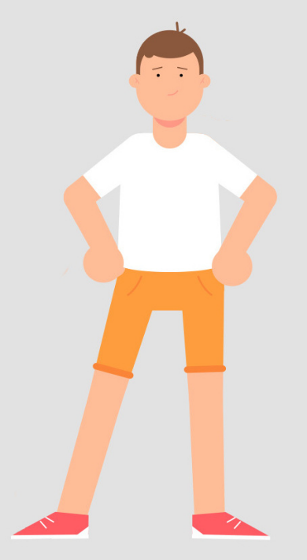
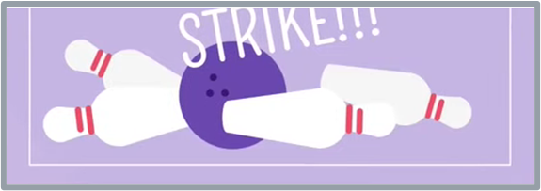
Meet Rosie
Rosie’s house
Rosie’s friend, Billy
Rosie’s teacher, Mr Green
Rosie’s Story-
What happens if families change?
Rosie likes to go bowling
Notes:
This slide introduces the pupils to Rosie, aged 9. In slideshow mode we are introduced to where Rosie lives, her friend from school, Billy, and her teacher, Mr Green. We are also told a little about her hobbies as she likes to go bowling.

Slide 11
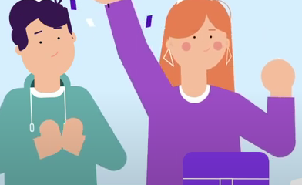
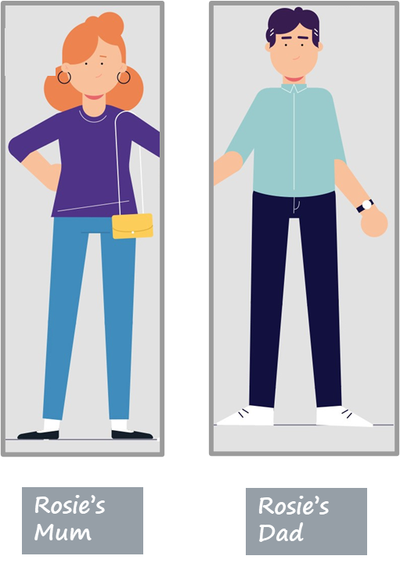
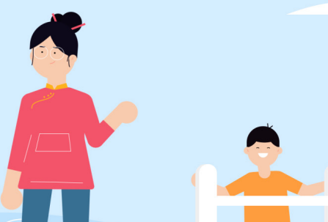
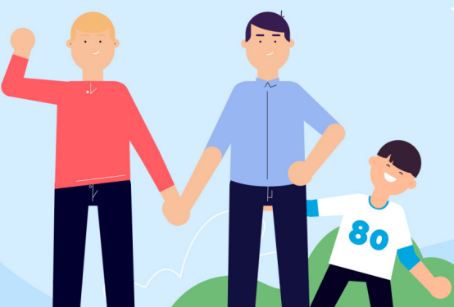
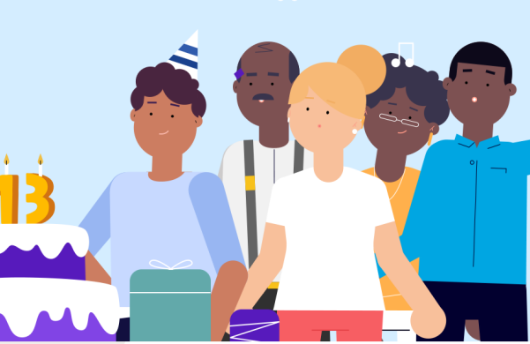
WHO IS IN Rosie’s Family?
Rosie’s brother Jack and her sister Chloe
Dad’s partner Min and her son, Jonny
Rosie’s Uncle Mike, Mike’s husband, Will and their adopted son, Ollie
Rosie’s dog, Max
Rosie’s neighbour Tom and Tom’s family
Notes:
Programme of Study 2020 KS2, R7 requires PSHE lessons to help pupils ‘to recognise and respect that there are different types of family structure (including single parents, same-sex parents, step-parents, blended families, foster parents); that families of all types can give family members love, security and stability’. In addition R5 requires pupils to learn, ‘that people who love and care for each other can be in a committed relationship (e.g. marriage), living together, but may also live apart.’ These themes are explored when looking at the different members of Rosie's family.
Encourage pupils to share any questions they may have during and/or after this activity.
Ask pupils to draw a table with the headings ‘family’ and ‘not family’ at the top. In slideshow mode, show pupils the various groupings and ask them to write down the characters under the heading they think they belong to:
Rosie’s mum and dad (pupils should readily agree that they are family). Explain that Rosie’s mum and dad separated a year ago and are now divorced. Rosie now lives with her mum and spends lots of time with her dad and his new partner Min and her son Jonny who have lived with her Dad for the last 9 months. Ask if pupils think it makes any difference that Rosie’s parents are divorced (again they should readily agree that it makes no difference).
Rosie's brother Jack and her sister Chloe. Pupils are likely to correctly agree that they are in Rosie's family.
Dad’s partner Min and her son Jonny. As Min and Rosie's dad have lived together for 9 months as a ‘blended family’, pupils are likely to agree that Min and Jonny form part of Rosie's family.
Rosie's dog, Max. For lots of children, their pets are an important member of ‘their family’.
Rosie’s Uncle Mike, Mike’s husband Will and their adopted son, Ollie. Pupils should be able to recognise that a same sex couple can be part of your family, here because Mike is Rosie’s uncle so Will is her uncle by marriage. Explain sometimes if a child cannot live with their birth parents then another couple may adopt them so that they become the child’s adoptive parents. This is what has happened to Ollie, making Ollie Rosie’s cousin.
Rosie’s next door neighbour Tom. Explain that Tom lives with his mum, dad, grandma and grandpa. This gets across to pupils that intergenerational families sometimes live together. Explain that Tom has lived next door to Rosie’s family since Rosie was a baby. Tom doesn't have any brothers and sisters so the two families have always been very close. Despite this, pupils should recognise that even though Tom and his family are important people in Rosie's life they do not form part of her family. They might feel like family, or they might be as close to Rosie’s family as some families are with other members of their family, but they are not actually part of Rosie’s family.
Ask: Does anyone have any questions about who is in Rosie’s family?
Encourage pupils to write anonymous questions they can add to the ask it basket which teachers can check at the end of the lesson.

Slide 12
Rosie’s feelings: How might Rosie have felt when her parents separated?
1) It’s not happening! Not wanting to believe that her parents are separating
2) Why is this happening? Frustrated, confused and angry that this is happening to her
3) How can I stop this happening? Thinking this is her fault/changing her behaviour to try to stop the separation
4) I don't want this to happen! Sad, wanting things to go back to how they were
5) I'm sad it's happened but I’m ok: Coming to terms with the changes in her family
It’s not happening!
Why is this happening?
How can I stop this happening?
I don’t want this to happen!
I'm sad it’s happened but I’m ok
Feelings
Notes:
Programme of Study 2020 KS2, R9 requires PSHE lessons to help pupils learn ‘how to recognise if family relationships are making them feel unhappy’. H6 requires PSHE lessons to help pupils to ‘learn about change and its impact on mental health and wellbeing and to recognise the need for emotional support during life changes and/or difficult experiences’. In addition, L4 requires pupils to learn, ‘the importance of having compassion towards others; shared responsibilities we all have for caring for other people… [and] how to show care and concern for others’ These themes are explored by considering the different feelings that Rosie may have experienced when her parents separated.
Explain to pupils that Rosie's parents separated a year ago and she found it hard to start off with, but she is now feeling much happier about the situation. Here the emphasis is on the fact that parental separation can be a form of grief for children and that many go through a five-stage cycle, much in the same way as they experience grief when someone dies. The emphasis should be on normalising some of the feelings that young people may have if their parents separate such as anger or sadness. Every child’s experience is unique and will depend in part on the situation at home prior to the separation and how amicable the parents are upon separation. If the home life had been difficult the separation may be a relief. Not every child will feel all of these things or progress in a linear fashion through them.
Ask pupils to write down how think Rosie may have felt when her parents first separated.
Answer: sad, hurt, angry, worried and/ or confused).
Distancing techniques should be used, so describing how it is normal that Rosie might feel hurt, sad, bewildered, angry, worried, confused or overwhelmed. Normalise how it is common for young people to feel that they were somehow responsible for the separation (the ‘bargaining’ aspect of how Rosie might feel– How can I stop this happening? - refers to attempts by young people to change their own behaviour in the hope that a parent will return home).
Tell the pupils that Rosie’s friend Billy wants to support Rosie. Give pupils 2-3 minutes on their tables to suggest 3 top tips for Billy that could help him support Rosie through her parents’ separation. Once pupils have had an opportunity to discuss this in their group Ask each group to feedback what would be their 3 top tips for Billy [listen to how Rosie is feeling, without judging and ‘be there’ for her; help her to seek out pastoral support at school; reassure her that she is not to blame for the separation and encourage her to keep up with friends, hobbies, exercise etc.]
As a support activity, consider asking pupils to think of just one thing that Billy could do to support Rosie through her parents’ separation.
As an extension activity, consider asking the pupils to think of something that Billy could do to support Rosie through each stage of how she might be feeling following her parents’ separation.

Slide 13
ENDPOINT ASSESSMENT ACTIVITY
What is a family?
Who can be part of a family?
What words do you think of when you think about a family?
Notes:
Endpoint assessment - summarise the ideas written on the original graffiti walls/on post-it notes on the graffiti walls and ask the class if they now have anything to add. Following on from the discussion about who is in Rosie's family, pupils may now recognise, for example, that a couple in a same sex relationship are a family, as is an adoptive family, blended families, single parent families and intergenerational families.
Teachers should be aware of and acknowledge cultural differences in meanings that pupils may attach to ‘family’, some cultures for example are more likely to live in intergenerational family units than others. Families have also changed over time with many parents having fewer children than in previous generations.
If pupils don’t have anything to add to the graffiti walls at the end of the lesson, and to ensure all pupils participate, you could instead ask pupils to complete the following sentence, ‘Family is…’ Pupils can describe in a sentence what they believe family is.

Slide 14
Further help and support in school
For further help and support in school contact:
your form teacher/ PSHE teacher
your Head of Year
the pastoral support team
Notes:
Remind pupils who they can talk to in school, e.g. teacher or head of year, or the pastoral support team (you may wish to personalise this slide with names of contact staff).

Slide 15
Further help and support out of school
The National Association of Child Contact Centres (NACCC) https://naccc.org.uk (tel: 01159 484557)
The National Youth Advocacy Service (NYAS) https://NYAS.net (tel: 0808 8081001)
Relate https://www.relate.org.uk
(tel: 300 0030396)
Childline
https://www.childline.org.uk (tel: 0800 1111)
The Child and Family Court Advisory and Support Service (Cafcass) https://www.cafcass.gov.uk (tel: 0300 456 4000)
Notes:
In slideshow mode each charity and its contact details are grouped and will be listed in turn.
Some pupils may have heard of Relate as a relationship counselling service but point out to them that Relate also offer counselling for young people.
Tell pupils that in the next lesson they will be finding out more about the charities listed and the support that they can give to young people whose parents have separated.
At the end of the lesson explain to pupils that in lesson 2 they will be learning about how young people can ‘get their voices heard’ when parents separate, the different sources of support available to young people when parents separate and the topic of divorce more generally and that, if they wish to, pupils can let the teacher know/put a note in the ‘ask it basket’ if that is an issue for them.

