Slide 1
Rosie’s story: What happens if families change?
Lesson 2
Notes:
This is the second of two lessons, ‘Rosie's Story: What happens if families change? ’ Lesson 1 introduces pupils to Rosie, aged 9 and the people who make up her family or are important to her. They learn that families come in all shapes and sizes and sometimes families change when parents separate. They consider the range of emotions that young people go through when parents separate. In lesson 2 pupils learn about the processes involved in divorce and separation, their rights to have their voices heard in the process and how this can be achieved. They also learn about the help and support available to young people at this time.

Slide 2
TEACHER SLIDE – PREPARING TO TEACH
Preparing to teach and using these slides:
The slides headed ‘teacher slides’ assist the teacher in setting up and running the lesson
Slide 8 onwards are for the pupil-facing lesson
Please read the Lesson Plan 2 Teacher Guide for ‘Rosie's Story’ before teaching
Have slides in presenter mode – notes are available under each slide to aid teaching
Support: and extension:
activities are suggested where appropriate (icons on bottom right corner of slides)
Resources:
Post-it notes
An ‘ask-it-basket’/ question box for pupils to ask questions confidentially
Handout for ‘quick fire quiz’ if using
Save for the above, no additional teaching resources are needed to teach this lesson
Timing:
The lesson is designed to be taught
over 45 minutes
Notes:
This two-part lesson plan for PSHE lessons has been devised for upper Key Stage 2 pupils
This slide gives an overview of the lesson. It should be read in conjunction with the Teacher Guide for ‘Rosie's Story’ lesson 2. Teachers are reminded to review and address any questions submitted in the anonymous ask-it-basket’/ question box, to ensure they are answering all pupils’ questions.

Slide 3
TEACHER SLIDE – PREPARING TO TEACH
This two-part lesson plan for Key Stage 2 PSHE aims:
in lesson 1, to outline different family forms, what family members do to show they care and the range of emotions children may go through when parents separate (Programme of Study 2020 KS2: R5-R9, H20, L4)
in lesson 2, to outline the processes involved in divorce and separation, children’s rights to have their voices heard in the process and how this can be achieved. Pupils learn about the help and support available to young people at this time (R9, H23, L2)
DfE Guidance on RE states that RE in primary school teaching should:
focus… on teaching the fundamental… characteristics of positive relationships, with particular reference to… family relationships (para 54)
be based on knowledge of pupils and their circumstances… [with] no stigmatisation of children based on their home circumstances and recognising that families of many forms provide a nurturing environment for children (para 59)
creates an opportunity to enable pupils to be taught about positive emotional and mental wellbeing (para 61)
Notes:
For PSHE, the teaching in this two-part lesson plan is aimed to meet the requirements of The Programme of Study for PSHE Education 2020 for Key Stage 2 which states that children pupils should learn:
that people who love and care for each other can be in a committed relationship (e.g. marriage), living together, but may also live apart (R5)
that a feature of positive family life is caring relationships [and] about the different ways in which people care for one another (R6)
to recognise and respect that there are different types of family structure (including single parents, same-sex parents, step-parents, blended families, foster parents); that families of all types can give family members love, security and stability (R7)
to recognise other shared characteristics of healthy family life, including commitment, care, spending time together; being there for each other in times of difficulty (R8)
how to recognise if family relationships are making them feel unhappy or unsafe, and how to seek help or advice (R9)
strategies to respond to feelings, including intense or conflicting feelings; how to manage and respond to feelings appropriately and proportionately in different situations (H20)
about change and loss… and how these can affect feelings; ways of expressing and managing grief (H23), here within the context of change associated with parental separation
to recognise there are human rights, that are there to protect everyone (L2)
the importance of having compassion towards others; shared responsibilities we all have for caring for other people… [and] how to show care and concern for others (L4)
The lesson centres on a young child, Rosie age 9 and her family. By exploring the changes in Rosie's family when her parents separated a year ago the themes outlined above are explored.
In line with the DfE Guidance on RE in primary schools the teaching should be based on knowledge of pupils and their circumstances… [with] no stigmatisation of children based on their home circumstances and recognising that families of many forms provide a nurturing environment for children. (Families can include for example, single parent families, LGBT parents, families headed by grandparents, adoptive parents, foster parents/carers amongst other structures) (para. 59).
N.B. the DfE Guidance on RSE in secondary schools provides that the lessons should assist teachers’ awareness of common ‘adverse childhood experiences’ (such as family breakdown…) and understanding of when and how these may be affecting any of their pupils and so may be influencing how they experience these subjects. Teachers should understand that pupils who have experienced problems at home may depend more on schools for support. (para 102). Given the prevalence of family breakdown amongst primary aged children, teachers should have the same considerations in mind when teaching KS2 pupils.

Slide 4
TEACHER SLIDE – the uncrc
The United Nations Convention on the Rights of the Child 1989 (UNCRC) is the global “gold standard” for children’s rights and sets out the fundamental rights of all children. It is the most widely and rapidly ratified human rights treaty in history. It sets out the civil, political, economic and cultural rights of every child. Governments agree to safeguard the rights and ensure that adults and children know about them.
It has been signed by 196 countries of which all but the USA have ratified it. (It was ratified in the UK in 1991.)
It has 4 guiding principles (non-discrimination; the best interests of the child; the right to life, survival and development; and the right of children to express their views freely and to be heard) which apply to all under 18s.
It consists of 54 Articles which include protecting children’s rights to life; healthcare; education; protection from discrimination, harm or exploitation (including violence, abuse, neglect, kidnapping, child labour and child soldiers) and to live with their family (where possible).
Notes:
This slide gives some details about The UNCRC.
This is covered in slide 12 in the pupil-facing slides below.
For further information on the UNCRC see: https://www.unicef.org.uk/what-we-do/un-convention-child-rights/

Slide 5
TEACHER SLIDE – YOUNG PEOPLE’S ART. 12 RIGHTS
The United Nations Convention on the Rights of the Child 1989 (UNCRC) Article 12 gives all children the right to have their voices heard and their opinions listened to and taken seriously by adults. This includes the right to information, consultation and representation (if needed) when their parents separate. These rights are universal and freestanding. In a minority of cases, it may be appropriate for the child to make their own application to the court. Legal aid (i.e. funding) is available for this and a solicitor or an advocate from NYAS, The National Youth Advocacy Service, (see side 22) can make the application for the child and represent them in court if needed. Children are also entitled to speak to the mediator if their parents are in mediation. This process is known as ‘child inclusive mediation’.
This does not mean that young people make the decisions – the responsible adults (usually their parents) do, but young people have the right to have their opinions listened to. The weight placed upon those opinions will depend upon the age and maturity of the child.
The parents of approximately 280,000 young people separate each year. In 2013 (the last year that the government collected this data), 48% of couples who divorced had at least 1 child under 16 living with them; 64% of these children were aged under 11(ONS, 2015).
Research indicates that children cope better when they are consulted about arrangements for them when their parents separate and that the arrangements made are longer-lasting, yet they are seldom consulted.
Notes:
This slide gives some statistics on the numbers of young people whose parents separate each year and young people’s rights to be heard in the decision making following parental separation.
This is covered in slides 12-13 in the pupil-facing slides below.
For further information on representing children in court cases see: https://www.nyas.net/services/legal-services/
For further information on consulting children in mediation see: https://www.familymediationcouncil.org.uk/mediation-isnt-only-for-the-adults/
For research on children’s outcomes when they are consulted when parents separate see: https://www.justice.gov.uk/downloads/family-mediation-task-force-report.pdf, page 40.

Slide 6
TEACHER SLIDE – the divorce LEGISLATION
The Matrimonial Causes Act 1973 (in force until 6th April 2022), provides that divorce can be granted on the ground of irretrievable breakdown, proved by one of five facts; the Respondent has committed adultery (had sex with a member of the opposite sex whom they are not married to) or behaved unreasonably; the parties have been separated for two years (provided the other party agreed) or five years if the other party did not agree (there is one other technical fact of two years desertion but this is rarely used). The Respondent can defend a ‘fault–based’ application, but this rarely happens as it is costly. The law has been widely criticised as the requirement to ‘blame’ the other person can increase animosity.
The Divorce, Dissolution and Separation Act 2020, to be introduced in April 2022, removes fault from the process. The ground for divorce remains the same – the marriage must have irretrievably broken down – but this is proved by the passage of time. The Applicant can apply for a final order 26 weeks after filing the application. There is no option to defend the divorce and the application can be made jointly. For some, it will increase the length of time it takes to get a divorce because the so called ‘quickie’ facts of adultery or unreasonable behaviour no longer apply.
Notes:
This slide gives some details about ‘old’ fault-based system of divorce in England and Wales and the new ‘no-fault‘ divorce to be introduced in April 2022.
The ‘new’ law is covered in slide 15 in the pupil-facing slides below. Further details of the processes involved and how children's voices can be included when parents separate are outlined on slides 16-19.

Slide 7
TEACHER SLIDE – LESSON OUTLINE AND TIMINGS
Activity | Description | Suggested timing
Introduction | Ground rules, learning objectives and outcomes | 5 minutes
Baseline activity | Pupils will draw a mind map of what questions Rosie may have had and her support needs when her parents first separated | 7 minutes
Introduction to the UNCRC | Pupils will be introduced to The United Nations, the UNCRC, and will complete the gap-fill exercise to recap on Article 12 | 5 minutes
Who can Rosie speak to for support? | In pairs, pupils will be asked to write down the people that Rosie has at home or at school who she could talk to if she is feeling upset | 3 minutes
Processes and quick fire quiz | Pupils will learn about the process of divorce and for making child arrangements, and how their voices are included then consolidate with a quiz | 15 minutes
Sources of support | Pupils will learn about the support, online and in the community, available to young people whose parents separate | 5 minutes
Endpoint assessment | Pupils will revisit and revise the baseline answers as appropriate and review the further help and support available | 5 minutes
Notes:
The lesson is designed to be taught over 45 minutes. Should you have time for a 60-minute lesson we suggest adding time to the following activities so that the revised times are:
Introduction (no change)
Baseline activity – 10 minutes
Introduction to the UNCRC– 8 minutes
Who can Rosie speak to for support? – 5 minutes
Processes and quick fire quiz – 18 minutes
Sources of support– 7 minutes
Endpoint assessment– 7 minutes

Slide 8
GROUND RULES
We will:
not talk about anything personal about ourselves or others
not talk about anything personal that others say in the lesson to anyone else
we will listen to other’s views and opinions respectfully, without judging them
not ask anyone to answer a question if they don’t want to, and we don’t have to answer either
talk about ‘someone I know…’ rather than using a person’s name
comment on what is said, not who has said it
not ask personal questions or try to embarrass someone
seek help in school/encourage friends to seek help if needed
Notes:
Pupils will be discussing the experiences of a young child, Rosie aged 9 whose parents separated a year ago. The subjects raised have the potential to be distressing for some if their own parents have separated, or they do not live with either parent. Teachers should refer to the Handling complex issues safely in the PSHE classroom guide (available at: https://pshe-association.org.uk/system/files/2018%20-%20Handling%20complex%20issues%20safely%20in%20the%20PSHE%20classroom.pdf) before teaching. It is important that ground rules are established to minimise the potential for distress to any pupil. Teachers may modify or explain ground rules as needed and if a teacher already has established ‘class ground rules’ then these can be substituted. Pupils can also be asked to add to the ground rules as appropriate.
Teachers should also:
have an ‘ask-it-basket’/ question box for pupils to ask questions confidentially
review and address any questions submitted in the anonymous ‘ask-it-basket’/ question box
work within the school’s policies on safeguarding and confidentiality
link PSHE education into the whole school approach to support pupil wellbeing
make pupils aware of sources of support, both inside and outside the school
explain to pupils that while confidentiality is important, if something is said or a behaviour causes concern, teachers may speak to another member of staff.

Slide 9
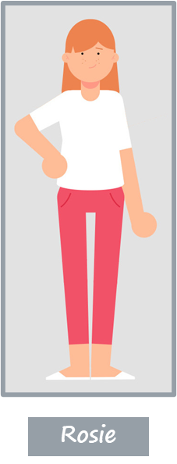
Rosie’s story: What happens if families change? LESSON 2
Learning Objectives - Pupils will learn:
about rights children have if parents separate and the type of support they might need
Notes:
Run through the Learning Objectives:
Pupils will learn:
about rights children have if parents separate and the type of support they might need (H6, H23, R9, L2)
Explain that the pupils will continue to look at 9-year-old Rosie’s changes in her family. Remind pupils that Rosie’s mum and dad separated a year ago and Rosie now lives with her mum, her brother Jack and her sister Chloe and spends lots of time with her dad and his new partner. Tell pupils that Rosie is much happier now but that they are going to look back at some of the help and support available to Rosie when her parents first separated.

Slide 10
Rosie’s story: What happens if families change? LESSON 2
Learning Outcomes - Pupils will be able to:
explain young people’s rights under Article 12, UNCRC when
parents separate
identify the different ways arrangements for children can be made and how young people can be consulted if parents separate
identify sources of support for these young people and explain how to access them
Notes:
Run through the Learning Outcomes:
Pupils will be able to:
explain young people’s rights under Article 12, UNCRC when parents separate (L2)
identify the different ways arrangements for children can be made and how young people can be consulted if parents separate (R9,L2)
identify sources of support for these young people and explain how to access them (R9, H6, H23)

Slide 11
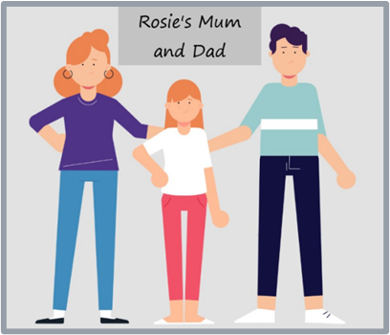
BASELINE ACTIVITY – support for children
Draw a mind map with the word ‘Rosie’ in the middle. Around the outside, write down:
questions you think Rosie may have had when her mum and dad first separated
support you think Rosie may have needed and examples of support you know of that may be available to her
Notes:
For this activity, if pupils wish to discuss questions with one another, remind them to work independently and any questions they may have will be answered after the baseline assessment is completed.
Ask pupils (without conferring) to each to draw a mind map with the word ‘Rosie’ in the middle. Around the outside, ask them to write down:
questions you think Rosie may have at this time. (Is this because of something I have done? Is there any chance of you staying together? Where am I going to live? Who am I going to live with? How often will I see my other parent? Will I have to change schools? Will I be able to keep up my friendships/hobbies/time with wider family? How will things get sorted out? Will I be asked what I want? If so, by whom? Will I have to go to court?)
the support you think Rosie may need and any examples you know of support that may be available to her. (Support needed may include - good friends around her; peer support from others who've been through this; good pastoral support at school; good information online to get some of her questions answered; someone to speak to about how she's feeling; someone to speak to about what she would like to happen around arrangements for her care. Sources of support may include- pastoral support at school; friends or wider family; ChildLine or other counselling service).
Note: Do not give any further hints or tips, even if pupils ask questions. They should not share their ideas with classmates during the activity. This will give you the opportunity to see what pupils’ own beliefs and ideas are before the lesson begins.
Circulate the room as pupils complete their mind maps in order to gauge what pupils know/think/feel/believe in relation to the topic. After pupils have had 3-4 minutes or so to complete their mind maps, ask for all class feedback (using the suggested answers above to guide you}. Ask pupils not to add anything else to their mind maps during class feedback and to put these to one side as they will return to them (and these two questions) at the end of the lesson.

Slide 12
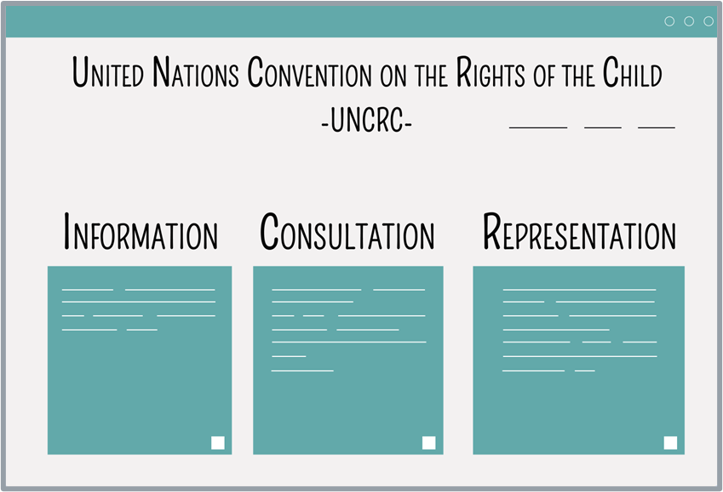
INTRODUCTION TO THE UNCRC
The Convention:
The United Nations Convention on the Rights
of the Child 1989 (UNCRC) is an important agreement by countries who have promised to protect children’s rights
The UNCRC explains the rights children have and how governments must make sure that the rights are upheld
Article 12 of the UNCRC gives children the right to give their opinions on matters affecting them and adults must take those opinions seriously
Notes:
(Further subject knowledge is outlined on slides 4-5 above.)
Explain that young people have the right to have their voices heard and their opinions taken into account when their parents separate. This right is contained in an important document called the United Nations Convention on the Rights of the Child. Begin by explaining key terms:
Governments: The group of people who make decisions and the laws for a country.
The United Nations: Organisation that most countries in the world including the UK belong to which exists to find solutions to the world’s problems.
Convention: Agreements that governments sign.
Explain that most countries in the world, including the UK, are members of the United Nations. Explain that the United Nations exists to find solutions to the world’s problems. Sometimes the United Nations makes conventions which are agreements that the countries sign. One very important convention is The United Nations Convention on the Rights of the Child 1989 (UNCRC). Explain that the UK ratified the convention in 1991 (i.e. they agreed to uphold it). The UNCRC is made up of 54 statements, known as articles, which protect children’s rights. Article 12 gives children the right to give their opinions on matters affecting them and adults must listen and take those opinions seriously. This means that when parents separate all children have the right to information about what will happen and what support is available and to be consulted. Most children won't need it, but they could also be represented in court if necessary.
Depending on level of engagement and level that the class are working at, either ask what consultation and representation mean or explain the terms:
Consultation – to be asked your opinion.
Representation – to have someone to speak on your behalf in court i.e. to have a lawyer whose role it is to tell the judge what you want and what is best for you.
Ask: What might a child think or feel if they aren’t given this right?’
Ask pupils to discuss this on their tables and feed their answers back to the class.
Suggested answers could include feeling unheard, unimportant or excluded.

Slide 13
ARTICLE 12: UNCRC
ARTICLE 12
You have the _________ to give your ___________ and for __________ to _________, and take it __________.
adults, opinion, seriously, right, listen
Notes:
In this lesson pupils will explore the sources of support available to them when their parents separate and how to access this support. This will be discussed as part of young people’s Article 12 right to give their opinion and for adults to listen and take it seriously. To set this up and to recap, ask pupils to use the suggested words to fill in the gaps on Article 12 above.
In slideshow mode, the gap-fill appears without the suggested words, with the suggested words appearing on a click to give you the option of doing the exercise as a support or extension task.
As a support activity consider giving pupils the sentence with only the word ‘right’ missing and ask them to tell you the missing word.
As an extension activity: Ask pupils to write a short statement/summary about the rights children have.

Slide 14
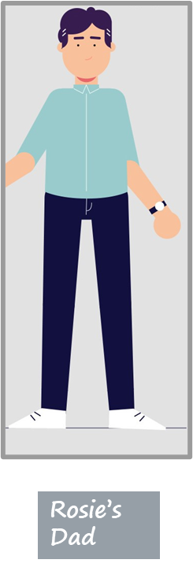
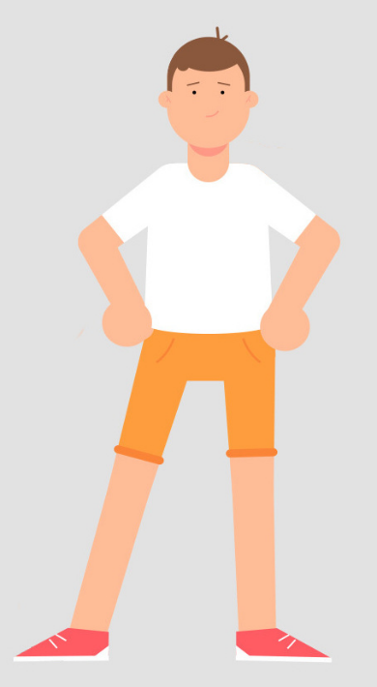
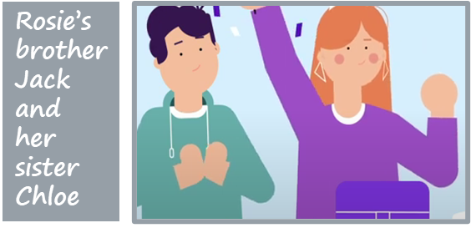
Who can ROSIE SPEAK TO FOR support?
Rosie’s friend, Billy
Rosie’s teacher, Mr Green
Rosie
Notes:
Ask: what does the term separation mean? What might happen when two people separate?
Remind pupils that Rosie's parents separated a year ago so she's feeling much better about the separation than she did at the time but sometimes still need some support.
Run through the characters again to remind pupils who Rosie has for support (or for any pupils who were absent for lesson 1). In slideshow mode each character is shown in turn. N.B. Rosie’s mum and dad have been grouped together to avoid any inference that one is superior or preferable to the other.
Ask pupils to list one advantage and one disadvantage for each person that Rosie speaks to:
Mum or Dad: advantage - Rosie will be used to speaking to them when she's upset; disadvantage - Rosie may be upset about them so it may be hard to talk to them about it.
Chloe or Jack, her sister and brother: advantage - they will be upset too so will understand how Rosie is feeling; disadvantage - Rosie may not want to speak to them in case it upsets them.
Rosie's friend Billy or one of her other friends: advantage – they are not part of Rosie's family so she doesn't risk upsetting them; disadvantage - Rosie’s friends may not have gone through this experience so may not fully understand how she's feeling.
Rosie's teacher, Mr. Green: advantage – he will have had others in his classes that have gone through what Rosie has gone through so he will be able to help Rosie too; disadvantage - at first it might be hard for Rosie to talk to Mr Green about things that are going on outside of school.
As a support activity consider asking pupils to list one advantage and one disadvantage for one or two of the people who Rosie could speak to for support.
As an extension activity consider asking pupils to script the opening to a conversation about seeking support – how might they ask someone for help?’

Slide 15
What is the process when parents separate?
If a couple aren't married they don't need to apply to the court to end their relationship.
If a couple are married they need to apply to the court for a ‘divorce’ to end their relationship but there is no need for anyone to attend court in person.
The person applying for the divorce is the Applicant. The other person is the Respondent.
From April 2022, The Divorce, Dissolution and Separation Act 2020 will be in force. This means that:
The Applicant does not need to show that it was the Respondent’s fault.
The Respondent cannot say to the court that they object to the divorce.
Notes:
Slides15-20 have information on divorce and separation and on the processes for agreeing child arrangements. Depending on the time available and engagement of the pupils, teachers may choose to a) run through all the information in the slides emphasising to pupils the key messages highlighted in bold in the notes or b) simply emphasise the key messages for each slide and give sufficient information to allow pupils to complete the quick fire quiz that follows.
To consolidate learning from this and the next four slides on processes and how children’s voices can be heard in these processes, and to scaffold this part of the teaching, there is a quick fire quiz on slide 21. To ensure that all pupils participate, either provide a handout for pupils to complete/refer back to if they find they need the information in future (a handout is at the end of the Teacher Guide) or write the questions on the whiteboard at the start of the lesson. If using the handout, hand it out now and ask the pupils to write the answers on the handout/make a note of the answers as you go through the slides as you will be asking individual pupils to give their answer to a question later.
Allow time, as you cover slides 15-21, for pupils to consider any thoughts or questions they have and ask questions if they would like.
The key message here is that from April 2022 there will be no need to show that the other person was at fault to get a divorce.
If pupils are particularly engaged or interested you could explain that parliament passes ‘Acts’ when it wants to change the law in a certain area and has recently passed The Divorce, Dissolution and Separation Act 2020 which comes into force in April 2022 and introduces ‘no fault divorce’ so that no one needs to blame the other person in order to get a divorce.
If pupils are particularly engaged you may also wish to point out, as a higher level point, that under the new rules from April 2022 the Applicant and Respondent can make a joint application on the basis that the marriage has broken down and the divorce can be obtained after 6 months.
Ask pupils to comment on why it might be better for children that the parents don't have to say that the relationship breakdown was the other parent’s fault when they divorce.
Answer: It may make the separation more friendly and the parents may be more open to listening to their children's views. It makes it easier for the parents to agree the arrangements for the children between themselves and therefore make it less likely that they will apply to court. It probably won’t cost as much.

Slide 16
How are child arrangements agreed?
Making child arrangements
Most parents agree arrangements between themselves – the court encourages this where it is safe to do so.
Sometimes children attend a contact centre, a safe and friendly place for children to spend time with the parent they don't live with. Usually this is just for a short time then children move to spending time with that parent away from the contact centre.
Notes:
Run through the information on the slide. The key message here is that most parents agree arrangements themselves to bust the myth that parents need to go to court to sort out child arrangements.
Explain that when Rosie's parents separated a year ago it had been hard for Rosie and her brother and sister at first. Their dad introduced his new girlfriend quite quickly which upset and confused Rosie, so she had been reluctant to see him. Rosie’s mum and dad agreed that Rosie would see her dad at a contact centre until things settled down. Rosie thought that the contact centre had been really useful for her family. Rosie’s dad applied to the court for a court order and now all three children saw their dad together, staying over with him and his new partner, and things were better.

Slide 17
mediation
Mediation
If parents can't agree between themselves, they can choose to meet with a ‘mediator’ to help them to reach agreement instead of going to court.
A mediator is someone who helps​ parents who have separated to agree the things that need to be sorted out.
The mediator doesn't take sides.
Notes:
Run through the information on the slide. The key message here is that parents can’t agree they don’t have to go to court, they can choose to meet with a mediator instead.
Begin by explaining the role of a mediator as outlined on the slide. Explain that if a relationships doesn’t work out and parents separate, some talk to a ​mediator to help them agree things. The trained​ mediator is a neutral person who helps​ parents to agree without going to court.​
Explain that Rosie's parents did not go to mediation but instead made an application to the court.
Ask: How do you think that going to mediation rather than to court might have helped Rosie’s family?
Answer: Her parents would be able to listen to each other and might have been able to agree things. This might be easier, less stressful and quicker than going to court.

Slide 18
Meeting the mediator
Child inclusive mediation
If children meet the mediator this is known as ‘child inclusive mediation’.
Mediators meet with children who are around 9 or older.
Child inclusive mediation gives young people the opportunity to meet and talk (alone or with their brothers and sisters) with the mediator who is helping their parents to sort things out.
The mediator then tells the parents what the young person wants the mediator to say to help the parents make decisions.​
Notes:
Run through the information on the slide. The key message here is that if parents are in mediation, children have the right to make their views known and to meet with the mediator.
Child inclusive mediation: Child ​inclusive mediation gives young people the opportunity to meet and talk (alone or with siblings) with the mediator who is helping their parents to sort things out for the family when parents separate. The mediator then tells the parents what the young person wants the mediator to say to help the parents make decisions - so children don't make the decisions, but their views inform the parental decision-making process.
Child inclusive mediation is voluntary, so children do not have to go even if they are given the option.
Mediators will usually see children who are around nine or older although some will see children as young as six if it is felt appropriate and in the child’s interests.
Ask: How do you think that speaking to the mediator might have helped Rosie when her parents separated?
Answer: It might have helped Rosie to understand the process better; get things off her chest; given her the chance to give the mediator messages to pass on to her parents that might be hard for her to say to her parents herself.

Slide 19
Meeting the family court advisor
The Family Court Advisor (FCA)
Sometimes the family court may ask an FCA to meet with a child or young person to talk about their wishes and feelings and to make sure the family court hears what they have to say.
The FCA will also usually meet the parents and will then gives their view to the court about what is best for the child.
FCAs do not need to meet all children and young people because sometimes families can agree themselves on what is best.
Notes:
Run through the information on the slide. The key message here is that If a parent makes an application to the family court, children and young people have the right to give their views on arrangements to be made by talking to the Family Court Advisor (FCA).
Explain that because Rosie's parents couldn't agree how much time Rosie, Chloe and Jack would spend with each parent, they made an application to the family court. The judge asked the FCA to write a report and the FCA spoke to the children individually to gather their views which he used to write his report for the court.

Slide 20
Decisions made at court
Decisions made at court
If parents cannot agree some will go to the family court where a person known as a judge will make a decision about what is best for the children.
The judge, the parents and any lawyers representing the parents will read the recommendations of the FCA and usually agree child arrangements on this basis.
Most parents agree, but if they can’t the judge will decide.
The children will not go to court unless they decide they want to see the judge.
Notes:
The key message here is that even if parents apply to court, most parents are able to reach an agreement without the judge having to decide and children do not have to attend court.
By the date of the court hearing the judge, the parents and any lawyers representing the parents will have had the FCA’s report and will usually agree child arrangements on the basis of the FCA’s recommendation.

Slide 21
QUICK FIRE QUIZ
After April 2022, do couples have to say whose ‘fault’ it was to get a divorce?
Where did Rosie see her dad at first?
What is the name of the person who helps parents to reach an agreement without going to court?
What is the name of the person who writes reports for the family court?
Do children have to go to court if their parents apply to the family court?
Can children make their own application to the family court?
1. UNHEALTHY: Attraction is important but friendship is crucial
2. UNHEALTHY: All relationships go through ups and downs
3. HEALTHY: Respectfully dealing with issues as they arise keeps relationships on track
No, from April 2022 you don’t need to blame the other person to get a divorce
A contact centre
A mediator
A Family Court Adviser (FCA)
No, the FCA tells the court the views of the children, although the child can ask to speak to the judge if they want to
Yes, if the court agrees, in rare cases they can apply and be represented separately
1. Relationship built mostly on FRIENDSHIP 2. BOTH PARTNERS SHOULD EXPECT IT TO BE PERFECT – IF IT’S NOT MOVE ON 3. CONFLICT DEALT WITH AT AN EARLY STAGE 4.
Notes:
Quick fire quiz: to consolidate learning, take 3 minutes to ask the class to answer the 6 questions. To ensure that all participate, either provide a handout for pupils to complete/refer back to if they find they need the information in future (a handout is at the end of the Teacher Guide), or ask pupils to write down their answers before asking individual pupils to give their answer to a question. As noted on slide 15, if using the handout, it should be handed out at the start of the discussion on the divorce process.
In slideshow mode, each question in the left hand box is followed by an answer in the right hand box.

Slide 22
Sources of support for young people
The National Association of Child Contact Centres (NACCC)
The National Youth Advocacy Service (NYAS)
The Child and Family Court Advisory and Support Service (Cafcass)
Relate
Childline
Notes:
Remind pupils of the support available to them in school from the pastoral lead. There is also lots of information and support available to young people online (it’s sufficient to highlight key information in bold below) including:
National Youth Advocacy Service (NYAS): NYAS provides information to young people on its website; a free helpline and an advocate for young people. Advocates ensure that the views of children and young people are listened to, particularly in decisions which are made about them. They help young people to tell people what the young person wants or speak for them, if they don’t want to. The advocate will represent a child or young person in court if needed.
National Association of Child Contact Centres: NACCC runs a network of 350 contact centres which provide a safe, neutral, welcoming space for children to spend time with parents (or other people important to them, such as grandparents). Contact centres are used for children, usually up to around the age of nine, often as a steppingstone to contact away from a contact centre where parents have not been able to agree contact. The NACCC website has lots of information for children and young people to help them to understand how they may be feeling when their parents separate as well as videos and stories of other young people’s experiences of using a contact centre. There is also guidance for professionals working with children and families when parents have separated.
Cafcass: Cafcass stands for Children and Family Court Advisory and Support Service. Cafcass works with children and young people in family court cases. They make sure that young people’s voices are heard by speaking to children and making recommendations to the court about arrangements for children when parents separate. The Cafcass website has lots of information for young people on the court process and resources to help young people whose parents have separated. FCAs are part of the Cafcass service.
Relate: Relate offers counselling to young people who are experiencing difficulties in any area of life, including if parents are arguing or have separated. Counselling is available in school, at a Relate Centre, by web chat, telephone or online. Children can be referred by a teacher, social worker, or can ask to see a counsellor themselves. What they say is confidential unless the counsellor is worried about their safety.
Childline has a huge amount of information, advice and support for young people whose parents have separated available online, by telephone or through one-to-one counselling.
Contact details for each of the organisations listed appear on slide 24.

Slide 23
ENDPOINT ASSESSMENT ACTIVITY
Return to the mind map you drew earlier and in a different colour add to your mind map by writing down:
any words for how you think Rosie might have felt once she learned she had the rights to express her opinion and for this to be taken seriously?
where Rosie could find information and support to help her now and in the future (give examples of organisations)?
Notes:
Ask the pupils to return to the mind map they drew earlier and in a different colour add to their mind map by writing down:
any words for how you think Rosie might have felt once she learned she had the rights to express her opinion and for this to be taken seriously? (Words like hopeful, happier, stronger and/or empowered will hopefully be suggested. It is important to acknowledge however that she may still be feeling sad.)
where Rosie could find information and support to help her now and in the future (giving specific examples of organisations)?
Pupils should mention:
National Youth Advocacy Service (NYAS);
National Association of Child Contact Centres (NACCC); Cafcass
Relate
Childline

Slide 24
Further help and support
For further help and support in school contact:
your form teacher/ PSHE teacher
your Head of Year
the pastoral support team
For further help and support outside of school:
National Youth Advocacy Service: https://NYAS.net (tel: 0808 8081001)
National Association of Child Contact Centres: https://naccc.org.uk (tel: 01159 484557)
Cafcass: https://www.cafcass.gov.uk (tel: 0300 456 4000)
Relate: https://www.relate.org.uk
ChildLine: https://www.childline.org.uk tel: 0800 1111)
Notes:
Remind pupils who they can talk to in school, e.g. teacher, head of year, or the pastoral support team (you may wish to personalise this slide with names of contact staff) or outside of school. Leave the slide up so that any pupil who wishes to can note down details.
Tell pupils that if anything that’s been discussed today is an issue for them and they need some support they can let you know or put a note in the ‘ask it basket’.

