Slide 1
Cover slide
The Rights Idea? Resource 2:
Young people’s rights when parents separate -
United Nations Convention on the Rights of the Child, Article 12
Notes:
This is the second of two teaching resources, ‘The Rights Idea?’ - Resource 1 introduced young people's rights under the UNCRC generally, including their right to have their voices heard under Article 12. In Resource 2 young people’s Article 12 rights are considered in the context of parental separation.

Slide 2
TEACHER SLIDE – PREPARING TO TEACH
Preparing to teach and using these slides:
The slides headed ‘teacher slides’ assist the teacher in setting up the learning
Slide 14 onwards are for the learner facing learning
Please read the Teacher Guidance for ‘The Rights Idea?’ (Resource 2) before teaching
Have slides in presenter mode – notes are available under each slide to aid teaching
Support: and extension:
activities suggested where appropriate (icons on bottom right corner of slides)
Resources:
Sticky notes
An ‘ask-it-basket’/ question box for learners to ask questions confidentially
Handout for ‘Quick fire quiz’ if using
Save for the above, no additional teaching resources are needed to teach this learning.
Timing:
The learning will take place over
55 minutes.
Notes:
This two-part teaching resource has been devised for learners working at Progression steps 4 and 5. This teaching is aimed at mandatory RSE teaching and citizenship within the ‘statements of what matters’ for Health and Well-being and Humanities respectively.
This slide gives an overview of the resource. It should be read in conjunction with the Teacher Guide for ‘The Rights Idea?’ Resource 2. Teachers are reminded to review and address any questions submitted in the anonymous ask-it-basket’/ question box, to ensure they are answering all learners’ questions.
This is teaching resource two of two. In Resource 1, learners will learn about the key rights that children and young people have under the United Nations Convention on the Rights of the Child (‘The UNCRC’). This includes the right to express their opinion and for adults to take that opinion seriously (Article 12). In Resource 2, Article 12 will be considered further with respect to young people's rights to information, consultation and (when needed) representation when their parents separate.
Keywords
Children’s rights, children’s voices, child-inclusive mediation, information, consultation, representation.

Slide 3
TEACHER SLIDE – the Curriculum for Wales
This resource for learners working at Progression steps 4 and 5 helps to meets two of the four purposes of the Curriculum for Wales assisting learners to become:
ethical, informed citizens who:
engage with contemporary issues based upon their knowledge and values
understand and exercise their human and democratic responsibilities and rights
and are ready to be citizens of Wales and the world.
healthy, confident individuals who:
are building their mental and emotional well-being by developing confidence, resilience and empathy
know how to find the information and support to keep safe and well
and are ready to lead fulfilling lives as valued members of society.
Notes:
This slide shows how the teaching resource fits into the curriculum for Wales.
This teaching resource for learners working at Progression Steps 4 and 5 helps to meets two of the four purposes of the Curriculum for Wales assisting learners to become:
ethical, informed citizens who:
engage with contemporary issues based upon their knowledge and values
understand and exercise their human and democratic responsibilities and rights
and are ready to be citizens of Wales and the world.
healthy, confident individuals who:
are building their mental and emotional well-being by developing confidence, resilience and empathy
know how to find the information and support to keep safe and well
and are ready to lead fulfilling lives as valued members of society.

Slide 4
TEACHER SLIDE – Guidance on rse
Curriculum for Wales Guidance on RSE states that RSE should:
enable human rights by discussing RSE in the context of UNCRC rights
highlight the right to be heard and involved in decision-making (Article 12)
be positive, protective and preventative, considering how learners might need to be supported to understand and cope with change.
Notes:
Curriculum for Wales Guidance on RSE - RSE should:
enable human rights by discussing RSE in the context of UNCRC rights
highlight the right to be heard and involved in decision-making (Article 12)
be positive, protective and preventative, considering how learners might need to be supported to understand and cope with change.
Human rights is a cross-cutting theme within the Curriculum for Wales. Schools must promote knowledge and understanding of the UNCRC (and the United Nations Convention on the Rights of Persons with Disabilities) among those who provide learning and teaching in respect of their school’s curriculum (Curriculum and Assessment (Wales) Act 2021, s 64(1)).
Teachers should also familiarise themselves with the Curriculum for Wales Relationships and Sexuality Education Code.

Slide 5
TEACHER SLIDE: statements of what matters
In Resource 1, in considering how some young activists are getting their voices heard' and in Resources 1 and 2, learning some key rights under the UNCRC addresses a number of 'statements of what matters' such as this one from Humanities:
Informed, self-aware citizens engage with the challenges and opportunities that face humanity, and are able to take considered and ethical action.
In Resource 2, discussing parental separation and normalising the range of emotions that young people may go through when parents separate addresses a number of ‘statements of what matters’. For example, from Health and Well-being:
How we process and respond to our experiences affects our mental health and emotional well-being.
Healthy relationships are fundamental to our well-being.
Notes:
This slide sets out some of the ‘statements of what matters’ from Humanities and Health and Well-being the teaching resources address.

Slide 6
TEACHER SLIDE – Progression steps
In Resource 1, in considering how some young activists are ‘getting their voices heard’ and in Resources 1 and 2, learning some key rights under the UNCRC helps learners to reach a number of the Progression steps 4 and 5 such as this one from Humanities:
Informed, self-aware citizens engage with the challenges and opportunities that face humanity, and are able to take considered and ethical action.
In Resource 2, discussing parental separation, normalising the range of emotions that young people may go through when parents separate and discussing sources of support helps learners to reach a number of the Progression steps 4 and 5. For example, from Health and Well-being:
How we process and respond to our experiences affects our mental health and emotional well-being.
Healthy relationships are fundamental to our well-being.
Notes:
This slide sets out some of the ‘Progression steps’ from Humanities and Health and Well-being the teaching resources address. Specifically:
Humanities
Informed, self-aware citizens engage with the challenges and opportunities that face humanity, and are able to take considered and ethical action.
In Resource 1, in considering how some young activists are ‘getting their voices heard’ and in Resources 1 and 2, learning some key rights under the UNCRC will help learners to reach a number of the progression steps in Progression step 4 in Humanities such as:
I can explain the importance of the roles played by individuals, societies, social movements and governments in defending people’s human rights.
I can make decisions, identify opportunities and plan appropriate action to make my voice heard.
I have identified, planned, reflected upon and evaluated the effects of action I have taken in my local community, or in Wales or the wider world, either individually or collaboratively.
Informed, self-aware citizens engage with the challenges and opportunities that face humanity, and are able to take considered and ethical action.
In Resource 1, in considering how some young activists are ‘getting their voices heard’ and in Resources 1 and 2, learning some key rights under the UNCRC will help learners to reach a number of the progression steps in Progression step 5 in Humanities such as:
I can evaluate the causes of human rights violations and the various factors that undermine or support people’s rights.
I can evaluate the importance of the roles played by individuals, societies, social movements and governments in respecting and defending people’s human rights.
Health and Well-being
How we process and respond to our experiences affects our mental health and emotional well-being.
In Resource 2, discussing parental separation, normalising the range of emotions that young people may go through when parents separate and discussing sources of support will help learners to reach a number of the progression steps in Progression step 4 for Health and Well-being such as:
I can identify different strategies to self-regulate my emotions in response to a range of experiences.
I can advocate the benefits of communicating about feelings as one of a range of strategies which can help promote positive mental health and emotional well-being.
I can identify people and groups who can help me with my mental health and emotional well-being.
I can reflect and learn from the past in order to anticipate and prepare myself and others for future experiences.
I can empathise with others and understand the value of demonstrating this through actions which are compassionate and kind.
Healthy relationships are fundamental to our well-being.
In Resource 2, discussing parental separation, which many young people will experience, the teaching will help learners to to reach a number of the progression steps in Progression step 4 for Health and Well-being such as:
I can show a developing awareness of the complex nature of relationships.
I can communicate my needs and feelings, and respect those of others.
I can exercise my own rights and respect those of others, and I can recognise that rights can be infringed.
How we process and respond to our experiences affects our mental health and emotional well-being.
In Resource 2, discussing parental separation, normalising the range of emotions that young people may go through when parents separate and discussing sources of support will help learners to reach a number of the progression steps in Progression step 5 for Health and Well-being such as:
:
I can use my self-awareness to appreciate the complexity of my emotions and apply strategies to self-regulate them in a healthy way and to connect with others.
I can contribute towards a culture where talking about mental health and emotional well-being is encouraged and normalised.
I can identify when to seek help based on a good understanding of my mental health and emotional well-being.
I can respond to current experiences, as well as reflect, and learn from the past, in order to anticipate and prepare myself and others for future experiences.
I can empathise with others which helps me to be compassionate and kind towards myself and others.
Healthy relationships are fundamental to our well-being
In Resource 2, discussing parental separation, which many young people will experience the teaching will help learners to reach a number of the progression steps in Progression step 5 for Health and Well-being such as:
I can show an understanding of the complex nature of relationships in a range of contexts and an understanding of how they are influenced by a range of factors.
I can take steps to avoid conflict and to remove myself from unsafe relationships. I can draw on support systems for myself and others when needed.
I can advocate the rights of myself and others.

Slide 7
TEACHER SLIDE – YOUNG PEOPLE’S ART 12 RIGHTS
The United Nations Convention on the Rights of the Child 1989 (UNCRC) Article 12 gives children the right to have their voices heard and their opinions listened to and taken seriously by adults. This includes the right to information, consultation and representation (if needed) when their parents separate.
This does not mean that young people make the decisions – the responsible adults (usually their parents) do, but young people have the right to have their opinions listened to. The weight placed upon those opinions will depend upon the age and maturity of the child.
The parents of approximately 287,000 young people separate each year. Research indicates that children cope better when they are consulted about arrangements for them when their parents separate and that the arrangements made are longer-lasting, yet research shows they are often not consulted.
Notes:
This slide gives details of young people’s Article 12 rights if their parents separate (separate (slides 7 and 8 of Resource 1 gives details about the UNCRC generally and slide 9 is Wales specific).
This slide gives some statistics on the numbers of young people his parents separated each year and young peoples rights to be heard in the decision making following parental separation. Further details of the processes involved/legal position when parents separate are outlined on slides 24-29.

Slide 8
TEACHER SLIDE – Myth-busting: MYTH 1
Myth 1: The only way to formalise a relationship is to get married.
In fact: Mixed-sex and same-sex couples can get married or enter into a civil partnership (CP). Both require a court process to legally end the relationship if it breaks down (unlike cohabitation).
Mixed-sex CP was introduced in 2019. Marriage and CPs are legal relationships, so require a legal process to end them. However parents do not need to attend court in person, this is an administrative process – it need not be adversarial i.e. it doesn’t have to be a fight.
Notes:
Slides 8 to 12 give full details of the legal position in relation to formalising relationships and ending them to inform the true or false exercise at slide 23 and myth busting exercise at slides 24-26.

Slide 9
TEACHER SLIDE – Myth-busting: MYTH 2
Myth 2: After a certain period together/if you have a child together, cohabiting couples have the same rights as married couples: ‘The common law marriage myth’.
In fact: unlike married or CPs, cohabiting partners are not entitled to claim financial support from their former partner for themselves if they separate (although both parents must financially support their children).

Slide 10
TEACHER SLIDE – Myth-busting: MYTH 2 (CONT.)
Cohabitation is the fastest growing family form in Wales and England. However, many cohabitants do not realise that they do not have the same legal rights as married couples or CPs.
Parents must financially support children, but not each other.
Rights to the couple’s home are based on land law which, unlike family law, does not take into account contributions towards the family life leaving many ‘stay at home’ or part-time working mothers financially disadvantaged.
In 2018, research by the University of Exeter showed that 46% believed that cohabiting couples form a ‘common law marriage’ when this is not the case, the so-called ‘common law marriage myth’.
Notes:
In 2020, an estimated 21% of individuals aged 16 and over living in a couple in Wales were cohabiting (322,697 individuals) and 79% were married or in a civil partnership (1,214,854 individuals) (see Office of National Statistics, 16 December 2021: https://www.ons.gov.uk/peoplepopulationandcommunity/populationandmigration/populationestimates/datasets/populationestimatesbymaritalstatusandlivingarrangementswales, Table 4).

Slide 11
TEACHER SLIDE – Myth-busting: MYTH 3
Myth 3: Parents must go to court to sort things out
In fact: Parents are strongly encouraged to agree finances and childcare arrangements without going to court.
In the absence of safety concerns, parents are expected to work together to ensure that the children have a good ongoing relationship with both parents/regular time with each parent.

Slide 12
TEACHER SLIDE – Myth-busting: MYTH 3 (CONT.)
Myth 3: Parents must go to court to sort things out (cont.)
Mediation is voluntary but where safety is not an issue, parents would be required to attend a meeting to find out about mediation before filing an application with the court to sort out finances or children. Children are entitled to speak to the mediator if they wish to do so.
For those parents who apply to court, decisions around finances and childcare must be made in the best interests of the children. With childcare arrangements, the child's wishes and feelings will be taken into account, often by them speaking to the Family Court Adviser as Chloe and her family did (see video – link to Welsh and English language versions is on slide 21).
If parents aren't able to put their children's needs first then the child could be separately represented in the proceedings and organisations like NYAS Cymru can provide an advocate for the child if needed.
Notes:
N.B. Mediation is a voluntary process in which an independent professional (a mediator) helps separated parents to reach an agreement without going to court. For a glossary of terms see the Teacher Guidance at pages 12 and 13.

Slide 13
TEACHER SLIDE – LEARNING AND SUGGESTED TIMINGS
Activity | Description | Suggested Timing
Introduction | Learning objectives and outcomes; feedback on homework task | 6 minutes
Article 12 recap | Learners will complete the gap-fill exercise to recap on Article 12 | 2 minutes
Baseline activity | Learners will draw a mind map of Tom’s feeling, questions he may have and his support needs | 6 minutes
The ‘grief cycle’ | Learners will consider the ‘grief cycle’ and how Tom’s friend Samir could support Tom | 6 minutes
The Rights Idea? video | Learners watch The Rights Idea? video noting 3 rights young people have when parents separate | 7 minutes
Quick fire quiz | Learners will answer quick fire quiz questions based on The Rights Idea? video | 3 minutes
True or false | True of false activity to assess learners’ knowledge | 2 minutes
Myth busting | Learners will consider some common misunderstandings around legal rights | 5 minutes
Divorce process | Learners will learn about changes to the law on divorce and consider the fairness of this | 7 minutes
Sources of support | Learners will learn about the support available to young people whose parents separate | 4 minutes
Endpoint assessment | Learners will revisit and revise the baseline mind map as appropriate | 5 minutes
Homework/extension | Wrap up and setting homework/extension task | 2 minutes

Slide 14
GROUND RULES
We will:
not disclose personal information about ourselves or others
keep anything that others say confidential
not judge others
not put anyone on the spot and we have the right to pass
talk about ‘someone I know…’ rather than using a person’s name
comment on what is said, not who has said it
not ask personal questions or try to embarrass someone
seek help in school/encourage friends to seek help if needed
Notes:
Learners will be discussing young people’s rights on parental separation which has the potential to be distressing for some. Teachers should refer to the Curriculum for Wales Guidance on RSE and the RSE Code before teaching. It is important that ground rules are established to minimise the potential for distress to any learner. If a teacher already has established ‘class ground rules’ then these can be substituted. Learners can also be asked to add to the ground rules as appropriate.
Teachers should also:
have an ‘ask-it-basket’/question box for learners to ask questions confidentially
review and address any questions submitted in the anonymous ‘ask-it-basket’/question box
work within the school’s policies on safeguarding and confidentiality
link RSE into the whole school approach to support learner well-being
make learners aware of sources of support, both inside and outside the school
explain to learners that while confidentiality is important, if something is said or a behaviour causes concern, teachers may speak to another member of staff.
Teachers should be alert for any potential disclosure of domestic violence, particularly when teaching Resource 2 and should familiarise themselves with the Violence against women - domestic abuse and sexual-violence educational toolkit and the accompanying guidance for secondary schools: Secondary schools' educational resources.

Slide 15
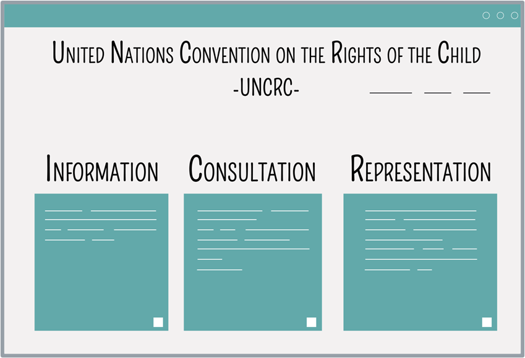
The Rights Idea – LESSON 2
Learning objectives
To learn about children and young people’s rights to information, consultation and (if needed) representation if parents separate under Article 12 of the United Nations Convention on the Rights of the Child (‘The UNCRC’) (including sources of support and how to access them).
To learn about the legal system in Wales and England relating to relationship breakdown.
Notes:
Learning objectives
Run through the learning objectives.
To learn about children and young people’s rights to information, consultation and (if needed) representation if parents separate, under Article 12 of the United Nations Convention on the Rights of the Child (‘The UNCRC’) (including sources of support and how to access them).
To learn about the legal system in Wales and England relating to relationship breakdown.
Explain to learners that the justice system in Wales and England is linked and the laws relating to relationship breakdown, so for example, obtaining a divorce, are the same in both countries.

Slide 16
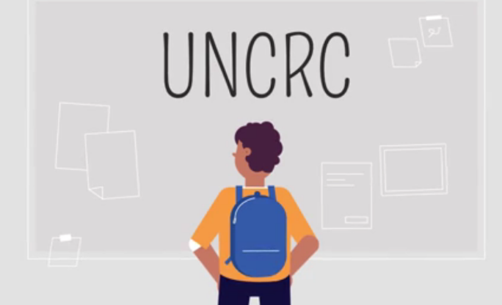
The Rights Idea – LESSON 2
Learning outcomes - learners will be able to:
explain young people’s rights under Article 12, UNCRC when
parents separate
describe the range of emotions that young people may feel when
parents separate
identify ways in which young people can be consulted if parents separate
identify sources of support for these young people and explain how to access them
explain the changes to the law relating to divorce and key differences between rights of married and unmarried couples on relationship breakdown in Wales and England.
Notes:
Introduce the topic and run through the learning outcomes:
Learners will be able to:
Explain young people’s rights under to Article 12, UNCRC when parents separate
Describe the range of emotions that young people may feel when parents separate
Identify ways in which young people can be consulted if parents separate
Identify sources of support for these young people and explain how to access them (see ‘what matters statements’ for Health and Well-being)
Explain the changes to the law relating to divorce and key differences between rights of married and unmarried couples on relationship breakdown in Wales and England.

Slide 17
The Rights Idea: HOMEWORK TASK FEEDBACK
By today you should have:
Written about an issue that you would like to campaign about and why you think it is important
Considered what ‘right’ under the UNCRC your chosen issue addresses
As part of this task, researched prominent activists who campaign for your chosen issue and considered what actions you could take yourself to campaign on this issue in the future.
Notes:
HOMEWORK TASK from Resource 1: For homework or as an extension task, you may have asked learners to write about an issue that they would like to campaign about and why. As part of this, they were to be asked to research prominent activists who campaign for their chosen issue and consider what actions they could take themselves to campaign on this issue in the future.
(As a reminder, as an extension activity you may have asked the learners to consider how they might campaign for their chosen issue within their school community. As a support activity you may have given the learners the name of a young person who is ‘getting their voice heard’).
Examples suggested for the support activity were:
Amy and Ella Meek - Set up Kids Against Plastic in 2016 when aged just 11 and 13 to campaign against the use of single use plastics (Article 6: The right to life, survival and development and Article 24: The right to healthcare as this includes the right to ‘a safe environment’).
Amika George - successfully campaigned for free sanitary products in secondary schools to end period poverty in 2017 when aged 17. She been honoured on the Time Magazine’s ‘Most Influential Teens of 2018’ list. (Article 24: The right to healthcare)
Heba Ahmed a human rights and anti-racist activist who was responsible for 15,000 people attending the Black Lives Matter protest in Manchester in June 2020 when aged 16. (Article 2: Protection from discrimination)
Jamie Windust a non-binary writer, editor, model, and public speaker. They made headlines in 2018 (when aged 21) for calling out the staff of Fantastic Beasts: The Crimes of Grindelwald for alleged misogyny, homophobia and transphobia, and in 2019 for petitioning the UK Parliament for gender-neutral passport options. (Article 2: Protection from discrimination and Article 6: The right to life, survival and development)
Shiden Tekle - in 2018 aged 18 he and three friends aged 17 recreated famous movie posters, including Titanic, Harry Potter and The Inbetweeners, with black people taking the leading roles, to put black faces in the big movies, and challenge people’s perceptions and assumptions. He set up ‘Legally Black’ whilst attending the Advocacy Academy – which trains young activists. (Article 2: Protection from discrimination)
(All of the above would also encompass Article 3 – The child’s best interests and Article 12: Getting your voice heard).
Depending on the task set, ASK one or two learners to feedback on the issue that they would like to campaign about/prominent activists who campaign for their chosen issue etc.
N.B. Teachers have some flexibility so that if you have chosen not to set the homework/extension task you will have some additional time to cover the key activities in greater detail.

Slide 18
ARTICLE 12: UNCRC
ARTICLE 12
You have the _________ to give your ___________ and for __________ to listen, and take it __________.
Obligation, adults, opinion, seriously, judges, casually, right
Notes:
In Resource 2 of ‘The Rights Idea?’ learners will explore the sources of support available to them when their parents separate and how to access this support. This will be discussed as part of young people’s Article 12 right to give their opinion and for adults to listen and take it seriously. To set this up and to recap, ask learners to use the suggested words to fill in the gaps on Article 12 above.
In slideshow mode, the word fill appears without the suggested words, with the suggested words appearing on a click to give you the option of doing the exercise as the extension task.
As a support activity consider giving learners only the three words needed to fill the gaps.
As an extension activity consider asking learners to complete the gap-fill without any suggested words.

Slide 19
Baseline activity – read the scenario below
Draw a circle with the word ‘Tom’ in the middle. Around the outside, write down:
a) how you think Tom may be feeling; b) questions you think Tom may have at this time c) support you think Tom may need and any examples you know of support that may be available to him.
Tom is 13 and an only child. Two weeks ago his parents told him that they had decided to separate. This was a big surprise to Tom as his parents didn't argue much. They said that they had drifted apart and reassured Tom that they both loved him and that ‘nothing would change’ for him but hadn't really explained what that meant. There had been lots of hushed talks between his parents. Tom knew that they were talking about plans for him and felt excluded. When his dad was away, he had heard his mum crying in the bedroom, so didn't want to make her feel worse by asking questions. Tom only has a few close friends at school and their parents are still together, so he feels he doesn't have anyone to talk to. ​
Notes:
Give learners a few minutes to read the scenario and then ask them (without conferring) to each draw a circle with the word ‘Tom’ in the middle. [If learners are familiar with ‘mind mapping’ then you can explain that that is they are going to do. If not, explain ‘mind-mapping’ to them, i.e. they will be drawing a diagram with a central theme (here, the character, Tom) and then branching out into different themes (here, different things Tom may be feeling etc.) to visually outline information]. Around the outside of the circle, ask them to write down:
how you think Tom may be feeling. (Sad, hurt, angry, worried and/or confused)
questions you think Tom may have at this time. (Is this because of something I have done? Is there any chance of you staying together? Where am I going to live? Who am I going to live with? How often will I see my other parent? Will I have to change schools? Will I be able to keep up my friendships/hobbies/time with wider family? How will things get sorted out? Will I be asked what I want? If so, by whom? Will I have to go to court?)
the support you think Tom may need and any examples you know of support that may be available to him. (Support needed may include - good friends around him; peer support from others who've been through this; good pastoral support at school; good information online to get some of his questions answered; someone to speak to about how he's feeling; someone to speak to about what he would like to happen around arrangements for his care. Sources of support may include - pastoral support at school; friends or wider family; ChildLine or other counselling service).
Note: Do not give any further hints or tips, even if learners ask questions. They should not share their ideas with classmates during the activity. This will give you the opportunity to see what learners’ own beliefs and ideas are before the learning begins.
Circulate the room as learners complete the exercise/their mind maps in order to gauge what learners know/think/feel/believe in relation to the topic. After learners have had 3-4 minutes or so to complete the exercise/their mind maps, ask for all class feedback (using the suggested answers above to guide you}. Ask learners not to add anything else to their sheet/mind maps during class feedback and to put these to one side as they will return to them (and these 3 questions) at the end of the learning.

Slide 20
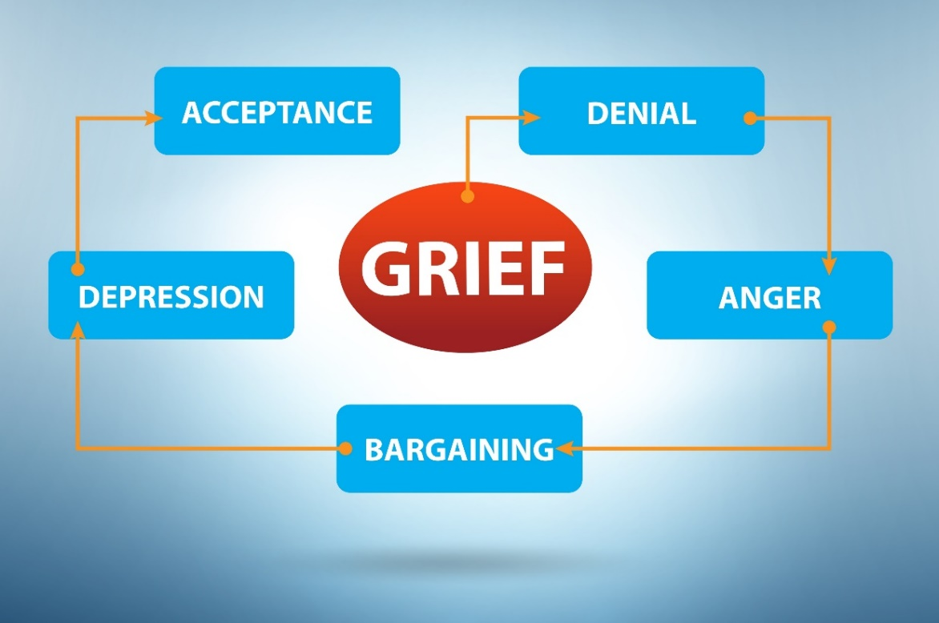
Young people’s responses to parents separating
Young people may show signs of:
1. Denial: feeling overwhelmed and bewildered
2. Anger: feeling frustrated, confused and angry
3. Depression: feeling sad all the time, longing for the past
4. Bargaining: changing their behaviour in the hope of getting their parents back together
5. Acceptance: a sense of understanding and a general desire to move forward
Notes:
The ‘statements of what matters’ for Health and Well-being state that learners must be able to ‘explore the connections between their experiences, mental health and emotional well-being… [and] recognise that feelings and emotions are neither fixed nor consistent’. Learners should also learn ‘how to communicate their feelings [so] learners will be better placed to create a culture where talking about mental health and emotional well-being is normalised’. The ‘statements of what matters’ for Health and Well-being also state that learners should be given opportunities to ‘[develop] empathy… [enabling them] … to act in a way which supports the mental health and emotional well-being of others.’ For learners whose parents have not separated, discussing the feelings of a young person whose parents have separated should help them to develop empathy and act in ways that support others who have experienced parental separation.
Here the emphasis is on the fact that parental separation can be a form of grief for children and that many go through a five-stage cycle, much in the same way as they experience grief because of bereavement. The emphasis should be on normalising some of the feelings that young people may have if their parents separate such as anger or sadness. Every child’s experience is unique and will depend in part on the situation at home prior to the separation and how amicable the parents are upon separation. If the home life had been difficult the separation may be a relief. Not every child will feel all of these things or progress in a linear fashion through them.
Distancing techniques should be used, so describing how it is normal that Tom might feel hurt, sad, bewildered, angry or overwhelmed. Normalise how it is common for young people to feel that they were somehow responsible for the separation (the bargaining aspect of the grief cycle refers to attempts by young people to change their own behaviour in the hope that a parent will return home).
Split the class into 5 groups and allocate to each group a stage to focus on and provide advice about. Tell the learners that Tom’s friend from football club, Samir wants to support Tom. Give learners 2-3 minutes to come up with 3 top tips for Samir that could help Samir support Tom through his parents’ separation. Once learners have had an opportunity to discuss their stage of the grief cycle (in their group).
Ask each group to feedback what their 3 top tips would be for Samir that could help Samir support Tom through his parent’s separation. [Listen to how he's feeling, without judging and ‘be there’ for him; help him to seek out pastoral support at school; reassure him that he is not to blame for the separation and encourage him to keep up with friends, hobbies, exercise, etc.].

Slide 21
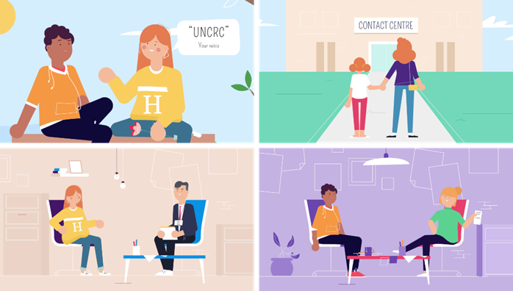
The Rights Idea – video
As you watch this video make a note of the three things that Tom discovered that young people are entitled to under the UNCRC when their parents separate.
The Rights Idea? Children and young people's rights when parents separate- Welsh language version
The Rights Idea? Children and young people's rights when parents separate- English language version
Notes:
Show the class the ‘The Rights Idea?’ video asking learners, as they watch, to make a note of and then feedback the three things that it indicates young people are entitled to under the UNCRC when their parents separate.
Press control, click on The Rights Idea? Children and young people's rights when parents separate- English language version link on the slide to play the video. For the Welsh language version click: https://www.youtube.com/watch?v=vp84Vr6hRDk The Rights Idea? Children and young people's rights when parents separate- Welsh language version
Take feedback from the class - learners should identify that young people are entitled to: Information, consultation and (if needed representation). Emphasise that these are all voluntary- young people have the right to have their voices heard and to be consulted but equally they have the right not to be consulted if they do not wish to be.
Support activity: Consider suggesting that learners pull out 1-2 points from the video only.
Extension activity: Consider asking learners to pull out the different ways that Chloe said that Tom could make his voice heard – (through meeting with the mediator if his parents went to mediation; speaking to the Family Court Adviser (FCA) or sometimes the judge if his parents went to court and by having a lawyer represent him in court if needed).

Slide 22
QUICK-FIRE QUIZ
1. UNHEALTHY: Attraction is important but friendship is crucial
2. UNHEALTHY: All relationships go through ups and downs
3. HEALTHY: Respectfully dealing with issues as they arise keeps relationships on track
What is the name of the person who helps parents to reach an agreement without going to court?
Where did Rosie have contact with her dad at first?
What does a Family Court Advisor do?
Do children have to go to court if their parents make an application to court?
Can children make their own application to the court?
A mediator.
A contact centre.
Speaks to children and reports to the court what the FCA thinks is in the children's best interests.
No, the FCA tells the court the views of the children although they sometimes speak to the judge directly if they wish.
Yes, if the court agrees, in rare cases they can apply and be represented separately.
1. Relationship built mostly on FRIENDSHIP 2. BOTH PARTNERS SHOULD EXPECT IT TO BE PERFECT – IF IT’S NOT MOVE ON 3. CONFLICT DEALT WITH AT AN EARLY STAGE 4.
Notes:
Quick-fire quiz: To consolidate learning from the video, take 3 minutes to ask the class to answer the 5 questions. To ensure that all participate, either provide a handout for learners to complete/refer back to if they find they need the information in future (a handout is at the end of the Teacher Guide), or ask learners to write down their answers before asking individual learners to give their answer to a question.
In slideshow mode, each question in the left hand box is followed by an answer in the right hand box.

Slide 23
TRUE OR FALSE?
1. UNHEALTHY: Attraction is important but friendship is crucial
2. UNHEALTHY: All relationships go through ups and downs
3. HEALTHY: Respectfully dealing with issues as they arise keeps relationships on track
The only way to make a relationship legally recognised is to get married.
More families with children under 18 in Wales, are married than living together.
If you live together for at least two years, your rights are the same as if married.
If you live together and have a child, your rights are the same as if married.
To sort out arrangement for children after separation you must go to court.
False. Since 2019 all couples have the option to enter into a civil partnership.
True. In Wales in 2020, the figures were 59% and 18% respectively.
False. Cohabitants rights depend on how property is owned not time together.
False. Unmarried couples do not have rights to financial support for themselves.
False. Couples are encouraged to resolve matters without going to court.
1. Relationship built mostly on FRIENDSHIP 2. BOTH PARTNERS SHOULD EXPECT IT TO BE PERFECT – IF IT’S NOT MOVE ON 3. CONFLICT DEALT WITH AT AN EARLY STAGE 4.
Notes:
Tell learners that Tom’s friend Samir has been helping to support Tom through his parents’ separation. It’s got Samir thinking about some of their other friends from football club whose parents aren’t married. Samir wonders what might happen if these parents split up.
True or false quiz: To set up the myth busting exercise on the next slide, run through this quick fire true or false quiz.
In slideshow mode, each question in the left hand box is followed by an answer in the right hand box.
Question 2, the balance of 23% of families are lone parent families.
To ensure that all learners actively engage with the learning, ask all learners to put their hands up or down/thumbs up or down, depending on what they think the answer is.
For glossary of terms, see the Teacher Guide.

Slide 24
INFORMATION – MYTH BUSTING 1
Myth 1: The only way to formalise a relationship is to
get married
In fact: Mixed-sex and same-sex couples can get married or enter into a
civil partnership (CP): both require a court process to legally end the relationship if
it breaks down.
Notes:
When parents separate, as the learners have just learned, young people are entitled to information. Some of the information they are likely to want will be on the ‘sources of support’ available to them (which follow on slide 30) and details about the process itself. What will happen? How will decisions be made?
The information here is an overview only of the process with the aim of busting some common myths and misunderstandings.
That the only way to formalise a relationship is to get married.
Myths around the rights of cohabitees - ‘the common law marriage myth’
That parents must go to court to sort things out
(The teacher facing slides, at slides 8 to 12 give fuller details of the legal position in relation to formalising relationships and ending them).
Myth 1: The only way to formalise a relationship is to get married
In fact: Mixed-sex and same-sex couples can get married or enter into a civil partnership (CP): both require a court process to legally end the relationship if it breaks down.

Slide 25
INFORMATION – MYTH BUSTING 2
Myth 2: After a certain period together/if you have a child together, cohabiting couples have the same rights as married couples: ‘The
common law marriage myth’
In fact: Cohabiting relationships are the fastest growing family form in Wales
and England but, unlike those who are married or in a CP, cohabitants are not
entitled to claim financial support from each other if they separate (although both parents must financially support their children).
Notes:
Myth 2: After a certain period together/if you have a child together, cohabiting couples have the same rights as married couples: ‘The common law marriage myth’
In fact: Cohabiting relationships are the fastest growing family form in Wales and England* but, unlike those who are married or in a CP, cohabitants are not entitled to claim financial support from each other if they separate (although both parents must financially support their children).
*In 2020, an estimated 21% of individuals aged 16 and over living in a couple in Wales were cohabiting (322,697 individuals) and 79% were married or in a civil partnership (1,214,854 individuals) (See Office of National Statistics, 16 December 2021: https://www.ons.gov.uk/peoplepopulationandcommunity/populationandmigration/populationestimates/datasets/populationestimatesbymaritalstatusandlivingarrangementswales, Table 4).

Slide 26
INFORMATION – MYTH BUSTING 3
Myth 3: Parents must go to court to sort things out
In fact: Parents are encouraged to agree child arrangements and finances
without going to court if possible, but if they can’t either parent can apply to
the court for an order.
Notes:
Myth 3: Parents must go to court to sort things out
In fact: Parents are strongly encouraged to agree finances and childcare arrangements without going to court wherever possible.

Slide 27
the ‘FAULT-BASED’ law on divorce
Matrimonial Causes Act 1973: ‘Fault-based’ divorce
Applicant must show that marriage has irretrievably broken down by proving one of five facts (fault-based and separation based).
Respondent can contest the fact. If successful, the Applicant can only divorce
after five years.
Uncontested divorce can be obtained within a few months – but only if one of the fault-based facts is relied on.
Notes:
In 2020, 59% of families in Wales with dependent children were married, 18% were cohabiting and 23% were lone parent families (see: https://www.ons.gov.uk/peoplepopulationandcommunity/populationandmigration/populationestimates/datasets/populationestimatesbymaritalstatusandlivingarrangementswales,Table 4. (Note figures on the slide above were for couples in general whereas these figures are for couples with dependant children i.e. children under the age of 16 or aged 16 to 18 and in full time education).
Whilst rates of cohabitation are increasing, most parents who separate will have been married. Here, therefore, we look briefly at the process of divorce, which is set to change in April 2022.
Explain to learners that different religions have different views on divorce, and those views will be respected, but this is not the focus of the learning.
The person applying for the divorce is called ‘the Applicant’ and the other party is called ‘the Respondent’.
Explain to learners that under the ‘old’ law (still in force until April 2022), the Matrimonial Causes Act 1973, if a spouse wants to divorce quickly than they must prove that the other has committed adultery (had sex with a member of the opposite sex whom they are not married to) or behaved unreasonably. If the Respondent objects to the allegation then they could defend the application, but this rarely happens as it is an extremely costly process involving court hearings. If an Applicant does not wish to allege fault they would need to show that they had been separated for two years (provided the other party agreed) or five years if the other party did not agree (there is one other technical fact of two years desertion but this is rarely used). The law has been widely criticised as the requirement to ‘blame’ the other person can increase animosity. Most English speaking western countries: USA, Canada and Australia as well as much of Europe have had a no-fault divorce system for many years.
[NB, in case a learner asks, the requirements for ending a married same-sex relationship is essentially the same as ending a mixed-sex marriage save that adultery can only be relied on if it involves sexual intercourse with a member of the opposite sex. Adultery is not a fact the party can rely on to end a civil partnership. The removal of fault, which is discussed on slide 24, removes this anomaly and the lack of a fair and even-handed approach for all couples – this is a higher level point so only cover if a learner raises it].

Slide 28
Changes to the law on divorce
Tom thinks that the ‘fault-based’ law is outdated but Samir isn’t so sure. In pairs create two lists – one with at least 3 reasons why Tom thinks it is outdated and one with at least 3 reasons why Samir thinks it isn’t.
Notes:
Tell learners that Tom and Samir have just learnt at school about changes happening to the divorce law. Tell learners that Tom thinks the ‘fault-based’ law is outdated but his friend Samir isn’t so sure. In pairs, ask learners to create 2 lists – noting down on one list at least 3 reasons why Tom might think the law is outdated (what are the ‘cons’ of the law?), and on the other at least 3 reasons Samir might disagree (what are the ‘pros’ of the law?). Ask some of the learners to feedback what they have put on the 2 lists.
As an extension task, consider asking learners to consider how they think the rates of marriage, civil partnership and cohabitation might change in future – do they think the trend of increasing rates of cohabitation will continue, or will the new divorce law encourage higher rates of marriage? Might the new divorce law encourage higher rates of divorce?

Slide 29
the ‘NO-FAULT’ law on divorce
Divorce, Dissolution and Separation Act 2020
Applicant (or Applicant and Respondent on a joint application) must show that the marriage has irretrievably broken down.
Respondent cannot contest the divorce.
Divorce can be obtained after 26 weeks.
Notes:
Now explain to the learners why the change was felt to be needed and what the ‘new’ law sets out. Explain that wider reforms in the family justice system in recent years have focussed on reducing conflict and promoting resolution yet alleging fault can cause distress, escalate conflict, increase costs and make resolution less likely. It is hoped that moving to a no-fault system of divorce will make it less acrimonious and therefore lead to better outcomes for children.
The Divorce, Dissolution and Separation Act 2020, to be introduced in April 2022, removes fault from the process. The ground for divorce remains the same – the marriage must have irretrievably broken down – but this is proved by the passage of time. The Applicant can apply for a final order 26 weeks after filing the application. There is no option to defend the divorce and the application can be made jointly. For some, it will increase the length of time it takes to get a divorce because the so called ‘quickie’ facts of adultery or unreasonable behaviour no longer apply.
Ensure, when teaching this, that you consider with learners the ‘rights’ of the different parties affected and how sometimes rights can be in tension with each other. For example if there is a ‘right’ to divorce for all adults, without having to allege fault, if one person wants the divorce but the other doesn’t then one person’s ‘right’ to divorce will be at the expense of the other person’s ‘right to family life’ under the Human Rights Act 1998, Article 8. Equally, even if the decision to separate is mutual, this will adversely impact on the child’s ‘right to family life’. Also, divorce can lead to economic disadvantage for women as they tend to reduce their work hours to care for children so tend to be earning less than men if they have children - but rules are in place to ensure that women’s contribution to the family life and viewed as equal to financial contributions.
Remind learners that in ‘The Rights Idea?’ video we learned that Chloe, Jack and Rosie's parents made an application to court because they couldn't agree arrangements for the children. As their parents separated a couple of years ago, they would have had to have applied for a divorce under the old law and alleged fault if they wanted to obtain a divorce without waiting for at least two years if they both agreed to the divorce or five years if one objected.
Ask learners to comment on what impact they think it may have had on the case if Chloe’s parents had divorced after the law changed and therefore ‘fault’ was not an issue:
Answer: It may have cost less. It may have made the separation less acrimonious. It may have made it easier for the parents to agree the arrangements for the children between themselves and therefore made an application to court less likely. Because it may have been more amicable, the parents may have been more open to listening to their children's views (and therefore it would have been more likely that the children’s Article 12 rights would have been upheld from the outset).

Slide 30
Sources of support for young people
The National Association of Child Contact Centres (NACCC)
The National Youth Advocacy Service, Cymru (NYAS Cymru)
Children’s Commissioner for Wales
The Child and Family Court Advisory and Support Service, Cymru
(Cafcass Cymru)
Relate Cymru
Childline Cymru
Notes:
Remind learners of the support available to them in school from the pastoral lead. There is also lots of information and support available to young people online including:
National Youth Advocacy Service, Cymru (NYAS Cymru): NYAS Cymru provides a range of rights-based services for children and young people through a network of qualified advocates. Advocates ensure that the views of children and young people are listened to, particularly in decisions which are made about them. NYAS Cymru works to ensure that young people’s Article 12 rights to information, consultation and representation are respected. It provides information to young people on its website; a free helpline and an advocate for young people. The advocate will find out what the young person’s wishes and feelings are. They will help the young person to start, change or stop something in their life. They can go with the young person to meetings, if the young person wants them to, and help them to tell people what the young person wants or speak for them if they don’t want to. The advocate will represent a young person in court if needed.
National Association of Child Contact Centres (NACCC): NACCC runs a network of 350 contact centres, including 13 in Wales, which provide a safe, neutral, welcoming space for children to spend time with parents (or other people important to them, such as grandparents). Contact centres are used for children, usually up to around the age of 9, often as a stepping stone to contact away from a contact centre where parents have not been able to agree contact. The NACCC website has lots of information for children and young people to help them to understand how they may be feeling when their parents separate as well as videos and stories of other young people’s experiences of using a contact centre. While contact centres are used for a younger cohort of children, this information can be useful to learners working at Progression steps 4 and 5 as they may have younger siblings/wider family/family friends in this younger age group.
Children’s Commissioner for Wales: The Children’s Commissioner for Wales speaks up for children and young people in Wales on important issues. The Commissioner supports children and young people to find out about their rights under the UNCRC; listens to children and young people to find out what’s important to them; advises children, young people and those who care for them if they think they’ve been treated unfairly and influences government and other organisations who say they’re going to make a difference to children’s lives, making sure they keep their promises to children and young people. The website has lots of resources for young people, particularly in relation to their UNCRC rights.
Cafcass Cymru: Cafcass stands for Children and Family Court Advisory and Support Service. Cafcass Cymru is an organisation in the Welsh Government that provides a voice for any child in Wales that is involved with the Family Justice system. When appointed by the family court, the Family Court Adviser (FCA) from Cafcass Cymru works with families and other organisations to find long-term solutions for the child. The Cafcass Cymru website has lots of information for young people, including a booklet explaining children’s rights under the UNCRC and the court process if parents apply to court.
Relate Cymru: Relate Cymru offers counselling to young people who are experiencing difficulties in any area of life, including if parents are arguing or have separated. Counselling is available in school, at a Relate Cymru Centre, by web chat, telephone or online. Young people can expect to be helped by a supportive and non-judgmental counsellor. They can be referred by a teacher, social worker, or can ask to see a counsellor themself – what they say is confidential unless the counsellor is worried about their safety.
Childline Cymru: Childline Cymru has a huge amount of information, advice and support for young people whose parents have separated available online, by telephone or through one-to-one counselling.
Contact details for each of the organisations listed appear on slides 32 and 33.

Slide 31
ENDPOINT ASSESSMENT ACTIVITY
Return to the mind map you drew earlier and in a different colour add to your mind map by writing down:
Any additional words for how you think Tom might have felt when his parents told him they were separating
Any words for how you think Tom might have felt once he had learned of his rights to express his opinion and spoken to the mediator his parents saw?
Where could Tom find information and support to help him at this time and in the future (giving specific examples of organisations)?
​
Notes:
Ask the learners to return to the mind map they drew earlier (by now they will have learned what a mind map is, if they weren't already familiar with them) and in a different colour add to their mind map by writing down:
any additional words for how you think Tom might have felt when his parents told him they were separating
any words for how you think Tom might have felt once he had learned of his rights to express his opinion and spoken to the mediator his parents saw? (Words like hopeful, happier, stronger and/or empowered will hopefully be suggested. It is important to acknowledge however that he may still be feeling sad.)
where could Tom find information and support to help him at this time and in the future (giving specific examples of organisations)?
Learners should mention:
National Youth Advocacy Service, Cymru (NYAS, Cymru)
National Association of Child Contact Centres (NACCC)
Children’s Commissioner for Wales
Cafcass, Cymru
Relate, Cymru
Childline, Cymru

Slide 32
HOMEWORK OR EXTENSION TASK
Look at the source of support for young people whose parents have separated which the teacher allocates to your table and be ready to share some information you learned from this research about children’s rights when parents separate:
National Youth Advocacy Service, Cymru: https://www.nyas.net/nyas-cymru/ (Tel: 0808 8081001)
National Association of Child Contact Centres: https://naccc.org.uk (Tel: 01159 484557)
Children’s Commissioner for Wales: https://www.childcomwales.org.uk (Tel: 0808 801 1000)
Cafcass Cymru: https://gov.wales/cafcass-cymru/family-separation (Tel: 0300 456 4000)
Childline Cymru: https://www.childline.org.uk/info-advice/home-families/family-relationships/divorce-separation/ or for Welsh language version: https://www.childline.org.uk/get-support/contacting-childline/contacting-childline-in-welsh/ (Tel: 0800 1111)
Relate Cymru: https://www.relate.org.uk/cymru/children-and-young-peoples-counselling (Tel: 03000030396)
Notes:
HOMEWORK OR EXTENSION TASK: For homework or as an extension task, allocate to each table one of the listed sources of support for young people whose parents have separated. Ask the learners to each carry out some independent research on the source of support allocated and be ready to share some information they learned from their research about children’s rights when parents separate.
An added benefit of this homework task is that any learner who needs these contact details for personal reasons, either for themselves or a friend, will be able to note them down without drawing attention to themselves.

Slide 33
HOMEWORK OR EXTENSION TASK (CONT.)
National Youth Advocacy Service, Cymru: https://www.nyas.net/nyas-cymru/ (Tel: 0808 8081001)
National Association of Child Contact Centres: https://naccc.org.uk (Tel: 01159 484557)
Children’s Commissioner for Wales: https://www.childcomwales.org.uk (Tel: 0808 801 1000)
Cafcass Cymru: https://gov.wales/cafcass-cymru/family-separation (Tel: 0300 456 4000)
Childline Cymru: https://www.childline.org.uk or for Welsh language version: https://www.childline.org.uk/get-support/contacting-childline/contacting-childline-in-welsh/ (Tel: 0800 1111)
Relate: Cymru https://www.relate.org.uk/cymru/children-and-young-peoples-counselling (Tel: 03000030396)
For the service allocated to you, research:
Who is the service designed to support?
How do they support people (e.g. online, telephone, text, etc.) and for what kinds of situations?
What information is available on the website about young people’s rights?
How does the service help to protect young people’s rights when parents separate?
Notes:
HOMEWORK OR EXTENSION TASK: This slide sets out the four questions that the learner will be asked to research from one of the six organisations allocated to them. The details from the previous slide are repeated here so that a young person who wants to write down the details without drawing attention to themselves will be able to do so.

