Slide 1
Opening slide
Rosie’s story: What happens if families change?
Resource 1
Notes:
This is the first of two teaching resources, ‘Rosie's Story: What happens if families change?’ Resource 1 introduces learners to Rosie, aged 9 and the people who make up her family or are important to her. They learn that families come in all shapes and sizes and sometimes families change when parents and carers separate. They will learn about the range of emotions that children and young people go through when parents and carers separate and discuss what children and young people can do to help to support a friend whose parents and carers have separated.
In Resource 2, learners consider their right to have their voices heard and their views taken into account in the decision-making when parents and carers separate under The United Nations Convention on the Rights of the Child (UNCRC), Article 12. They will consider the processes available to help parents and carers to reach an agreement (including mediation and court) and the help and support available to children and young people at this time.

Slide 2
TEACHER SLIDE – PREPARING TO TEACH
Preparing to teach and using these slides
The slides headed ‘teacher slides’ assist the teacher in setting up and running the learning.
Slide 8 onwards are for the learner-facing learning.
Please read the Teacher Guidance (Resource 1) for ‘Rosie's Story’ before teaching.
Have slides in presenter mode – notes are available under each slide to aid teaching
Support: and extension:
activities are suggested where appropriate (icons on bottom right corner of slides).
Resources
Sticky notes.
An ‘ask-it-basket’/question box for learners to ask questions confidentially.
Save for the above, no additional teaching resources are needed to teach this learning session.
Timing
The learning will take place over
45 minutes.
Notes:
This two-part teaching resource has been devised for learners working at Progression steps 2 and 3. The resource supports the teaching of relationships and sexuality education and developing awareness of the rights of children and young people. A number of statements of what matters covers these, predominantly in the Health and Well-being and Humanities Areas of Learning and Experience.
This slide gives an overview of the resource. It should be read in conjunction with the Teacher Guidance for ‘Rosie's Story’ Resource 1. Teachers are reminded to review and address any questions submitted in the anonymous ask-it-basket’/question box, to ensure they are answering all learners’ questions.

Slide 3
TEACHER SLIDE – the Curriculum for Wales
This resource for learners working at Progression steps 2 and 3 helps to meet the four purposes
of the Curriculum for Wales which states that the aim of a school’s curriculum is to support its learners to become:
ambitious, capable learners, ready to learn throughout their lives
enterprising, creative contributors, ready to play a full part in life and work
ethical, informed citizens of Wales and the world
healthy, confident individuals, ready to lead fulfilling lives as valued members of society.
This resource will particularly help on two of these four purposes, helping learners to become:
ethical, informed citizens of Wales and the world
healthy, confident individuals, ready to lead fulfilling lives as valued members of society.
Notes:
This slide shows how the teaching resource fits into the curriculum for Wales.
This teaching resource for learners working at Progression steps 2 and 3 will particularly help on two of the four purposes of the Curriculum for Wales in particular helping learners to become:
ethical, informed citizens who:
engage with contemporary issues based upon their knowledge and values
understand and exercise their human and democratic responsibilities and rights
respect the needs and rights of others, as a member of a diverse society
and are ready to be citizens of Wales and the world
healthy, confident individuals who:
are building their mental and emotional well-being by developing confidence, resilience and empathy
know how to find the information and support to keep safe and well
and are ready to lead fulfilling lives as valued members of society.

Slide 4
TEACHER SLIDE – Guidance on rse
Curriculum for Wales Guidance on RSE states that RSE should:
discuss RSE in the context of children’s rights as protected by the United Nations Convention on the Rights of the Child (UNCRC) rights
highlight the right … to be heard and involved in decision-making (UNCRC, Article 12)
be positive, protective and preventative, considering how learners might need to be supported to:
understand and cope with change conflicts and pressure [here, if parents and carers separate]
… know how to seek support [and]
… seek help and advice where appropriate.
Notes:
Curriculum for Wales Guidance on RSE
RSE should:
discuss RSE in the context of children’s rights as protected by the United Nations Convention on the Rights of the Child (UNCRC) rights
highlight the right … to be heard and involved in decision-making (UNCRC, Article 12)
be positive, protective and preventative, considering how learners might need to be supported to:
understand and cope with change conflicts and pressure [here, if parents and carers separate]
… know how to seek support [and]
… seek help and advice where appropriate.
Human rights is a cross-cutting theme within the Curriculum for Wales. Schools must promote knowledge and understanding of the UNCRC (and the United Nations Convention on the Rights of Persons with Disabilities) among those who provide learning and teaching in respect of their school’s curriculum (Curriculum and Assessment (Wales) Act 2021, s 64(1)).
Teachers should also familiarise themselves with the Curriculum for Wales: Relationships and Sexuality Education Code.

Slide 5
TEACHER SLIDE – statements of what matters
In Resource 1 and 2, discussing when parents and carers separate and normalising the range of emotions that children and young people may go through when parents and carers separate covers a number of ‘statements of what matters’. For example, from Health and Well-being:
how we process and respond to our experiences affects our mental health and emotional well-being
healthy relationships are fundamental to our well-being.
In Resource 2, children and young people learning about their right to express their opinions under the UNCRC, Article 12 when decisions are being made following the separation of their parents and carers covers a number of 'statements of what matters' such as this one from Humanities:
Informed, self-aware citizens engage with the challenges and opportunities that face humanity, and are able to take considered and ethical action.
Notes:
This slide sets out some of the ‘statements of what matters’ from Health and Well-being and Humanities that the teaching resources address.

Slide 6
TEACHER SLIDE – Progression steps
Resource 1, discusses parental separation and normalises emotions that children and young people may go through. Resource 2 discusses sources of support for children and young people on parental separation. Both resources will help learners understand key areas outlined in Progression steps 2 and 3. For example, from Health and Well-being:
how we process and respond to our experiences affects our mental health and emotional well-being
healthy relationships are fundamental to our well-being.
In Resource 2, children and young people learn about their right to express their voice and be heard when decisions are being made following the separation of their parents and carers. Learners will increase their understanding in Progression steps 2 and 3 such as this one from Humanities:
Informed, self-aware citizens engage with the challenges and opportunities that face humanity, and are able to take considered and ethical action.
Notes:
This slide sets out some of the ‘progression steps’ from Health and Well-being and Humanities that the teaching resources address. Specifically:
Health and Well-being
How we process and respond to our experiences affects our mental health and emotional well-being.
Resource 1 discusses parental separation and normalises emotions that children and young people may go through. Resource 2 discusses sources of support for children and young people on parental separation.
Both resources will help learners understand key areas outlined in Progression step 2 such as:
I can notice and communicate my feelings.
I am beginning to notice when I need help to manage my feelings.
I can reflect on my experiences.
I can pay attention to the feelings of others and I am learning to think about why they may feel that way.
Both resources will help learners understand key areas outlined in Progression step 3 such as:
I can see the benefits of communicating about feelings as one of a range of strategies which can help promote positive mental health and emotional well-being.
I can ask for help when I need it from people I trust.
I can reflect on the way that past events and experiences have affected my thoughts, feelings and actions.
I can anticipate how future events may make me and others feel.
I can empathise with others.
I can understand how and why experiences affect me and others.
Healthy relationships are fundamental to our well-being
Resource 1 discusses different family forms and normalises emotions that children and young people may go through. Resource 2 discusses sources of support for children and young people and their right to have their voices heard when decisions are being made following the separation of their parents and carers.
Both resources will help learners understand key areas outlined in Progression step 2 such as:
I can recognise that there are different types of relationships beyond my family and friends.
I can communicate my needs and feelings in my relationships, and notice the needs and feelings of others.
I can understand that everyone has rights and, with support, I can respect those rights.
Both resources will help learners understand key areas outlined in Progression step 3 such as:
I can understand that there are differences within types of relationships and that relationships change over time.
I can communicate my needs and feelings, and respond to those of others.
I can reflect on the characteristics of safe relationships and I can seek support when needed.
I can respect the rights of others and I understand how these impact on myself and others.
Humanities
Informed, self-aware citizens engage with the challenges and opportunities that face humanity, and are able to take considered and ethical action.
In Resource 2, children and young people learn about their right to express their voice and be heard when decisions are being made following the separation of their parents and carers.
Learners will increase their understanding in Progression step 2 such as:
I am beginning to understand what human rights are and why they are important.
I can understand that we need to respect the rights of others.
Learners will increase their understanding in Progression step 3 such as:
I have an understanding that injustice and inequality exist in societies. I also have an understanding of what human rights are and why they are important to me and other people.
I can explain who is responsible for upholding rights in my locality and in Wales, as well as in the wider world. I also have an understanding that some people are denied their rights.

Slide 7
TEACHER SLIDE – Learning AND suggested TIMING
Activity | Description | Suggested timing
Introduction | Ground rules, learning objectives and outcomes. | 5 minutes
Baseline activity | Learners will suggest key words associated with ‘family’ and the different people who can be part of a family. | 8 minutes
What do families do for one another? | Learners will discuss on their tables what family members, or people that are special to them, do to make them feel loved and cared for. | 7 minutes
Introducing Rosie | Learners will be introduced to Rosie; her home, school friend, teacher and hobby. | 2 minutes
Who is in Rosie’s family? | In pairs, learners will be asked to consider the people and groups that are important to Rosie and decide which are part of her family. | 6 minutes
Rosie’s feelings | Learners will consider how Rosie might have been feeling after her parents separate and how Rosie’s friend Billy could support Rosie. | 10 minutes
Endpoint assessment | Learners will revisit and revise the baseline answers as appropriate. | 5 minutes
Further support | Learners will consider the further support available in school and online. | 2 minutes
Notes:
The resource is designed to be taught over 45 minutes. Should you have time for a 60-minute teaching session we suggest adding time to the following activities so that the revised times are:
Introduction (no change – 5 minutes)
Baseline activity – 10 minutes
What do families do for one another? – 10 minutes
Introducing Rosie - 3 minutes
Who is in Rosie’s family? – 7 minutes
Rosie’s feelings – 15 minutes
Endpoint assessment – 6 minutes
Further support – 4 minutes

Slide 8
GROUND RULES
We will:
be kind and compassionate towards each other
talk about ‘someone I know…’ rather than using a person’s name
have the right not to answer
comment on what is said, not who has said it
seek help in school/encourage friends to seek help if needed.
We will not:
give information about our family’s story
tell anyone else about other people’s story
judge others
put anyone on the spot
ask personal questions or try to embarrass someone.
Notes:
Learners will be discussing the experiences of a young child, Rosie aged 9 whose parents separated a year ago. The subjects raised have the potential to be distressing for some if their own parents and carers have separated, or they do not live with either parent. Teachers should refer to the Curriculum for Wales Guidance on RSE and the RSE Code before teaching. They should also familiarise themselves with ‘the Framework on embedding a whole-school approach to emotional and mental well-being’ available at: https://gov.wales/sites/default/files/publications/2021-03/framework-on-embedding-a-whole-school-approach-to-emotional-and-mental-well-being.pdf.
It is important that ground rules are established to minimise the potential for distress to any learner. Teachers may modify or explain ground rules as needed and if a teacher already has established ‘class ground rules’ then these can be substituted. Learners can also be asked to add to the ground rules as appropriate.
Teachers should also:
have an ‘ask-it-basket’/question box for learners to ask questions confidentially
review and address any questions submitted in the anonymous ‘ask-it-basket’/question box
work within the school’s policies on safeguarding and confidentiality
link RSE into the whole-school approach to support learner well-being
make learners aware of sources of support, both inside and outside the school
explain to learners that while confidentiality is important, if something is said or a behaviour causes concern, teachers may speak to another member of staff.

Slide 9
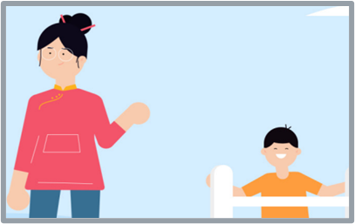
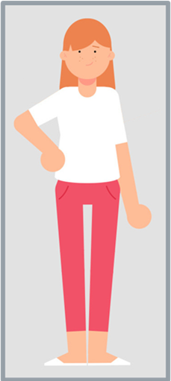
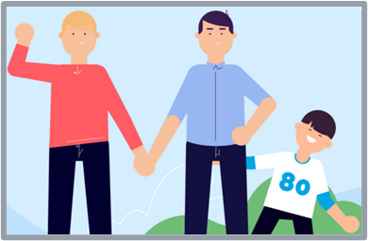
Rosie’s story: What happens if families change? Resource 1 – Learning objective
Learning objective
To learn about different types of families and how they can change
Notes:
Run through the learning objective:
To learn about different types of families and how they can change.
Explain that most parents and carers stay together but some don‘t and that the learners will be introduced to a fictitious 9-year-old, Rosie, and will discuss the changes in her family when her parents separated 12 months ago.
Distancing techniques are employed in the learning session – learners follow the separation journey of Rosie over a twelve-month period to explore children and young people’s rights when their parents and carers separate. The narrative normalises how children and young people may feel at this difficult time of transition. Learners should be encouraged to discuss how Rosie may be feeling, to discourage personal disclosures.

Slide 10
Rosie’s story: What happens if families change? Resource 1 – Learning outcomes
Learning outcomes
Learners will be able to:
describe the different ways in which people can be a family
explain some of the ways that families show that they care for each other
describe the range of emotions that children and young people may feel when parents and carers separate and what friends can do to support them at that time.
Notes:
Run through the learning outcomes
Learners will be able to:
describe the different ways in which people can be a family
explain some of the ways that families show that they care for each other
describe the range of emotions that children and young people may feel when parents and carers separate.

Slide 11
BASELINE ACTIVITY –WHAT is A Family?
What is a family?
Who can be part of a family?
What words do you think of when you think about a family?
Notes:
To begin, place three graffiti walls around the room with one heading per piece of sugar/flip chart paper: ‘What is a family?’, ‘Who can be part of a family?’, ‘What words do you think of when you think about a family?’
Ask the whole class to privately think about these questions and then either ask learners to get up and move around the room or, if you would prefer, you could hand out post it notes for learners to complete in response to these questions, that they then stick on each ‘wall’.
Do not give any further hints or tips, even if learners ask questions. They should not share their ideas with classmates during the activity. This will give you the opportunity to see what learners’ own beliefs and ideas are on ‘family’ before the learning begins.
Learners may suggest:
What is a family? (A group of people who usually live together who share their money and food and – take care of one another.)
Who can be part of a family? (Parents/step parents, children, grandparents/step-grandparents, siblings, aunts, uncles, cousins, etc., including single parents, same-sex parents, step-parents, blended families, foster parents or adoptive parents.)
- What words do you think of when you think about a family? (Loving, caring, helpful, sharing, trust, playing, comforting.)

Slide 12
WHAT do Families do for one another?
What do families do for one another to show that they care?
Help each other, e.g. tie shoelaces
Make food for each other
Play together, e.g. in the park
Go on holidays together
Look after each other, e.g. when ill
Help with homework
Help each other to clean the house
Praise each other when they do well
Say they love each other/give hugs
Say sorry when they have upset each other
Notes:
As Resource 1 aims to help learners to understand that there are different family forms and sometimes families change, this exercise considers the commonalities between different family forms first by exploring what families do for one another to show that they care.
Explain that sometimes family relationships can be difficult as well as happy. Sometimes parents and carers have to discuss things and don’t always agree. Sometimes brothers and sisters argue but that doesn't mean that families don’t care for each other.
Give the class 3 minutes to discuss ideas on their tables about the things that families do for one another to show that they care. Ask them to then feedback some of their suggestions and write these on the whiteboard. In slideshow mode, go through the suggestions on the PowerPoint, pointing out those that the class had already suggested and any that are in addition to the suggestions made by the class (adding the further suggestions to the whiteboard).
As a support activity, consider giving the learners some of the answers to start them off, or asking them to name 3 things only that families do for one another to show that they care.
As an extension activity, consider asking the learners to list which of the actions on the slide (and any additional actions they have come up with) are actions that care for their physical health, which are actions that care for their mental health and well-being and which care for both physical health and mental health and well-being.

Slide 13
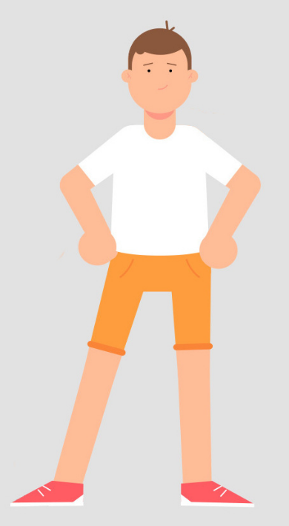
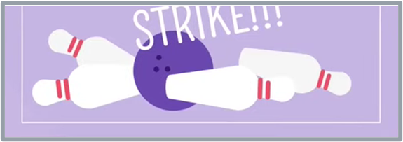
Meet Rosie
Rosie’s house
Rosie’s friend, Billy
Rosie’s teacher, Mr Green
Rosie
Rosie likes to go bowling
Notes:
This slide introduces the learners to Rosie, aged 9. In slideshow mode we are introduced to where Rosie lives, her friend from school, Billy, and her teacher, Mr Green. We are also told a little about her hobbies as she likes to go bowling.

Slide 14
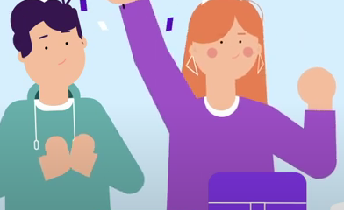
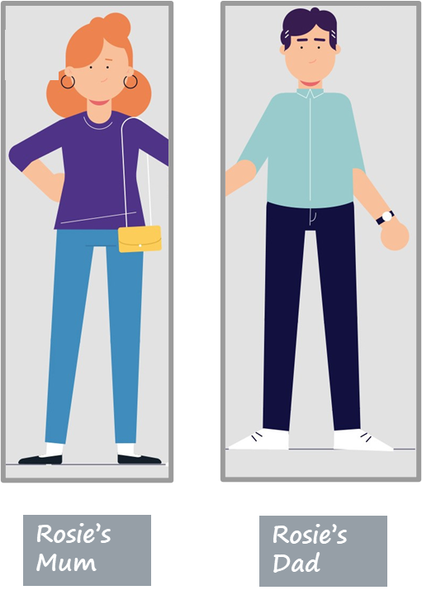
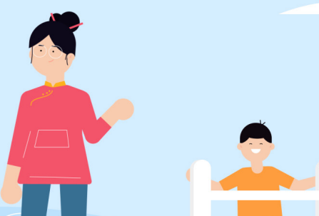
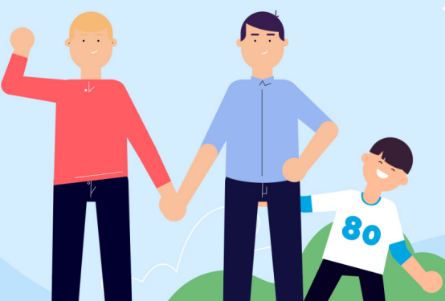
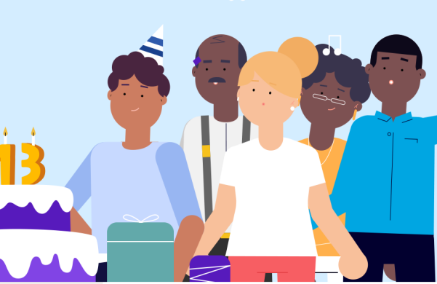
WHO IS IN Rosie’s Family?
Rosie’s brother Jack and her sister Chloe
Dad’s partner Min and her son, Jonny
Rosie’s dog, Max
Rosie’s Uncle Mike, Mike’s husband, Will and their adopted son, Ollie
Rosie’s neighbour Tom and Tom’s family
Notes:
In Health and Well-being learners who have reached Progression step 2 can recognise that there are different types of relationships beyond their family and friends and learners who have reached Progression step 3 can understand that there are differences within types of relationships and that relationships change over time. To help learners reach the progression steps, they will explore the different members of Rosie's family including the different and sometimes changing types of family structure.
Encourage learners to share any questions they may have during and/or after this activity.
Ask learners to draw a table with the headings, ‘family’ and ‘not family’ at the top. In slideshow mode, show learners the various groupings and ask them to write down the characters under the heading they think they belong to.
Rosie’s mum and dad (learners should readily agree that they are family). Explain that Rosie’s mum and dad separated a year ago and are now divorced. Rosie now lives with her mum and spends lots of time with her dad and his new partner Min and her son Jonny who have lived with her Dad for the last 9 months. Ask if learners think it makes any difference that Rosie’s parents are divorced (again they should readily agree that it makes no difference).
Rosie's brother Jack and her sister Chloe. Learners are likely to correctly agree that they are in Rosie's family.
Dad’s partner Min and her son Jonny. As Min and Rosie's dad have lived together for 9 months as a ‘blended family’, learners are likely to agree that Min and Jonny form part of Rosie's family.
Rosie's dog, Max. For lots of children, their pets are an important member of ‘their family’.
Rosie’s Uncle Mike, Mike’s husband Will and their adopted son, Ollie. Learners should be able to recognise that a same sex couple can be part of your family, here because Mike is Rosie’s uncle so Will is her uncle by marriage. Explain sometimes if a child cannot live with their birth parents, then another couple may adopt them so that they become the child’s adoptive parents. This is what has happened to Ollie, making Ollie Rosie’s cousin.
Rosie’s next door neighbour Tom. Explain that Tom lives with his mum, dad, grandma and grandpa. This gets across to learners that intergenerational families sometimes live together. Explain that Tom has lived next door to Rosie’s family since Rosie was a baby. Tom doesn't have any brothers or sisters, so the two families have always been very close. Despite this, learners should recognise that even though Tom and his family are important people in Rosie's life they do not form part of her family. They might feel like family, or they might be as close to Rosie’s family as some families are with other members of their family, but they are not actually part of Rosie’s family.
Ask: Why might some people feel like they are family when they are not? Answers might include that they provide help and support, like a family member would; we see lots of them, perhaps they live close by when people who are in our family may not live close to us. Perhaps ask in what ways contact with wider members of the family has changed in the last 50 years? Answers may include that people may move away for work or it is more likely that both parents may work which means there is not as much time to stay connected. However, often if both parents work a grandparent might help to look after the children. Also, we have better means of communication over long distances e.g., Zoom WhatsApp etc. which makes staying connected easier.
Ask: Does anyone have any questions about who is in Rosie’s family?
Encourage learners to write anonymous questions they can add to the ask-it-basket which teachers can check at the end of the learning.

Slide 15
Rosie’s feelings: How might Rosie have felt when her parents separated?
1) It’s not happening! Not wanting to believe that her parents are separating.
2) Why is this happening? Frustrated, confused and angry that this is happening to her.
3) How can I stop this happening? Thinking this is her fault/changing her behaviour to try to stop the separation.
4) I don't want this to happen! Sad, wanting things to go back to how they were.
5) I'm sad it's happened but I’m ok: Coming to terms with the changes in her family.
I'm sad it’s happened but I’m ok.
It’s not happening!
Feelings
I don’t want this to happen!
Why is this happening?
How can I stop this happening?
Notes:
Next, learners will consider the different feelings that Rosie may have experienced when her parents separated.
The ‘statements of what matters’ for Health and Well-being state that learners must be able to ‘explore the connections between their experiences, mental health and emotional well-being… [and] recognise that feelings and emotions are neither fixed nor consistent’. Learners should also learn ‘how to communicate their feelings [so] learners will be better placed to create a culture where talking about mental health and emotional well-being is normalised’. The ‘statements of what matters’ for Health and Well-being also state that learners should be given opportunities to ‘[develop] empathy… [enabling them] … to act in a way which supports the mental health and emotional well-being of others.’ For learners whose parents and carers have not separated, discussing the feelings of a young person whose parents and carers have separated should help them to develop empathy and act in ways that support others who have experienced parental separation.
Explain to learners that Rosie's parents separated a year ago and she found it hard to start off with, but she is now feeling much happier about the situation. Here the emphasis is on the fact that parental separation can be a form of grief for children and that many go through a five-stage cycle, much in the same way as they experience grief when someone dies. The emphasis should be on normalising some of the feelings that children and young people may have if their parents and carers separate such as anger or sadness. Every child’s experience is unique and will depend in part on the situation at home prior to the separation and how amicable the parents and carers are upon separation. If the home life had been difficult the separation may be a relief. Not every child will feel all of these things or progress in a linear fashion through them.
Ask learners to write down how think Rosie may have felt when her parents first separated.
Answer: sad, hurt, angry, worried and/or confused).
Distancing techniques should be used, so describing how it is normal that Rosie might feel hurt, sad, bewildered, angry, worried, confused or overwhelmed. Normalise how it is common for children and young people to feel that they were somehow responsible for the separation (the ‘bargaining’ aspect of how Rosie might feel – How can I stop this happening? – refers to attempts by children and young people to change their own behaviour in the hope that a parent will return home).
Tell the learners that Rosie’s friend Billy wants to support Rosie. Give learners 2-3 minutes on their tables to suggest 3 top tips for Billy that could help him support Rosie through her parents’ separation. Once learners have had an opportunity to discuss this in their group ask each group to feedback what would be their 3 top tips for Billy [listen to how Rosie is feeling, without judging and ‘be there’ for her; help her to seek out pastoral support at school; reassure her that she is not to blame for the separation and encourage her to keep up with friends, hobbies, exercise, etc.]
As a support activity, consider asking learners to think of just one thing that Billy could do to support Rosie through her parents’ separation.
As an extension activity, consider asking the learners to think of something that Billy could do to support Rosie through each stage of how she might be feeling following her parents’ separation.

Slide 16
ENDPOINT ASSESSMENT ACTIVITY
What is a family?
Who can be part of a family?
What words do you think of when you think about a family?
Notes:
Endpoint assessment – summarise the ideas written on the original graffiti walls/sticky notes on the graffiti walls and ask the class if they now have anything to add. Following on from the discussion about who is in Rosie's family, learners may now recognise, for example, that a couple in a same sex relationship are a family, as is an adoptive family, blended families, single parent families and intergenerational families.
Teachers should be aware of and acknowledge cultural differences in meanings that learners may attach to ‘family’, some cultures for example are more likely to live in intergenerational family units than others. Families have also changed over time with many parents and carers having fewer children than in previous generations.
If learners don’t have anything to add to the graffiti walls at the end of the learning, and to ensure all learners participate, you could instead ask learners to complete the following sentence, ‘Family is…’ Learners can describe in a sentence what they believe family is.

Slide 17
Further help and support in school
For further help and support in school contact:
your teacher/teaching assistant
senior staff in the school
Notes:
Remind learners who they can talk to in school, e.g. teacher, teaching assistant or senior staff in the school (you may wish to personalise this slide with names of contact staff) or ask the learners who they think they should talk to in school, then provide details of any members of staff that the learners have not mentioned.

Slide 18
Further help and support out of school
NYAS Cymru - www.nyas.net/nyas-cymru/ (Tel: 0808 8081001)
Children’s Commissioner for Wales - www.childcomwales.org.uk/ (Tel 0808 801000)
NACCC - https://naccc.org.uk (Tel: 01159 484557)
Relate Cymru - www.relate.org.uk/cymru/children-and-young-peoples-counselling (Tel: 03000030396)
Childline Cymru - www.childline.org.uk/info-advice/home-families/family-relationships/divorce-separation/ (Tel: 0800 1111)
Cafcass Cymru - https://gov.wales/cafcass-cymru/family-separation (Tel: 0300 456 4000)
The Exchange- https://www.exchange-counselling.com/primary/
(Tel: 0330 2020283)
Notes:
In slideshow mode each charity and its contact details are grouped and will be listed in turn – this will help the slide not to look too crowded.
Some learners may have heard of Relate as a relationship counselling service but point out to them that Relate also offer counselling for children and young people.
Tell learners that in the next learning session they will be finding out more about the organisations listed and the support that they can give to children and young people whose parents and carers have separated. In case learners want more details of the support each organisation offers it is as follows:
National Youth Advocacy Service, Cymru (NYAS, Cymru): NYAS Cymru provides information to children and young people on its website; a free helpline and an advocate for children and young people (a person to speak on the young person’s behalf) in the family court if needed.
National Association of Child Contact Centres: NACCC runs a network of 350 contact centres, including 13 in Wales, which provide a safe, neutral, welcoming space for children to spend time with parents and carers (or other people important to them, such as grandparents).
Childline Cymru: Childline Cymru has a huge amount of information, advice and support for children and young people whose parents and carers have separated, available online, by telephone or through one-to-one counselling.
The Exchange: The Exchange is a counselling and wellbeing service for children and young people, which partners with Welsh Government to provide counselling for children, including at primary schools.
Children’s Commissioner for Wales: The Children’s Commissioner for Wales speaks up for children and young people in Wales on important issues.
Relate Cymru: Relate Cymru offers counselling to children and young people who are experiencing difficulties in any area of life, including if parents and carers are arguing or have separated.
Cafcass Cymru: Cafcass stands for Children and Family Court Advisory and Support Service. Cafcass Cymru is an organisation in the Welsh Government that provides a voice for any child in Wales that is involved with the Family Justice system.
At the end of the learning explain to learners that in Resource 2 they will be learning about how children and young people can ‘get their voices heard’ when parents and carers separate, the different sources of support available to children and young people when parents and carers separate and the topic of divorce more generally and that, if they wish to, learners can let the teacher know/put a note in the ‘ask-it-basket’ if that is an issue for them.

