Slide 1
Opening slide
Rosie’s story: What happens if families change?
Resource 2
Notes:
This is the second of two teaching resources, ‘Rosie's story: What happens if families change?’ Resource 1 introduces learners to Rosie, aged 9 and the people who make up her family or are important to her. They learn that families come in all shapes and sizes and sometimes families change when parents and carers separate. They consider the range of emotions that children and young people go through when parents and carers separate. In Resource 2, learners learn about the processes involved in divorce and separation, their rights to have their voices heard in the process and how this can be achieved. They also learn about the help and support available to children and young people at this time.

Slide 2
TEACHER SLIDE – PREPARING TO TEACH
Preparing to teach and using these slides
The slides headed ‘teacher slides’ assist the teacher in setting up and running the learning.
Slide 10 onwards are for learner-facing learning.
Please read the Teacher Guidance (Resource 2) for ‘Rosie's Story’ before teaching.
Have slides in presenter mode – notes are available under each slide to aid teaching
Support and extension:
activities are suggested where appropriate (icons on bottom right corner of slides).
Resources
Sticky notes.
An ‘ask-it-basket’/question box for learners to ask questions confidentially.
Handout for ‘quick fire quiz’ if using.
Save for the above, no additional teaching resources are needed to teach this learning session.
Timing
The learning will take place over
45 minutes.
Notes:
This two-part teaching resource has been devised for learners working at Progression steps 2 and 3. The resource supports the teaching of relationships and sexuality education and developing awareness of the rights of children and young people. A number of statements of what matters covers these, predominantly in the Health and Well-being and Humanities Areas of Learning and Experience.
This slide gives an overview of the resource. It should be read in conjunction with the Teacher Guidance for ‘Rosie's Story’ Resource 2. Teachers are reminded to review and address any questions submitted in the anonymous ask-it-basket’/question box, to ensure they are answering all learners’ questions.

Slide 3
TEACHER SLIDE: statements of what matters
In Resource 1 and 2, discussing when parents and carers separate and normalising the range of emotions that children and young people may go through when parents and carers separate covers a number of ‘statements of what matters’. For example, from Health and Well-being:
How we process and respond to our experiences affects our mental health and emotional well-being.
Healthy relationships are fundamental to our well-being.
In Resource 2, children and young people learning about their right to express their opinions under the UNCRC, Article 12 when decisions are being made following the separation of their parents and carers covers a number of 'statements of what matters' such as this one from Humanities:
Informed, self-aware citizens engage with the challenges and opportunities that face humanity, and are able to take considered and ethical action.
Notes:
This slide sets out some of the ‘statements of what matters’ from Health and Well-being and Humanities the teaching resources address.

Slide 4
TEACHER SLIDE – Progression steps
Resource 1, discusses parental separation and normalises emotions that children and young people may go through. Resource 2 discusses sources of support for children and young people on parental separation. Both resources will help learners understand key areas outlined in Progression steps 2 and 3. For example, from Health and Well-being:
How we process and respond to our experiences affects our mental health and emotional well-being.
Healthy relationships are fundamental to our well-being.
In Resource 2, children and young people learn about their right to express their voice and be heard when decisions are being made following the separation of their parents and carers. Learners will increase their understanding in Progression steps 2 and 3 such as this one from Humanities:
Informed, self-aware citizens engage with the challenges and opportunities that face humanity, and are able to take considered and ethical action.
Notes:
This slide sets out some of the ‘progression steps’ from Health and Well-being and Humanities that the teaching resources address. Specifically:
Health and Well-being
How we process and respond to our experiences affects our mental health and emotional well-being.
Resource 1 discusses parental separation and normalises emotions that children and young people may go through. Resource 2 discusses sources of support for children and young people on parental separation.
Both resources will help learners understand key areas outlined in Progression step 2 such as:
I can notice and communicate my feelings.
I am beginning to notice when I need help to manage my feelings.
I can reflect on my experiences.
I can pay attention to the feelings of others and I am learning to think about why they may feel that way.
Both resources will help learners understand key areas outlined in Progression step 3 such as:
I can see the benefits of communicating about feelings as one of a range of strategies which can help promote positive mental health and emotional well-being.
I can ask for help when I need it from people I trust.
I can reflect on the way that past events and experiences have affected my thoughts, feelings and actions.
I can anticipate how future events may make me and others feel.
I can empathise with others.
I can understand how and why experiences affect me and others.
Healthy relationships are fundamental to our well-being
Resource 1 discusses different family forms and normalises emotions that children and young people may go through. Resource 2 discusses sources of support for children and young people and their right to have their voices heard when decisions are being made following the separation of their parents and carers.
Both resources will help learners understand key areas outlined in Progression step 2 such as:
I can recognise that there are different types of relationships beyond my family and friends.
I can communicate my needs and feelings in my relationships, and notice the needs and feelings of others.
I can understand that everyone has rights and, with support, I can respect those rights.
Both resources will help learners understand key areas outlined in Progression step 3 such as:
I can understand that there are differences within types of relationships and that relationships change over time.
I can communicate my needs and feelings, and respond to those of others.
I can reflect on the characteristics of safe relationships and I can seek support when needed.
I can respect the rights of others and I understand how these impact on myself and others.
Humanities
Informed, self-aware citizens engage with the challenges and opportunities that face humanity, and are able to take considered and ethical action.
In Resource 2, children and young people learn about their right to express their voice and be heard when decisions are being made following the separation of their parents and carers.
Learners will increase their understanding in Progression step 2 such as:
I am beginning to understand what human rights are and why they are important.
I can understand that we need to respect the rights of others.
Learners will increase their understanding in Progression step 3 such as:
I have an understanding that injustice and inequality exist in societies. I also have an understanding of what human rights are and why they are important to me and other people.
I can explain who is responsible for upholding rights in my locality and in Wales, as well as in the wider world. I also have an understanding that some people are denied their rights.

Slide 5
TEACHER SLIDE – the uncrc
The United Nations Convention on the Rights of the Child 1989 (UNCRC) is the global “gold standard” for children’s rights and sets out the fundamental rights of all children. It is the most widely and rapidly ratified human rights treaty in history and sets out the civil, political, economic and cultural rights of every child. Countries that have ratified the UNCRC agree to safeguard the rights and ensure that adults and children know about them.
The Convention:
has been signed by 196 countries of which all but the USA have ratified it. (It was ratified in the UK in 1991.)
has 4 guiding principles (non-discrimination; the best interests of the child; the right to life, survival and development; and the right of children to express their views freely and to be heard) which apply to all under 18s.
consists of 54 Articles which include protecting children’s rights to life; healthcare; education; protection from discrimination, harm or exploitation (including violence, abuse, neglect, kidnapping, child labour and child soldiers) and to live with their family (where possible).
Notes:
This slide gives some details about The UNCRC.
This is covered in slide 14 in the learner-facing slides below.
For further information on the UNCRC see: www.unicef.org.uk/what-we-do/un-convention-child-rights/.

Slide 6
TEACHER SLIDE – children and YOUNG PEOPLE’S ART. 12 RIGHTS
The United Nations Convention on the Rights of the Child 1989 (UNCRC) Article 12 gives all children the right to have their voices heard and their opinions listened to and taken seriously by adults.
This includes the right to information, consultation and representation (if needed) when their parents and carers separate. These rights are universal and freestanding.
In a minority of cases, it may be appropriate for the child to make their own application to the family court. Legal aid (i.e. funding) is available for this and a solicitor or an advocate from The National Youth Advocacy Service, Cymru (NYAS, Cymru – see slide 24) can make the application for the child and represent them in the family court if needed.
Children are also entitled to speak to the mediator if their parents and carers are in mediation. This process is known as ‘child inclusive mediation’.
Notes:
This slide gives some statistics on the numbers of children and young people whose parents and carers separate each year and children and young people’s rights to be heard in the decision making following parental separation.
This is covered in slides 14–15 in the learner-facing slides below.
For further information on representing children in the family court cases see: https://www.nyas.net/services/legal-services/
For further information on consulting children in mediation see: https://www.familymediationcouncil.org.uk/mediation-isnt-only-for-the-adults/

Slide 7
TEACHER SLIDE – Article 12 RIGHTS (cont.)
Article 12 rights do not mean that children and young people make the decisions – the responsible adults (usually their parents) do, but children and young people have the right to have their opinions listened to. The weight placed upon those opinions will depend upon the age and maturity of the child.
The parents of approximately 280,000 children and young people separate each year.
There were approximately 87,000 dependent children living in lone parent households in Wales in 2021.
Evidence from the Millennium Cohort Study indicates that 39% of children were not living in the same household as both parents by the age of 11.
Research indicates that children cope better when they are consulted about arrangements for them when parents separate and arrangements made are longer-lasting, yet they are seldom consulted.
Notes:
This slide gives some statistics on the numbers of children and young people whose parents separate each year and children and young people’s rights to be heard in the decision making following parental separation.
This is covered in slides 14–15 in the learner-facing slides below.
For the number of children and young people whose parents separate see the Report of The Family Solutions Group Report, November 2020 at page 19, available at: www.judiciary.uk/wp-content/uploads/2020/11/FamilySolutionsGroupReport_WhatAboutMe_12November2020.pdf-final.pdf
For figures on lone parent families in Wales see: https://www.ons.gov.uk/peoplepopulationandcommunity/birthsdeathsandmarriages/families/datasets/householdsbytypeofhouseholdandfamilyregionsofenglandandukconstituentcountries (Table 7, Wales).
For the Millennium Cohort Study see: https://cls.ucl.ac.uk/wp-content/uploads/2017/07/Millennium-Cohort-Study-Initial-findings-from-the-Age-11-survey-Full-report-WEB-VERSION.pdf.
For research on children’s outcomes when they are consulted when parents and carers separate see: www.justice.gov.uk/downloads/family-mediation-task-force-report.pdf, page 40.

Slide 8
TEACHER SLIDE – the divorce LEGISLATION
The Matrimonial Causes Act 1973 (‘the old law’) was in force until 6 April 2022. It provided that divorce could be granted on the ground of irretrievable breakdown, proved by one of five facts;
the Respondent has committed adultery (had sex with a member of the opposite sex whom they are not married to)
the Respondent has behaved unreasonably
the Respondent has deserted the Petitioner for a period of 2 years
the parties have been separated for two years (provided the other party agreed)
the parties have been separated for five years (agreement of the other party not required
The Respondent could defend a ‘fault–based’ application, but that rarely happened as it was costly. The law was widely criticised as the requirement to ‘blame’ the other person could increase animosity.
The Divorce, Dissolution and Separation Act 2020, (‘the new law’) was introduced in April 2022. It removes fault from the process. The ground for divorce remains the same – the marriage must have irretrievably broken down – but this is proved by the passage of time. The Applicant can apply for a final order 26 weeks after filing the application. There is no option to defend the divorce and the application can be made jointly. For some, it will increase the length of time it takes to get a divorce because the so called ‘quickie’ facts of adultery or unreasonable behaviour no longer apply.
Notes:
This slide gives some details about ‘old’ fault-based system of divorce in England and Wales and the new ‘no-fault‘ divorce introduced in April 2022.
The ‘new’ law is covered in slide 17 in the learner-facing slides below. Further details of the processes involved and how children's voices can be included when parents and carers separate are outlined on slides 18–22.

Slide 9
TEACHER SLIDE – Learning AND suggested TIMING
Activity | Description | Suggested timing
Introduction | Ground rules, learning objective and outcomes. | 5 minutes
Baseline activity | Learners will draw a mind map of what questions Rosie may have had and her support needs when her parents first separated. | 7 minutes
Introduction to the UNCRC | Learners will be introduced to The United Nations, the UNCRC, and will complete the gap-fill exercise to recap on Article 12. | 5 minutes
Who can Rosie speak to for support? | In pairs, learners will be asked to write down the people that Rosie has at home or at school who she could talk to if she is feeling upset. | 3 minutes
Processes and quick- fire quiz | Learners will learn about the process of divorce and for making child arrangements, and how their voices are included then consolidate with a quiz. | 15 minutes
Sources of support | Learners will learn about the support, online and in the community, available to children and young people whose parents and carers separate. | 5 minutes
Endpoint assessment | Learners will revisit and revise the baseline answers as appropriate and review the further help and support available. | 5 minutes
Notes:
The resource is designed to be taught over 45 minutes. Should you have time for a 60-minute teaching session we suggest adding time to the following activities so that the revised times are:
Introduction (no change – 5 minutes)
Baseline activity – 10 minutes
Introduction to the UNCRC – 8 minutes
Who can Rosie speak to for support? – 5 minutes
Processes and quick-fire quiz – 18 minutes
Sources of support – 7 minutes
Endpoint assessment – 7 minutes

Slide 10
GROUND RULES
We will:
be kind and compassionate towards each other
talk about ‘someone I know…’ rather than using a person’s name
have the right not to answer
comment on what is said, not who has said it
seek help in school/encourage friends to seek help if needed.
We will not:
give information about our family’s story
tell anyone else about other people’s story
judge others
put anyone on the spot
ask personal questions or try to embarrass someone.
Notes:
Learners will be discussing the experiences of a young child, Rosie aged 9 whose parents separated a year ago. The subjects raised have the potential to be distressing for some if their own parents and carers have separated, or they do not live with either parent. Teachers should refer to the Curriculum for Wales Guidance on RSE and the RSE Code before teaching. They should also familiarise themselves with the ‘Framework on embedding a whole-school approach to emotional and mental well-being’ available at: https://gov.wales/sites/default/files/publications/2021-03/framework-on-embedding-a-whole-school-approach-to-emotional-and-mental-well-being.pdf.
It is important that ground rules are established to minimise the potential for distress to any learner. Teachers may modify or explain ground rules as needed and if a teacher already has established ‘class ground rules’ then these can be substituted. Learners can also be asked to add to the ground rules as appropriate.
Teachers should also:
have an ‘ask-it-basket’/question box for learners to ask questions confidentially
review and address any questions submitted in the anonymous ‘ask-it-basket’/question box
work within the school’s policies on safeguarding and confidentiality
link RSE into the whole-school approach to support learner well-being
make learners aware of sources of support, both inside and outside the school
explain to learners that while confidentiality is important, if something is said or a behaviour causes concern, teachers may speak to another member of staff.

Slide 11
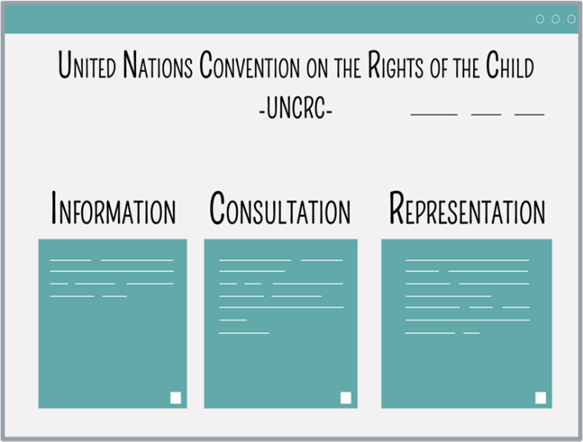
Rosie’s story: What happens if families change? Resource 2 – LEARNING OBJECTIVE
Learning objective
Learners will learn:
about rights children and young people have if parents and carers separate and the type of support they might need.
Notes:
Run through the learning objective.
Learners will learn:
about rights children and young people have if parents and carers separate and the type of support they might need.

Slide 12
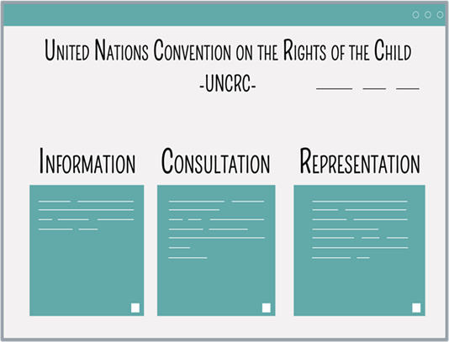
Rosie’s story: What happens if families change? Resource 2 – LEARNING OUTCOMES
Learning outcomes - Learners will be able to:
explain children and young people’s rights under Article 12, UNCRC when parents and carers separate
identify the different ways arrangements for children and young people can be made and how children and young people can be consulted if parents and carers separate
identify sources of support for these children and young people and explain how to access them.
Notes:
Run through the learning outcomes.
Learners will be able to:
explain children and young people’s rights under Article 12, UNCRC when parents and carers separate
identify the different ways arrangements for children and young people can be made and how children and young people can be consulted if parents and carers separate
identify sources of support for these children and young people and explain how to access them.
Explain that the learners will continue to look at 9-year-old Rosie’s changes in her family in the last year.
Ask learners, ‘what do you remember about Rosie from the last teaching session?’
She is aged 9
She has an older brother, Jack and an older sister, Chloe
Rosie's parents separated a year ago and are now divorced (Rosie found it hard to start off with, but she is feeling much happier about the situation)
Rosie now lives with her mum, her sister Chloe and her brother Jack.
The three children spend lots of time with their dad. his new partner Min and her son Jonny who have lived with her Dad for the last 9 months.

Slide 13
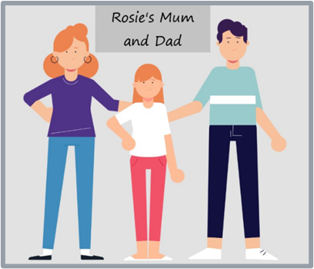
BASELINE ACTIVITY – support for children
Draw a circle with the word ‘Rosie’ in the middle. Around the outside, write down:
questions you think Rosie may have had when her mum and dad first separated
support you think Rosie may have needed and examples of support you know of that may be available to her.
Notes:
For this activity, if learners wish to discuss questions with one another, remind them to work independently and any questions they may have will be answered after the baseline assessment is completed.
Ask learners (without conferring) to each to draw a circle with the word ‘Rosie’ in the middle. [If learners are familiar with ‘mind mapping’ then you can explain that this is what they are going to do. If not, explain ‘mind-mapping’ to them i.e. they will be drawing a diagram with a central theme (here, the character, Rosie) and then branching out into different themes (here, questions that Rosie may have, etc.) to visually outline information]. Around the outside of the circle, ask them to write down:
questions you think Rosie may have at this time. (Is this because of something I have done? Is there any chance of you staying together? Where am I going to live? Who am I going to live with? How often will I see my other parent? Will I have to change schools? Will I be able to keep up my friendships/hobbies/time with wider family? How will things get sorted out? Will I be asked what I want? If so, by whom? Will I have to go to court?)
the support you think Rosie may need and any examples you know of support that may be available to her. (Support needed may include – good friends around her; peer support from others who've been through this; good pastoral support at school; good information online to get some of her questions answered; someone to speak to about how she's feeling; someone to speak to about what she would like to happen around arrangements for her care. Sources of support may include – pastoral support at school; friends or wider family; ChildLine or other counselling service).
Note: Do not give any further hints or tips, even if learners ask questions. They should not share their ideas with classmates during the activity. This will give you the opportunity to see what learners’ own beliefs and ideas are before the learning begins.
Circulate the room as learners complete their mind maps in order to gauge what learners know/think/feel/believe in relation to the topic. After learners have had 3–4 minutes or so to complete their mind maps, ask for all class feedback (using the suggested answers above to guide you}. Ask learners not to add anything else to their mind maps during class feedback and to put these to one side as they will return to them (and these two questions) at the end of the learning.

Slide 14
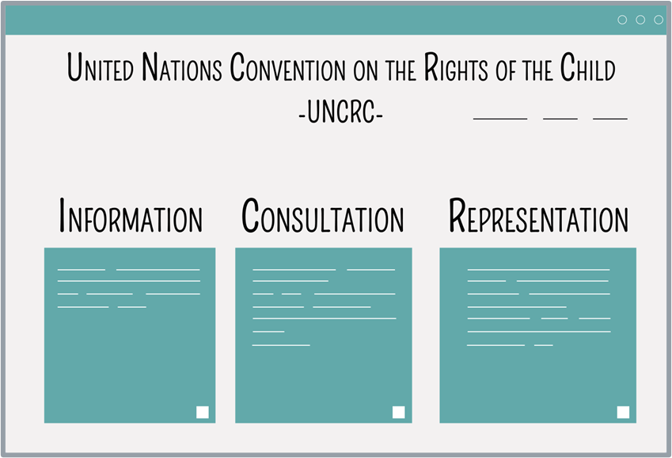
INTRODUCTION TO THE UNCRC
The Convention
The United Nations Convention on the Rights
of the Child 1989 (UNCRC) is an important agreement by countries who have promised to protect children’s rights.
The UNCRC explains the rights children have and how governments must make sure that the rights are upheld.
Article 12 of the UNCRC gives children the right to give their opinions on matters affecting them and adults must take those opinions seriously.
Notes:
(Further subject knowledge is outlined on slides 5–7 above.)
Explain that children and young people have the right to have their voices heard and their opinions taken into account when their parents and carers separate. This right is contained in an important document called the United Nations Convention on the Rights of the Child (UNCRC). Begin by explaining key terms such as:
Governments: The group of people who make decisions and the laws for a country.
The United Nations: Organisation that most countries in the world including the UK belong to which exists to find solutions to the world’s problems.
Convention: Agreements that governments sign.
Explain that most countries in the world, including the UK, are members of the United Nations. Explain that the United Nations exists to find solutions to the world’s problems. Sometimes the United Nations makes conventions which are agreements that the countries sign. One very important convention is The United Nations Convention on the Rights of the Child 1989 (UNCRC). Explain that the UK ratified the convention in 1991 (i.e. they agreed to uphold it). The UNCRC is made up of 54 statements, known as articles, which protect children’s rights. Article 12 gives children the right to give their opinions on matters affecting them and adults must listen and take those opinions seriously. This means that when parents and carers separate all children have the right to information about what will happen and what support is available and to be consulted. Most children won't need it, but they could also be represented in the family court if necessary.
Depending on the level of engagement and level that the class are working at, either ask what consultation and representation mean or explain the terms:
Consultation – to be asked your opinion.
Representation – to have someone to speak on your behalf in the family court, i.e. to have a lawyer whose role it is to tell the judge what you want and what is best for you.
Ask: What might a child think or feel if they aren’t given this right?’
Ask learners to discuss this on their tables and feed their answers back to the class.
Suggested answers could include feeling unheard, unimportant or excluded.

Slide 15
ARTICLE 12: UNCRC
ARTICLE 12
You have the _________ to give your ___________ and for __________ to _________, and take it __________.
adults, opinion, seriously, right, listen
Notes:
In this learning session, learners will explore the sources of support available to them when their parents and carers separate and how to access this support. This will be discussed as part of children and young people’s Article 12 right to give their opinion and for adults to listen and take it seriously. To set this up and to recap from the previous slide, ask learners to use the suggested words to fill in the gaps on Article 12 above.
In slideshow mode, the gap-fill appears without the suggested words, with the suggested words appearing on a click to give you the option of doing the exercise with or without the word hints.
As a support activity consider giving learners the sentence with only the word ‘right’ missing and ask them to tell you the missing word.
As an extension activity: Ask learners to write a short statement/summary about the rights children have.

Slide 16
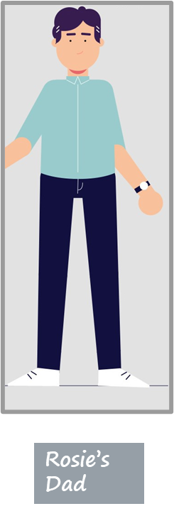
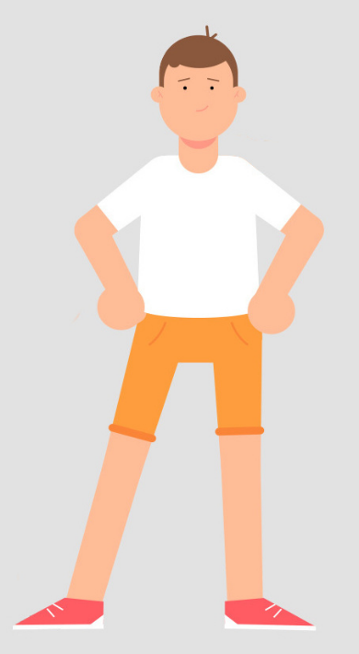
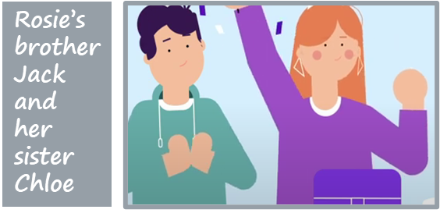
Who can ROSIE SPEAK TO FOR support?
Rosie’s friend, Billy
Rosie’s teacher, Mr Green
Rosie
Notes:
Ask: what does the term separation mean? What might happen when two people separate?
Remind learners that Rosie's parents separated a year ago and she's feeling much better about the separation than she did at the time but sometimes still need some support.
Run through the characters again to remind learners who Rosie has for support (or for any learners who were absent when Resource 1 was taught). In slideshow mode each character is shown in turn. N.B. Rosie’s mum and dad have been grouped together to avoid any inference that one is superior or preferable to the other.
Ask learners to list one advantage and one disadvantage for each person that Rosie speaks to:
Mum or Dad: advantage – Rosie will be used to speaking to them when she's upset; disadvantage – Rosie may be upset about them so it may be hard to talk to them about it.
Chloe or Jack, her sister and brother: advantage – they will be upset too so will understand how Rosie is feeling; disadvantage – Rosie may not want to speak to them in case it upsets them further.
Rosie's friend Billy or one of her other friends: advantage – they are not part of Rosie's family so she doesn't risk upsetting them; disadvantage – Rosie’s friends may not have gone through this experience so may not fully understand how she's feeling.
Rosie's teacher, Mr. Green: advantage – he will have had others in his classes that have gone through what Rosie has gone through so he will be able to help Rosie too; disadvantage – at first it might be hard for Rosie to talk to Mr Green about things that are going on outside of school.
As a support activity consider asking learners to list one advantage and one disadvantage for one or two of the people who Rosie could speak to for support.
As an extension activity consider asking learners to script the opening to a conversation about seeking support – how might they ask someone for help?

Slide 17
What is the process when parents and carers separate?
If a couple aren't married, they don't need to apply to the family court to end their relationship.
If a couple are married, they need to apply to the family court for a ‘divorce’ to end their relationship but there is no need for anyone to attend the court in person.
The person applying for the divorce is the Applicant. The other person is the Respondent.
From April 2022, The Divorce, Dissolution and Separation Act 2020 has been in force. Since then:
The Applicant does not need to show that it was the Respondent’s fault.
The Respondent cannot say to the family court that they object to the divorce.
Notes:
Slides 17–22 have information on divorce and separation and on the processes for agreeing child arrangements. Depending on the time available and engagement of the learners, teachers may choose to a) run through all the information in the slides emphasising to learners the key messages highlighted in bold in the notes or b) simply emphasise the key messages for each slide and give sufficient information to allow learners to complete the quick-fire quiz that follows.
Explain to learners that the family court is the place where parents can sort out what needs to be addressed when they separate, such as getting a divorce if they were married or getting the judge (the person appointed to make decisions when families can’t agree) to decide the arrangements for the children if the parents cannot agree them. If necessary, reassure learners that the family court is not like the criminal court and that nobody is ‘in trouble’ if they go there.
To consolidate learning from this and the next four slides on processes and how children’s voices can be heard in these processes, and to scaffold this part of the teaching, there is a quick-fire quiz on slide 23. To ensure that all learners participate, either provide a handout for learners to complete/refer back to if they find they need the information in future (a handout is at the end of the Teacher Guidance) or write the questions on the whiteboard at the start of the learning. If using the handout, hand it out now and ask the learners to write the answers on the handout/make a note of the answers as you go through the slides as you will be asking individual learners to give their answer to a question later.
Allow time, as you cover slides 17–22, for learners to consider any thoughts or questions they have and ask questions if they would like.
The key message here is that from April 2022 there has been no need to show that the other person was at fault to get a divorce.
If learners are particularly engaged or interested you could explain that parliament passes ‘Acts’ when it wants to change the law in a certain area and has recently passed The Divorce, Dissolution and Separation Act 2020 which came into force in April 2022 and introduced ‘no fault divorce’ so that no one needs to blame the other person in order to get a divorce.
If learners are particularly engaged you may also wish to point out, as a higher-level point, that under the new rules from April 2022 the Applicant and Respondent can make a joint application on the basis that the marriage has broken down and the divorce can be obtained after 6 months.
Ask learners to comment on why it might be better for children that the parents and carers don't have to say that the relationship breakdown was the other parent’s fault when they divorce.
Answer: It may make the separation more friendly and the parents and carers may be more open to listening to their children's views. It makes it easier for the parents and carers to agree the arrangements for the children between themselves and therefore make it less likely that they will apply to the family court. It probably won’t cost as much.

Slide 18
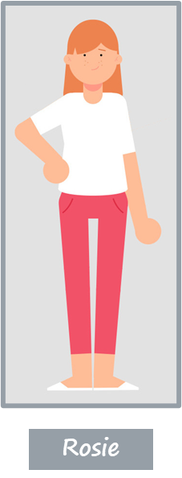
Rosie’s Story
Rosie is aged 9. She lives with her mum, her brother Jack, aged 13, her sister Chloe aged 15 and their dog Max. Explain that when Rosie's parents separated a year ago it had been hard for Rosie and her brother and sister at first. Their dad introduced his new girlfriend quite quickly which upset and confused Rosie, so she had been reluctant to see him. Rosie’s mum and dad agreed that Rosie would see her dad at a contact centre until things settled down. Because Rosie’s parents couldn’t agree the arrangements for when the children should spend time with each parent, Rosie’s dad applied to the family court for a court order and now all three children see their dad together, staying over with him, his new partner, Min and Min’s son Jonny. Rosie is feeling better about the situation now.
Notes:
To enable learners to works through the different processes for agreeing on arrangements for children after parents separate, read to them or allow them to read the overview on the slide of what happened to Rosie. This should consolidate what's the learners could remember about Rosie from slide 12 and help to contextualise the learning from slides 19 to 23.

Slide 19
How are child arrangements agreed?
Making child arrangements
Most parents and carers agree arrangements between themselves – the family court encourages this where it is safe to do so.
Sometimes children attend a contact centre, a safe and friendly place for children to spend time with the parent they don't live with. Usually this is just for a short time then children move to spending time with that parent away from the contact centre.
Notes:
Run through the information on the slide. The key message here is that most parents and carers agree arrangements themselves to bust the myth that parents and carers need to go to court to sort out child arrangements.
Explain that Rosie thought that the contact centre had been really useful for her family.

Slide 20
mediation
Mediation
If parents and carers can't agree between themselves, they can choose to meet with a ‘mediator’ to help them to reach agreement instead of going to the family court.
A mediator is someone who helps​ parents and carers who have separated to agree the things that need to be sorted out.
The mediator doesn't take sides.
Notes:
Run through the information on the slide. The key message here is that parents and carers can’t agree they don’t have to go to the family court, they can choose to meet with a mediator instead.
Begin by explaining the role of a mediator as outlined on the slide. Explain that if a relationships doesn’t work out and parents and carers separate, some talk to a ​mediator to help them agree things. The trained​ mediator is a neutral person who helps​ parents and carers to agree without going to the family court.​
Explain that Rosie's parents did not go to mediation but instead made an application to the family court.
Ask: How do you think that going to mediation rather than to the family court might have helped Rosie’s family?
Answer: Her parents would be able to listen to each other and might have been able to agree things. This might be easier, less stressful and quicker than going to the family court.

Slide 21
Meeting the mediator
Child inclusive mediation
If children meet the mediator this is known as ‘child inclusive mediation’.
Mediators meet with children who are around 9 or older.
Child inclusive mediation gives children and young people the opportunity to meet and talk (alone or with their brothers and sisters) with the mediator who is helping their parents and carers to sort things out.
The mediator then tells the parents and carers what the young person wants the mediator to say to help the parents and carers make decisions.​
Notes:
Run through the information on the slide. The key message here is that if parents and carers are in mediation, children have the right to make their views known and to meet with the mediator.
Child inclusive mediation: Child ​inclusive mediation gives children and young people the opportunity to meet and talk (alone or with siblings) with the mediator who is helping their parents and carers to sort things out for the family when parents and carers separate. The mediator then tells the parents and carers what the young person wants the mediator to say to help the parents and carers make decisions – so children don't make the decisions, but their views help the parents and carers to make decisions that take the child’s views into account.
Child inclusive mediation is voluntary, so children do not have to go even if they are given the option.
Mediators will usually see children who are around nine or older although some will see children as young as 6 if it is felt appropriate and in the child’s interests.
Ask: How do you think that speaking to the mediator might have helped Rosie when her parents separated?
Answer: It might have helped Rosie to understand the process better, get things off her chest and given her the chance to give the mediator messages to pass on to her parents that might be hard for her to say to her parents herself.

Slide 22
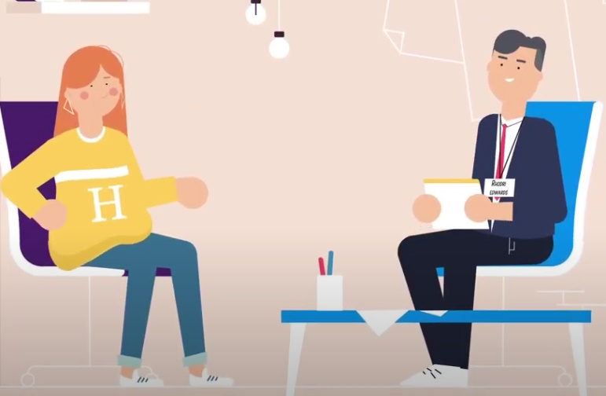
Meeting the family court advisor
The Family Court Advisor (FCA)
Sometimes the family court may ask an FCA to meet with a child or young person to talk about their wishes and feelings and to make sure the family court hears what they have to say.
The FCA will also usually meet the parents and carers and will then gives their view to the family court about what is best for the child.
FCAs do not need to meet all children and young people because sometimes families can agree themselves on what is best.
Notes:
Run through the information on the slide. The key message here is that if a parent makes an application to the family court, children and young people have the right to give their views on arrangements to be made by talking to the Family Court Advisor (FCA).
Explain that because Rosie's parents couldn't agree how much time Rosie, Chloe and Jack would spend with each parent, they made an application to the family court. The judge asked the FCA to draft a report and the FCA spoke to the children individually to gather their views which he used to draft his report for the family court.

Slide 23
Decisions made at the family court
Decisions made at the family court
If parents and carers cannot agree, some will go to the family court where a person known as a judge will make a decision about what is best for the children.
The judge, the parents and carers and any lawyers representing the parents and carers will read the recommendations of the FCA and usually agree child arrangements on this basis.
Most parents and carers agree, but if they can’t then the judge will decide.
The children will not go to the family court unless they decide they want to see the judge.
Notes:
The key message here is that even if parents and carers apply to the family court, most parents and carers are able to reach an agreement without the judge having to decide and children do not have to attend the family court.
By the date of the court hearing the judge, the parents and carers and any lawyers representing the parents and carers will have had the FCA’s report and will usually agree child arrangements on the basis of the FCA’s recommendation.

Slide 24
QUICK-FIRE QUIZ
After April 2022, do couples have to say whose ‘fault’ it was to get a divorce?
Where did Rosie see her dad at first?
What is the name of the person who helps parents and carers to reach an agreement without going to the family court?
What is the name of the person who drafts reports for the family court?
Do children have to go to the family court if their parents and carers apply to the family court?
Can children make their own application to the family court?
1. UNHEALTHY: Attraction is important but friendship is crucial
2. UNHEALTHY: All relationships go through ups and downs
3. HEALTHY: Respectfully dealing with issues as they arise keeps relationships on track
No, from April 2022 you don’t need to blame the other person to get a divorce.
A contact centre.
A mediator.
A Family Court Adviser (FCA).
No, the FCA tells the family court the views of the children, although the child can ask to speak to the judge if they want to.
Yes, if the court agrees, in rare cases they can apply and be represented separately.
1. Relationship built mostly on FRIENDSHIP 2. BOTH PARTNERS SHOULD EXPECT IT TO BE PERFECT – IF IT’S NOT MOVE ON 3. CONFLICT DEALT WITH AT AN EARLY STAGE 4.
Notes:
Quick-fire quiz: to consolidate learning, take 3 minutes to ask the class to answer the 6 questions. To ensure that all participate, either provide a handout for learners to complete/refer back to if they find they need the information in future (a handout is at the end of the Teacher Guide), or ask learners to write down their answers before asking individual learners to give their answer to a question. As noted on slide 17, if using the handout, it should be handed out at the start of the discussion on the divorce process.
In slideshow mode, each question in the left-hand box is followed by an answer in the right-hand box.

Slide 25
Sources of support for children and young people
Notes:
Remind learners of the support available to them in school from the pastoral lead. There is also lots of information and support available to children and young people online including:
National Youth Advocacy Service, Cymru (NYAS, Cymru): NYAS Cymru provides information to children and young people on its website; a free helpline and an advocate for children and young people (a person to speak on the young person’s behalf) in the family court if needed.
National Association of Child Contact Centres: NACCC runs a network of 350 contact centres, including 13 in Wales, which provide a safe, neutral, welcoming space for children to spend time with parents and carers (or other people important to them, such as grandparents).
Children’s Commissioner for Wales: The Children’s Commissioner for Wales speaks up for children and young people in Wales on important issues.
Cafcass Cymru: Cafcass stands for Children and Family Court Advisory and Support Service. Cafcass Cymru is an organisation in the Welsh Government that provides a voice for any child in Wales that is involved with the Family Justice system.
Relate Cymru: Relate Cymru offers counselling to children and young people who are experiencing difficulties in any area of life, including if parents and carers are arguing or have separated.
Childline Cymru: Childline Cymru has a huge amount of information, advice and support for children and young people whose parents and carers have separated, available online, by telephone or through one-to-one counselling.
In slideshow mode Each organisations logo will appear on a click. Explain a little about the support that each organisation offers using the information outlined above.
Contact details for each of the organisations listed appear on slide 27.

Slide 26
ENDPOINT ASSESSMENT ACTIVITY
Return to the mind map you drew earlier and in a different colour add to your mind map by writing down:
any words for how you think Rosie might have felt once she learned she had the rights to express her opinion and for this to be taken seriously.
where Rosie could find information and support to help her now and in the future (give examples of organisations).
Notes:
Ask the learners to return to the mind map they drew earlier and in a different colour add to their mind map by writing down:
any words for how you think Rosie might have felt once she learned she had the rights to express her opinion and for this to be taken seriously? (Words like hopeful, happier, stronger and/or empowered will hopefully be suggested. It is important to acknowledge however that she may still be feeling sad.)
where Rosie could find information and support to help her now and, in the future, (giving specific examples of organisations).
Learners should mention:
National Youth Advocacy Service, Cymru (NYAS Cymru)
National Association of Child Contact Centres (NACCC)
Cafcass Cymru
Relate Cymru and/or
Childline Cymru.

Slide 27
Further help and support in school
For further help and support in school contact:
your teacher/teaching assistant
senior staff in the school
Notes:
Remind learners who they can talk to in school, e.g. teacher, teaching assistant or senior staff in the school (you may wish to personalise this slide with names of contact staff) or ask the learners who they think they should talk to in school, then provide details of any members of staff that the learners have not mentioned.

Slide 28
Further help and support - out of school
For further help and support outside of school contact:
National Youth Advocacy Service, Cymru: https://www.nyas.net/nyas-cymru/ (Tel: 0808 8081001)
National Association of Child Contact Centres: https://naccc.org.uk (Tel: 01159 484557)
Children’s Commissioner for Wales: https://www.childcomwales.org.uk (Tel: 0808 801 1000)
Cafcass Cymru: https://gov.wales/cafcass-cymru/family-separation (Tel: 0300 456 4000)
Childline Cymru: https://www.childline.org.uk/info-advice/home-families/family-relationships/divorce-separation/ or for Welsh language version: https://www.childline.org.uk/get-support/contacting-childline/contacting-childline-in-welsh/ (Tel: 0800 1111)
Relate Cymru: https://www.relate.org.uk/cymru/children-and-young-peoples-counselling (Tel: 03000030396)
The Exchange: https://www.exchange-counselling.com/primary/ (Tel: 0330 2020283)
Notes:
Remind learners who they can talk to outside of school. Leave the slide up so that any learner who wishes to can note down details.
Tell learners that if anything that’s been discussed today is an issue for them and they need some support they can let you know or put a note in the ‘ask-it-basket’.

