Slide 1
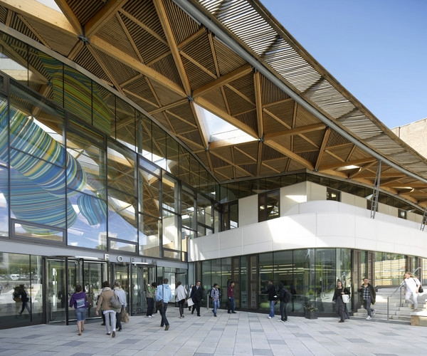
Council Induction 16th October 2013 – Infrastructure
Geoff Pringle Lynne Tucker Phil Attwell Hugh McCann

Slide 2
Infrastructure
Introduction by Geoff Pringle
Deputy Chief Operating Officer and Director Campus Services
IT Infrastructure by Lynne Tucker
Chief Information Officer
Estate Infrastructure by Hugh McCann
Director Estate Development Service
Campus Services Operations by Phil Attwell
Deputy Director Campus Services and Director of Sport
Lucem sequimur (We follow the light)

Slide 3
Introduction & Overview
Campuses
Streatham
St Luke’s
Veysey
Wonford
Penryn
Truro
Key Partners
FX+
FXU
Students’ Guild
INTO
UPP
Student Com
Exeter Northcott Theatre

Slide 4
Liaison with third parties such as UPP, INTO, Northcott Theatre, Innovation Centre, Students’ Guild, FXplus
Close working partnership Legal Services, Procurement Services and the Finance Team
Scrutiny is via the Project Procedures and overseen by
ICG – Infrastructure Coordination Group
ISG – Infrastructure Strategy Group
University Council

Slide 5
Challenges
Capital
Space
Backlog Maintenance
Cultural Change
Teaching Day
Use of Office Space

Slide 6
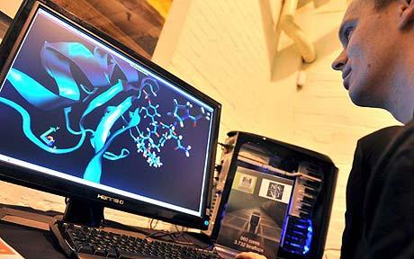
Exeter IT – key objectives
IT is pervasive in the University:
central to the student experience
vital to research
underpins decision making, planning and administration
Exeter IT:
Provides core IT infrastructure, application and advice services in support of teaching and learning, research and administration across the University.
Manages the portfolio of projects which comprise the University’s strategic IT investment programme to deliver new and enhanced technology-based services in support of the University’s strategic goals.

Slide 7
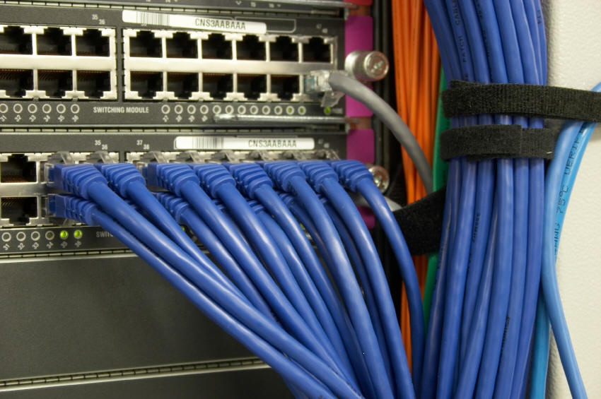
Exeter IT – services and systems
Infrastructure
Networks: 20,000 data points, 95% wifi building coverage, 950 wifi points, 6500 devices on wifi concurrently
Servers: 250 real and 460 virtual servers, High Performance Computing
Data Centres (Streatham and St Luke’s + FXPlus at Penryn)
Applications (30+)
Learning & Teaching: Virtual Learning Environment, Lecture Capture, Online assessment, Library System
Research: Research repositories, research data archive
University Administrative: Student records & Student Information Desk, Timetabling, Research admin, Alumni
General Administrative: HR, Finance, Estates Management
Governance and Support
IT Security & Compliance: 2100 incoming web threats filtered out last year
IT Support: 4500 support calls a year
IT Helpdesks & Quality: 58,000 queries last year 24/7 (7000 out of hours)
Project Office: 26 Strategic projects, 60 departmental
£5.6M committed projects from Tranche 2 of IF
£15.4M allocated from Tranche 3
Infrastructure
Applications
Governance & Support

Slide 8
IT Vision
Mobility
Video
Cloud
Connection
Example text
Go ahead and replace it with your own text.
Infrastructure, services and content to support mobility: for students and staff on the move and via mulitple devices
Video and media enabling infrastructure and process to support student, research and administrative requirements
On demand,
modern service delivery to manage peak academic cycle demand and broker flexible research facilities
Next -generation portals and web environments to enable connection to people and information.
Key transformational capabilities
Agility & responsiveness: an IT function capable of anticipating and responding to the University’s need to rapidly deliver services and institutional change
Resilience & capacity: a secure, robust IT infrastructure with capacity to grow and contract in response to staff and student demand
Customer Focus
Sustainability: demonstrated commitment to energy and carbon reduction and use of IT to enable the University to achieve its sustainability goals
Partnership
Example text
Information access and process improvement: a focus on enabling efficiency through seamless access to academic and corporate information and IT-enabled process improvement.
Key IT Competencies

Slide 9
Exeter IT – Key Challenges
Mobility & supporting consumerisation “Bring Your Own Device”
Supporting staff and students in the effective use of technology in teaching, learning and assessment
Delivering 24/7 resilient services and support
Managing secure access to data in an open environment
Supporting the research mission and growth through High Performance Computing, data storage and data centre capacity
Optimising a blended delivery model: in house, outsourced, Cloud
Systems integration facilitating efficiency & management information
Demonstrating impact of investment and value for money

Slide 10
Estate Development Service
The Estate Development Service consists of:
A team of 42 staff, including chartered surveyors, engineers and architects, environmentalists and energy professionals.
Located at Streatham Campus in Lafrowda House, Streatham.
We provide the following services for all Colleges and Professional Services:
Delivery of all Capital Infrastructure Projects for Buildings and Engineering – soft landings with Property Services, Facilities and Commercial teams
Estate Custodial role, including asset management, lead contact with Exeter City and Devon County, including master planning for the estate
Deliver the annual Long Term Maintenance programme of works
Statutory compliance responsibility for areas such as gas mains, high voltage electric, asbestos regulations, mains water system etc.
Sustainability Manager and her team – Green League and Sustainable Travel
Energy Manager and his team – Carbon management and utilities procurement, target 43% reduction from 2006 baseline – current 20000 tonnes

Slide 11
Estate Development Service
Space management and design
Furniture and equipment purchase

Slide 12
Estate Development Service
Existing three Campuses with buildings also at Truro and Wonford;
Streatham Campus 300 acres
Total 218,00 sqm in 141 buildings on Campus and surrounding area
204,000 sqm non-residential and 14,000 residential
St Luke's 12 acres
Total 37,500 sqm in 43 buildings on Campus and surrounding area
33,000 sqm non-residential and 4,500 residential
Penryn Campus 100 acres, shared with Falmouth University
Total 24,500 sqm in 15 buildings on Campus and surrounding area
18,500 sqm non-residential and 6,000 residential
Total area consists 280,000 sqm gross in 199 buildings ( 3.0m sqft)
Insurance Replacement Value (IRV) of Exeter £636m, Tremough £215m

Slide 13
Potential Capacity
Streatham has capacity for additional 77,400 sqm total.
Penryn has capacity for additional 20,000 sqm total, 50% of remaining capacity (this could double if further land to the north was purchased).
St Luke’s has capacity for additional 14,000 sqm total (this would include substantial demolition).
Wonford has capacity for additional 8,000sqm total (subject to agreement).
Total additional capacity of 119,400 sqm non-residential space

Slide 14
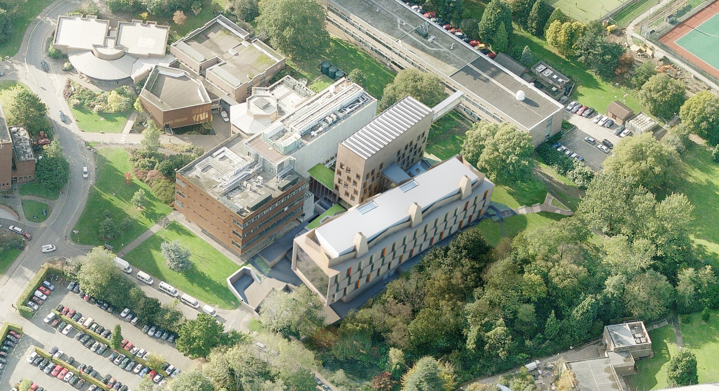
Living Systems Update

Slide 15
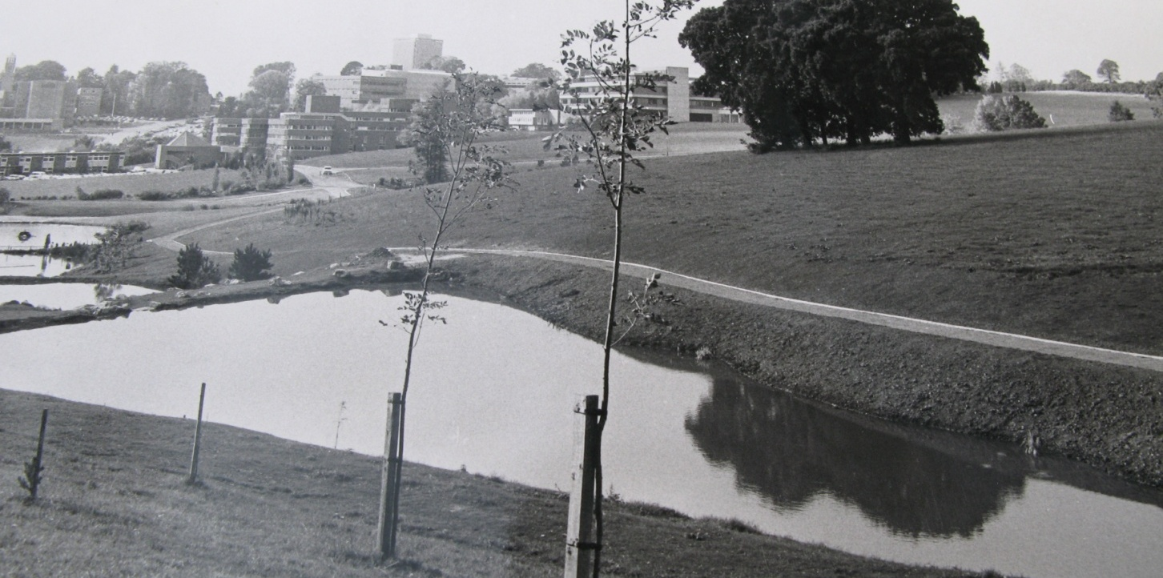
Grounds

Slide 16
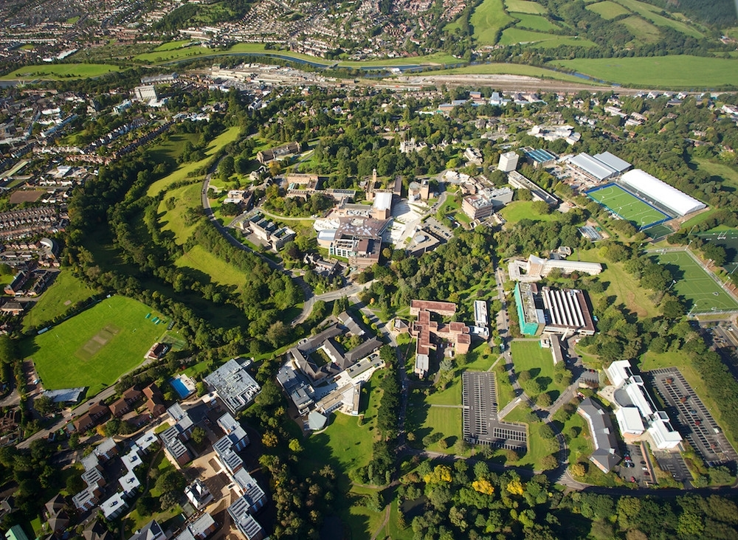

Slide 17
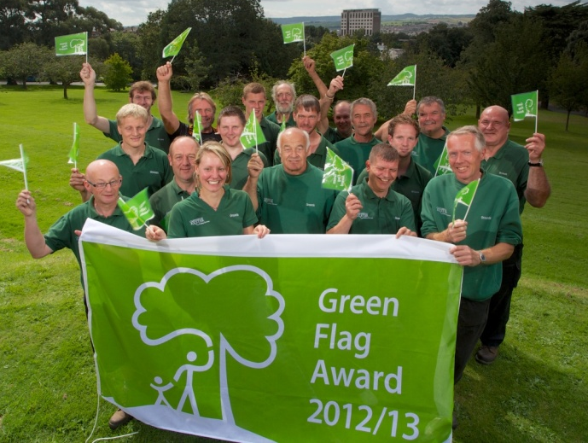
Grounds
377 acres of grounds
247 acres of gardens
76 acres of spots field
Over 10,000 trees
Achieved and retained Green Flag status since 2011
Annual bird survey conducted
Nest and bat boxes, habitat piles and eco strips provided for biodiversity
Launched Birds and Bees Campaign in 2010 in partnership with Devon Wildlife Trust
University maintains grounds for UPP and INTO
Salt and gritting of University Estates

Slide 18
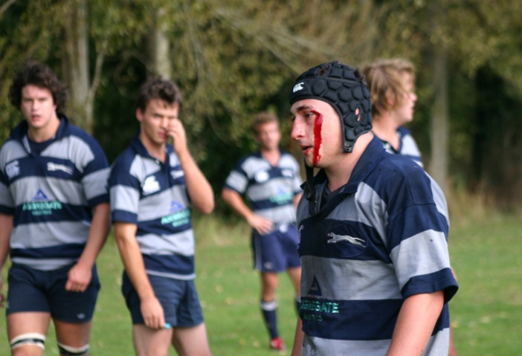
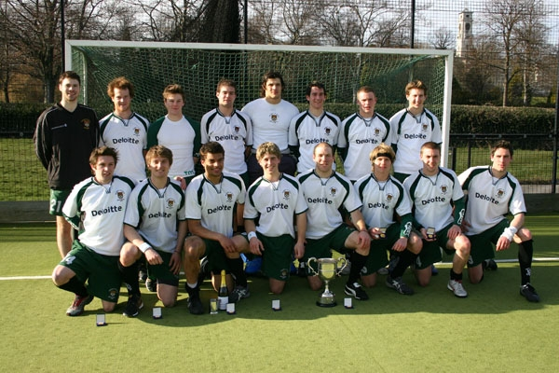
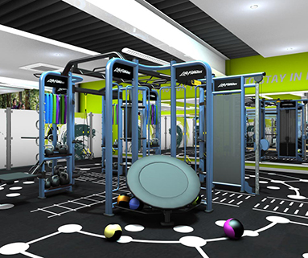
Sport
£8.1m investment in sports facilities on Streatham Campus completed in September 2013
Covering of the outdoor tennis and netball courts with a frame-fabric tensile structure to allow expansion from four to 10 indoor courts with a new pavilion to support outdoor pitches. 200 station gym, new studio, changing rooms and entrance
0ver 9,000 students engaged in sport through membership, clubs and intramural sport
Volunteering and employability initiatives
Loyalty to the brand
Highest ever finish in BUCS in 2012/13 – 5th position

Slide 19
Property Services
Responsible for the completion and monitoring of statutory legal requirements such as legionella inspections; gas testing; fume cabinets; air conditioning; lifting equipment; lifts; PAT testing and lightening protection
Provide property maintenance and improvements to the University estate
Staff available 8am to 8pm Monday to Friday. On call arrangements in place

Slide 20
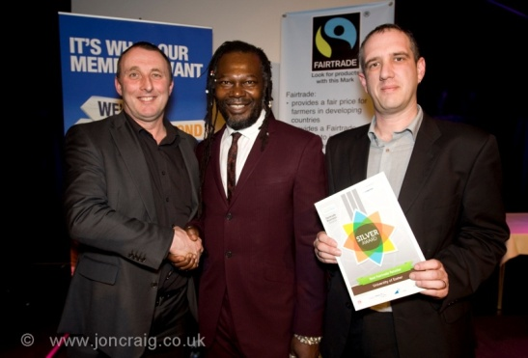
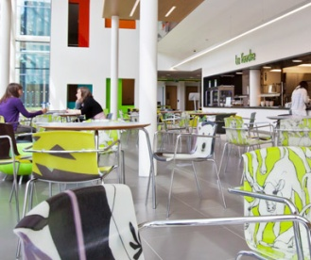
Retail Services
Retail Shops & Vending
Farmers Market attends campus once per month on the Forum piazza
Shops - The Market Place (Forum), Premier International Cornwall House, Premier Stores at Birks Grange (Accommodation) St David’s and St Luke’s
Over 100 vending machines across the Exeter campuses. Also provide services to third parties
Retail Services – Catering
Cafes – The Terrace & Coffee Bar (Devonshire House), La Touché (Business School), Cloisters ReFresh (St Luke’s)
Fresh Ideas – delivered food service. Wide selection of menus available, order on-line for delivery to your door. Special diets catered for, healthy options available.
Event catering
The Exeter Team achieved gold at the 2012 TUCO Chefs Competition in Blackpool
The Reed Hall Kitchen Team provide the private dining at Redcot, the Vice Chancellors private residence

Slide 21
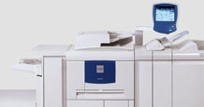
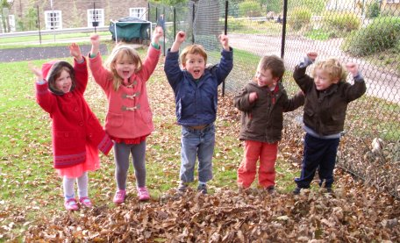
Retail Services
Retail Services – Print and Copy Services
Latest digital equipment to provide clients with high-speed
turnarounds
Manage multi-functional Xerox print devices (copiers) across campuses
Manage University stationery printing
Retail Services – Family Centre
No of children cared for 60 -70
Open from 8:15 to 17:30 Monday to Friday, 43½ weeks per year
(school terms, half term and new extended opening) plus an
optional 2½ weeks summer play scheme
University staff, students and parents from the community may use the Centre, which caters for children from six weeks to five years of age
The menus have been developed, under advice from local authority nutritionists, to ensure they provide a healthy balanced diet suitable for developing children
The most recent (2009) Ofsted inspection rated the Family Centre as outstanding in all areas of provision

Slide 22
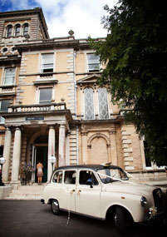
Event Exeter
Also responsible for Reed Hall, the University’s all year round venue for
conferences, weddings and functions
Forum and Great Hall Operational Manager and University Reception
Team report to this department
Over 6000 conference and group travel visitors per annum
Awarded Commercial University of the Year – College and University
Business Officers (CUBO) Awards.
Promotional Video http://www.exeter.ac.uk/eventexeter/aboutus/video/#d.en.151108

Slide 23
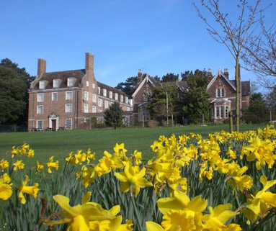
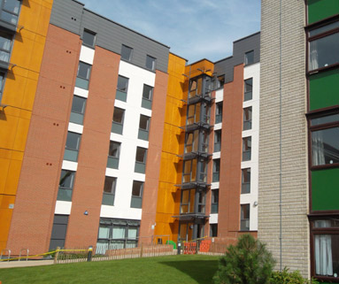
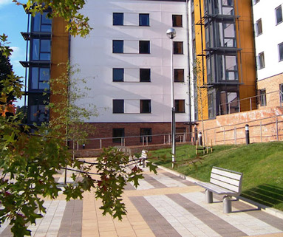
Residential Services
Residential Services – Student Accommodation
ResNet
Mix of standard (shared bathroom facilities) and en-suite rooms on catered or self-catered basis
Studio rooms, self-contained flats and townhouses available
Partnership with UPP (University Partnership Programme) 43year lease
Residence Life Team with an in-depth knowledge of the support and wellbeing services on offer at the University, provide support to students living in University accommodation
5464 rooms (1363 catered + 4101 self-catered)
ReUse – The Student ReUse Project has run successfully for 4 years and encourages students, at the end of the academic year to donate items that they no longer need. These items can benefit local charities, or other students who can put them to good use. The ReUse Project reduces the amount sent to landfill by over 3.5 tonnes per annum

Slide 24
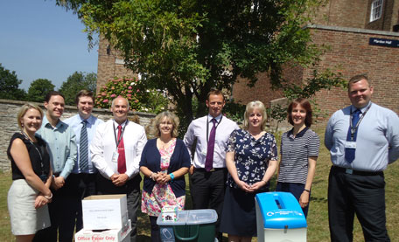
The BICSc Cleaning Academy opened in January 2010 and has already seen over 200
members of the cleaning staff successfully completing the minimum 14 BICSc Skills
Investors in People, Customer First – lead on achieving accreditation
Business Support is in the process of recruiting a pool of students from a variety of
degree disciplines and year groups to act as mystery shoppers for Campus Services.
The programme also benefits our student by allowing them to gain valuable skills and
work experience, which supports the University’s strategic aim to actively engage our
students in the workplace
Business Support

Slide 25
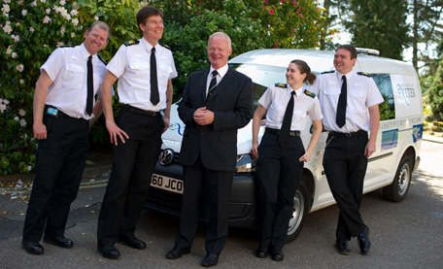
Estate Patrol
Uniformed security staff available to provide advice and assistance, 24 hours a day
365 days a year
Monitor fire and intruder alarms, the University’s extensive CCTV system and
provide a rapid response when required
Night Patrol Team work overnight during the term time to provide extra security
around the University residences
Patrol and management of car parking the 1,493 spaces on the Exeter campuses

Slide 26
Help Desk
Administration of car parking permits – a total of almost 3000 permits per annum issued
Over 2000 jobs logged per month
Provide a Reception Service to Streatham Farm
Help Desk available 8am to 8pm Monday to Friday
Provision of Property Services Stores

Slide 27
Facilities Management
Security of each building - locking and unlocking doors and windows every day
Mail Room deals with all University mail internal and external
Internal moves in individual buildings
Preparation of exam areas & Graduation
Awarded British Association of Cleaning in Higher Education (BACHE) Sustainability Award and Runner Up for Best Cleaning Operative of the Year
Cleaning of all academic and administrative buildings
Management of University cars and chauffeurs
Run free University staff mini bus service to St David’s Station

Slide 28
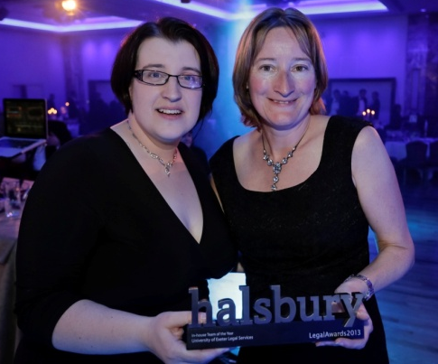
Legal and Insurance Services
Promoting best practice in managing risk relating to legal matters, insurance cover
and unplanned events and provide training and updates on key issues
Oversee the development of business continuity and incident management plans
across the University
Provide assistance with Research Contracts

