Slide 1
WELCOME FROM YOUR GUILD!

Slide 2
WHO ARE WE?
We’re the University of Exeter Students’ Guild – here to help you Love Exeter! We exist to encourage and inspire you to find your people, your passion and your place.
Day to day, we’re the home of societies, events, representation campaigning, advice – all the best bits when it comes to student life.

Slide 3
WHAT WE DO …

Slide 6
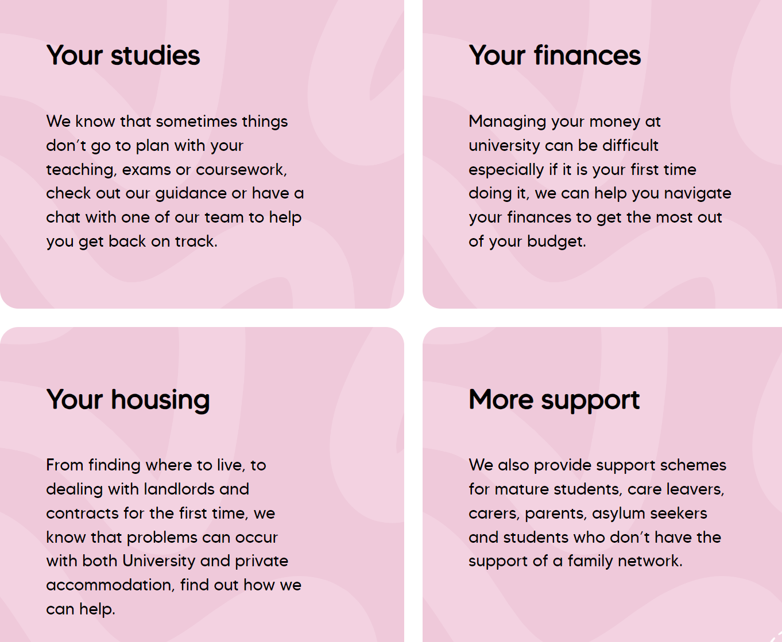
We are here to give student free, independent and impartial advice.

Slide 7
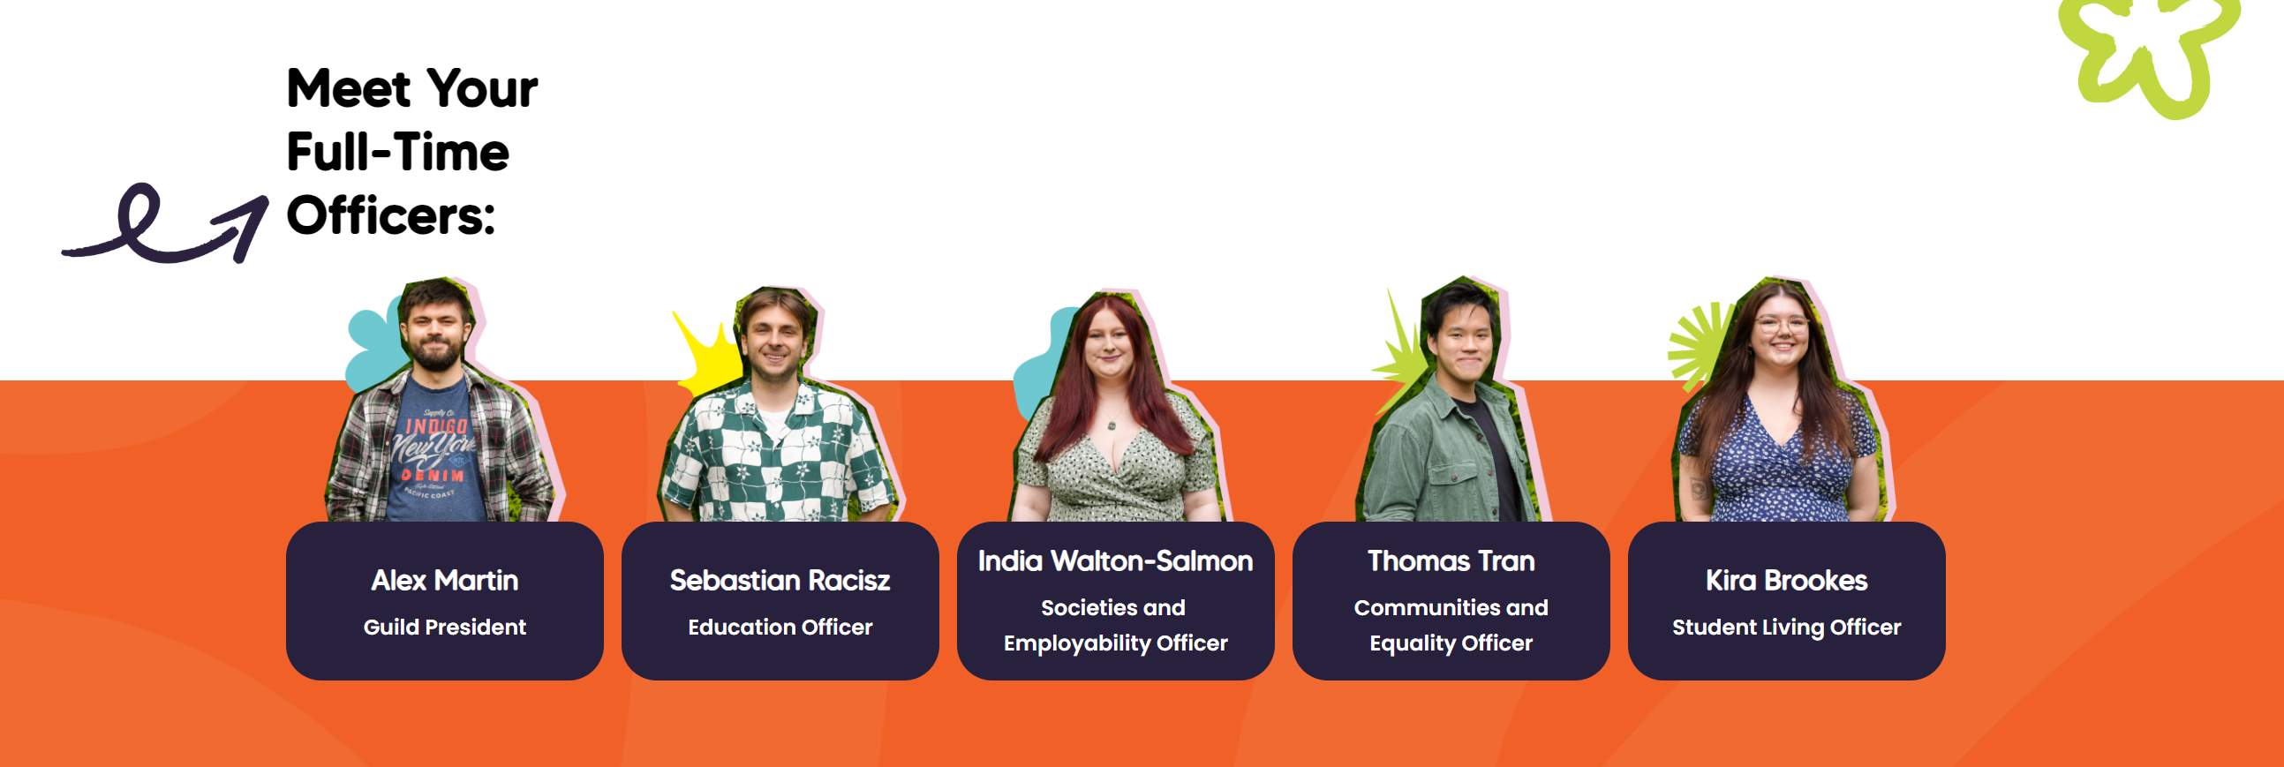
Your Officer Team

Slide 12
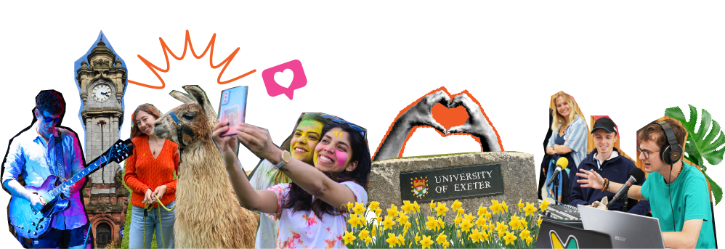
BEYOND WELCOME WEEK
Weeks 1-6 will have lots of opportunities to continue to try out societies
Give it a Go Events
Become a rep
Take it at a pace that works for you
Don’t put pressure to do everything in one week
You can join a society at anytime!

Slide 13
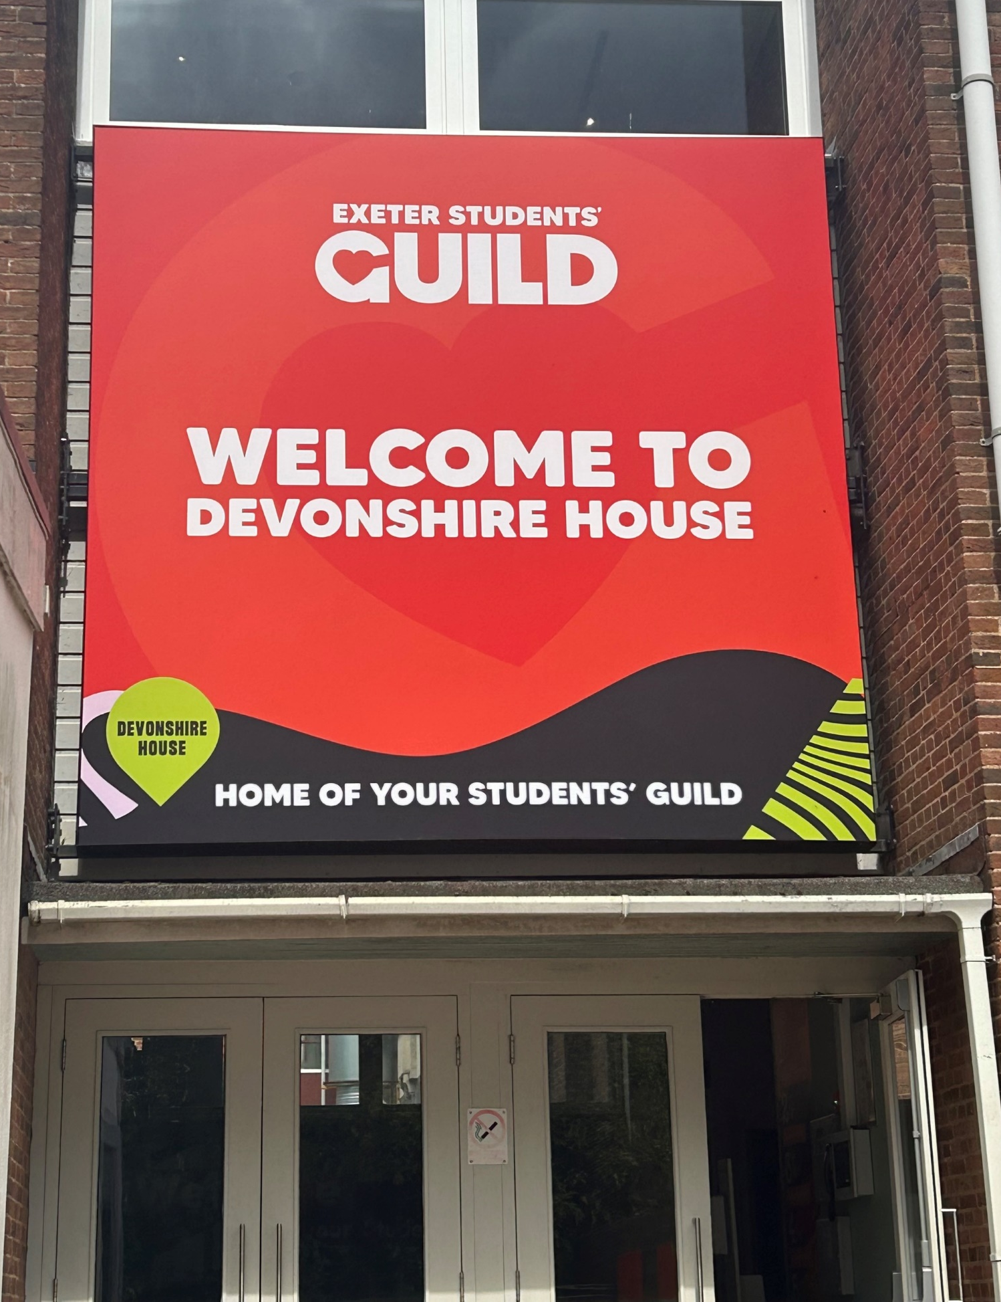
WHERE TO FIND US?
Devonshire House, Streatham Campus
G48, St Luke’s Campus

Slide 14
ANY QUESTIONS?

