Slide 1
Student Life as a Mature Student Benny Clatworthy

Slide 2
This session will cover: -What it is like to be a mature student at university -Expectations -Answer any questions you may have

Slide 3
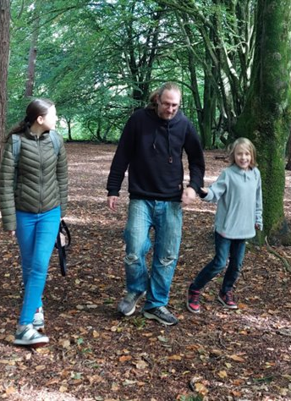
Introductions
-Just graduated from studying BA Sociology -I was on the Access to HE: Social Science course at Exeter College - I am a mature student, before returning to study I worked as a chef for 20 years. - Returning to education was never on the horizon for me but I was lucky enough to get the chance to return and I have loved my time studying. - We are not here accidently we chose to return - Mature students have super-powers. The life experience you have will make studying so much easier. Work experience age, and life experience count for so much - Imposter syndrome?

Slide 4
Transition to university
Type of learning and level of independence is very different to A Level or equivalent such as the Access to HE course.​
University expect you to take total responsibility for your progression.​​
The teaching day is from 8:30am to 7:30pm! ​ Don’t expect staff to know your personal/additional needs (if you have any), keep them up-to-date and liaise with your personal tutor on a regular basis.​

Slide 5
Being a mature student
Have a lot more things to juggle, may have caring responsibilities, job, etc.​
May have additional commute time/costs to consider.​
Less in common with some of the students on the course.​
May have health issues and disabilities to manage alongside studies.​
Have life skills that make time management and group work easier.

Slide 6
Support​
Lecturers are really supportive and happy to give extra help to mature students​
Personal tutor​
Other mature students on the course and U of E mature student society​
Timetable adjustments*​
Wellbeing support- including therapies such as CBT ​
Accessibility- including learner support for learning disabilities such as dyslexia ​
ILP’s- Independent Learning plan​
Peer mentoring
*Dependant on a case by case need and varies across schools and disciplines

Slide 7
Expectations
So much more practical support available at H.E.​
Be aware you need to enquire for additional support such as the timetable changes, it isn’t a given.​
Similarly, don’t expect additional help such as DSA/learner support to be ready for when you start.​
TOP TIP- make enquiries before you start your course and get the ball rolling in Freshers week to beat the rush! ​

Slide 8
Any questions

