Slide 1
Overview of Support Services

Slide 2
Introduction to the Education Welfare team in Penryn

Slide 3
Who we are
Title to go here
Alex Lewis Education Welfare manager
Fiona Williams Education Welfare adviser
Sally Wears Education Welfare adviser
Tracey Burrell Education Welfare officer
We are part of Exeter University Wellbeing services and are based in Penryn where we work alongside a wide range of student support and specialist team from Fxplus
We are a confidential service and will ask you to complete a Consent to Liaise form ahead of or at a meeting with us.
Body copy to go here
Welfare.Penryn@exeter.ac.uk

Slide 4
What can we help with?
Title to go here
Concerns about the impact of health or welfare issues on your studies.
Advice and assistance with support available internally and externally. Bespoke inductions.
Advice and assistance with mitigation alongside long term support and adjustments through “Health Wellbeing and Support for Study” procedures.
Field trip support and adjustments.
If you are worried about an element of your studies impacting upon your health or welfare please get in touch as we are here to help!
Body copy to go here
Welfare.Penryn@exeter.ac.uk

Slide 5
How can we be accessed?
Title to go here
Opening hours are 09:00 – 17:00 Monday to Friday
Appointments will need to be booked in advance by self-booking a drop in on our webpage or by emailing welfare.penryn@exeter.ac.uk
Options include: - Video meetings, Telephone meetings and in person meetings.
Online chat drop ins accessed from our webpage between 10am and 12pm on Tuesday and Thursday morning from week 2 to 12 each term.
Body copy to go here
Welfare.Penryn@exeter.ac.uk

Slide 6
Inclusive Learning
We advise and support students with dyslexia, dyspraxia, ADHD and Autism.
Our Study Hub pages have information, checklists and resources for a range of neurodivergent conditions.
We work to promote a more inclusive teaching and learning environment, both in real life and online.
inclusive@fxplus.ac.uk
01326 259 340

Slide 7
Supporting student learning on Cornwall campuses

Slide 8
Could you use some study guides, tips, hacks and impartial advice on getting the most from your study time?
Study Zone Digital – excellent online study guides from University of Exeter (needs log-in)
Study Skills catch-up – online sessions advertised in the Library and on Study Hub
Write Time - informal online writing group every Wednesday and Thursday
Book a 1-to-1 - for individual advice online or in-person

Slide 9
Accessibility Team
We support and advise students who have disabilities and long-term health conditions such as:
Autism Spectrum Conditions/ Neurodivergencies
Physical disabilities
Blind or visual impairment
Deaf or hearing impairment
Specific learning differences (SpLDs) such as dyslexia, dyspraxia and ADHD
Long term medical conditions such as epilepsy, diabetes chronic fatigue syndrome or
arthritis.
Mental health difficulties such as eating disorders and selective mutism

Slide 10
Individual Learning Plans: ILPs Apply via the Study Hub website
An Individual Learning Plan (ILP) is a document that tells course teams about any reasonable adjustments required for students.
To get an ILP, students will need to have a disability, health condition (including mental health conditions) or Specific Learning Difference which is long term and impacts their usual daily activities.
We can only put an ILP in place for a student if they have diagnostic / medical evidence of their disability.
Evidence can be a letter from GP, DSA medical form or an SpLD/ADHD/ASC assessment.
ILPs are tailored to each students' needs. There is no "one size fits all"
ILPs are tailored to the impact each students' condition has on them, not the condition itself.
They are Living Documents that can be updated and amended at any time.

Slide 11
ILP Exam Deadlines for 2024/25
ILP Deadlines | Date
January Exams | 04/11/2024
May Exams | 10/02/2025
Ref/Def Exams | 26/06/2025

Slide 12
Disabled Students’ Allowances: DSAs
This is a government fund to provide support and equipment to UK based disabled students.
Students will need evidence in the form of a GP, consultant letter or diagnostic assessment.
If students are waiting for a diagnostic assessment the DSA will accept a "Working Diagnosis" from their GP.
Students may be recommended the following support through their DSA package;
Laptop
Printer/scanner and printing allowance
Specialist software: dictation, text to speech and note taking
Specialist equipment: ergonomic, HI/VI
Non-Medical Helper (NMH) ASC and SpLD Support: Mentor, Study Skills, Assistive Technology Trainer
Taxi/ travel allowance

Slide 13
Any questions??

Slide 14
Accessibility Contact Info
Please email
Accessibility@fxplus.ac.uk
Phone - Compass Helpdesk
01326 370 460

Slide 15
Personal Tutors

Slide 16
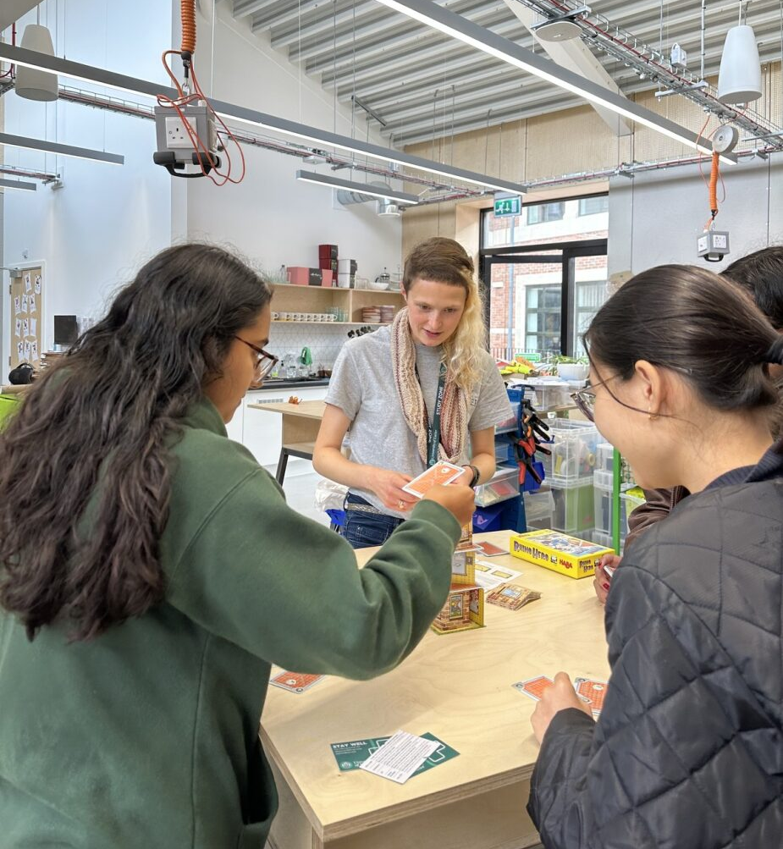
Peer Support – who are we?
We pair 1st year UG students with 2nd-final year UG students (Mentors) across disciplines
27+ schemes, including:
Mature Student Peer Mentoring
Disabled Student Peer Mentoring
Carer, Care Leaver, and Estranged
Peer Mentoring
Global Chums (Penryn)
These schemes will match you with Mentors before you arrive in September
Streatham, St Luke’s and Penryn-based
BMBS Exeter and Cornwall Year 2 → Year 1 Peer Mentoring
And more!
Website: http://ex.ac.uk/peersupport
@uoepeersupport

Slide 17
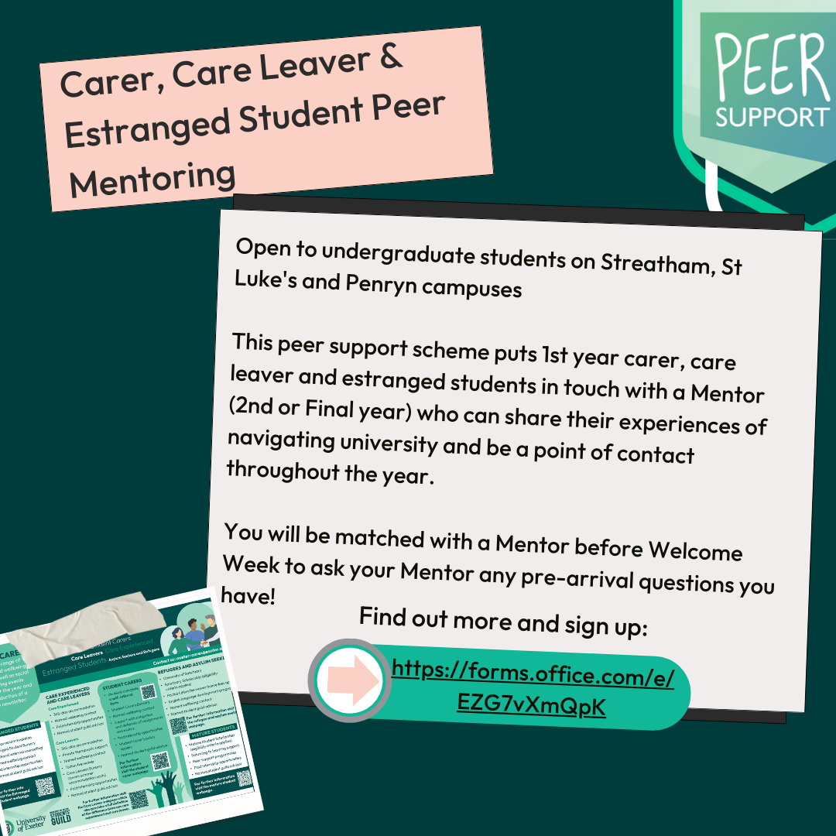
How does it work?
If you would like to be mentored (1st years)
For the Disabled Student, Mature Student, & Care Leaver and Estranged Student schemes:
Sign up pre-arrival (before 9th September) using the sign-up forms below
Matched with a Mentor based on preferences (as much as possible) before Welcome Week
Meet with Mentor how you like
For other schemes:
1. Sign up in Term 1 or 2 as appropriate
Carer, Care Leaver and Estranged Student Peer Mentoring
Disabled Student Peer Mentoring
Mature Student Peer Mentoring
Notes:
Our forms are found on our website under ‘Programmes’ and ‘Cross Faculty’

Slide 18
Email peersupport@exeter.ac.uk or chat to some of our Mentors today For more info including full list of schemes: http://ex.ac.uk/peersupport Follow us on @uoepeersupport
Any questions?

