Slide 1
Streatham slides

Slide 2
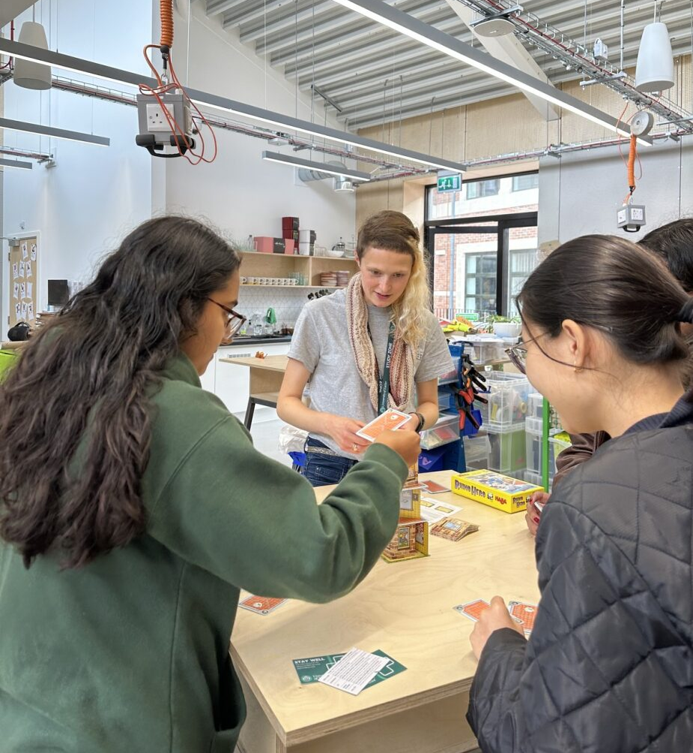
Peer Support – who are we?
We pair 1st year UG students with 2nd-final year UG students (Mentors) across disciplines
27+ schemes, including:
Mature Student Peer Mentoring
Disabled Student Peer Mentoring
Carer, Care Leaver, and Estranged
Peer Mentoring
MFL PAL
These schemes will match you with Mentors before you arrive in September
Streatham, St Luke’s and Penryn-based
CBS Ethnic Minority Student Peer Mentoring
Politics Buddy Up
UEBS UG Buddy Up
Medical Sciences Peer Mentoring
And more!
Website: http://ex.ac.uk/peersupport
@uoepeersupport

Slide 3
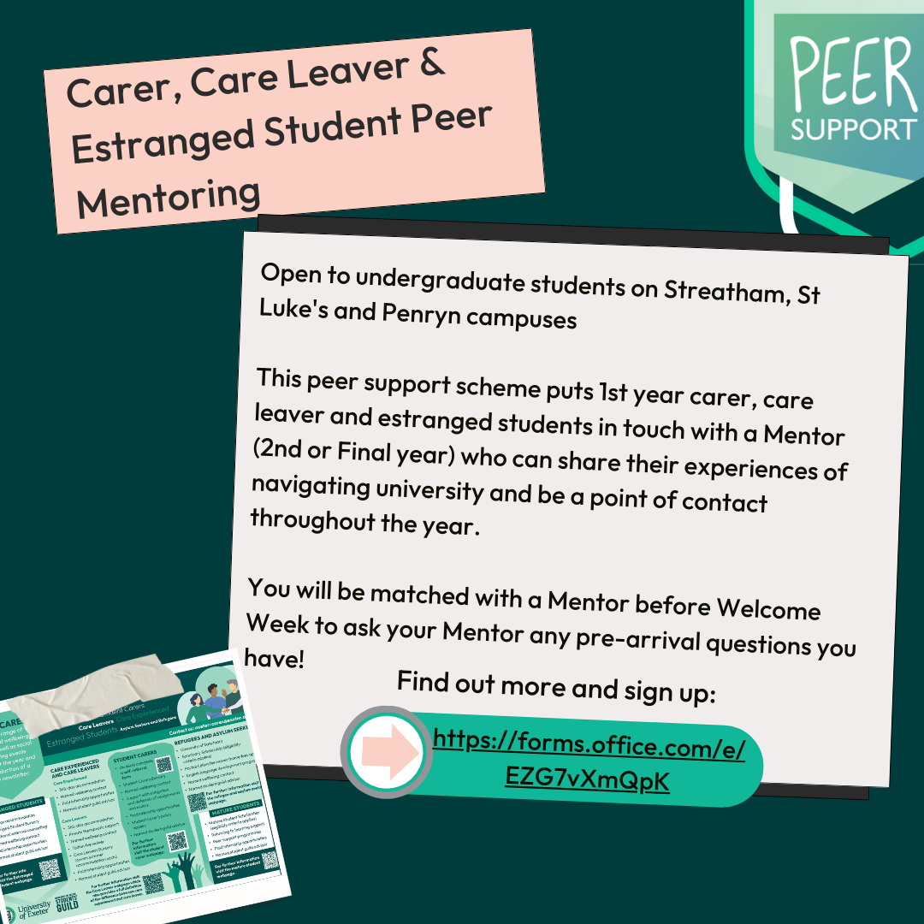
How does it work?
If you would like to be mentored (1st years)
For the Disabled Student, Mature Student, & Care Leaver and Estranged Student schemes:
Sign up pre-arrival (before 9th September) using the sign-up forms below
Matched with a Mentor based on preferences (as much as possible) before Welcome Week
Meet with Mentor how you like
For other schemes:
1. Sign up in Term 1 or 2 as appropriate
Carer, Care Leaver and Estranged Student Peer Mentoring
Disabled Student Peer Mentoring
Mature Student Peer Mentoring
Notes:
Our forms are found on our website under ‘Programmes’ and ‘Cross Faculty’

Slide 4
Email peersupport@exeter.ac.uk or chat to me (Emma) or some of our Mentors today For more info including full list of schemes: http://ex.ac.uk/peersupport Follow us on @uoepeersupport
Any questions?

Slide 5
Penryn slides

Slide 6
Peer Support – who are we?
We pair 1st year UG students with 2nd-final year UG students (Mentors) across disciplines
27+ schemes, including:
Mature Student Peer Mentoring
Disabled Student Peer Mentoring
Carer, Care Leaver, and Estranged
Peer Mentoring
Global Chums (Penryn)
These schemes will match you with Mentors before you arrive in September
Streatham, St Luke’s and Penryn-based
BMBS Exeter and Cornwall Year 2 → Year 1 Peer Mentoring
And more!
Website: http://ex.ac.uk/peersupport
@uoepeersupport

Slide 7
How does it work?
If you would like to be mentored (1st years)
For the Disabled Student, Mature Student, & Care Leaver and Estranged Student schemes:
Sign up pre-arrival (before 9th September) using the sign-up forms below
Matched with a Mentor based on preferences (as much as possible) before Welcome Week
Meet with Mentor how you like
For other schemes:
1. Sign up in Term 1 or 2 as appropriate
Carer, Care Leaver and Estranged Student Peer Mentoring
Disabled Student Peer Mentoring
Mature Student Peer Mentoring
Notes:
Our forms are found on our website under ‘Programmes’ and ‘Cross Faculty’

Slide 8
Email peersupport@exeter.ac.uk or chat to some of our Mentors today For more info including full list of schemes: http://ex.ac.uk/peersupport Follow us on @uoepeersupport
Any questions?

