Slide 1
Managing your Money

Slide 2
The Big Picture
We know University is expensive. That’s why we want to make sure that you are as prepared as possible to start your University journey.
Student Finance England have made a 2.5% increase to the maintenance element of your student finance. We know that this is not always enough to support your financial cost throughout your academic year.

Slide 3
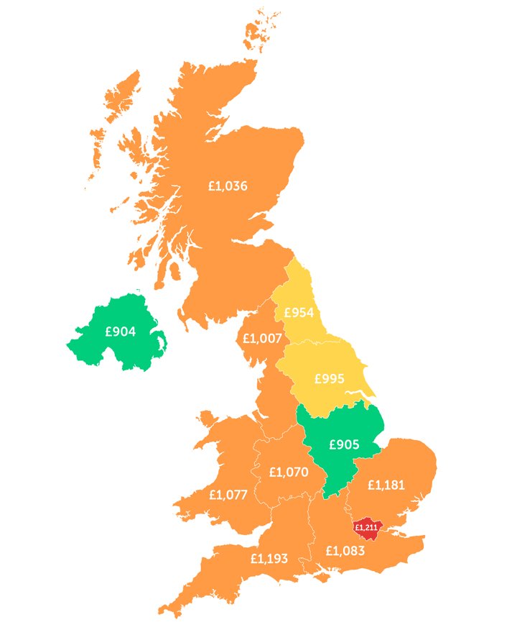
Research
Many tools that are showing you the average cost of University life cannot always be reflective of Exeter.
The Southwest is the 1st most expensive area outside of London.
What should I do?
Take some time to research what you are needing to spend your money on and make some priorities to help managing your spending.
Do not rush into any big decision, take your time and check the facts.
Source: National Student Money Survey 2023

Slide 4
Budget
Be a master at your own finances. Create a plan so you know what your income is versus your expenditure.
Do you know the difference between your obligations, needs and wants?
Obligations- your contractual costs.
Needs- what do you need to live comfortably and maintain your wellbeing.
Wants- things that would be nice and a luxury.

Slide 5
Let’s look at a budget…
Usings the budget provided take a sticky note and put each category into the obligation needs and wants box.

Slide 6
Maximise income
Can you work? A small part time job is a great was to boost your money and build community. (The Guild have great flexible roles)
Be sure to know all the different funding sources you are eligible for.
Make sensible savings where possible… Heinz for own brands? (you can choose)
Try changing a provider to make a saving on a bill?
Tips to make your money go further
Money Saving Expert
Student Discount – TOTUM, UNIDAYS
Railcard
Bank deals for your Current Account
Loyalty Cards
Use library for books

Slide 7
Managing spending
How do we stick to our budget?​
Review your budget regularly to ensure you are on track – be realistic at all times
Use of Apps (examples to follow)
Set yourself a goal to motivate you to keep to your budget
Talk to friends share your goals and ask for help to keep to these

Slide 8
Resources:
MoneySavingExpert also has lots of finance tips and tools, as well as information about the latest student deals and discounts.
Blackbullion- https://www.blackbullion.com
Emma - Money Management (emma-app.com) – allows you to track your spending.
Fudget: https://www.fudget.com This is a simple app that helps people to easily budget their money
Splitwise: https://www.splitwise.com This is an app that helps students keep track of their shared expenses and balances with housemates, groups, friends, and family.
The Student Money Manual- https://themoneycharity.org.uk/work/young-people/student-money-manual/ A free interactive download for students that acts as a guide to help them manage their money.
The Complete University Guide: https://www.thecompleteuniversityguide.co.uk/student-advice/after-you-start/budgeting-for-university
Yolt: uses open banking to show you an overview of your finances. You can set and track budgets for 21 categories, including things like travel, groceries and housing. - Yolt | Leading Open Banking API
Money Dashboard: displays your spending in colourful charts and graphs, so you can see where your money’s gone at a glance. Money Dashboard | Master Your Money | Budgeting App UK
Cleo: this AI guide can answer questions about your finances. The app works through Facebook Messenger and lets you pay friends, set spending goals and alerts. -Cleo | Stress less about money (meetcleo.com)
Monzo: and of course, you can use our app to track different types of expenses, keep an eye on daily spending, put money aside and anticipate upcoming costs. Monzo – Online Banking Made Easy | Open An Account Online

Slide 9
Resources:
Money Helper: This website offers lots of useful tips but also has a budget planner to help students manage money. https://www.moneyhelper.org.uk/en/family-and-care/student-and-graduate-money/budgeting-for-college-or-university
Railcard discounts (railcard.co.uk)
Student bank accounts (comparethemarket.co.uk)
General discounts (vouchercodes.co.uk)
Money-Ready for Uni (blackbullion.com)
TV Licensing (tvlicensing.co.uk)
NHS Prescription pre-payment (Buy an NHS Prescription Prepayment Certificate (nhsbsa.nhs.uk)
Useful tools and resources for students (savethestudent.org)
The Open University offer a free course for young adults and managing money: Managing your Money
Money Dashboard Neon: An app that lets you see all your accounts in one place. It also lets you know how much money you have left until your next payday or student loan payment. https://www.moneydashboard.com
Budget Builder (by The Money Charity): https://budgetbuilder.themoneycharity.org.uk The Money Charity Budget Builder is a free, easy-to-use, interactive tool, available on desktop and mobile, which will help students create their own customised budget and then use it to keep track of day-to-day spending
Save The Student:Suggests ways that you can save money as a student https://www.savethestudent.org/shopping/the-best-money-saving-tips.html
More budgeting videos (youtube.com)
Registering for a Student Discount Card (totum.com)
Student discounts: (unidays.com / studentbeans.com)

