Slide 1
Towards a cultural-political-economy of nature recovery in regional development An emerging agenda for England's rural-periphery
Dr. Jack Reed, Prof. Jane Wills, Prof. Ian Bateman, Jennifer Dodsworth & Prof. Juliet Osborne

Slide 2
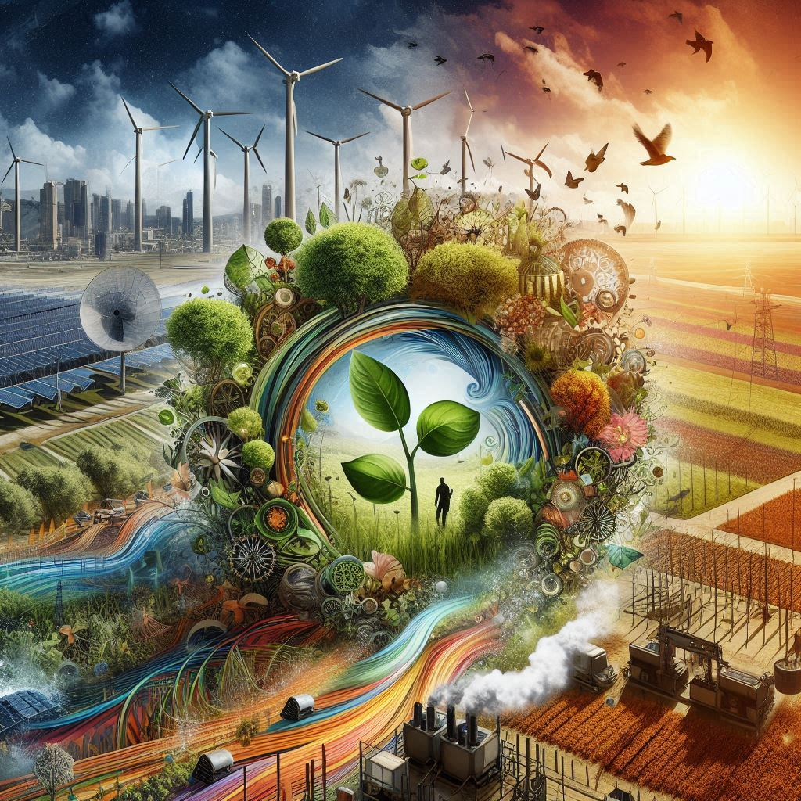
Our project
Three-year ESRC-funded project which started in January 2024.
Aiming to examine the relationships between nature recovery and (sustainable) regional development.
This includes tracking new finance, business, employment, skills and opportunities for regional development through nature recovery.
Seeking to develop a national framework to integrate nature recovery and regional development in England’s rural areas.
Image from Bing AI

Slide 3
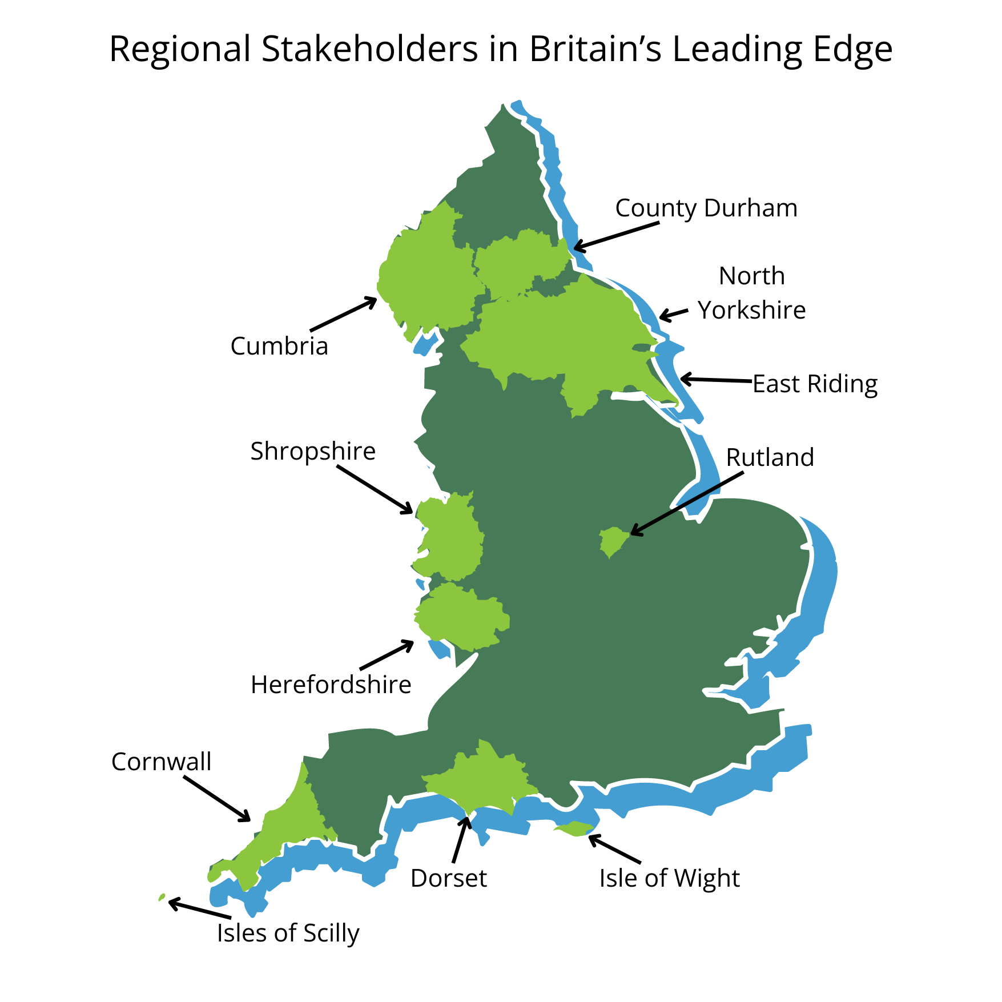
Our collaborative partner
Partnered with “Britain’s Leading Edge” (BLE).
A consortium of 12 upper-tier local authorities in England.
Engaging across the BLE with key stakeholders, including policymakers, land and marine users and managers, local communities, wildlife trusts, national parks, and national landscapes.
Link to Local Government Association for sharing findings and informing national policy.

Slide 4
Our paper: Introduction
There is growing global momentum to reverse the decline in biodiversity and abundance, often with a focus on ‘nature recovery’ (a broader approach than ‘conservation’).
The United Kingdom government has mandated all 48 upper-tier local authorities in England to develop a local nature recovery strategy by 2025 (Defra, 2023a). This is a new duty and role for local government to pick up.
It is likely that the most significant impacts of nature recovery will be in rural and peripheral areas, already rich in natural resources, with potential to generate new (and consolidate existing) regional development paths.
Notes:
1. The UN has declared the 2020s to be a Decade of ‘Ecosystem Restoration’.
At COP15, there was international agreement to adopt the Kunming-Montreal Biodiversity Framework.
2. These strategies are required by law to be a "system of spatial strategies for nature and environmental improvement" (Defra, 2023, p. 4).
3. Nature recovery represents a different, and largely neglected, dimension of the green transition.

Slide 5
Defining nature recovery
We define nature recovery as action taken to improve habitat quality, coverage, and connections, to enhance biodiversity and species abundance. In relation to the development of local nature recovery strategies, this will involve a place-based collaborative and community-focussed approach.

Slide 6
The role of ecological economics
By recognising the value of ‘natural capital’, valuations can be made to account for nature’s financial value and the cost of destruction.
This has stimulated new markets and finance for nature recovery.
The Office for National Statistics (2023) has valued England’s natural capital at £1.4 trillion, with ecosystem services valued at £35.7 billion.
Image from Bing AI
Notes:
“Natural Capital can be defined as the world’s stocks of natural assets which include geology, soil, air, water and all living things. It is from this Natural Capital that humans derive a wide range of services, often called ecosystem services, which make human life possible. The most obvious ecosystem services include food, the water, plant materials used for fuel, building materials and medicines.

Slide 7
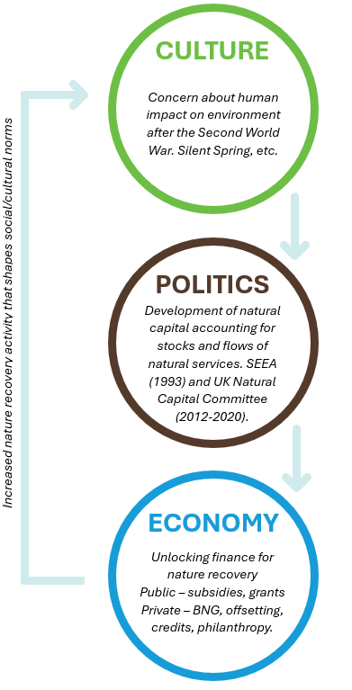
A historical cultural-political-economy of nature recovery for regional development
A CPE is an approach to political economy that focuses on how economic systems are products of specific human, technical, and natural relations (Jessop, 2004).
A CPE for nature recovery recognises how shifting cultural norms, new forms of economic accounting, and the related development of policy interventions, is shaping flows of finance, investment and behaviour.
We need to know how local culture, politics, and economy shape nature recovery and its impact on regional development.
LNRSs encourage collaboration among local authorities, landowners, farmers, conservation organisations, and communities.

Slide 8
Place-based approaches to nature recovery and rural economies
Four key areas
Reforestation and forest businesses
Coastal protection and marine-based enterprises
Nature friendly farming supported by payment for public goods
Nature-based tourism and recreation
Notes:
Link to Rewilding Britain (2021) report.

Slide 9
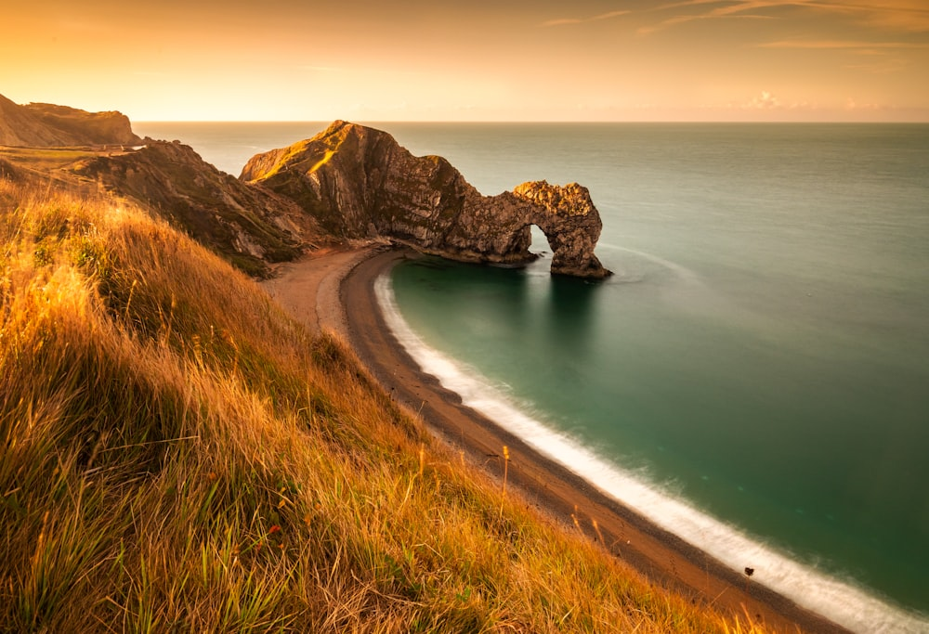
Nature-based tourism and recreation
It has been estimated that £22.5 billion of Great Britain’s £36 billion tourism industry is attributable to natural capital (Fitch et al. (2022).
England’s 10 national parks contribute between £4.1 billion and £6.3 billion to the economy every year (Cumulus Consultants, 2013).
Nature recovery in England’s rural areas is an opportunity to boost eco-tourism, the well-being economy, and recreation.
Charities and philanthropists are also buying up land to take it out of production. This may create new ‘wilded’ areas, and potentially add to tourist interest (such as Knepp in West Sussex).
Image from Unsplash

Slide 10
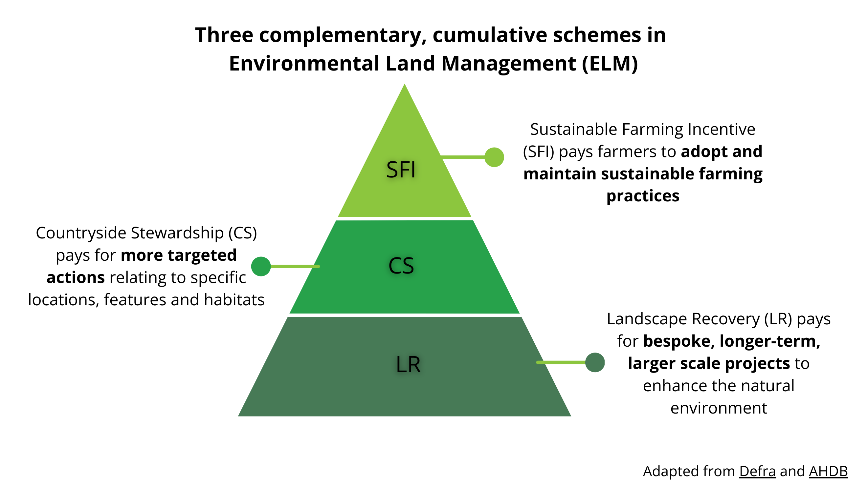
Nature friendly farming and payment for public goods
68% of England’s total area (8.8 million hectares) is utilised as agricultural land (Defra & Government Statistical Service, 2022).
The total income from farming in 2022 was £7.9 billion (Defra, 2023b).
The new Environmental Land Management scheme provides payments for land-managers and farmers to improve the environment.
There is a link to ecotourism and new food markets through regenerative agri-ecotourism, reflecting the opportunity for farmers to diversify their activities.

Slide 11
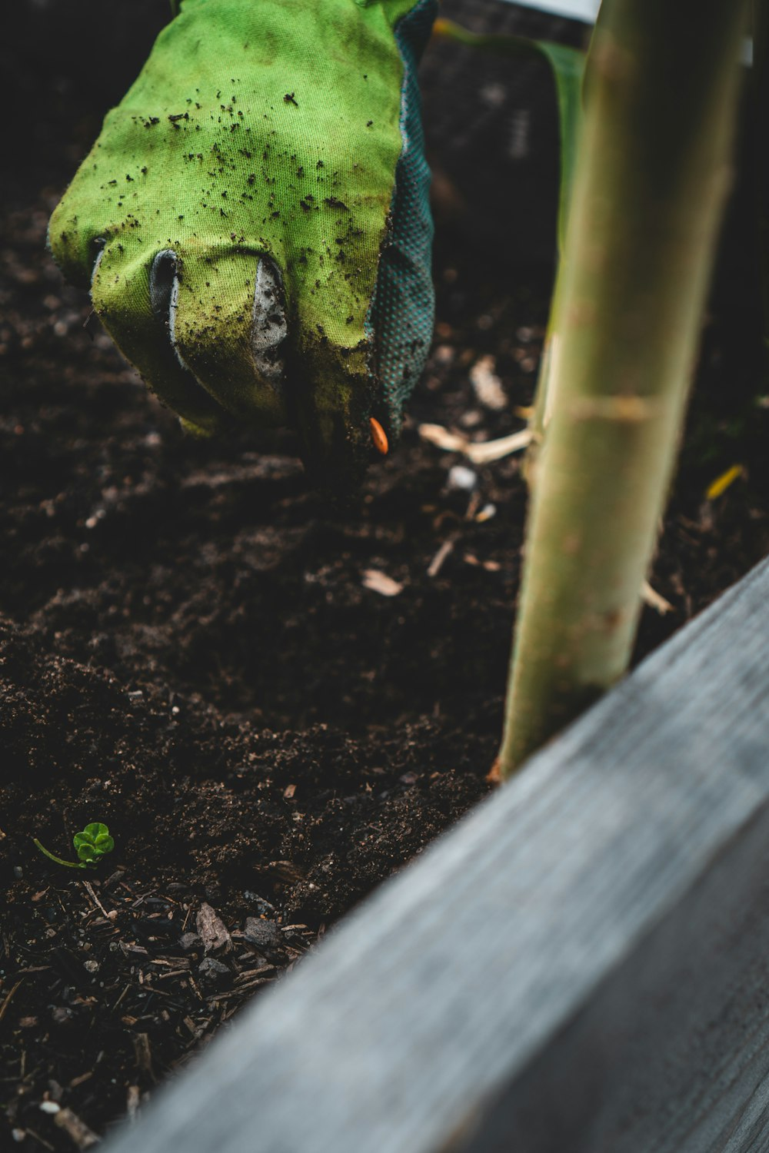
Reforestation and forest businesses
The UK land area covered by woodlands increased from 7% in 1965 to 13% in 2023.
The asset value of UK woodlands was an estimated £382 billion in 2021. Although timber and wood fuel is often seen as the main woodland asset, it accounted for 3.9% of this £382 billion valuation (Office for National Statistics, 2024). The remaining value is found in non-market benefits such as recreation and health.
In England, a “woodland creation” offer has been created, paying up to £10,200 per hectare of new woodland to landowners.
Image from Unsplash

Slide 12
Coastal protection and marine-based enterprises
The marine economy in the UK was worth an estimated £192 billion. (Stebbings et al., 2020). Marine areas are not included in LNRSs.
The ‘blue economy’ scoping report from Le Gouvello and Simard (2024) describes a triple crisis for marine ecosystems: Overfishing, pollution, climate change and habitat destruction.
There are 178 ‘marine protected areas’ in the UK, covering 51% of inshore and 37% of offshore waters (Marine Management Organisation, 2023). Three newly designated ‘highly protected marine areas’.
A recent Marine Net Gain (MNG) consultation process has revealed stakeholder support for habitat and species assessments to offset impacts from new marine developments, such as offshore wind.
Image from Unsplash

Slide 13
Emerging research questions
Area | Key questions
Green path development | How does nature recovery investment impact the local economy (in eco-tourism, farming/food, forestry, marine) and communities?
Local government policy and practice | How does nature recovery and the development of LNRSs relate to ongoing local and regional development plans? How will nature recovery be supported longer term, how will impact be measured and how will changes be communicated to local stakeholders and communities?
Cultural-political-economy | How does nature recovery and its impact reflect geographical differences in cultural-political-economy? How can this policy and practice be supported long-term?

Slide 14
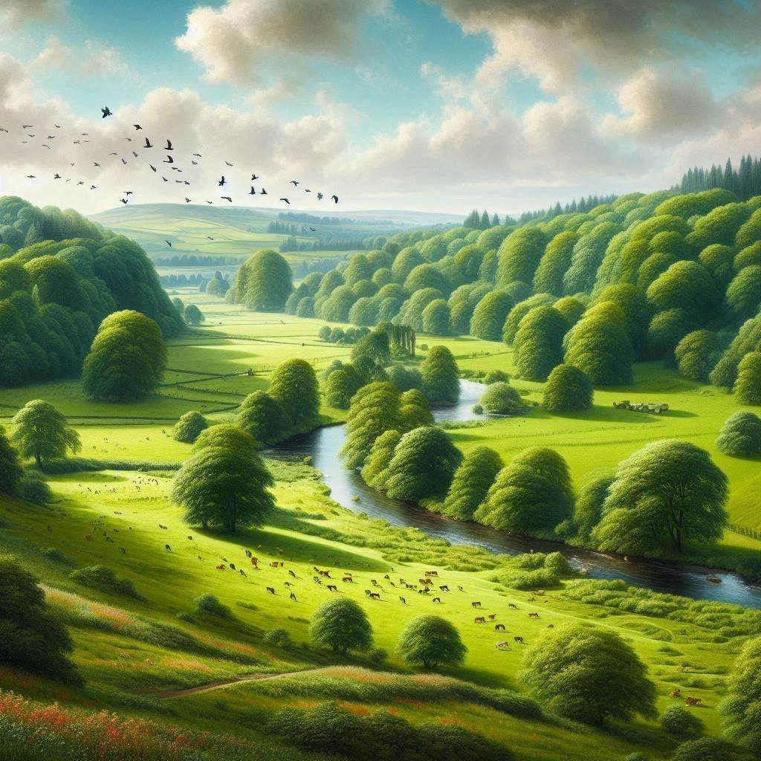
Summary and implications
There has been a significant shift in policy that is beginning to make it possible to link nature recovery with regional development paths.
To what extent will nature recovery activities facilitate investment in local communities?
Taking a CPE approach highlights the intersection of cultural norms, economic accounting practices, and political leadership that will prove critical to realising nature-friendly regional development paths.
We anticipate that these outcomes will be very different in each of the 12 BLE local authority regions.
We welcome your comments and questions.
Image from Bing AI

Slide 15
Get in touch
Thank you!
Dr Jack Reed: J.Reed2@exeter.ac.uk
Prof. Jane Wills: J.Wills2@exeter.ac.uk
Prof. Ian Bateman: I.Bateman@exeter.ac.uk
Jennifer Dodsworth: J.Dodsworth@exeter.ac.uk
Prof. Juliet Osborne: J.L.Osborne@exeter.ac.uk
And we acknowledge the early development of this work via a PhD studentship supported by Cornwall Council (2020-23), supervised by Jane Wills and Joanie Willett and undertaken by Nicholas Woolgrove.

Slide 16
References
Cumulus Consultants. (2013). Valuing England’s national parks. https://cumulus-consultants.co.uk/case_studies/valuing-englands-national-parks/
Day, B., Mancini, M., Bateman, I. J., Binner, A., Cho, F., de Gol, A., ... & Smith, G. (2024). Natural capital approaches for the optimal design of policies for nature recovery. Philosophical Transactions of the Royal Society B, 379(1903), 20220327. https://doi.org/10.1098/rstb.2022.0327
Defra. (2023a). Local nature recovery strategy statutory guidance: What a local nature recovery strategy should contain. https://www.gov.uk/government/publications/local-nature-recovery-strategy-what-to-include
Defra. (2023b). Total income from farming in the UK in 2022. https://www.gov.uk/government/statistics/total-income-from-farming-in-the-uk/total-income-from-farming-in-the-uk-in-2022
Defra., & Government Statistical Service. (2022). Agriculture in the UK evidence pack: September 2022 update. https://assets.publishing.service.gov.uk/media/6331b071e90e0711d5d595df/AUK_Evidence_Pack_2021_Sept22.pdf
Fitch, A., Kuyer, J., Kharadi, N., Gower, J., Roberts, C., Dewey, N., ... & Jones, L. (2022). Under the influence of nature: The contribution of natural capital to tourism spend. Plos One, 17(6), e0269790. https://doi.org/10.1371/journal.pone.0269790
Jessop, B. (2004). Critical semiotic analysis and cultural political economy. Critical Discourse Studies, 1(2), 159-174. https://doi.org/10.1080/17405900410001674506
Le Gouvello, R., & Simard, F. (2024). Towards a regenerative blue economy: Mapping the blue economy. International Union for Conservation of Nature. https://portals.iucn.org/library/efiles/documents/2024-005-En.pdf
Marine Management Organisation. (2023). Guidance: Marine protected areas (MPAs). https://www.gov.uk/guidance/marine-protected-areas-mpas
Office for National Statistics. (2024). Woodland natural capital accounts, UK: 2024. https://www.ons.gov.uk/economy/environmentalaccounts/bulletins/woodlandnaturalcapitalaccountsuk/2024
Office for National Statistics. (2023). England natural capital accounts: 2023. Estimates the value of English natural capital and its beneficial effects for the population. https://www.ons.gov.uk/economy/environmentalaccounts/bulletins/englandnaturalcapitalaccounts/2023
Stebbings, E., Papathanasopoulou, E., Hooper, T., Austen, M. C., & Yan, X. (2020). The marine economy of the United Kingdom. Marine Policy, 116, 103905. https://doi.org/10.1016/j.marpol.2020.103905

