Slide 1

The History of Stewardship
Background image copyright Helen C. John

Slide 2

Take 5 minutes to refresh your memory of Genesis 1-2

Slide 3

Click for an introductory video: History

Slide 4
Lesson aims
To show how texts like Genesis 1-2 have generated different readings in changing contexts
To encourage reflection on the ways in which our environmental crisis has prompted new perspectives on biblical texts
To raise questions about the meaning and interpretation of texts: is there one true meaning (the author's intention?) or are new meanings made in new contexts?

Slide 5
Responsibility
Power
Care
Kingship
Nurture
Control
Kinship
Stewardship
Equality
Subdue

Slide 6
Interpreting texts
Historical context
  Why did the writer say that?
Present-day context
  - How do we understand the text today?

Slide 7
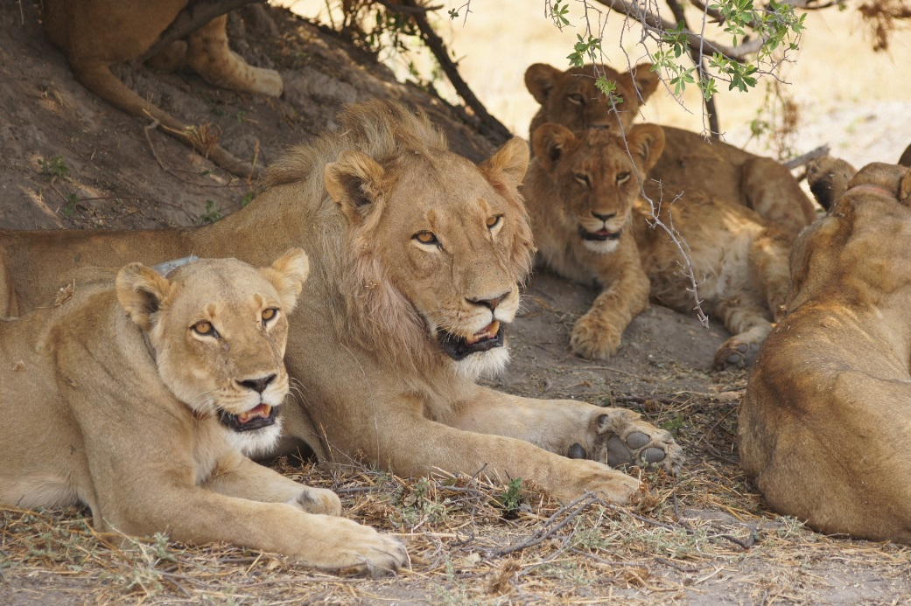
Genesis 1-2 in historical context
Ancient, pre-industrial context
Threats of nature
Genesis: ‘subduing’ nature
for survival
Image copyright Helen C. John

Slide 8

Modern science: controlling nature for human benefit
Renaissance/Enlightenment (16th century)
Optimistic time
Genesis: using human power

Slide 9

An age of ecological crisis
End to optimism
Environmental damage
Genesis: care and responsibility
Image copyright Helen C. John

Slide 10
Individual work
Using the information from your handout, complete the interpretation table to show how the Genesis text have been understood in different contexts.
You have 20 minutes

Slide 11
For discussion
Do you think texts have one meaning or can their meaning change?
How far are interpretations of biblical texts influenced by the concerns of the age in which the interpreter lives?
Is the emphasis on stewardship the product of what the Bible says, or of our environmental crisis, or both?

