Slide 1
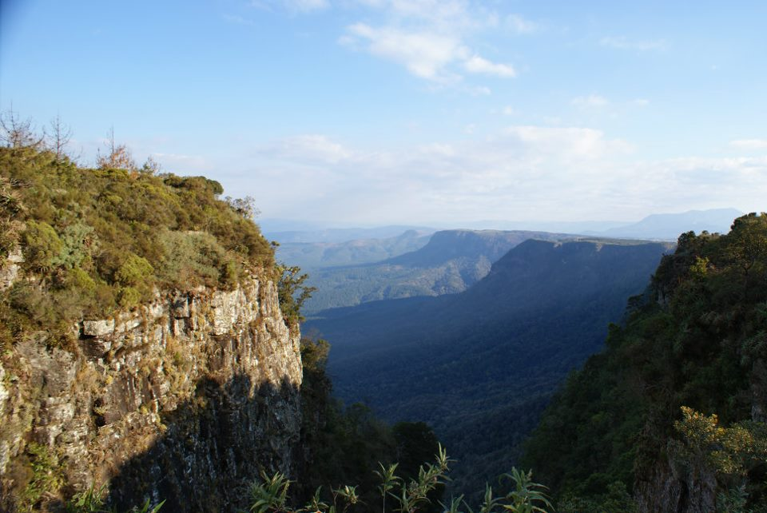
Catholic Teaching Explored Further
Background image copyright Helen C. John

Slide 2

Click for an introductory video: Catholic

Slide 3
Lesson aims
To examine the development of Catholic approaches towards the environmental crisis
To show how this involves an understanding of stewardship
To show how Catholic teaching integrates social care with creation care, especially in the recent encyclical Laudato Si’

Slide 4
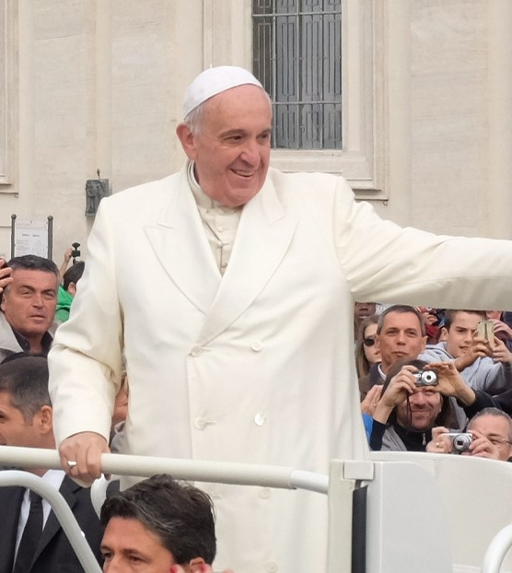
What is an encyclical?
‘Circular Letter’
From the Pope…
… to Roman Catholic Bishops
Delivers official teaching
Teaching filters down to Catholic communities: bishop → church → individuals (and now the web)

Slide 5
Imago Dei and Dominion (i)
‘For Sacred Scripture teaches that man was created "to the image of God," is capable of knowing and loving his Creator, and was appointed by Him as master of all earthly creatures that he might subdue them and use them to God's glory.’ (§12)
Gaudium et spes (1965)
[This document doesn’t mention stewardship]
How are the ideas of Imago Dei and Dominion connected?

Slide 6
Imago Dei and Dominion (ii)
‘For man, created to God's image, received a mandate to subject to himself the earth and all it contains, and to govern the world with justice and holiness; …’. (§34)
Gaudium et spes (1965)
[This document doesn’t mention stewardship]
How are the ideas of Imago Dei and Dominion connected?

Slide 7
Imago Dei and Stewardship (i)
‘… the International Theological Commission seeks … to reaffirm the truth that human persons are created in the image of God in order to enjoy personal communion with the Father, Son and Holy Spirit and with one another in them, and in order to exercise, in God's name, responsible stewardship of the created world.’ (§4)
Communion and Stewardship (2002)
How are the ideas of Imago Dei and Stewardship connected?

Slide 8
Imago Dei and Stewardship (ii)
‘Human stewardship of the created world is precisely a stewardship exercised by way of participation in the divine rule and is always subject to it. Human beings exercise this stewardship by gaining scientific understanding of the universe, by caring responsibly for the natural world (including animals and the environment), and by guarding their own biological integrity.’ (§61)
Communion and Stewardship (2002)
What change in emphasis do you notice between Gaudium et spes and Communion and Stewardship?
Notes:
Dominion to Stewardship; language of subduing the earth and mastery over it (Gaudium et spes) to responsibility and care (Communion and Stewardship).

Slide 9
Pope Francis: A Relational Approach
‘The creation accounts in the book of Genesis … suggest that human life is grounded in three fundamental and closely intertwined relationships: with God, with our neighbour and with the earth itself.’
BUT
‘The harmony between the Creator, humanity and creation as a whole was disrupted by our presuming to take the place of God and refusing to acknowledge our creaturely limitations. This in turn distorted our mandate to “have dominion” over the earth (cf. Gen 1:28), to “till it and keep it” (Gen 2:15). As a result, the originally harmonious relationship between human beings and nature became conflictual (cf. Gen 3:17-19).’ (§66)
Laudato Si’ (2015)

Slide 10
Pope Francis: A Relational Approach
‘… nowadays we must forcefully reject the notion that our being created in God’s image and given dominion over the earth justifies absolute domination over other creatures .’
AND
There is ‘a relationship of mutual responsibility between human beings and nature. Each community can take from the bounty of the earth whatever it needs for subsistence, but it also has the duty to protect the earth and to ensure its fruitfulness for coming generations.’ (§67)
Laudato Si’ (2015)
Image copyright Helen C. John

Slide 11
Summarise your understanding of Topic A
What is the significance of the Imago Dei idea for Catholic teaching about care for the environment? How has its influence changed over time?

Slide 12
Group Work
Phase 1: Pair (Topic B or C)
  15 minutes
  Prepare content to teach to rest of class – Key Question on handout
  Focus: CONTENT
Phase 2: Find a pair who are doing the same topic
  15 minutes
  Agree content and decide HOW to teach it to the rest of the class
  Focus: DELIVERY
Phase 3: Present findings to the class (2-3 minutes per group)

