Slide 1


GRAMMAR FOR WRITING
Choice and Control.

Slide 2



Slide 3
INTRODUCING THE CPD DAYS

Slide 4
Now it’s your turn!
3 CPD days:
  Sharing the Grammar for Writing pedagogy
  Support for subject knowledge
  Two fully resourced schemes of work
  Our thoughts with the benefit of hindsight
  Support for future planning

Slide 5
An overview
CPD day 1
  The principles behind the pedagogy
  Subject knowledge support
  Activities illustrating the approach
CPD day 2
  Subject knowledge support
  Narrative Fiction Scheme of work
CPD day 3
  Argument Scheme of Work
  Sharing what we have learned
  Support for future planning

Slide 6
The Research Project
Government funding to EEF (Education Endowment Foundation) to fund interventions to raise attainment;
These interventions use a very particular research approach called a randomised controlled trial which has its own very particular ‘rules’;
The University of Exeter team led the intervention;
A team from the University of York evaluated the effectiveness of the intervention;
We will let you know the outcomes of the evaluation.

Slide 7
The Research Project
155 schools involved in the project;
All of year 6 in each school is involved;
Schools have been randomly allocated to an intervention or a comparison group;
You are the comparison group!
The comparison group is used so that we can measure rigorously whether any improvement in writing groups is due to the intervention or whether it is just natural progress over time.

Slide 8
A taste of things to Come
Note that this approach:
1. uses authentic texts
2. is playful
3. emphasises choice not error
4. uses grammar terms with examples

Slide 9
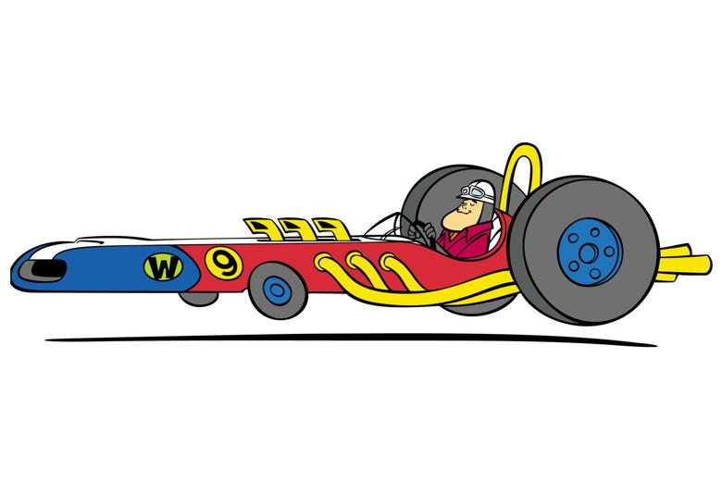
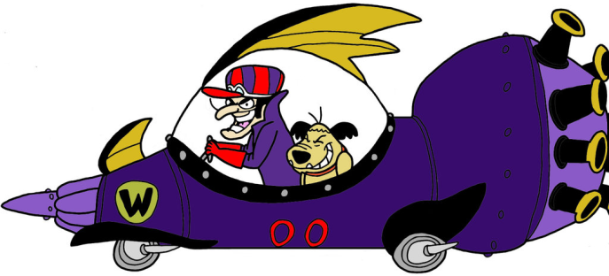
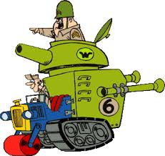
A Classroom Example
Grammar terms with examples
Context: creating character description
Learning Focus: using proper nouns to convey information about character
Making
choices
Authentic texts
Playful
Peter Perfect in the Turbo Terrific
Dick Dastardly in the Mean Machine
Sergeant Blast and Private Meekly
in the Army Surplus Special
Create your own character and vehicle for the race,
can you use proper nouns to show character?

Slide 10
An Embedded Approach
The aim is not to teach grammar, the aim is to teach writing
Grammar is embedded in the teaching of writing – NOT SEPARATED FROM IT
The aim is not to highlight and correct error, the aim is to highlight how grammar choices shape meaning
The aim is to make explicit how different grammatical constructions offer the writer choice and control
The aim is for young writers to understand the grammar-meaning relationship

Slide 11
GRAMMAR SUBJECT KNOWLEDGE
Phrase – Clause – Sentence -Verb

Slide 12
Phrase, clause, sentence
Notes:
Card sort activity

Slide 13

Phrase, clause, sentence?
Beauty and the Beast - Geraldine McCaughrean (2000)
Notes:
45 minutes for phrase, clause, sentence and clause elements
Card activity: work in groups of about 4
1. Sort into sentence/non-sentence
2. How did you know which were which?
Sentence has a verb
Complete grammatical idea – (makes sense)
Punctuation
Tell them simple sentence is a single clause.
Have you got any sentences with more than one clause? – usually go to the rose garden one (single clause). Only one is ‘when he looked up…’ Clarify sub clause adding info; each has one verb – be hammering at this point.
3. Clauses
Pile of not sentences – have you got any in your non pile that are clauses but not sentences? What does a clause have to have in it? What is the difference between a sentence and a clause? Obvious one is ‘though she told herself often’ but the verb phrases ‘would have stayed’ and ‘is dying’ could be clauses if in a list of clauses. Don’t deal with this listing thing unless someone raises it.
Make sure we get to 1 clause = 1 verb.
4. Phrase
Look at what is left in non-sentence pile – what are they? Phrases – group of words clustered around a head word.
Sort into different types – talk about head words; phrase beginning with preposition is prep phrase – can fill adverbial slot; can expand noun (will do more later)

Slide 14
What’s in a clause?
Notes:
To understand a bit more about how phrases and clauses work we want to look at the elements that make up a clause – we think of these as ‘slots’. We will exemplify with a single clause sentence.
5 elements/slots that can be combined and ordered in different ways – don’t have to have one of each in every single clause sentence.
EXPLAIN EXAMPLES ON FLIPCHART
S V O A C – these are the 5 elements that can be included and combined in different ways.
Gregor ate.
Gregor ate bread.
Gregor ate bread hungrily.
Now clarify we have these main slots in a clause which can be filled with one word, several words (phrases) or sometimes several words which might be clauses.
Then demo with phrases in each slot.

Slide 15
‘Slots’ in a clause
Subject
Verb
Object
Adverbial
Complement (adjective) / Complement (noun)
Gregor ate bread greedily.
Beauty’s father was eating the freshly baked bread in the sumptuous palace.
Notes:
This wasn’t here in the original PPT – we could add more examples – putting on a slide what Jenny and Becca modelled on flipchart?

Slide 16


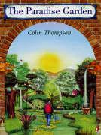

Phrase, Clause or Sentence?
Which is which?
phrase?
the noise was driving Peter crazy
in the west of the city
who had lived all his life in narrow streets
when it rained
sentence?
beneath their crystal skies
life was so peaceful
the only house
summer grew weary
clause?
from The Paradise Garden by Colin Thompson
Notes:
With a partner, test yourself – are these phrases, clauses, or sentences?
Hammer the verbs to help you.
If a phrase – what sort?
Anchor the subject knowledge.
the noise was driving Peter crazy – sentence
in the west of the city – prep phrase (with another one inside it)
who had lived all his life in narrow streets – subordinate (relative )clause
the city had dropped to a faint murmur - sentence
when it rained - subordinate (adverbial) clause
beneath their crystal skies – prep phrase
life was so peaceful – sentence (with complement)
the only house - phrase
summer grew weary - sentence

Slide 17
Big Ideas: Phrase, clause, sentence
A sentence:
Has at least a subject and a verb e.g Beauty waited. The verb is finite (has person and tense).
Has at least one clause but may have more (single clause sentence or multi-clause sentence). When he looked up, he was not out of doors at all.
Begins with a capital letter and finishes with ‘end punctuation’.

Slide 18
Big Ideas: Phrase, clause, sentence
A clause:
Has to have a verb (finite or non-finite) and usually has a subject although this may be implied.
May make grammatical sense on its own and be a single clause/simple sentence OR a main clause in a multi-clause sentence. Eg Gregor ate bread because he was hungry.
May start with a subordinating conjunction eg if, because, when, although. This type of clause (subordinate) is dependent on a main clause to make complete grammatical sense eg Gregor ate bread because he was hungry.

Slide 19
Big Ideas: Phrase, clause, sentence
A phrase:
is a group of words clustered around a head word. The head word give the phase its name e.g noun phrase - his horse; adverbial phrase – very warily;
fills a ‘slot’ in a clause e.g SVOAC;
a verb phrase can fill the verb ‘slot’ instead of a single word verb e.g is scoffing, has been scoffed.

Slide 20
VERBS

Slide 21
The Problem of the ‘Doing’ Word
A VERB IS A DOING WORD
What is the verb in this sentence?
Many verbs in authentic texts are not evidently ‘doing’ words at all: the verbs to be and to have are the most frequent;
Often the word which seems to evoke ‘doing’ in a sentence is not the verb:
  I love hunting.
  I saw the dreamcatcher.
  It quickly came from nowhere

Slide 22
Getting confused
‘We called it the garage’ called can’t be a verb because ‘it’s not really a doing word or anything’
A statue quickly came out of nowhere – student identifies ‘quickly’ as the verb because it is a doing word
‘he tugged open the door’ – student identifies tugged as an adjectives because it is describing what he is doing to the door

Slide 23
Find all the Verbs…
Mr and Mrs Dursley, of number four, Privet Drive, were proud to say that they were perfectly normal, thank you very much. They were the last people you’d expect to be involved in anything strange or mysterious, because they just didn’t hold with such things.
Mr Dursley was the director of a firm called Grunnings, which made drills. He was a big, beefy man with hardly any neck, although he did have a very large moustache. Mrs Dursley was thin and blonde and had nearly twice the usual amount of neck, which came in very useful as she spent so much of her time craning over garden fences, spying on the neighbours. The Dursleys had a small son called Dudley and in their opinion there was no finer boy anywhere.

Slide 24
Verbs
Mr and Mrs Dursley, of number four, Privet Drive, were proud to say that they were perfectly normal, thank you very much. They were the last people you’d expect to be involved in anything strange or mysterious, because they just didn’t hold with such things.
Mr Dursley was the director of a firm called Grunnings, which made drills. He was a big, beefy man with hardly any neck, although he did have a very large moustache. Mrs Dursley was thin and blonde and had nearly twice the usual amount of neck, which came in very useful as she spent so much of her time craning over garden fences, spying on the neighbours. The Dursleys had a small son called Dudley and in their opinion there was no finer boy anywhere.

Slide 25
Language Detectives
Display posters of all the possible variations of the verbs be and have and explain they are very common verbs in English;
Give out a range of authentic texts of about 200 words and ask children to underline all incidences of the verbs be and have in their texts, using the posters as a guide. Who has the most examples?
Support children from an early age in simply knowing that these variations of be and have are always verbs.
be am are is was were being been
have has had having

Slide 26
Language Detectives: Lexical Verbs
Lexical (main) verbs are the verbs teachers are referring to when they talk about a ‘doing’ word;
But they often don’t express a lot of doing.
It can be helpful to think about action verbs, reporting verbs and sensing verbs
Action verbs:
these verbs express an action, such as: jump, dance, eat or ache. They do also express actions which are less obviously active such as: organise, lead, or survive.
Reporting verbs:
these verbs tend to relate to speech and how something is said, such as: whisper, suggest, exclaim or shout.
Sensing verbs:
these verbs express thinking, feeling or understanding, and include verbs such as: believe, know, imagine, enjoy, fear, see or hear.

Slide 27
Teacher Knowledge
It does help you in your work with children if you understand the difference between main and auxiliary verbs, including modal verbs.
.
I dance
I am dancing
I danced
I was dancing
I had danced
I could have danced
I might be dancing
I should have been dancing
These are all verb phrases: a verb phrase can be one verb or a string of verbs one after another
I is a pronoun: not part of the verb phrase but here to help the examples make sense

Slide 28
Teacher Knowledge
It does help you in your work with children if you understand the difference between main and auxiliary verbs, including modal verbs.
.
I dance
I am dancing
I danced
I was dancing
I had danced
I could have danced
I might be dancing
I should have been dancing
The main verb:
this is often the ‘doing’ verb. It is the main verb in the phrase and the one you’d look up in a dictionary
Look at the position of the main verb: it is either on its own or last in the verb phrase

Slide 29
Teacher Knowledge
It does help you in your work with children if you understand the difference between main and auxiliary verbs, including modal verbs.
.
I dance
I am dancing
I danced
I was dancing
I had danced
I could have danced
I might be dancing
I should have been dancing
The auxiliary verb:
It helps to create shades of meaning in the verb phrase and is usually formed with variations of be or have, but sometimes with do or get

Slide 30
Teacher Knowledge
It does help you in your work with children if you understand the difference between main and auxiliary verbs, including modal verbs.
I dance
I am dancing
I danced
I was dancing
I had danced
I could have danced
I might be dancing
I should have been dancing
The modal verb:
expresses shades of possibility and certainty
Modal verbs are one kind of auxiliary verb

Slide 31
Verbs: Main or Auxiliary?
Mr and Mrs Dursley, of number four, Privet Drive, were proud to say that they were perfectly normal, thank you very much. They were the last people you’d expect to be involved in anything strange or mysterious, because they just didn’t hold with such things.
Mr Dursley was the director of a firm called Grunnings, which made drills. He was a big, beefy man with hardly any neck, although he did have a very large moustache. Mrs Dursley was thin and blonde and had nearly twice the usual amount of neck, which came in very useful as she spent so much of her time craning over garden fences, spying on the neighbours. The Dursleys had a small son called Dudley and in their opinion there was no finer boy anywhere.
Don’t forget that be and have are common main verbs!

Slide 32

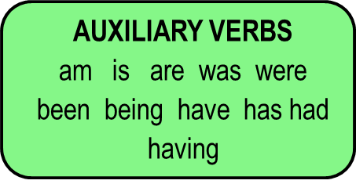
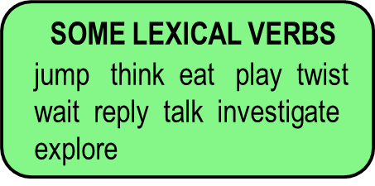
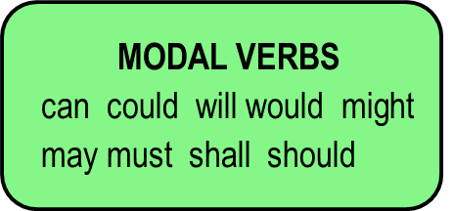
Teaching Ideas
Language Detectives: the Curious Case of the Verb Phrase
Select ten sentences from a book or a text you are reading together, and reproduce on a strip of paper. Put these strips into an envelope for each group, with an imaginary detective agency name label on it.
Display the three different verb groups (the modal verbs; the auxiliary verbs; and a sample of lexical verbs). Recap on their understanding of these.

Slide 33
Teaching Ideas
Language Detectives: the Curious Case of the Verb Phrase
Ask children to underline all the verb phrases in each of the sentences, and then to see if they can work out the order in which these types of verb occur in a verb phrase.
Then come together as a whole class to discuss the findings of the detectives and to see if they have found a solution. Using a whiteboard with modals, auxiliaries and lexical verbs colour-coded may act as a visual support here.

Slide 34

Verbs: A classroom example
The Snow Leopard by Jackie Morris
Pattern of three co-ordinated clauses
back in the mountains, the young Snow Leopard looked up at the stars mirrored in her blue cat’s eyes, heard the whisper – and began a new song.
Grammar-meaning link:
Conveys narrative information concisely and emphasises the sequence of events.
Verbs can carry the plot
Patterns of three create good rhythm in a text.

Slide 35
Impact on writing: an example
… and the cat stirred, rose and leapt up to the high wild mountains with the Child clinging tight on her back.
And back in the mountains, the young Snow Leopard looked up at the stars mirrored in her blue cat’s eyes, heard the whisper – and began a new song.
The Snow Leopard – Jackie Morris
Golden Lion Tamarin forced the trees to form a cunning cage to protect the heart of the forest; the magical, black diamond. She wrapped the trees in loving leaves, crowded creatures onto the tropical trees and gave the plants the sun and water they needed. Year 6 – able writer
At first peak of light, over the ever green mountain, the bald eagle raced to create the wind, soared through the secret forest to awaken all animals and squawked over the green ocean canopy to make the mystical mist. Year 6 – weak writer

Slide 36
Planning for progression: The Verb
Develop children’s learning of verbs in steps which help build their ‘concept’ knowledge:
Make sure they have secure understanding of verbs be and have and all their variations;
Tell them a verb which is an ‘action’ word is one kind of verb (lexical);
Make sure they can see that lots of lexical verbs don’t have much doing: talking about action, reporting and sensing verbs might be helpful;
Develop understanding of verb phrases: both a single verb and a sequence of verbs

Slide 37
HoW Grammar CREATES CHOICE

Slide 38
The Exeter Approach
It is not a course in grammar; it is a way of teaching writing;
It draws on many of the good practices already commonly used in the teaching of writing: drafting, revising, editing; creative stimuli for writing; peer collaboration; the scaffolding of writing tasks…
The attention to grammar is embedded within this and is intended to be explicit and to help writers develop understanding and independence in making choices in their writing;
It constantly makes links between reading and writing;
It is underpinned by a set of pedagogical principles to guide how the grammar is used;
The goal is to support young writers in developing a ‘repertoire of infinite possibilities’ for writing.
It is research-based.

Slide 39
Teaching Writing Creatively
To write well we all need to have something to say and a desire to say it;
Before young writers can meaningfully attend to how they have written something, they need to have engaged with what they want to say – the ideas;
Engaging young writers’ imaginations, emotions and personal beliefs is a really important part of teaching writing;
Allowing young writers freedom to explore ideas, test things out, and to write to find out what they want to say is critical
We often move far too quickly to pinning things down, and making writing a very linear process – we need to create space for exploration, experimentation and re-drafting.
This is built into both of our Schemes of Work.

Slide 40
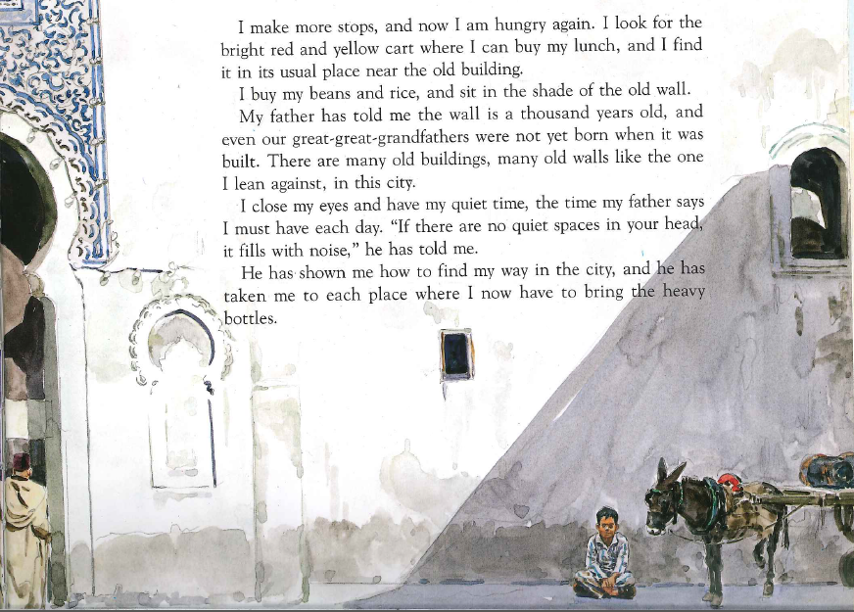
The Day Of Ahmed’s Secret
Florence Parry Heide & Judith Heide Gilliland (1997)
Notes:
Give brief context to text.
Read the extract – what does it make you think or feel? What impact does it have? Don’t think ‘grammar’ – think like a reader!
Feedback – record their ideas.
Make sure they talk about relationship with father and his being alone.
Focus on impact/effect:
1. Come back to the notes they made on this book at beginning of the section on verbs.
Focus on relationship with father – how do we know about it? Which words tell you?
- Has told, has shown, has taken
2. Talk about use of present perfect – experience that started in the past but has relevance in the present. Repeated experience – how many times do you think his father told/showed etc? What happens if you use past simple? Get them to transform What if past perfect?
Is his father with him?
Is his father alive?
How often has his father shown him/taken him/told him?
3. Look at the first few lines – what tense is this written in? why? – journey through the day – habitual actions; internal monologue as it happens.
Final summing up:
Round off with emphasising that writers choose the tense and also the particular aspect of that tense to create subtle effects – NOT just about the choice of the lexical verb.

Slide 41
Writers’ Choices
Choice of verb tense (present) and verb aspect (present perfect) can convey shades of meaning, such as illustrating the relationship between Ahmed and his father.

Slide 42
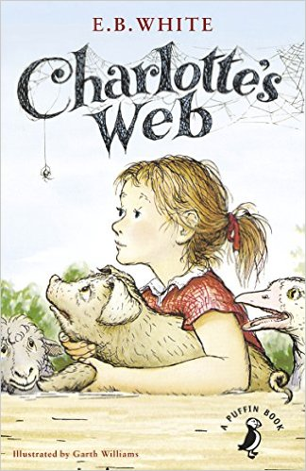
The next day was rainy and dark. Rain fell on the roof of the barn and dripped steadily from the eaves. Rain fell in the barnyard and ran in crooked courses down into the lane where thistles and pigweed grew. Rain spattered against Mrs Zuckerman’s kitchen windows and came gushing out of the downspouts. Rain fell on the backs of the sheep as they grazed in the meadow. When the sheep tired of standing in the rain, they walked slowly up the lane and into the fold.
Notes:
Invite teachers to visualise the scene – what do they see?

Slide 43
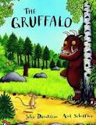
through the deep dark wood
by this lake
In my underground house
by these rocks
in my treetop house
by this stream
in my log pile house
over his back
on the end of his nose
in the leaves
Prepositional phrases:
Usually, a preposition (in; on; under; for; by; near; beside….) plus a noun/noun phrase.

Slide 44
through the deep dark wood
by this lake
In my underground house
by these rocks
in my treetop house
by this stream
in my log pile house
over his back
on the end of his nose
in the leaves
Prepositional phrases:
A prepositional phrase is usually composed of a preposition (in; on; under; for; by; near; beside….) plus a noun/noun phrase.

Slide 45
Creating Visual Descriptions
The next day was rainy and dark. Rain fell on the roof of the barn and dripped steadily from the eaves. Rain fell in the barnyard and ran in crooked courses down into the lane where thistles and pigweed grew. Rain spattered against Mrs Zuckerman’s kitchen windows and came gushing out of the downspouts. Rain fell on the backs of the sheep as they grazed in the meadow. When the sheep tired of standing in the rain, they walked slowly up the lane and into the fold.
From Charlotte’s Web by E.B.White

Slide 46
Creating Visual Descriptions
The next day was rainy and dark. Rain fell on the roof of the barn and dripped steadily from the eaves. Rain fell in the barnyard and ran in crooked courses down into the lane where thistles and pigweed grew. Rain spattered against Mrs Zuckerman’s kitchen windows and came gushing out of the downspouts. Rain fell on the backs of the sheep as they grazed in the meadow. When the sheep tired of standing in the rain, they walked slowly up the lane and into the fold.
From Charlotte’s Web by E.B.White

Slide 47
Writers’ Choices
One way to create a strong visual description of a narrative scene is to use precisely-chosen prepositional phrases.

Slide 48
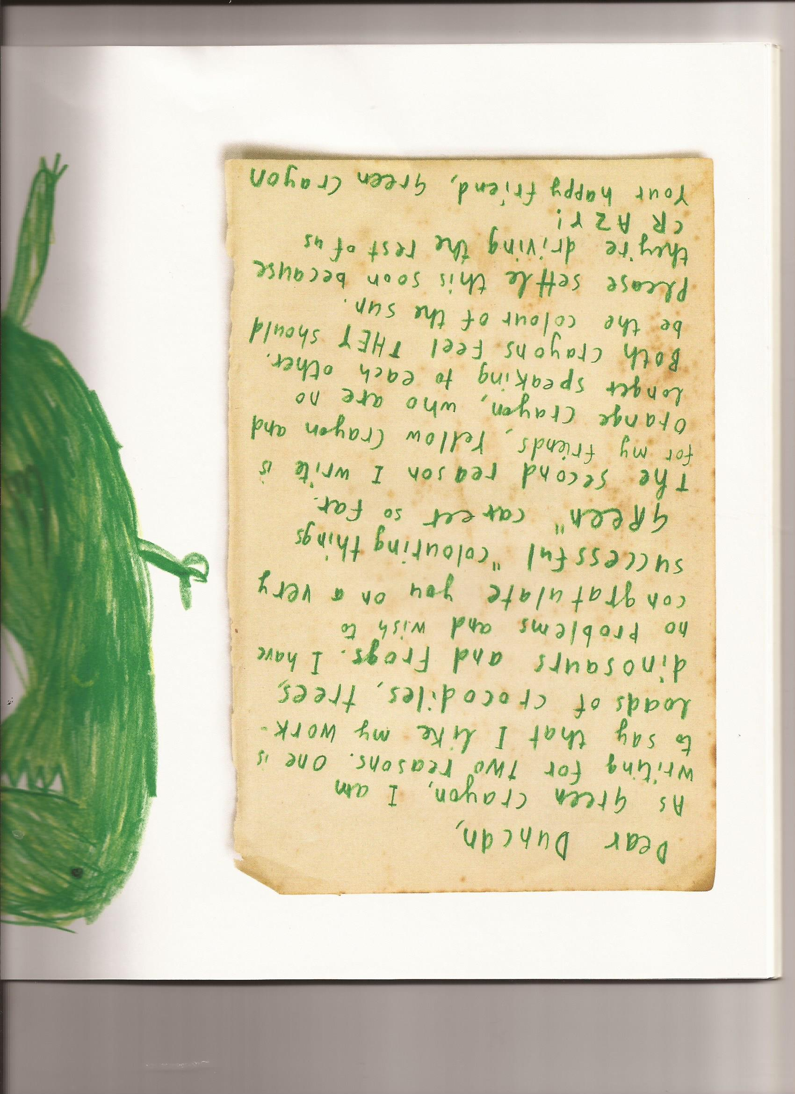
What might you draw attention to grammatically in this text as features of a persuasive argument?
Think of a new crayon colour and what the crayon’s complaint might be? Write a new letter to Duncan outlining your complaint.

Slide 49
Writers’ Choices
There are many different things you can do to write a persuasive argument eg:
Use formal language to signal your ‘authority’ (Verbs: I wish to congratulate);
Use informal language to build a relationship with your reader (loads; crazy);
Use nouns instead of adverbials to signal structure (two reasons; one; the second reason)
Make a clear statement sentence to express what you want (Please settle …)

Slide 50
GfW: Four Key Teaching Principles
Make a link between the grammar being introduced and how it works in the writing being taught;
eg exploring how past and present tense are used in newspaper reports for recount and comment
Explain the grammar through examples, not lengthy explanations;
eg exploring how prepositional phrases can establish setting in narrative through a card sort of a range of prepositional phrases from ‘The Gruffalo’.
Build in high-quality discussion about grammar and its effects.
eg discussing as a whole class the different grammatical choices in two students’ drafts of the ending to an argument piece.
Use examples from authentic texts to links writers to the broader community of writers;
eg using the class shared book as a source for exploring how grammar shapes meaning
Notes:
The Big Three!

Slide 51
Using this approach
Three key pre-requisites for teachers:
Strong grammatical knowledge:
so this approach sets out to strengthen your grammatical knowledge;
An ability to notice how texts are ‘working’:
so this approach sets out to give you examples of the ways texts work;
The ability to plan purposefully, integrating an attention to grammar within teaching units:
so this approach gives you two models of teaching units with grammar meaningfully integrated into the teaching.
Students who understand better the choices they can make in their writing and the meanings they create
Students produce better written outcomes.

Slide 52
A Preview: Narrative Fiction
Uses Michael Morpurgo’s book, Arthur, High King of Britain as a creative springboard and a model text;
Uses the BBC Merlin series to draw attention to how to communicate visual information verbally;
Focuses on strengthening character development – they create a new Arthurian character;
Focuses on how to write about key moments in a plot;
Sets out to fire young writers’ imaginations.
You might want to buy a copy of the Morpurgo book and read it.

Slide 53
A Preview: Persuasive Writing
Uses a video clip to engage children with fact that so much good food is thrown away;
Uses a newspaper article as a model text;
Focuses on the use of clear statement sentences to make an argument;
Focuses on the use of positioning vocabulary to indicate the writer’s point of view; and the use of adverbs to emphasise the point of view;
Sets out to engage young writers with important ideas relevant to their lives.

Slide 54
PLENARY

Slide 55
And finally….
Don’t rush to the grammar point too soon – before we think about saying something well – we first have to have something to say
Focus on what any grammar feature does rather than on what it is
Focus on choice, by pointing out choices
Consider your weak spots in grammar subject knowledge
Consider your weak spots in articulating effects
Always put writing first - not grammar

Slide 56
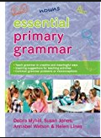
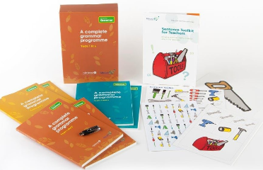


Resources to help you…
Essential Primary Grammar:
Myhill, Jones, Watson & Lines (2016)
No Nonsense Grammar: Babcock LDP Literacy Team, Raintree (2016)
www.babcock-education.co.uk/ldp/literacy
Resources for Teachers website: we have recently set up a website for primary and secondary teachers with new resources added regularly:
http://socialsciences.exeter.ac.uk/education/research/centres/centreforresearchinwriting/grammar-teacher-resources/
Merlin and Food Waste schemes can be found here.

