Slide 1
GRAMMAR FOR WRITING
Choice and Control.

Slide 2
INTRODUCtion

Slide 3
Aims of Session: CPD Day 2
To re-iterate the teaching principles underpinning the writing intervention;
To secure grammatical subject knowledge of the noun phrase and subject-verb inversions;
To understand the teaching approaches in the narrative fiction SoW.

Slide 4
GfW: Four Key Teaching Principles
Make a link between the grammar being introduced and how it works in the writing being taught;
Explain the grammar through examples, not lengthy explanations;
Build in high-quality discussion about grammar and its effects.
Use examples from authentic texts to links writers to the broader community of writers.

Slide 5
Teaching Writing Creatively
To write well we all need to have something to say and a desire to say it;
Before young writers can meaningfully attend to how they have written something, they need to have engaged with what they want to say – the ideas;
Engaging young writers’ imaginations, emotions and personal beliefs is a really important part of teaching writing;
Allowing young writers freedom to explore ideas, test things out, and to write to find out what they want to say is critical
We often move far too quickly to pinning things down, and making writing a very linear process – we need to create space for exploration, experimentation and re-drafting.
This is built into both of our Schemes of Work.

Slide 6
Enchanted Objects in King Arthur
Any everyday object can become an enchanted object:
stones; rings; goblets; swords; shields; cloaks; boxes; potions …
Enchanted Objects each have special power, enchanted by a wizard or witch:
The evil witch, Nimueh, casts a spell on a dragon’s egg and she throws it into the water supply for the castle. The next day a plague erupts: people’s skin turns white with dark blue veins, and many die;
The Lady of the Lake gave a jewelled necklace to Sir Pelleas after he helped an old woman across a river. It was enchanted so that its wearer would be eternally loved by the person they desired;
Enchanted objects can be good or evil; and their enchantment can only be overcome by more powerful magic.
They are sometimes named to show who or where they come from:
The Stone of Astolat;
The Goblet of Morgana.

Slide 7
Free writing
Write about one of the enchanted objects - or one of your own – and how it might be used and what character might use it;
Let your thoughts play out without trying to shape or edit or evaluate them too much.

Slide 8
Teaching Writing Creatively
Narrative Fiction Scheme of Work
Magpie books: so they can play with drafting little sections of the story – a description of a character; plot outlines; plot events. Encourage experimentation and playfulness in these books, including free-writing or multiple versions of drafts.
Magic Silence: creating imaginative space for writing in a calm and uninterrupted atmosphere; some teachers use a signal for this (windchime); you could also use very gentle, low volume background music
Creative starting points: enchanted objects; picture/video stimuli; visualisation; teacher storytelling…
The Writing Process: gives space for idea generating, planning, outlining, drafting and revising throughout the scheme, and Week 4 pays particular attention to supporting drafting and revising.

Slide 9
GRAMMAR SUBJECT KNOWLEDGE
Noun Phrase and Subject-Verb inversions

Slide 10
‘Slots’ in a clause
Subject
Verb
Object
Adverbial
Complement (adjective) / Complement (noun)
Gregor ate bread greedily.
Beauty’s father was eating the freshly baked bread in the sumptuous palace.
Gregor was hungry.
Gregor was her father.

Slide 11
NOUN PHRASES

Slide 12
Grammar across the curriculum
Using the noun phrase
On menus: A crumbly goats’ cheese tart, lying on a bed of wilted leaves
was the highlight of the meal
In science: a colourless gas, that gives off a strong choking smell
is the result of this chemical reaction
In sports writing: a real ‘Roy of the Rovers’ goal, crushing their opponents in the closing minutes of the game
ended the match in style
In earth sciences: the damaging concentrations of 'greenhouse gases' in the earth’s atmosphere
are now well above their pre-industrial levels.

Slide 13
Book Titles - Noun Phrases
The Tiger who Came to Tea – Judith Kerr
The Gruffalo – Julia Donaldson
The Tale of Peter Rabbit – Beatrix Potter
Private Peaceful – Michael Morpurgo
Diary of a Wimpy Kid – Jeff Kinney
Fantastic Mr Fox – Roald Dahl
The Worst Thing about my Sister – Jacqueline Wilson
A different pattern: two noun phrases joined by ‘and’
Harry Potter and the Philosopher’s Stone
Harry Potter and the Chamber of Secrets

Slide 14
Food Packaging: Noun Phrases
Year 5 children doing a project on Food looked at the packaging of food and found lots of noun phrases…
our heavenly desserts
Belgian white chocolate curls
hidden layers of deliciousness that simply melt in the mouth
a luxury all-butter fruit cake with vine fruits, nuts and brandy
full flavour
lovely crisp texture
this tasty mix of carefully chosen rice and whole grain wheat flakes plus vitamins and iron

Slide 15
Task:
Create your own three course menu of delicious food using three noun phrases: eg
Spiced pumpkin soup with chilli oil and toasted sunflower seeds
Oven-roasted Devon Red Ruby Beef on a golden Yorkshire pudding with horseradish and peppercorn corm
Colombian coffee ice-cream, dripping with maple syrup and macadamia nuts

Slide 16
Subject Knowledge: Noun Phrase
Let’s look at the structure of the noun phrase:
Spiced pumpkin soup with chilli oil and toasted sunflower seeds
Oven-roasted Devon Red Ruby Beef on a golden Yorkshire pudding with horseradish and peppercorn corm
Colombian coffee ice-cream, dripping with maple syrup and macadamia nuts
This meal is actually soup, beef and ice-cream: the rest is description and detail to entice us. Soup, beef and Ice-cream are the head nouns ie the noun that all the rest of the phrase describes.

Slide 17
Subject Knowledge: Noun Phrase
Let’s look at the structure of the noun phrase:
Spiced pumpkin soup with chilli oil and toasted sunflower seeds
Oven-roasted Devon Red Ruby Beef on a golden Yorkshire pudding with horseradish and peppercorn corm
Colombian coffee ice-cream, dripping with maple syrup and macadamia nuts
The head nouns are each preceded by some descriptive detail: the pre-modification. In these examples, the pre-modification is all adjectives (including nouns like coffee and pumpkin functioning as adjectives). Determiners and adverbs can also precede the head noun and post-modify: eg
The spiced pumpkin soup…. (determiner: the)
Some very spicy pumpkin soup… (determiner: some; adverb: very)

Slide 18
Subject Knowledge: Noun Phrase
Let’s look at the structure of the noun phrase:
Spiced pumpkin soup with chilli oil and toasted sunflower seeds
Oven-roasted Devon Red Ruby Beef on a golden Yorkshire pudding with horseradish and peppercorn corm
Colombian coffee ice-cream, dripping with maple syrup and macadamia nuts
The head nouns here are also followed by more description and detail: this is post-modification. In English, there are lots of ways to post-modify, but there are two very common ones here:
Prepositional phrase: with chilli oil and toasted sunflower seeds
Non-finite verb: dripping with maple syrup and macadamia nuts

Slide 19
Developing the noun phrase by adding words before the main noun: pre-modification
Determiner | Adverb | Adjective | Noun | Head Noun
a, an, the this, that, these, those, some, any, my, our, his, their, several, few | slightly very extremely rather quite | fierce hooked deadly black spiked steely-ribbed barbed scaly rough grey veined | stone mountain fire | dragon wings claws tail head body
Notes:
Chart shows different ways that we can pre-modify a noun.
Emphasis with children is on the quality of word choice and the combinations eg unusual combinations; alliterative etc, emphasis to build a particular feeling (but not tautology – the cold freezing wind).
NB: - this is end of Y2 expectations.
Other things we want to draw attention to:
Range of determiners and impact they can have eg six spiked claws
Adverbs to qualify/modify eg an extremely scaly tail
Use of noun to qualify eg stony v stone; fiery v fire: a fierce fire dragon; his stone claws
Hyphenated adjectives – eg steely-ribbed wings; deadly-spiked claws

Slide 20
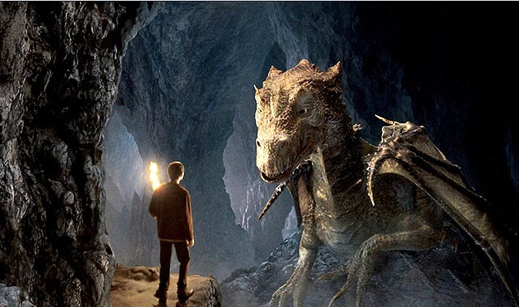
Building a noun phrase
Choose a noun from this image
Add some pre-modifying detail
Change the detail and change the mood
Notes:
Image used in Merlin scheme
Link choices to intention: What image do you want to build of the dragon/cave/boy?
eg to stress the darkness/danger of the cave: the dimly-lit, slimy cavern walls
to stress the non-threatening nature of the dragon: a surprisingly small, friendly-looking dragon

Slide 21
Developing the noun phrase by adding words after the main noun: post-modification
Noun | Adjective | Prepositional phrase | Relative clause | Non Finite Clause
dragon wings claws tail head body | spiky delicate rough scaly turquoise jade-green fierce | with steel-grey spikes of immense strength | which rules the skyline who towers above the horizon, that terrorises the valleys | towering above the world silhouetted against the darkening skies

Slide 22
Building a noun phrase
Choose a noun from this image
Add some post-modifying detail
Change the detail and change the mood
Notes:
Link choices to intention: What image do you want to build of the dragon/cave/boy?
eg to stress the darkness/danger of the cave: cavern walls that were twisted into monstrous shapes
to stress the non-threatening nature of the dragon: a dragon with pleading eyes, whispering in a low, soft voice

Slide 23
Task: Writer’s intention: What image do you want to build of the dragon/cave/boy? What do you want your reader to see, think or feel?
Select the best noun phrase to achieve this, using your earlier
Ideas.
Read your example to a
partner and ask them what
their impressions were.
Did you achieve the impact
you intended?

Slide 24
Planning for progression: The NP
Understanding a noun [tiger]
Understanding (common) noun and Proper noun [Siberian Tiger]
Understanding a simple pre-modified noun phrase, introducing the concept of an adjective and determiner, if not already known [the man-eating tiger]
Understanding how an adverb pre-modifies [a terribly fierce tiger]
Understanding post-modification with a prepositional phrase [the man-eating tiger, with enormous jaws]
Understanding post-modification with a relative clause [the man-eating tiger, who was hunting for prey]
Understanding post-modification with a non-finite clause [the tiger, prowling silently]
Notes:
NB This is an attempt to model development in learning about the noun phrase, to inform teachers’ understanding of how to consolidate and build on students’ understanding across the key stages. It is not intended as a ‘step by step ladder’ of attainment.

Slide 25
Subject Verb Inversion

Slide 26
In most clauses, the subject typically comes before the verb.
This is a very common pattern
The most natural pattern for a young writer to write
27

Slide 27
Effective use of the typical pattern
The tiger padded through the night. Joe Maloney smelt it, the hot, sour breath, the stench of its pelt. The odour crept through the streets, through his open window and into his dreams. He felt the animal wildness on his tongue, in his nostrils. The tiger moved as if it knew him, as if it was drawn to him. Joe heard its footpads on the stairs. He heard its long slow breath, the distant sighing in its lungs, the rattle in its throat.
From Secret Heart, David Almond

Slide 28
Subject Verb Inversion
However, the subject verb pattern is so common, it is worth pointing out what happens when this typical pattern is disrupted
Into a forest of fifty thousand trees rode a lone traveller.
Beauty and Beast- Geraldine McCaughrean
Can you identify the subject and the verb?
Can you recast the sentence in the more typical pattern?
Can you describe the effect of switching the subject verb order?
28

Slide 29
Subject Verb Inversion
And there, at last, was the robin.
Arthur, High King of Britain – Michael Morpurgo
In the west of the city was a fabulous garden.
The Paradise Garden – Colin Thompson
“There’s a light up ahead,” said Gregor.
29

Slide 30
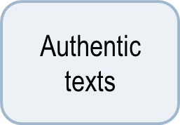
A taste of things to come
Discussion
Read both these sentences aloud – can you hear how they emphasise different things and create different effects?
30
Notes:
Activity from the Merlin scheme

Slide 31
Arthur, merlin and the knights of the round table
Narrative fiction

Slide 32
Project Website
http://socialsciences.exeter.ac.uk/education/research/centres/centreforresearchinwriting/projects/grammarforwriting/teacherpages/
Username: Lancelot
Password: Avalon
The Merlin scheme can also be downloaded from:
www.exeter.ac.uk/education/grammar-teacher-resources

Slide 33
SoW Overview
Week 1: Story-building and understanding narrative structure
Week 2: Word choices, especially noun phrases, and how they help create character
Week 3: Sentence shaping and how it supports plot development and revising text
Week 4: Designing text – focusing on drafting and revising

Slide 34
Narrative Structure
Week 1: Key Focuses
Use of story mountain image and structure
The image deliberately has two peaks to avoid suggesting too rigid a story structure
Activities which secure understanding of story structure
The concepts of ‘problem’ and ‘climax’ are the hardest: try to ensure these are securely understood
The idea of bare bones being just the plot; and how as writers we have to flesh it to make it an engaging story

Slide 35
Developing Character
Week 2: Key Focuses
From visual images to verbal – painting in words
Helping readers see our characters
Using noun phrases to paint pictures
Using well-chosen nouns rather than too many adjectives
Developing descriptive post-modification in noun phrases
Making readers infer about our characters through show not tell

Slide 36
Creating Visual images in words
Creating Character

Slide 37
From visual to verbal
The video clip in words:
Then, out of the darkness, came a lady, dark-haired and beautiful, wearing a gown of wine-red. She stood over the burial casket of a knight and began to speak in a strange language, the words flowing from her lips like a dark song. She raised her arm over the casket, her long fingers extended, and her eyes, wide and intense. The flow of words grew louder, the lady’s voice grew stronger and more insistent, until almost shrieking, she spoke the name, ‘Uther Pendragon!’

Slide 38
Noun Phrases to Build Description
Sometimes noun phrases are built by putting adjectives before the noun:
a strange language
a dark song
her long fingers
Look at your description of a character from the Arthur and Merlin stories: have you created any noun phrases like this?
What did you want to make you reader see or think about your character?

Slide 39
Noun Phrases to Build Description
You can also build noun phrases by adding more description after the noun
You could add adjectives:
her fingers, long, white and dancing,
her eyes, wide and intense,
a lady, dark-haired and beautiful,
You could add a prepositional phrase:
the colour of honey
the hood of his dark cloak
You could add a non-finite clause beginning with an –ing or –ed verb:
gold washed in milk
a lady, dark-haired and beautiful, wearing a gown of wine-red
the words flowing from her lips

Slide 40
Describing Characters
Building detail by adding information after the noun (post-modification):
Character | Determiner | NOUN | Adjectives | Non-finite clause
Merlin | his | face | parchment-silver | etched with age
Guinevere | her | fingers | long, white and dancing
Morgana | a | lady | dark-haired and beautiful | wearing a gown of wine-red
Morgana | the | words |  | flowing from her lips

Slide 41
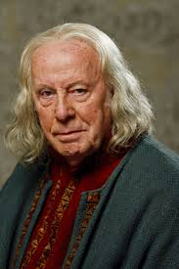
Examples of Noun Phrases
… her fingers, long, white and dancing, …
… her eyes, wide and intense, …
… a lady, dark-haired and beautiful, …
… the hood of his dark cloak, …
… his face, parchment-silver and etched with age …
CREATE YOUR OWN NOUN PHRASE TO DESCRIBE THIS CHARACTER AND PAINT A PICTURE OF HIM IN WORDS

Slide 42
From visual to verbal
One aspect of writing is conveying in words the images we have in our heads of characters and scenes
We have to paint in words
Well-chosen noun phrases help us to paint a visual picture of our characters for our readers
In general, better writers use more post-modification; weaker writers use very little modification but if they do it is before the noun
Better writers use fewer adjectives before the noun; and choose stronger nouns

Slide 43
MAKing the reader infer: show not tell
Creating Character

Slide 44
Show, not Tell: make your reader infer
When we describe characters for our readers, sometimes we tell them directly about the character: here’s Roald Dahl’s description of Mr and Mrs Wormwood’s house:-
‘Matilda’s parents owned quite a nice house with three bedrooms upstairs, while on the ground floor there was dining-room and a living-room and a kitchen’
This gives us precise information about their house.
But good writers also make the readers think about, or infer, what characters are like from a description:
‘Mr Wormwood was a small ratty-looking man whose front teeth stuck out underneath a thin ratty moustache.’
This description is not just information about what Matilda’s dad looks like: by showing us what he looks like, Dahl also makes us think, or infer, about what kind of man he is. What kind of a man is ‘ratty-looking’? What do we think about rats as creatures? How different it would have been if Dahl had described him as ‘a cuddly bear-like man’?

Slide 45
Show, not Tell: make your reader infer
Show not tell: Dahl doesn’t tell us that Mr Wormwood is a nasty little man, he tells us he is ‘ratty-looking’ and so shows us he is a nasty little man. We have to work this out for ourselves (or infer this).
When we write, sometimes we do tell our readers about characters, but good writers also make the reader infer what the character is like.

Slide 46
Show, not Tell
What does the physical description of the man and his horse suggest about his character?
What might a reader think about a man who is completely green?
What does the description of how the man arrives suggest about his character?
At that moment, from outside in the courtyard, came the clatter of horses’ hooves on the cobbles. The doors of the hall flew open, and before I had time to call for them to be closed, a giant of a man rode in on a towering warhorse that pawed the ground, sides lathered up, tossing its fine head, snorting its fury. The man swept the hall with terrible eyes, wolfish eyes that froze the courage in a man’s veins, eyes you could not hold with your own. But it was not the man’s eyes that amazed us most, it was not his size either - and I tell you I’d never in my life set eyes on a bigger man – no. It was the colour of him. Green, the man was green from head to foot.
Arthur, High King of Britain by Michael Morpurgo

Slide 47
Show, not Tell: through noun phrases
At that moment, from outside in the courtyard, came the clatter of horses’ hooves on the cobbles. The doors of the hall flew open, and before I had time to call for them to be closed, a giant of a man rode in on a towering warhorse that pawed the ground, sides lathered up, tossing its fine head, snorting its fury. The man swept the hall with terrible eyes, wolfish eyes that froze the courage in a man’s veins, eyes you could not hold with your own. But it was not the man’s eyes that amazed us most, it was not his size either - and I tell you I’d never in my life set eyes on a bigger man – no. It was the colour of him. Green, the man was green from head to foot.

Slide 48
Show, not Tell: through noun phrases
At that moment, from outside in the courtyard, came the clatter of horses’ hooves on the cobbles. The doors of the hall flew open, and before I had time to call for them to be closed, a giant of a man rode in on a towering warhorse that pawed the ground, sides lathered up, tossing its fine head, snorting its fury. The man swept the hall with terrible eyes, wolfish eyes that froze the courage in a man’s veins, eyes you could not hold with your own. But it was not the man’s eyes that amazed us most, it was not his size either - and I tell you I’d never in my life set eyes on a bigger man – no. It was the colour of him. Green, the man was green from head to foot.

Slide 49
Show, not Tell: through noun phrases
… the clatter of horses’ hooves on the cobbles ….
… a towering warhorse that pawed the ground, sides lathered up, tossing its fine head, snorting its fury …
… a giant of a man…
… terrible eyes, wolfish eyes that froze the courage in a man’s veins, eyes you could not hold with your own…
… a bigger man …
… the colour of him…
Michael Morpurgo shows us through his noun phrases that:
He is a giant of a man – so he is likely to be strong, possibly fierce;
His horse is towering and it is a warhorse so he must be a fighting man;
The man has terrible eyes, like a wolf’s (wolfish ), and it makes the other knights frightened (froze the courage in a man’s veins) so he might be evil or nasty
The man is a strange colour (green) – what kind of man is green?

Slide 50
Show, not Tell: through noun phrases
Michael Morpurgo could have told us about the Green Knight by writing:
The Green Knight was a huge man who was very powerful and intimidating, and who was ready to fight , and he had a horse that was very fierce and threatening.
Instead he shows us what the Green Knight is like by writing:
a giant of a man rode in on a towering warhorse that pawed the ground, sides lathered up, tossing its fine head, snorting its fury. The man swept the hall with terrible eyes, wolfish eyes that froze the courage in a man’s veins, eyes you could not hold with your own.
He shows us the character of the Knight by describing what he looks like; he doesn’t tell us. We have to infer what the character is like.

Slide 51
Show not Tell
Create character descriptions by showing readers things which make us infer what the character is like
Noun phrases are one way to provide these detailed descriptions
Verb choices can also do this: eg flew, rode, swept, pawed, tossing, snorting

Slide 52
Shaping NARrative events
Subject Verb Inversion

Slide 53
Shaping Sentences
Week 3: Key Focuses
Looking at how to write well about narrative events
Shaping sentences is one way to enhance meaning in a story
Writers can choose where to put information in a sentence to give it different emphasis
Putting the subject last in the sentence, after the verb, can create emphasis or anticipation
Varied sentence lengths create a good text rhythm
Short sentences can draw attention to key events or moments

Slide 54
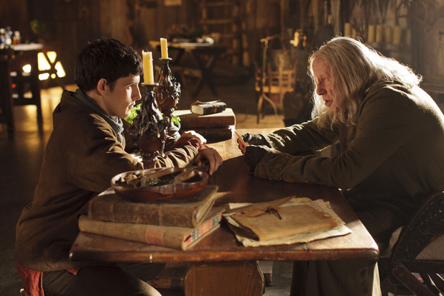

Slide 56
Sentence Structure
an arm in a white silk sleeve to my amazement came and
up out of the lake a shining sword a hand holding it
A shining sword came up out of the lake.
A shining sword, and a hand holding it, came up out of the lake.
To my amazement, a shining sword, and a hand holding it, came up out of the lake.
To my amazement, a shining sword, a hand holding it, and an arm in a white silk sleeve came up out of the lake.
Can the sentence chunks be arranged in any other order?
What is the subject and the verb in these sentences?

Slide 57
Sentence Structure
an arm in a white silk sleeve to my amazement came and
up out of the lake a shining sword a hand holding it
A shining sword came up out of the lake.
A shining sword, and a hand holding it, came up out of the lake.
To my amazement, a shining sword, and a hand holding it, came up out of the lake.
To my amazement, a shining sword, a hand holding it, and an arm in a white silk sleeve came up out of the lake.
Can the sentence chunks be arranged in any other order?
What is the subject and the verb in these sentences?

Slide 58
The Lady of the Lake
I looked, but I could see nothing at first. But then as I looked I saw the surface of the lake shiver and break. And, to my amazement, up out of the lake came a shining sword, a hand holding it, and an arm in a white silk sleeve.
‘There,’ Merlin whispered. ‘You have your answer. That is Excalibur. It comes from the half-world of Avalon, the blade forged by elf-kind, the scabbard woven by the Lady Nemue herself, the Lady of the Lake, and my lady too.’ And as he spoke her name, his voice faltered. ‘See, here she comes.’
And out of the mists came a figure in flowing green, walking across the water. Yet the water seemed undisturbed beneath her feet as if she was walking on air. She came towards us, holding a scabbard in both her hands, and a swordbelt hanging from it.

Slide 59
Putting the Subject After the Verb
And, to my amazement, up out of the lake came a shining sword, a hand holding it, and an arm in a white silk sleeve.
And out of the mists came a figure in flowing green, walking across the water.
Usually the subject comes before the verb, so when it comes after the verb it changes how we read it.
Why do you think Michael Morpurgo reversed the position of the subject and put it after the verb?
What effect does it have on the reader?
How did you read this sentence aloud?
Putting the subject after the verb makes us wait to find out what the sentence is about – it can create suspense or anticipation. It can also help us visualise a scene the way the writer wants us to see it.

Slide 60
Subject Verb Inversions
Sentences can be shaped to enhance meanings in your story
Writers can choose where to put information in a sentence to give it different emphasis
Putting the subject last in the sentence, after the verb, can create emphasis or anticipation

Slide 61
Text Designers
Week 4: Key Focuses
Consolidating key learning about writing narrative fiction
Giving quality time for the writing process
Supporting all aspects of the writing process: generating ideas and imaginative engagement; outlining the narrative; drafting; revising

Slide 62
plenary

Slide 63
Evaluating students’ writing
Evaluating how controlled and deliberate students’ choices are - and how effective they are - is not straightforward, for example:
we want students to try out new structures but not all experiments ‘work’
success in applying one feature may be at the expense of others – what do we prioritise in any one written outcome?
application may be immediately successful but not consolidated or built on in subsequent written outcomes
we want students to understand the effectiveness of their choices, not just deploy what they’ve been taught

Slide 64
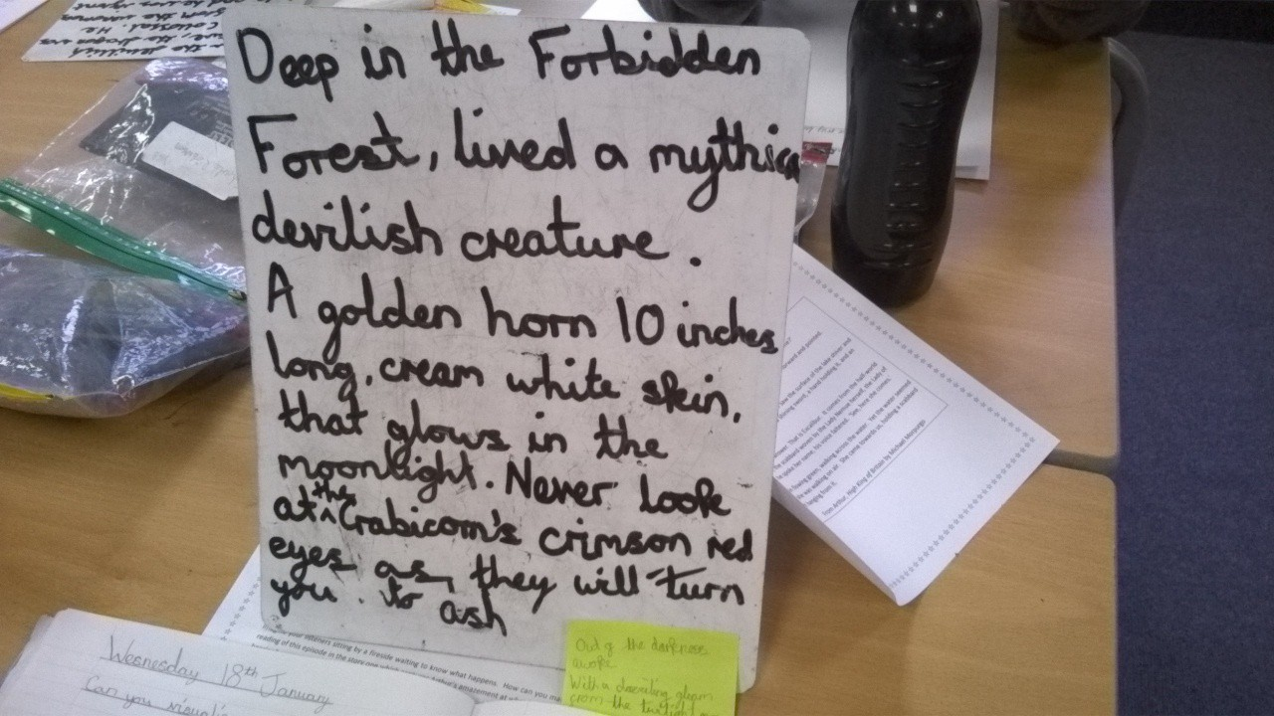
What has this student learned and applied? How successfully?
Notes:
Example of work in progress from Gleadless Primary in Sheffield
Deep in the forbidden forest, lived a mythical devilish creature. A golden horn 10 inches long, cream white skin, that glows in the moonlight. Never look at the Crabicorn’s crimson red eyes as they will turn you to ash.
Note: use of subject-verb inversion (examples on post-it note read ‘out of the darkness came’)
Different patterns of noun phrase – pre and post modifying
Not quite understood – second noun phrase not used in a complete sentence

Slide 65
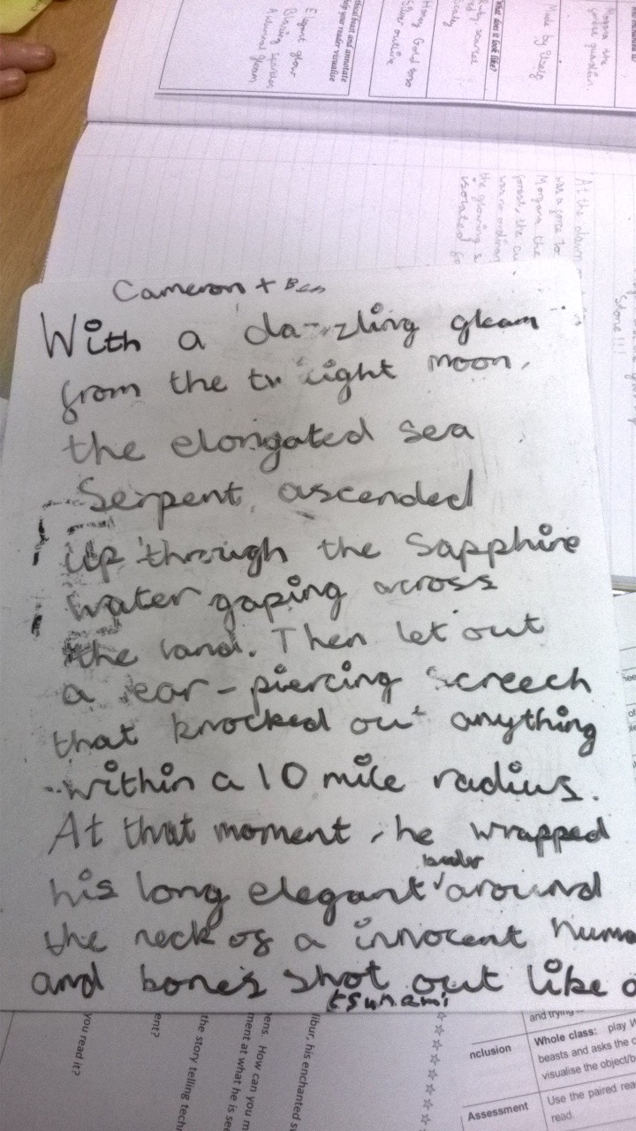
What has this student learned and applied? How successfully?
With a dazzling gleam from the twilight moon, the elongated sea serpent ascended through the sapphire water gaping across the land. Then let out a ear-piercing scream that knocked out anything within a 10 mile radius. At that moment, he wrapped his long elegant feelers around the neck of a innocent human being and bones shot out like a tsunami.

Slide 66
How has this student used the mentor text? How successfully?
In a cloud of azure blue smoke a mysterious lady appeared; she had long, flowing hair the colour of the sun but more milky, more smooth. Her skin was pale but had almost a hint of blue and her lips were a coral peach which reflected the light wondrously like a shiny mirror. Crystal blue eyes stared at him and seeing her would make you feel faint, as though you had just met the most beautiful woman ever. Soft words filled the room like a magnificent song and as she spoke her flawless legs moved towards him slowly and silently like a tiger approaching its prey in the jungle.
Notes:
Mentor Text:
The crypt was cold and dimly lit, and smelt musty, of ancient times. Row by row, through the chamber, stood the burial caskets of people long since dead, knights and their ladies. Cobwebs shivered in a shaft of moonlight piercing the gloom. Then, out of the darkness, came a lady, dark-haired and beautiful, wearing a gown of wine-red. She stood over the burial casket of a knight and began to speak in a strange language, the words flowing from her lips like a dark song. She raised her arm over the casket, her long fingers extended, and her eyes wide and intense. The flow of words grew louder, the lady’s voice grew stronger and more insistent, until almost shrieking, she spoke the name, ‘Uther Pendragon!’. A splitting, cracking noise filled the chamber. A deep crack grew along the length of the tomb, from toe to head, and the solid surface crumbled into dust. From the tomb rose a gloved hand, clad in an iron gauntlet, and as the hand stretched upwards, the fingers moved slowly. The lady smiled.

Slide 67
King Arthur Stories
Consider reading the Morpurgo story, Arthur, High King of Britain, before you do the scheme of work or alongside it.
There are lots of other Arthur stories you might want to get for the library and encourage children to read: see this website: http://trinity.nsw.libguides.com/c.php?g=5552&p=23821
Strongly recommended for year 6:
Kevin Crossley-Holland’s Trilogy: Arthur and the Seeing Stone etc
Geraldine McCaughrean: King Arthur and a World of Other Stories
Philip Reeve: Here Lies Arthur

Slide 68
Before you teach this
What resources might you gather?
How might the theme work across the curriculum?
What other creative activities might support the theme?
As well as the written outcomes what else might you hope to get out of using this scheme of work?

