Slide 1
GRAMMAR FOR WRITING
Choice and Control.
CPD Day 3

Slide 2
INTRODUCtion

Slide 3
Aims of Session: CPD Day 3
To re-iterate the teaching principles underpinning the writing intervention;
To secure grammatical subject knowledge of adverbials, modal verbs, and the passive voice’
To understand the teaching approaches in the persuasive writing SoW.

Slide 4
GfW: Four Key Teaching Principles
Make a link between the grammar being introduced and how it works in the writing being taught;
Explain the grammar through examples, not lengthy explanations;
Build in high-quality discussion about grammar and its effects.
Use examples from authentic texts to links writers to the broader community of writers.
Notes:
The Big Three!

Slide 5
Teaching Writing Creatively
To write well we all need to have something to say and a desire to say it;
Before young writers can meaningfully attend to how they have written something, they need to have engaged with what they want to say – the ideas;
Engaging young writers’ imaginations, emotions and personal beliefs is a really important part of teaching writing;
Allowing young writers freedom to explore ideas, test things out, and to write to find out what they want to say is critical
We often move far too quickly to pinning things down, and making writing a very linear process – we need to create space for exploration, experimentation and re-drafting.
This is built into both of our Schemes of Work.

Slide 6
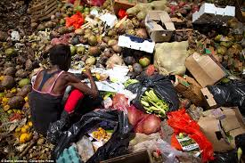
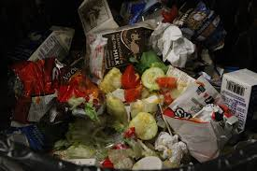
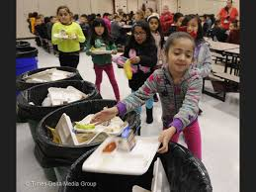
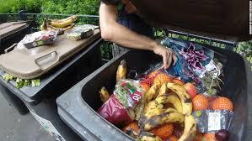
https://www.youtube.com/watch?v=tU1m6EWMZaY

Slide 7
Teaching Writing Creatively
Persuasive Writing: Scheme of Work
Real life issue: connecting persuasive writing with an issue which they can understand, and which can be extended in the local context.
Content input: video and text information to ensure the children have the information to be persuasive with;.
On the Soapbox: practising written speech orally in an authentic persuasive context; generating confidence in public speaking;
The Writing Process: gives space for idea generating, planning, outlining, drafting and revising throughout the scheme, with a particular emphasis on initial collaborative writing, then independent writing.

Slide 8
GRAMMAR SUBJECT KNOWLEDGE
Modal verbs, adverbials and passive voice

Slide 9
Overview of the session:
Using language devices to position the reader
Adverbials
Modal verbs
Passive voice
Notes:
All about: Language features that the author uses that makes the reader attend to the things they want them to attend to and when.
As usual we will use a range of texts to illustrate these 3 elements and how they create that positioning effect.

Slide 10
Adverbs/Adverbials
Subject
Verb
Object
Adverbial
Complement (adjective) / Complement (noun)
Gregor ate bread greedily.
Beauty’s father was eating the extremely fresh bread.
Gregor ate bread so greedily…
Surprisingly, Beauty’s father was eating the freshly baked bread .

Slide 11
Activity – in small groups
Teachers’ demanding workload is growing.

Slide 12
A letter from the RSPB
Look at the adverbs/adverbials identified in the text.
What is each one trying to do?
How do they position the reader?

Slide 13
Adverbs/adverbials: big ideas
Adverbs/adverbials modify (almost everything)
They provide additional information:
Time
Place
Manner
Reason
Degree
Some types link ideas across clauses, sentences or paragraphs (conjuncts and conjunctions) or comment on a whole clause or sentence (disjuncts)
Adverbs/adverbials are often mobile within a sentence
Notes:
.

Slide 14
Modal Verbs
We ___________ open the door.
shall, should, can, could, might, may, must, will, would

Slide 15
Kensuke’s Kingdom - Michael Morpurgo
But I knew now I couldn’t have been.
I must have dreamed it, dreamed the whole thing.
I must have clung to my football and kept myself afloat until I was washed up.
From where I now stood I could see that the forest grew more sparsely up the side of a great hill some way inland, and it occurred to me then that if I could reach the bare rocky outcrop at the summit.
Or perhaps there’d be some house or farm further inland, or maybe a road, and I could find someone to help.

Slide 16
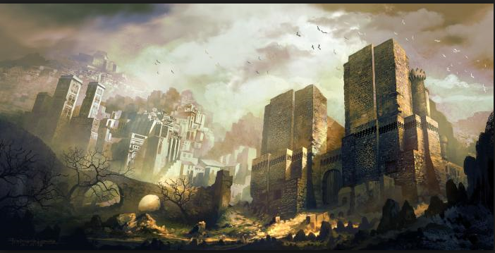

Slide 17
A letter from the RSPB
Activity
Find the modal verbs
What is the effect on the reader?
How are they used across the text?

Slide 18
Modal verbs: big ideas
Type of auxiliary verb and help form verb phrases
Always go before other auxiliaries (You could have heard; Time could be running out.)
Express degrees of possibility and certainty (and therefore can be used to position a reader)
Do not have an ‘s’ form or non-finite forms (-ing, -ed, to - )

Slide 19
The Passive Voice
Form
Auxiliary verb ‘be’ + past participle of the main verb.
The pen was dropped.

Slide 20
The picture is painted.
Modal
may
might
can
could
will
would
must
Auxiliary
is
was
has been
have been
be
Lexical/Main
painted

Slide 21
Formation of passive
Verb ‘be’ + past participle
The picture is painted (by the artist).
The picture was painted.
The picture will be painted.
The picture is being painted.
The picture was being painted.
The picture has been painted.
The picture had been painted.
The picture might have been painted.

Slide 22
Passive Voice
The door was pushed slowly open…
As the cable is wound in…
A rucksack was loaded on my back…
“Where are the biscuits I bought yesterday?”
“I don’t know…I think they’ve been eaten.”
Thousands were made homeless.
Rules are made to be broken.

Slide 23
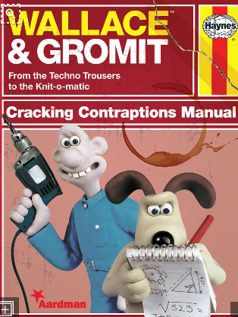
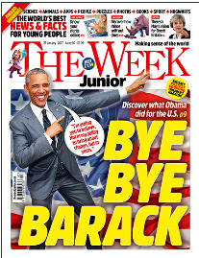
Activity
In your table group, work in pairs:
Each pair read one of the texts
Find examples of the passive voice
Tell your whole group what effect the passive has and give an example

Slide 24
SV inversion:
Other ways to create the same effects
Delaying/distancing: passive voice
Every corridor was lined with great gilded mirrors, each one cracked like broken ice. Every vase was filled with fresh flowers, every statue blindfolded with a scarf of silk.
Beauty and the Beast – Geraldine McCaughrean

Slide 25
Passive voice: big ideas
Constructed with auxiliary verb ‘be’ + past participle of the main verb
Can create different effects for the reader
Mystery and suspense
Formality – the agent is unimportant
Abdication of responsibility
Lack of control
Focus on result of an incident, outcome or argument
General truths

Slide 26
Overview of the session:
Using language devices to position the reader
Adverbials
Modal verbs
Passive voice

Slide 27
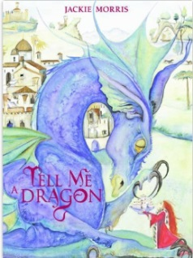
He swam to the bottom of the deepest ocean.
He climbed to the tops of the tallest trees.
…whisper-thin wings of rainbow hues.

Slide 28
Developing the noun phrase by adding words after the main noun: post-modification
Noun | Adjective | Prepositional phrase | Relative clause | Non Finite Clause
dragon wings body | spiky delicate rough scaly turquoise jade-green fierce | with steel-grey spikes of immense strength | which rules the skyline who towers above the horizon, that terrorises the valleys | towering above the world silhouetted against the darkening skies

Slide 29
The Ice Bear Jackie Morris
…a piece of amber, smoothed by oceans, coloured, clear and beautiful, like a fragment of fire, washed ashore from a far off place.

Slide 30
The Ice Bear Jackie Morris
…a piece of amber, smoothed by oceans, coloured, clear and beautiful, like a fragment of fire, washed ashore from a far off place.

Slide 31
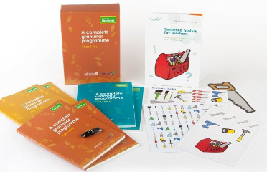
Resources to help you…
Essential Primary Grammar:
Myhill, Jones, Watson & Lines (2016)
No Nonsense Grammar: Babcock LDP Literacy Team, Raintree (2016)
www.babcock-education.co.uk/ldp/literacy

Slide 32
Food WASTE: cAn YOU CHANGE THE WORLD?
Persuasive Writing

Slide 33
SoW Overview
This scheme of work focuses on developing students’ awareness of the need to craft and shape a persuasive text. Through collaborative joint composition and collaborative revision, it supports students in learning about the writing process and how to plan and revise. The scheme draws attention to some characteristics of a persuasive text, developing students’ understanding of 3 core issues.
Task awareness: Who is the reader? What is the purpose of the text? What are the writer’s authorial intentions?
Content: What do we need to know about the topic of food waste to create a persuasive text?
Grammar and Language Choices: How are we going to write the text?

Slide 34
Grammar-Writing Links
Understanding how to create a persuasive argument through:
Using clear statement sentences to make important points
Using single clause sentences to draw attention to key points
Choosing positioning vocabulary to indicate your point of view
Choosing information, such as statistics, to support your point of view
Using modal verbs to indicate different levels of assertion/possibility
Choosing adverbs to reveal or emphasise your point of view
Choosing connecting adverbials to link ideas across sentences

Slide 35
Being Persuasive
These are all sentences from different reports on food waste. The writers have thought about how to be persuasive – thinking about what they write and how they express it.
With food bank visits at an all-time high, the amount supermarkets are throwing away is appalling.
A survey reveals a staggering two thirds of some freshly bought food goes to waste.
The average UK family is wasting nearly £60 a month by throwing away almost an entire meal a day.
One third of all food produced in the world ends up as waste.

Slide 36
Being Persuasive
These are all sentences from different reports on food waste. The writers have thought about how to be persuasive – thinking about what they write and how they express it.
With food bank visits at an all-time high, the amount supermarkets are throwing away is appalling.
A survey reveals a staggering two thirds of some freshly bought food goes to waste.
The average UK family is wasting nearly £60 a month by throwing away almost an entire meal a day.
One third of all food produced in the world ends up as waste.
The sentences are all clear statements which express the writer’s point of view.

Slide 37
Being Persuasive
They use vocabulary which emphasises the point of view.
These are all sentences from different reports on food waste. The writers have thought about how to be persuasive – thinking about what they write and how they express it.
With food bank visits at an all-time high, the amount supermarkets are throwing away is appalling.
A survey reveals a staggering two thirds of some freshly bought food goes to waste.
The average UK family is wasting nearly £60 a month by throwing away almost an entire meal a day.
One third of all food produced in the world ends up as waste.
The sentences are all clear statements which express the writer’s point of view

Slide 38
Being Persuasive
They use vocabulary which emphasises the point of view.
These are all sentences from different reports on food waste. The writers have thought about how to be persuasive – thinking about what they write and how they express it.
With food bank visits at an all-time high, the amount supermarkets are throwing away is appalling.
A survey reveals a staggering two thirds of some freshly bought food goes to waste.
The average UK family is wasting nearly £60 a month by throwing away almost an entire meal a day.
One third of all food produced in the world ends up as waste.
They choose facts which support their point of view.
The sentences are all clear statements which express the writer’s point of view

Slide 39
Being Persuasive
You can sometimes make your point stronger by stating it using a short single clause sentence:
With food bank visits at an all-time high, the amount supermarkets are throwing away is appalling.
The amount of food waste from supermarkets is appalling.
The average UK family is wasting nearly £60 a month by throwing away almost an entire meal a day.
The average UK family throws away almost an entire meal a day.
One third of all food produced in the world ends up as waste.
One third of the world’s food ends up as waste.

Slide 40
Being a Persuasive Writer
There are many choices you can make as a writer to make your writing more persuasive and express your point of view strongly. We have been looking at:
Making vocabulary choices which signal your point of view:
eg appalling; staggering; waste;
Using clear statement sentences to make important points:
A survey reveals a staggering two thirds of some freshly bought food goes to waste.
Choosing information which supports your point of view:
One third of all food produced in the world ends up as waste.
Using short single clause sentences to draw attention to your point:
The amount of food waste from supermarkets is appalling.
You can make choices as a writer which could persuade people to take action to change the world!

Slide 41
Words to Change the World
Nouns:
rubbish wastefulness disposal refuse environment
consumer consumption perishables landfill produce suppliers exporters packaging emissions pollution resources
Verbs
squander misuse redistribute pollute
Adjectives:
nourishing unsold edible consumable mis-shapen imperfect

Slide 42
PERSUADING WITH MODAL VERBS

Slide 43
Modal Verbs
must can will may would shall should could might ought to
loud
You can have chocolate after dinner.
Turning up the volume: modal verbs can be used for gentle persuasion or strong persuasion, like turning up or turning down the volume on the television
soft

Slide 44
Modal Verbs
can could will would shall should may might must ought to
they simply cannot make ends meet
more could be done to reduce food waste
Just imagine what it must be like …
supermarkets should also be encouraged to offer a service …
Delivery vans could then drop much needed perishables to people on the delivery route …
My health would have improved immeasurably …
I would have been spared…
France has already proven that this can work

Slide 45
Reflection Point
What do you know about food waste now?
What facts do you know that might support an argument?
What are the different ways in which food gets wasted?
What are the consequences of food waste?
Why does it matter?

Slide 46
Video clip 2:
https://www.youtube.com/watch?v=ZVkaYxJDqmI

Slide 47
Planning and Drafting
What strategies do you use when you have to plan a piece of writing?
What strategies do you use when you are drafting a piece of text?

Slide 48
Planning and Drafting
What strategies do you use when you have to plan a piece of writing?
making sure you know enough about the topic you have to write about
thinking about the vocabulary you might need
making sure you know what kind of writing you have to do
gathering ideas for what to write about
What strategies do you use when you are drafting a piece of text?
pausing occasionally to re-read the text
thinking ahead to where the text will end
remembering what kind of writing you have to do
thinking about your reader and how you want them to think or feel

Slide 49
Writing Task
What is the opinion you want to express?
Who is the audience?
Write a letter to your local paper arguing that so much food waste is wrong and suggesting what action we should take to reduce food waste. [No more than 300 words]
What is the purpose of this task? What do you want to happen if someone reads your letter?
How do you need to write this letter to be persuasive?
What do you know about how to write letters?

Slide 50
Writing Together
One pen: three heads!
Collaborative writing is about using everyone in the group to compose a single piece of writing.
You will need to:
listen to each other’s suggestions
try out different possibilities for your writing
make suggestions yourself
discuss disagreements politely and thoughtfully (they are often the most interesting points!)

Slide 51
PERSUASIVE ADVERBS

Slide 52
From Adjectives to Adverbs
disgusting disgustingly
amazing amazingly
remarkable remarkably
incredible incredibly
Can you think of more?

Slide 53
Adverbs to show Point of View
I'm passionate about making this happen because a few years ago I fell on hard luck myself. I lost my job through no fault of my own due to a chronic illness. My health would have improved immeasurably had I been able to afford fresh, healthy, fruit and vegetables.
If a scheme whereby these life-giving items were available to me for free had been provided back then, I would have been spared the constant choice of eating properly or paying the ever-mounting bills. I was incredibly lucky that I had friends and family to bail me out and buy me a few groceries during the bleakest of times, but so many others are just not as fortunate.
Now that I am well enough to support myself again, I don't want anyone else to experience the hell I went through. The food is THERE and it’s perfectly good and nourishing. There are so many people who need it right now, despite what the government might try to make you believe.
So what are we waiting for? France has already proven that this can work. So I’m asking for Parliament to take this campaign seriously and rush through a change in the law as soon as possible, before anyone else in the UK starves needlessly.

Slide 54
Adverbials to connect Ideas
After reading about the bill being passed in France to force supermarkets to give their unsold but still consumable food products to at least one food charity I decided that I’d try to do something for us here in the UK. For, while we may be separated by the Channel, our problems with waste are very much the same. For example, two years ago Tesco announced that it had generated almost 30,000 tonnes of food waste over just six months.
In light of the successful French campaign to cut waste, I started a petition in the UK hoping that it may eventually make it to a debate in Parliament. I needed to get 100,000 signatures for this to happen. It's now got over 150,000, and has been popping up all over the world, across the press and social media.
There are two main threads to my campaign. First of all, I believe that supermarkets should be legally obliged to hand over all unsold but still edible foods to various food distribution charities instead of it going straight to landfill. On top of this, supermarkets should also be encouraged to offer a service whereby customers can opt in for voluntary weekly donations (a small sum, around £2) when they buy their groceries online.

Slide 55
Adverbials to connect Ideas
There are two main threads to my campaign. First of all, I believe that supermarkets should be legally obliged to hand over all unsold but still edible foods to various food distribution charities instead of it going straight to landfill. On top of this, supermarkets should also be encouraged to offer a service whereby customers can opt in for voluntary weekly donations (a small sum, around £2) when they buy their groceries online.
In this paragraph the two adverbial phrases, ‘First of all’ and ‘On top of this’, link back to the opening sentence and the ‘two main threads’. Thread 1 is introduced by ‘First of all’ and thread 2 by ‘On top of this’. This helps to make the paragraph coherent and flow well.
Have you noticed that this writer uses a short single clause sentence to introduce this paragraph?

Slide 56
Adverbials to Connect Ideas
Some examples of other adverbial phrases which can connect ideas across sentences and across your writing:
on the other hand
despite this
even so
to sum up
in contrast
as a result
for instance
You might know some more?

Slide 57
Have your Say!
Your chance to change the world!
Make an argument expressing your opinion about food waste.
Draft and rehearse to each other a 30 seconds to one minute soapbox speech (perhaps just four or five sentences), presenting your opinion on food waste, using positioning adverbs and some of the adverbial connectives to make it cohesive.

Slide 58
Revising Well
Revising what you have written: the content:-
How strong are the points you have made?
How much detail or information have you given to support your argument?
Revising how you have written it: the choices you have made:-
How have you made your text persuasive?
What language choices can you make to create a really persuasive text?
Revising strategies:
Reading and re-reading; crossing out words and phrases; writing new words or phrases in margins; using arrows to show where things need to move around; reading aloud to each other; trying out different choices …
Revising is messy!

Slide 59
Writing Assessment
New KS2 assessment too unreliable to use
York University team will come in and administer a writing assessment (an old KS2 paper).
They will ensure it is not stressful.
The test will be after the KS2 tests.
They will handle all the administration, and if you want to keep a copy of the children’s writing. They will sort that for you.
We will be contacting headteachers for consent (ethical procedures)

Slide 60
Project Website
http://socialsciences.exeter.ac.uk/education/research/centres/centreforresearchinwriting/projects/grammarforwriting/interventionteachers/
Username: Merlin
Password: Excalibur

