Slide 1


GRAMMAR FOR WRITING
Choice and Control.
CPD Day 3

Slide 2
Aims of the day:
To understand the teaching approaches in the persuasive writing SoW;
To secure grammatical subject knowledge of modal verbs and adverbials;
To support your own planning and teaching of writing informed by Grammar for Writing principles.
Notes:
Third point: thinking of the CPD days we’ve provided as a foundation for teachers to develop similar approaches to teaching writing in their own schools.
Reminder of GfW principles on next slide. Can they remember the ‘big four’? Think LEAD (link grammar to effect; grammar taught through examples not lengthy explanations; authentic texts; discussion)

Slide 3
GfW: Four Key Teaching Principles
Make a link between the grammar being introduced and how it works in the writing being taught;
Explain the grammar through examples, not lengthy explanations;
Use examples from authentic texts to links writers to the broader community of writers;
Build in high-quality discussion about grammar and its effects.
Notes:
LEAD! Link/examples/authentic text/discussion

Slide 4
Teaching Writing Creatively
To write well we all need to have something to say and a desire to say it.
Before young writers can meaningfully attend to how they have written something, they need to have engaged with what they want to say – the ideas.
Engaging young writers’ imaginations, emotions and personal beliefs is a really important part of teaching writing.
Allowing young writers freedom to explore ideas, test things out, and to write to find out what they want to say is critical.
We often move far too quickly to pinning things down, and making writing a very linear process – we need to create space for exploration, experimentation and re-drafting.
This is built into both of our Schemes of Work.
Notes:
Reminder of meaningful and creative contexts for teaching writing. Leads into explanation of food waste topic on next slides.

Slide 5
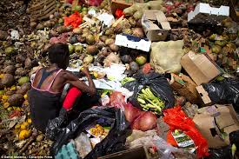
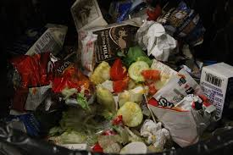
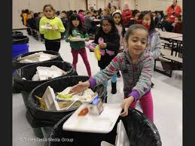
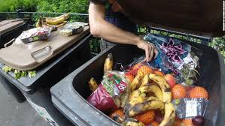
https://www.youtube.com/watch?v=tU1m6EWMZaY

Slide 6
Teaching Writing Creatively
Persuasive Writing Scheme of Work – ‘Food Waste: Can you Change the World?’
Real life issue: connecting persuasive writing with an issue which they can understand, and which can be extended in the local context.
Content input: video and text information to ensure the children have the information to be persuasive with.
On the Soapbox: practising written speech orally in an authentic persuasive context; generating confidence in public speaking.
The Writing Process: gives space for idea generating, planning, outlining, drafting and revising throughout the scheme, with a particular emphasis on initial collaborative writing, then independent writing.

Slide 7
Food Waste: SoW Overview
This scheme of work focuses on developing students’ awareness of the need to craft and shape a persuasive text. Through collaborative joint composition and collaborative revision, it supports students in learning about the writing process and how to plan and revise. The scheme draws attention to some characteristics of a persuasive text, developing students’ understanding of 3 core issues:
Task awareness: Who is the reader? What is the purpose of the text? What are the writer’s authorial intentions?
Content: What do we need to know about the topic of food waste to create a persuasive text?
Grammar and Language Choices: How are we going to write the text?

Slide 8
Food Waste: SoW Overview
Grammar-Writing Links:
Understanding how to create a persuasive argument through:
Using clear statement sentences to make important points
Using single clause sentences to draw attention to key points
Choosing positioning vocabulary to indicate your point of view
Choosing information, such as statistics, to support your point of view
Using modal verbs to indicate different levels of assertion or possibility
Choosing adverbs to reveal or emphasise your point of view
Choosing connecting adverbials to link ideas across sentences

Slide 9
Writing Task
What is the opinion you want to express?
Who is the audience?
Write a letter to your local paper arguing that so much food waste is wrong and suggesting what action we should take to reduce food waste. [No more than 300 words]
What is the purpose of this task? What do you want to happen if someone reads your letter?
How do you need to write this letter to be persuasive?
What do you know about how to write letters?
Notes:
Collaborative writing activity for teachers to try in pairs/threes
Handout Food Waste fact sheet
Allow 10 mins for discussion of questions on the slide and to draft the opening paragraph of their letter

Slide 10
Planning and Drafting
What strategies do you use when you have to plan a piece of writing?
making sure you know enough about the topic you have to write about
thinking about the vocabulary you might need
making sure you know what kind of writing you have to do
gathering ideas for what to write about
What strategies do you use when you are drafting a piece of text?
pausing occasionally to re-read the text
thinking ahead to where the text will end
remembering what kind of writing you have to do
thinking about your reader and how you want them to think or feel

Slide 11
Writing Together
One pen: three heads!
Collaborative writing is about using everyone in the group to compose a single piece of writing.
You will need to:
listen to each other’s suggestions
try out different possibilities for your writing
make suggestions yourself
discuss disagreements politely and thoughtfully (they are often the most interesting points!)

Slide 12
Using language devices to position the reader
GRAMMAR SUBJECT KNOWLEDGE:
Adverbials and modal verbs
Notes:
11.15 -12.30
All about the language features the author uses to make the reader attend to the things they want them to attend to and persuade them to their point of view.
Resources:
Modal card sets x 20
Adverbial card sets x 20
RSPB text with adverbials highlighted
Independent article with modals highlighted

Slide 13

Adverbs/Adverbials
Subject
Verb
Object
Adverbial
Complement (adjective) / Complement (noun)
Gregor ate bread greedily.
Beauty’s father was eating the extremely fresh bread.
Gregor ate bread so greedily…
Surprisingly, Beauty’s father was eating the freshly baked bread .
13
Notes:
Animated slide – just show title first.
Intro:
Massive area of grammar – pared down to look at effects in particular texts.
Because so mobile, they can affect how you feel/think – this is how writers use them to position us as readers
They can link ideas across a whole text – another reason why they are a powerful positioning tool.
Run through slide egs quickly to remind them:
Many of them can be moved around – talk alternatives in first sentence.
What can they modify?
Verb – don’t limit children’s understanding to this.
Adjective – extremely fresh
Another adverb – so greedily
Whole clause or sentence – Surprisingly,…
Adverbials have lots of functions and can be words, phrases or clauses
Can often move around in the sentence but not always (eg if modifying an adjective).
Cannot modify a noun
Going to do an activity to explore how you can use them.

Slide 14
Activity – in small groups
Teachers’ demanding workload is growing.
14
Notes:
NEED ADVERBIAL ACTIVITY CARDS HERE
Ask them to make the basic sentence and to get all the adverbial cards out.
2. Tell them to modify:
The verb
The adjective
The whole sentence/clause
3. Then explore more freely – make a sentence that expresses the meaning that you want to communicate. Think about what your adverbs are modifying.
Feedback
Listen to some sentences – talk about the meaning
Change the meaning as significantly as you can with the adverbials given – don’t add or change any other elements.
e.g Perhaps teachers’ somewhat demanding workload is growing.
Without doubt, teacher’s extremely demanding workload is growing.
Now want to take this idea into a text and look at what a writer does.
Handout RSPB letter and read through.
Look at the adverbs/adverbials we have identified (highlighted on text)

Slide 15
A letter from the RSPB
Look at the adverbs/adverbials identified in the text.
What is each one trying to do?
How do they position the reader?
15
Notes:
RSPB letters here.
Discuss as on slide – persuasive technique etc.
Take any feedback

Slide 16
Adverbs/adverbials: big ideas
Adverbs/adverbials modify (almost everything)
They provide additional information:
  Time
  Place
  Manner
  Reason
  Degree
Some types link ideas across clauses, sentences or paragraphs (conjuncts and conjunctions) or comment on a whole clause or sentence (disjuncts)
Adverbs/adverbials are often mobile within a sentence
16
Notes:
Handout article on Food Waste from Independent.
Read together; ask pairs to sum up 3 or 4 main ideas in the article, in short statement sentences. (Leads into next slide)

Slide 17
Being Persuasive
They use vocabulary which emphasises the point of view.
These are all sentences from different reports on food waste. The writers have thought about how to be persuasive – thinking about what they write and how they express it.
With food bank visits at an all-time high, the amount supermarkets are throwing away is appalling.
A survey reveals a staggering two thirds of some freshly bought food goes to waste.
The average UK family is wasting nearly £60 a month by throwing away almost an entire meal a day.
One third of all food produced in the world ends up as waste.
The sentences are all clear statements which express the writer’s point of view.
Notes:
Explain this is a slide from teaching PPT on Food Waste scheme – one of the grammar focuses is on making precise vocabulary choices and using clear statement sentences for main points. They can compare these with their own summary points on the article.

Slide 18
PERSUADING WITH
ADVERBS and ADVERBIALS

Slide 19
Adverbs to show Point of View
I'm passionate about making this happen because a few years ago I fell on hard luck myself. I lost my job through no fault of my own due to a chronic illness. My health would have improved immeasurably had I been able to afford fresh, healthy, fruit and vegetables.
If a scheme whereby these life-giving items were available to me for free had been provided back then, I would have been spared the constant choice of eating properly or paying the ever-mounting bills. I was incredibly lucky that I had friends and family to bail me out and buy me a few groceries during the bleakest of times, but so many others are just not as fortunate.
Now that I am well enough to support myself again, I don't want anyone else to experience the hell I went through. The food is THERE and it’s perfectly good and nourishing. There are so many people who need it right now, despite what the government might try to make you believe.
So what are we waiting for? France has already proven that this can work. So I’m asking for Parliament to take this campaign seriously and rush through a change in the law as soon as possible, before anyone else in the UK starves needlessly.
19
Notes:
Show slides from scheme PPT to illustrate the teaching of adverbs and adverbials in the scheme. Clarify the work being done by these adverbs and their placing within the text.
Ask them to note other suggestions for single positioning adverbs that could be used – stress that scheme supports building a range of adverbials to add to their existing stock.

Slide 20
Adverbials to Connect Ideas
There are two main threads to my campaign. First of all, I believe that supermarkets should be legally obliged to hand over all unsold but still edible foods to various food distribution charities instead of it going straight to landfill. On top of this, supermarkets should also be encouraged to offer a service whereby customers can opt in for voluntary weekly donations (a small sum, around £2) when they buy their groceries online.
In this paragraph the two adverbial phrases, ‘First of all’ and ‘On top of this’, link back to the opening sentence and the ‘two main threads’. Thread 1 is introduced by ‘First of all’ and thread 2 by ‘On top of this’. This helps to make the paragraph coherent and flow well.
Have you noticed that this writer uses a short single clause sentence to introduce this paragraph?
20

Slide 21
Adverbials to connect Ideas
After reading about the bill being passed in France to force supermarkets to give their unsold but still consumable food products to at least one food charity I decided that I’d try to do something for us here in the UK. For, while we may be separated by the Channel, our problems with waste are very much the same. For example, two years ago Tesco announced that it had generated almost 30,000 tonnes of food waste over just six months.
In light of the successful French campaign to cut waste, I started a petition in the UK hoping that it may eventually make it to a debate in Parliament. I needed to get 100,000 signatures for this to happen. It's now got over 150,000, and has been popping up all over the world, across the press and social media.
There are two main threads to my campaign. First of all, I believe that supermarkets should be legally obliged to hand over all unsold but still edible foods to various food distribution charities instead of it going straight to landfill. On top of this, supermarkets should also be encouraged to offer a service whereby customers can opt in for voluntary weekly donations (a small sum, around £2) when they buy their groceries online.
21
Notes:
Ask them to note other connecting phrases that will link ideas across the text – some examples are shown on next slide

Slide 22
Adverbials to Connect Ideas
Some examples of other adverbial phrases which can connect ideas across sentences and across your writing:
  on the other hand
  despite this
  even so
  to sum up
  in contrast
  as a result
  for instance
  You might know some more?

Slide 23
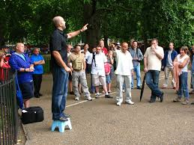
Have your Say!
Your chance to change the world!
Make an argument expressing your opinion about food waste.
Draft and rehearse to each other a 30 – 60 second soapbox speech (perhaps just four or five sentences), presenting your opinion on food waste, using positioning adverbs and some of the adverbial connectives to make it cohesive.
Notes:
Invite them to look back at their writing from the first session for ideas, and refer to food waste facts and Independent article. Emphasis on use of adverbs and adverbials to position reader and connect ideas securely.
Hear some.

Slide 24
PERSUADING WITH
MODAL VERBS

Slide 25
Modal Verbs
We ___________ open the door.
shall, should, can, could, might, may, must, will, would
(ought to)
25
Notes:
Handout: modal verb cards – one between 3
Sort cards into CERTAIN to NOT VERY LIKELY using sentence above.
Feedback re the shades of meaning. Ask them to imagine scenarios in which different choices apply.
Focus on modal use to express possibility and certainty in NC. Touch on other functions as they come up (future, obligation, permission).
Talk about ‘ought to’ as marginal modal (also ‘need to’ and one or two others) OR take ‘ought to’ out of our sets.

Slide 26
A letter from the RSPB
Activity
Find the modal verbs
What is the effect on the reader?
How are they used across the text?
26
Notes:
5 mins then take Feedback:
Change in the modals used across the text – would and could to can – moves to certainty
Used as a persuasive device – paints a possible negative picture and then tells us we have the power (can) to change it.
Then sum up with big ideas on next slide

Slide 27


Modal Verbs
must can will may would shall should could might
ought to
loud
You can have chocolate after dinner.
Turning up the volume: modal verbs can be used for gentle persuasion or strong persuasion, like turning up or turning down the volume on the television
soft
Notes:
Show slide from Food Waste scheme and explain how focus on modal verbs is dealt with. Try out this idea of ‘volume control’ on Independent article. Pairs/3s – locate where modal verbs are used. How would you rank each in terms of persuasive force in context of arguments across the whole article (loud or soft)?
Use next slide (also from scheme) for brief feedback.

Slide 28


Modal Verbs
can could will would shall should may might must ought to
they simply cannot make ends meet
more could be done to reduce food waste
Just imagine what it must be like …
supermarkets should also be encouraged to offer a service …
Delivery vans could then drop much needed perishables to people on the delivery route …
My health would have improved immeasurably …
I would have been spared…
France has already proven that this can work
Notes:
Could point out that as well as contributing to the persuasive force/tone, modals function as a cohesive device, linking ideas across the whole text.

Slide 29
Modal verbs: big ideas
Type of auxiliary verb and help form verb phrases: We must act now; this can work
Always placed first in a verb phrase, before other auxiliaries and before lexical verbs: how empty life would be; my health would have improved
Express degrees of possibility and certainty (and therefore can be used to position a reader)
Do not have an ‘s’ form or non-finite forms (-ing, -ed, to - ) 29
Notes:
Final point:
Can’t say musts, mights etc or coulding etc

Slide 30
REVISING WRITING
Notes:
15 mins - point out emphasis in Food Waste scheme on redrafting, both to revise what is said and how it’s said eg use of additional video material half way through scheme to check students have enough ideas to be persuasive with; emphasis on trying out what has been taught, collaboratively and then independently – illustrated in next 2 slides from Intervention school. Leads to 5 mins revision/strengthening of own writing (opening paragraph to letter they wrote collaboratively early in day).

Slide 31
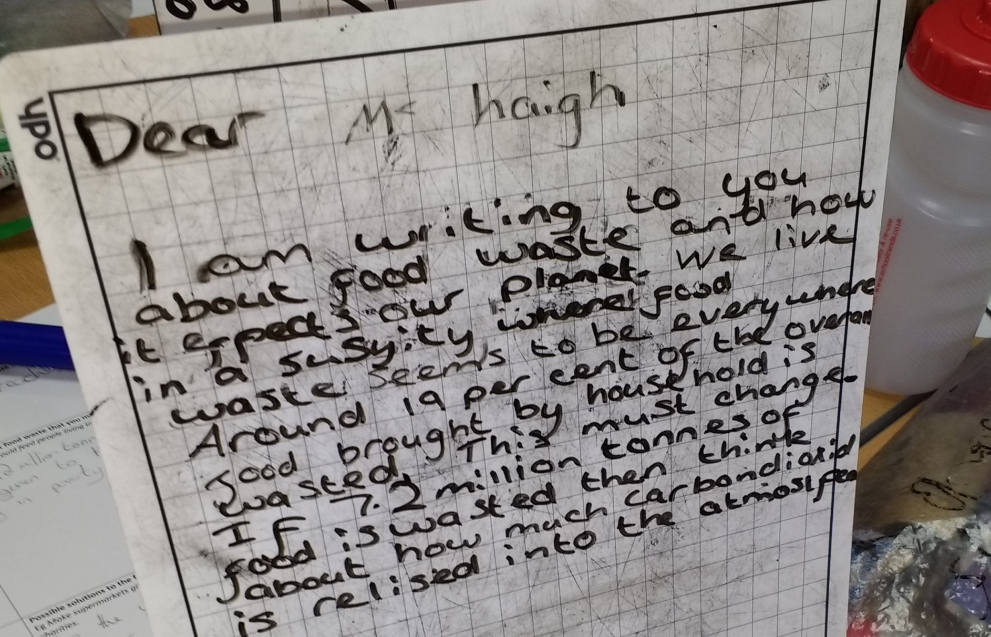
Persuasive letter: first draft
Notes:
Draft of persuasive letter to local MP from student at Gleadless Primary in Sheffield:
Dear Ms Haigh, I am writing to you about food waste and how it affects our planet. We live in a society where food waste seems to be everywhere. Around 19 per cent of the overall food bought by households is wasted. This must change. If 7.2 million tonnes of food is wasted then think about how much carbon dioxide is released into the atmosphere.
Discuss: what works well? How is the student using what they have been taught in the Food Waste scheme? How might this draft be improved?
Could mention: use of clear opening statement sentence; use of statistics; use of ‘think about’ to address reader directly; positioning vocabulary to make opinion clear eg ‘food waste seems to be everywhere’; choice of foreceful modal, ‘must’.

Slide 32
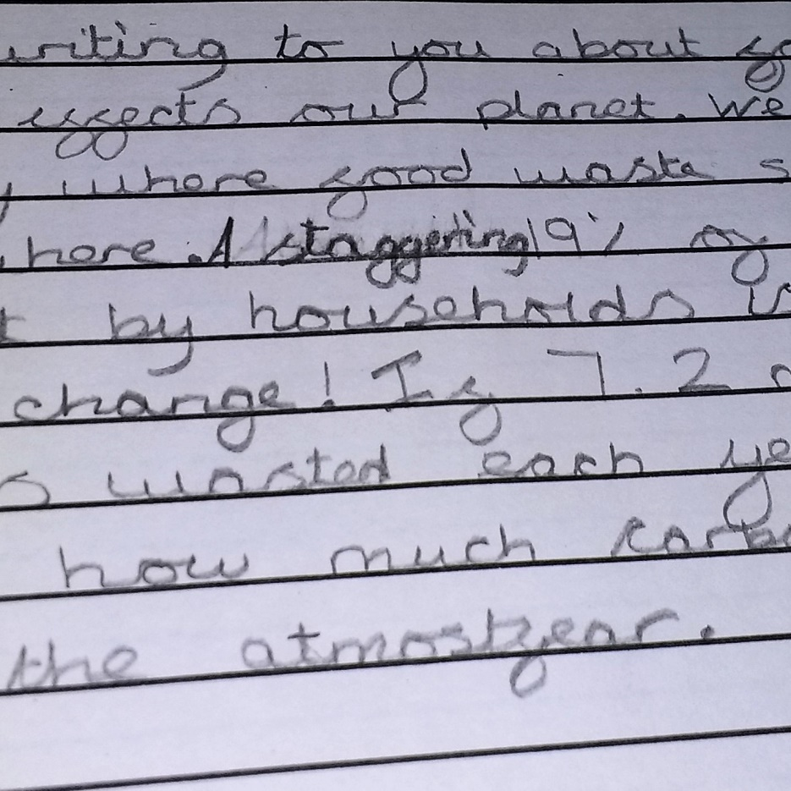
Persuasive letter redraft: what has this student learned and applied? How successfully?
Dear Madam Haigh
I am writing to you about food waste and how it effects our planet. We live in a sersyety where food waste seems to be everywhere. A staggering 19% of the food bought by households is wasted. This must change! If 7.2 million tonnes of food is wasted each year then think about how much carbon dioxide is released into the atmosfear.
Notes:
Changes following class discussion and a specific individual intervention by the teacher:
Ms to Madam Haigh – not really appropriate. Reminder that not all changes actually improve!
‘Around 19% of the food bought’ to ‘A staggering 19%’ – a much more effective change’ – it affects the sentence rhythm and intonation for extra emphasis on the fact.
Inclusion of exclamation mark – appropriate emphasis – sparingly used in piece so really draws attention to the demand and reinforces choice of modal ‘must’.

Slide 33
Revising Well
Revising what you have written: the content:-
How strong are the points you have made?
How much detail or information have you given to support your argument?
Revising how you have written it: the choices you have made:-
How have you made your text persuasive?
What language choices can you make to create a really persuasive text?
Revising strategies:
Reading and re-reading; crossing out words and phrases; writing new words or phrases in margins; using arrows to show where things need to move around; reading aloud to each other; trying out different choices …
Revising is messy!
Notes:
Slide from Food Waste scheme.
Activity: In the light of teaching about adverbials and modals, revise the opening paragraph for newspaper letter from earlier in the day.

Slide 34
TAKING THE PROJECT FORWARD
Notes:
Final session aims to support own planning and teaching of grammar for writing

Slide 35
What we have learned
Teachers and students have been strongly engaged by the teaching units;
The power of imaginative engagement in ‘Merlin’ unit – it is easy to move so quickly to analysing text or talking about success criteria that young writers have no time to engage with ideas and purpose. But imaginative engagement is key.
Strong take-up of the idea of linking grammar with making meaning in writing;
Some schools reporting strong improvement in writing;
Some schools have planned whole school or whole academy roll-out of this project.

Slide 36
What we have learned
Some development points to consider:
Verbalising more clearly the effect of a particular grammatical choice:
  being sure you can articulate the effect yourself, perhaps in your planning, until it becomes more natural;
  modelling this kind of language talk for children;
  creating tasks which give children opportunities to verbalise their understanding of the effect of a particular choice;
  displaying visually examples of expressing the effect;
  giving formative feedback where you articulate the effect of a child’s choice for them.

Slide 37

Have a go!
Late one evening, in a cave of soft mosses high in the mountains where the air was thin and stars sparkled in sky and snow, the Child took the great leopard’s head in her hands.
The Snow Leopard licked the Child’s cold face, rough cat tongue against soft skin, purring her final spirit song. And as she licked, Child became Leopard, thick-furred and wild-eyed, mottled like shadows, spirit cat.
As the old Leopard finished her song she leapt from the mountain into the star-filled sky, her dappled coat blending with the stars of the Milky Way, and her song changed to a whisper of starlight.
And back in the mountains, the young Snow Leopard looked up at the stars mirrored in her blue cat’s eyes, heard the whisper – and began a new song.

Slide 38
What we have learned
Some development points to consider:
Creating classrooms where children talk about language choices:
  group or paired talk tasks discussing different versions of a text or different choices;
  inviting children to explain the choices they have made in their own writing and why they think they are effective;
  using whole class discussion to generate real enquiry about language and its possibilities
  leading a discussion drawing on your expertise but not directed towards a single right answer; naming the effect of a particular choice is not right/wrong but an interpretation, just as in literary interpretation

Slide 39
Have a go!
On Saturday, he ate through one piece of chocolate cake, one ice-cream cone, one pickle, one slice of Swiss cheese, one slice of salami, one lollipop, one piece of cherry pie, one sausage, one cupcake, and one slice of watermelon.
The Very Hungry Caterpillar – Eric Carle
Then Mr Gumpy and the goat and the calf and the chickens and the sheep and the pig and the dog and the cat and the rabbit and the children all swam to the bank and climbed out to dry in the sun.
Mr Gumpy’s Outing – John Burningham
Why do you think Eric Carle chooses to use commas to separate his long list of noun phrases and John Burningham chooses to use ‘and’?

Slide 40
What we have learned
Teaching grammar purposefully requires strong subject knowledge:
Understanding the grammatical concepts yourself;
Knowing how to teach grammatical concepts;
Knowing how to make links between a grammatical feature and its possible effects in writing
Knowing how and when to intervene to improve students’ writing
Knowing what to look for as evidence of transfer of learning into students’ writing, and to focus feedback

Slide 41
‘The Long Walk’: consolidating grammar subject knowledge
Choosing texts that engage the imagination or stimulate ideas
Identifying how effects have been created grammatically to focus the grammar teaching
Planning grammar activities which will support children’s understanding and independent application when creating their own texts
41
Notes:
Emphasise practical use of subject knowledge. In next 30 mins we want to focus on:
Modelling how to take the approach we’ve been working on and apply that to other texts that you might choose to teach from
Unpicking what you need to do to get to a place where you can create your own units like Merlin and Persuasive Writing
Giving you a chance to have a go at applying yourself using a text that we’ve brought.

Slide 42
Read the text and decide what is important about it.
Which sections would you choose to focus on and what does the writer do grammatically to create the effects?
Which specific parts would you use as examples?
What sequence of activities might you do?
42
Notes:
Summarising the process we will model using ‘The Long Walk’

Slide 43
The Long Walk
From The Fib and Other Stories by George Layton
Read the story
What is really important about this text?
43
Notes:
Read story
Then video clip to model the talk
Then continue the conversation in pairs – might want to look at different parts.
Following that discussion, Joy and Becca honed it down to 2 things:
Telling through the boy’s eyes
Sense of place
Attending to the things that are really significant – understanding how the writer has created the effect that is so powerful.
Not much in the way of a plot!
Talk about choice of setting as teaching focus – strong sense of the journey to a new place. Evocative descriptions.

Slide 44
Writerly Knowledge Charts
Noticing the impact or effect of the text
Identifying how those effects have been created by the writing
Noting specific examples
44
Notes:
Introduce term Writerly Knowledge Chart – show blank side on handout and make it clear that this is a teacher tool.
What we’ve done so far is start thinking about the first column and engaged with text. Going to go a bit deeper now in terms of thinking about effects.
Explain 3 columns of blank chart
This is all about us as adults and teachers:
being able to look at a text, notice the effect/impact – start engaging creatively/imaginatively with the ideas and the purpose of the text.
Identifying what creates the effects/impact eg vocab choice, layout, illustrations, whole text elements BUT crucially the grammar. Column 3 is where you note down egs – these are really useful then when you are planning activities and discussing with the children.
Planning appropriate activities that will enable the children to create similar effects when they write their own texts – again we would think more widely than grammar but we will focus on this for what we are doing today. Need to think carefully about selecting the part of the text that you want to use to exemplify the grammar and what sort of grammar activities will enable the children to talk about effects, experiment and play with the language and then to apply themselves and evaluate the effect that they get. (Think about what we modelled for you in the Merlin text – selected particular parts to teach specific grammar).
It’s not just about seeing that the text has complex sentences, practising how you form them and then putting them in a success criteria when they do their writing. Hopefully we’ve shown you that we are engaging with the effects and meaning of grammar at a deeper level than this.
Pull together: We are gradually narrowing in from thinking about the big element of narrative we want to focus on (setting or character?) through to the best sections that illustrate this.
Show them the filled in WKC and explain how it works – big areas + going back in and looking more closely at how it’s done.
This is where we begin to identify what grammar focuses we might be taking (as well as noting specific vocab use). It all comes from becoming aware of what we noticed and then finding out how it was done. Nothing else!
Talk about focusing on one or two key areas to teach but might think about Good Developing Struggling writers eg we are choosing setting but might do with point of view/positioning the reader/characterisation through dialogue.
Once we are here, we are ready to plan some specific activities.

Slide 45
Planning a sequence of grammar activities that includes:
Noticing, exploring and discussing the effect of the grammar in the text
Learning about and playing with the construction
Practising, discussing and evaluating the effect
Applying independently to create meaning
45

Slide 46
Planning a sequence of grammar activities
Identifying words and phrases that create effects in texts – text marking
Card sorting and classifying
Using cards to manipulate parts of sentences to create different effects – controlled to freer experimentation
Using a picture to create a phrase and then prompt cards to transform the meaning/mood
Using a chart to generate phrases/clauses and then manipulating them to create different meanings
Using a picture to practise/apply new knowledge
Direct instruction about the form of a grammatical element
Using a film clip to apply film techniques to writing
Experimenting with sentences: adding words/substituting words/ deconstructing sentences
Notes:
Remind of range of activities we’ve done – not exhaustive.
Each time we’ve focused on an element of grammar, we’ve worked through a sequence of activities. Thought logically how to build up understanding of the grammar, move to practising and then application for meaning.
Ahmed’s Secret; RSPB letter
Phrase, Clause, Sentence
SV inversion – ordering the parts in different ways
NPs with dragon picture
NP chart and verb chart with modals and other auxiliaries
Modal verbs
Merlin clips

Slide 47
GfW: Four Key Teaching Principles
Make a link between the grammar being introduced and how it works in the writing being taught;
Explain the grammar through examples, not lengthy explanations;
Use examples from authentic texts to links writers to the broader community of writers.
Build in high-quality discussion about grammar and its effects.
Notes:
Reminder of the key principles underlying the approach. Think LEAD!

Slide 48
PLENARY

Slide 49
Grammar Subject Knowledge
The project has tried to support you in developing and strengthening grammar knowledge;
This is a journey that all of us are still travelling on, the project team included!
Our current research is showing how important teachers’ grammar knowledge is in helping students understand grammatical concepts and understand how language is working.
Task: Reflect on and evaluate what you have learned and have still to learn.

Slide 50
Project Website
http://socialsciences.exeter.ac.uk/education/research/centres/centreforresearchinwriting/projects/grammarforwriting/comparisonteachers/
Username: Lancelot
Password: Avalon

Slide 51
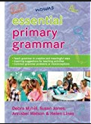
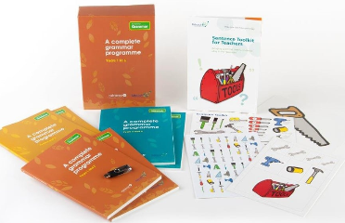


Resources to help you…
Essential Primary Grammar:
Myhill, Jones, Watson & Lines (2016)
No Nonsense Grammar: Babcock LDP Literacy Team, Raintree (2016)
www.babcock-education.co.uk/ldp/literacy
Exeter’s Resources for Teachers website:
www.exeter.ac.uk/education/grammar-teacher-resources

