Slide 1
GRAMMAR FOR WRITING
Choice and Control.

Slide 2
INTRODUCtion

Slide 3
Aims of Session: CPD Day 2
To re-iterate the teaching principles underpinning the writing intervention;
To secure grammatical subject knowledge of the noun phrase and subject-verb inversions;
To understand the teaching approaches in the narrative fiction SoW.

Slide 4
GfW: Four Key Teaching Principles
Make a link between the grammar being introduced and how it works in the writing being taught;
Explain the grammar through examples, not lengthy explanations;
Build in high-quality discussion about grammar and its effects.
Use examples from authentic texts to links writers to the broader community of writers.
Notes:
The Big Three!

Slide 5
Teaching Writing Creatively
To write well we all need to have something to say and a desire to say it;
Before young writers can meaningfully attend to how they have written something, they need to have engaged with what they want to say – the ideas;
Engaging young writers’ imaginations, emotions and personal beliefs is a really important part of teaching writing;
Allowing young writers freedom to explore ideas, test things out, and to write to find out what they want to say is critical
We often move far too quickly to pinning things down, and making writing a very linear process – we need to create space for exploration, experimentation and re-drafting.
This is built into both of our Schemes of Work.

Slide 6
Enchanted Objects in King Arthur
Any everyday object can become an enchanted object:
stones; rings; goblets; swords; cloaks; boxes; potions …
Enchanted Objects each have special power, enchanted by a wizard or witch:
The evil witch, Nimueh, casts a spell on a dragon egg and she throws into the water supply for the castle. The next day a plague erupts: people’s skin turns white with dark blue veins, and many die;
Enchanted objects can be good or evil; and their enchantment can only be overcome by more powerful magic.
They are sometimes named to show who or where they come from:
The Stone of Astolat;
The Goblet of Morgana.

Slide 7
Teaching Writing Creatively
Narrative Fiction Scheme of Work
Magpie books: so they can play with drafting little sections of the story – a description of a character; plot outlines; plot events. Encourage experimentation and playfulness in these books, including free-writing or multiple versions of drafts.
Magic Silence: creating imaginative space for writing in a calm and uninterrupted atmosphere; some teachers use a signal for this (windchime); you could also use very gentle, low volume background music
Creative starting points: enchanted objects; picture/video stimuli; visualisation; teacher storytelling…
The Writing Process: gives space for idea generating, planning, outlining, drafting and revising throughout the scheme, and Week 4 pays particular attention to supporting drafting and revising.

Slide 8
GRAMMAR SUBJECT KNOWLEDGE
Noun Phrase and Subject-Verb inversions

Slide 9
‘Slots’ in a clause
Subject
Verb
Object
Adverbial
Complement (adjective) / Complement (noun)
Gregor ate bread greedily.
Beauty’s father was eating the freshly baked bread in the sumptuous palace.
Gregor was hungry.
Gregor was her father.

Slide 10
Slots in a clause game
S V
S V O
S V A
A S V O A
A A S V A
A S V A
A V S A

Slide 11
Subject Verb Inversion
Into a forest of fifty thousand trees rode a lone traveller.
Beauty and Beast- Geraldine McCaughrean
And there, at last, was the robin.
Arthur, High King of Britain – Michael Morpurgo
In the west of the city was a fabulous garden.
The Paradise Garden – Colin Thompson
In went the sun and down came the rain.

Slide 12
Other uses of SV inversion
Speech:
“There’s a light up ahead,” said Gregor.
With a complement:
Van Gogh was famous for the vibrancy of his paintings. Most famous were his sunflower paintings.
Equally inexplicable was his behaviour towards his son.

Slide 13
Other ways to create the same effects
Delaying/distancing
Through the dark night a darker shape slid.
Beowulf – Kevin Crossley Holland
Every corridor was lined with great gilded mirrors, each one cracked like broken ice. Every vase was filled with fresh flowers, every statue blindfolded with a scarf of silk.
Beauty and the Beast – Geraldine McCaughrean
Cohesion
Triops erupt from this new source of life. These minnow like crustaceans grow domed shells that look like tiny horseshoe crabs.
Survival at 40 Above – Debbie S. Miller

Slide 14
Big Ideas: Subject Verb Inversion
Writers can choose to reverse the typical subject verb pattern within a clause to create particular effects including:
In narrative: distance, mystery, delay
In non-fiction (with a complement): cohesion

Slide 15
Nouns and Noun Phrases

Slide 16
‘Slots’ in a clause
Subject
Verb
Object
Adverbial
Complement (adjective) / Complement (noun)
Gregor ate bread greedily.
Beauty’s father was eating the freshly baked bread in the sumptuous palace.
Gregor was hungry.
Gregor was her father.

Slide 17
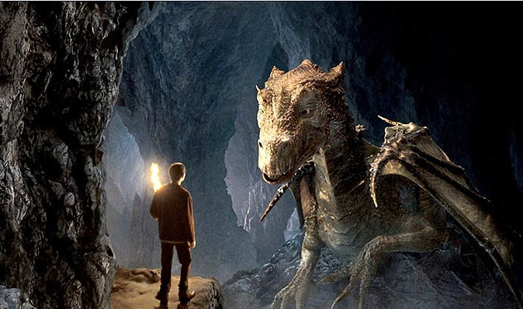
So how do we construct a noun phrase?

Slide 18
So how do we construct a noun phrase?
Add some adjectives
Change the determiner

Slide 19
Developing the noun phrase by adding words before the main noun: pre-modification
Determiners | Adverbs | Adjectives | Noun | Head Noun
a, an, the this, that, these, those, some, any, my, our, his, their, several, few, last, next, first, seventh, six, twelve | slightly very extremely rather quite | fierce hooked deadly black spiked steely-ribbed ribbed scaly rough grey veined | stone mountain fire | dragon wings claws tail head body

Slide 20
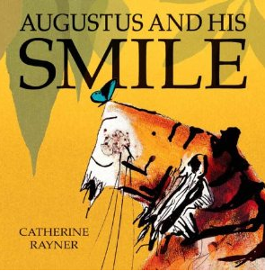
Catherine Rayner

Slide 21
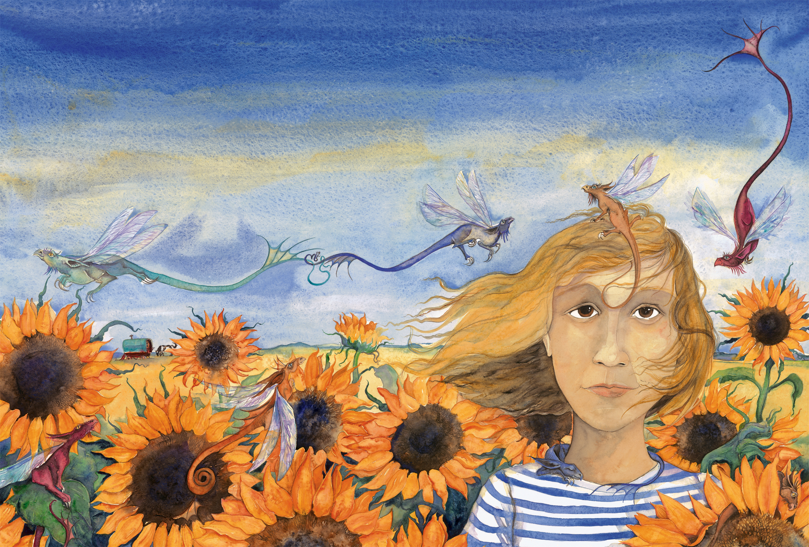
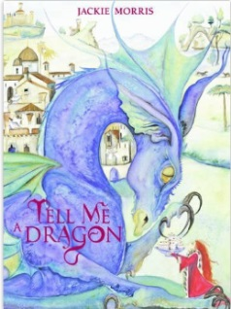
My dragons are tiny,
with whisper-thin wings of rainbow hues.
Jackie Morris

Slide 22
So how do we construct a noun phrase?
Add some adjectives
Change the determiner
Add a prepositional phrase
(with…of…)

Slide 23
Prepositions
as…as a…
over
after
through
on
of
under
before
beyond
with
beside
for
in
on top of
from
between
to
at
like a…

Slide 24
He swam to the bottom of the deepest ocean.
He climbed to the tops of the tallest trees.
…whisper-thin wings of rainbow hues.

Slide 25
So how do we construct a noun phrase?
Add some adjectives
Change the determiner
Add a prepositional phrase
(with…of…)
Add a relative clause
(who, that, which…)

Slide 26
Using a relative clause
Relative pronoun | Example, with noun phrase emboldened
who | The small boy, who was hiding from the dragon, sneezed.
which | His broken wing, which dragged on the floor, was of no more use. He had a broken wing which dragged on the floor.
that | The dark cave, that appeared before them, was the refuge they sought.
Relative pronouns: who, whom, whose, which, that

Slide 27
Developing the noun phrase by adding words after the main noun: post-modification
Noun | Adjective | Prepositional phrase | Relative clause | Non Finite Clause
dragon wings body | spiky delicate rough scaly turquoise jade-green fierce | with steel-grey spikes of immense strength | which rules the skyline who towers above the horizon, that terrorises the valleys | towering above the world silhouetted against the darkening skies

Slide 28
So how do we construct a noun phrase?
Complete the sentence…and change the mood.

Slide 29
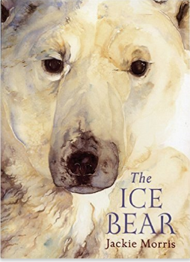
The Ice Bear Jackie Morris
…a piece of amber, smoothed by oceans, coloured, clear and beautiful, like a fragment of fire, washed ashore from a far off place.

Slide 30
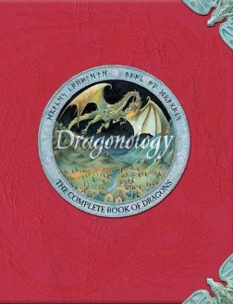
Dragonology Dugald A. Steer
Essential Equipment:
A reasonably powerful magnifying glass
Special heat-proof clothing
A relief map of the area, that shows both flora-types and geological formations
Abramelin’s Taming Spell
Take three troy ounces of dragondust from a silver dish that has been thrice washed in water that has reflected a new moon.

Slide 31
An enchanted object
Read your writing with a partner and explore your use of noun phrases.
Compare these with the writing about the dragon picture.
Is there anything you would change and why?

Slide 32
Big Ideas: Noun Phrases
Nouns can be expanded in many ways
Additional information can be added before the noun and after the noun (pre and post-modification)
Nouns can be expanded with single words, phrases and clauses
The choice of vocabulary used within a noun phrase determines the mood/picture in the reader’s mind/information conveyed

Slide 33
Arthur, merlin and the knights of the round table
Narrative fiction

Slide 34
SoW Overview
Week 1: Story-building and understanding narrative structure
Week 2: Word choices, especially noun phrases, and how they help create character
Week 3: Sentence shaping and how it supports plot development and revising text
Week 4: Designing text – focusing on drafting and revising

Slide 35
Narrative Structure
Week 1: Key Focuses
Use of story mountain image and structure
The image deliberately has two peaks to avoid suggesting too rigid a story structure
Activities which secure understanding of story structure
The concepts of ‘problem’ and ‘climax’ are the hardest: try to ensure these are securely understood
The idea of bare bones being just the plot; and how as writers we have to flesh it to make it an engaging story

Slide 36
Developing Character
Week 2: Key Focuses
From visual images to verbal – painting in words
Helping readers see our characters
Using noun phrases to paint pictures
Using well-chosen nouns rather than too many adjectives
Developing descriptive post-modification in noun phrases
Making readers infer about our characters through show not tell

Slide 37
Creating Visual images in words
Creating Character

Slide 38
From visual to verbal
The video clip in words:
Then, out of the darkness, came a lady, dark-haired and beautiful, wearing a gown of wine-red. She stood over the burial casket of a knight and began to speak in a strange language, the words flowing from her lips like a dark song. She raised her arm over the casket, her long fingers extended, and her eyes, wide and intense. The flow of words grew louder, the lady’s voice grew stronger and more insistent, until almost shrieking, she spoke the name, ‘Uther Pendragon!’

Slide 39
Noun Phrases to Build Description
Sometimes noun phrases are built by putting adjectives before the noun:
a strange language
a dark song
her long fingers
Look at your description of a character from the Arthur and Merlin stories: have you created any noun phrases like this?
What did you want to make your reader see or think about your character?

Slide 40
Noun Phrases to Build Description
You can also build noun phrases by adding more description after the noun
You could add adjectives:
her fingers, long, white and dancing,
her eyes, wide and intense,
a lady, dark-haired and beautiful,
You could add a prepositional phrase:
the colour of honey
the hood of his dark cloak
You could add a non-finite clause beginning with an –ing or –ed verb:
gold washed in milk
a lady, dark-haired and beautiful, wearing a gown of wine-red
the words flowing from her lips

Slide 41
Describing Characters
Building detail by adding information after the noun (post-modification):
Character | Determiner | NOUN | Adjectives | Non-finite clause
Merlin | his | face | parchment-silver | etched with age
Guinevere | her | fingers | long, white and dancing
Morgana | a | lady | dark-haired and beautiful | wearing a gown of wine-red
Morgana | the | words |  | flowing from her lips

Slide 42
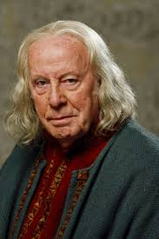
Examples of Noun Phrases
… her fingers, long, white and dancing, …
… her eyes, wide and intense, …
… a lady, dark-haired and beautiful, …
… the hood of his dark cloak, …
… his face, parchment-silver and etched with age …
CREATE YOUR OWN NOUN PHRASE TO DESCRIBE THIS CHARACTER AND PAINT A PICTURE OF HIM IN WORDS

Slide 43
From visual to verbal
One aspect of writing is conveying in words the images we have in our heads of characters and scenes
We have to paint in words
Well-chosen noun phrases help us to paint a visual picture of our characters for our readers
In general, better writers use more post-modification; weaker writers use very little modification but if they do it is before the noun
Better writers use fewer adjectives before the noun; and choose stronger nouns

Slide 44
MAKing the reader infer: show not tell
Creating Character

Slide 45
Show, not Tell: make your reader infer
When we describe characters for our readers, sometimes we tell them directly about the character: here’s Roald Dahl’s description of Mr and Mrs Wormwood’s house:-
‘Matilda’s parents owned quite a nice house with three bedrooms upstairs, while on the ground floor there was dining-room and a living-room and a kitchen’
This gives us precise information about their house.
But good writers also make the readers think about, or infer, what characters are like from a description:
‘Mr Wormwood was a small ratty-looking man whose front teeth stuck out underneath a thin ratty moustache.’
This description is not just information about what Matilda’s dad looks like: by showing us what he looks like, Dahl also makes us think, or infer, about what kind of man he is. What kind of a man is ‘ratty-looking’? What do we think about rats as creatures? How different it would have been if Dahl had described him as ‘a cuddly bear-like man’?

Slide 46
Show, not Tell: make your reader infer
Show not tell: Dahl doesn’t tell us that Mr Wormwood is a nasty little man, he tells us he is ‘ratty-looking’ and so shows us he is a nasty little man. We have to work this out for ourselves (or infer this).
When we write, sometimes we do tell our readers about characters, but good writers also make the reader infer what the character is like.

Slide 47
Show, not Tell
What does the physical description of the man and his horse suggest about his character?
What might a reader think about a man who is completely green?
What does the description of how the man arrives suggest about his character?
At that moment, from outside in the courtyard, came the clatter of horses’ hooves on the cobbles. The doors of the hall flew open, and before I had time to call for them to be closed, a giant of a man rode in on a towering warhorse that pawed the ground, sides lathered up, tossing its fine head, snorting its fury. The man swept the hall with terrible eyes, wolfish eyes that froze the courage in a man’s veins, eyes you could not hold with your own. But it was not the man’s eyes that amazed us most, it was not his size either - and I tell you I’d never in my life set eyes on a bigger man – no. It was the colour of him. Green, the man was green from head to foot.
Arthur, High King of Britain by Michael Morpurgo

Slide 48
Show, not Tell: through noun phrases
At that moment, from outside in the courtyard, came the clatter of horses’ hooves on the cobbles. The doors of the hall flew open, and before I had time to call for them to be closed, a giant of a man rode in on a towering warhorse that pawed the ground, sides lathered up, tossing its fine head, snorting its fury. The man swept the hall with terrible eyes, wolfish eyes that froze the courage in a man’s veins, eyes you could not hold with your own. But it was not the man’s eyes that amazed us most, it was not his size either - and I tell you I’d never in my life set eyes on a bigger man – no. It was the colour of him. Green, the man was green from head to foot.

Slide 49
Show, not Tell: through noun phrases
At that moment, from outside in the courtyard, came the clatter of horses’ hooves on the cobbles. The doors of the hall flew open, and before I had time to call for them to be closed, a giant of a man rode in on a towering warhorse that pawed the ground, sides lathered up, tossing its fine head, snorting its fury. The man swept the hall with terrible eyes, wolfish eyes that froze the courage in a man’s veins, eyes you could not hold with your own. But it was not the man’s eyes that amazed us most, it was not his size either - and I tell you I’d never in my life set eyes on a bigger man – no. It was the colour of him. Green, the man was green from head to foot.

Slide 50
Show, not Tell: through noun phrases
… the clatter of horses’ hooves on the cobbles ….
… a towering warhorse that pawed the ground, sides lathered up, tossing its fine head, snorting its fury …
… a giant of a man…
… terrible eyes, wolfish eyes that froze the courage in a man’s veins, eyes you could not hold with your own…
… a bigger man …
… the colour of him…
Michael Morpurgo shows us through his noun phrases that:
He is a giant of a man – so he is likely to be strong, possibly fierce;
His horse is towering and it is a warhorse so he must be a fighting man;
The man has terrible eyes, like a wolf’s (wolfish ), and it makes the other knights frightened (froze the courage in a man’s veins) so he might be evil or nasty
The man is a strange colour (green) – what kind of man is green?

Slide 51
Show, not Tell: through noun phrases
Michael Morpurgo could have told us about the Green Knight by writing:
The Green Knight was a huge man who was very powerful and intimidating, and who was ready to fight , and he had a horse that was very fierce and threatening.
Instead he shows us what the Green Knight is like by writing:
a giant of a man rode in on a towering warhorse that pawed the ground, sides lathered up, tossing its fine head, snorting its fury. The man swept the hall with terrible eyes, wolfish eyes that froze the courage in a man’s veins, eyes you could not hold with your own.
He shows us the character of the Knight by describing what he looks like; he doesn’t tell us. We have to infer what the character is like.

Slide 52
Show not Tell
Create character descriptions by showing readers things which make us infer what the character is like
Noun phrases are one way to provide these detailed descriptions
Verb choices can also do this: eg flew, rode, swept, pawed, tossing, snorting

Slide 53
Shaping NARrative events
Subject Verb Inversion

Slide 54
Shaping Sentences
Week 3: Key Focuses
Looking at how to write well about narrative events
Shaping sentences is one way to enhance meaning in a story
Writers can choose where to put information in a sentence to give it different emphasis
Putting the subject last in the sentence, after the verb, can create emphasis or anticipation
Varied sentence lengths create a good text rhythm
Short sentences can draw attention to key events or moments

Slide 55
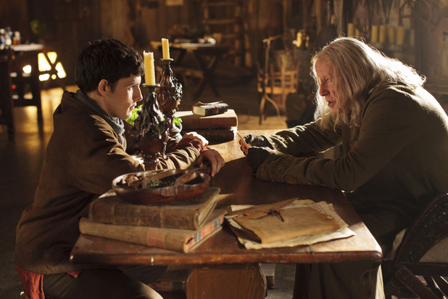

Slide 57
Sentence Structure
in flowing green came walking across the water out of the mists a figure
A figure came out of the mist.
A figure in flowing green came out of the mist.
A figure in flowing green came walking across the water out of the mist.
Can the sentence chunks be arranged in any other order?
Eg Out of the mist, a figure in flowing green came walking across the water.
What is the subject and the verb in these sentences?
A figure came out of the mist.
A figure in flowing green came out of the mist.
A figure in flowing green came walking across the water out of the mist.
Out of the mist, a figure in flowing green came walking across the water.

Slide 58
Sentence Structure
an arm in a white silk sleeve to my amazement came and
up out of the lake a shining sword a hand holding it
A shining sword came up out of the lake.
A shining sword, and a hand holding it, came up out of the lake.
To my amazement, a shining sword, and a hand holding it, came up out of the lake.
To my amazement, a shining sword, a hand holding it, and an arm in a white silk sleeve came up out of the lake.
Can the sentence chunks be arranged in any other order?
What is the subject and the verb in these sentences?

Slide 59
Sentence Structure
an arm in a white silk sleeve to my amazement came and
up out of the lake a shining sword a hand holding it
A shining sword came up out of the lake.
A shining sword, and a hand holding it, came up out of the lake.
To my amazement, a shining sword, and a hand holding it, came up out of the lake.
To my amazement, a shining sword, a hand holding it, and an arm in a white silk sleeve came up out of the lake.
Can the sentence chunks be arranged in any other order?
What is the subject and the verb in these sentences?

Slide 60
The Lady of the Lake
I looked, but I could see nothing at first. But then as I looked I saw the surface of the lake shiver and break. And, to my amazement, up out of the lake came a shining sword, a hand holding it, and an arm in a white silk sleeve.
‘There,’ Merlin whispered. ‘You have your answer. That is Excalibur. It comes from the half-world of Avalon, the blade forged by elf-kind, the scabbard woven by the Lady Nemue herself, the Lady of the Lake, and my lady too.’ And as he spoke her name, his voice faltered. ‘See, here she comes.’
And out of the mists came a figure in flowing green, walking across the water. Yet the water seemed undisturbed beneath her feet as if she was walking on air. She came towards us, holding a scabbard in both her hands, and a swordbelt hanging from it.

Slide 61
The Lady of the Lake
I looked, but I could see nothing at first. But then as I looked I saw the surface of the lake shiver and break. And, to my amazement, up out of the lake came a shining sword, a hand holding it, and an arm in a white silk sleeve.
‘There,’ Merlin whispered. ‘You have your answer. That is Excalibur. It comes from the half-world of Avalon, the blade forged by elf-kind, the scabbard woven by the Lady Nemue herself, the Lady of the Lake, and my lady too.’ And as he spoke her name, his voice faltered. ‘See, here she comes.’
And out of the mists came a figure in flowing green, walking across the water. Yet the water seemed undisturbed beneath her feet as if she was walking on air. She came towards us, holding a scabbard in both her hands, and a swordbelt hanging from it.

Slide 62
The Lady of the Lake
I looked, but I could see nothing at first. But then as I looked I saw the surface of the lake shiver and break. And, to my amazement, up out of the lake came a shining sword, a hand holding it, and an arm in a white silk sleeve.
‘There,’ Merlin whispered. ‘You have your answer. That is Excalibur. It comes from the half-world of Avalon, the blade forged by elf-kind, the scabbard woven by the Lady Nemue herself, the Lady of the Lake, and my lady too.’ And as he spoke her name, his voice faltered. ‘See, here she comes.’
And out of the mists came a figure in flowing green, walking across the water. Yet the water seemed undisturbed beneath her feet as if she was walking on air. She came towards us, holding a scabbard in both her hands, and a swordbelt hanging from it.

Slide 63
Putting the Subject After the Verb
And, to my amazement, up out of the lake came a shining sword, a hand holding it, and an arm in a white silk sleeve.
And out of the mists came a figure in flowing green, walking across the water.
Usually the subject comes before the verb, so when it comes after the verb it changes how we read it.
Why do you think Michael Morpurgo reversed the position of the subject and put it after the verb?
What effect does it have on the reader?
How did you read this sentence aloud?
Putting the subject after the verb makes us wait to find out what the sentence is about – it can create suspense or anticipation. It can also help us visualise a scene the way the writer wants us to see it.

Slide 64
Subject Verb Inversions
Sentences can be shaped to enhance meanings in your story
Writers can choose where to put information in a sentence to give it different emphasis
Putting the subject last in the sentence, after the verb, can create emphasis or anticipation

Slide 65
plenary

Slide 66
Text Designers
Week 4: Key Focuses
Consolidating key learning about writing narrative fiction
Giving quality time for the writing process
Supporting all aspects of the writing process: generating ideas and imaginative engagement; outlining the narrative; drafting; revising

Slide 67
GfW: Four Key Teaching Principles
Make a link between the grammar being introduced and how it works in the writing being taught;
Explain the grammar through examples, not lengthy explanations;
Build in high-quality discussion about grammar and its effects.
Use examples from authentic texts to links writers to the broader community of writers;
Notes:
The Big Three!

Slide 68
Using this approach
Three key pre-requisites for teachers:
Strong grammatical knowledge:
so this intervention sets out to strengthen your grammatical knowledge;
An ability to notice how texts are ‘working’:
so this intervention sets out to give you examples of the ways texts work;
The ability to plan purposefully, integrating an attention to grammar within teaching units:
so this intervention gives you two models of teaching units with grammar meaningfully integrated into the teaching.
Students who understand better the choices they can make in their writing and the meanings they create
Students produce better written outcomes.

Slide 69
Project Website
http://socialsciences.exeter.ac.uk/education/research/centres/centreforresearchinwriting/projects/grammarforwriting/interventionteachers/
Username: Merlin
Password: Excalibur

Slide 70
King Arthur Stories
Consider reading the Morpurgo story, Arthur, High King of Britain, before you do the scheme of work or alongside it.
There are lots of other Arthur stories you might want to get for the library and encourage children to read: see this website: http://trinity.nsw.libguides.com/c.php?g=5552&p=23821
Strongly recommended for year 6:
Kevin Crossley-Holland’s Trilogy: Arthur and the Seeing Stone etc
Geraldine McCaughrean: King Arthur and a World of Other Stories
Philip Reeve: Here Lies Arthur

Slide 71
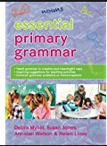
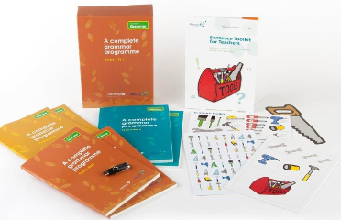
Resources to help you…
Essential Primary Grammar:
Myhill, Jones, Watson & Lines (2016)
No Nonsense Grammar: Babcock LDP Literacy Team, Raintree (2016)
www.babcock-education.co.uk/ldp/literacy

