Slide 1

The Grammar of School-Age Writing Development:
What do we Already
(Think we Maybe (don’t)) Know?
Mark Brenchley
Phil Durrant

Slide 2
Growth in Grammar Project
BACKGROUND
A national corpus of student writing
Age and ability range of the English education system
3 subject areas: English, Science, Humanities (History)
Multi-dimensional analysis of grammatical features
Comprehensive map of grammatical development in writing

Slide 3
Growth in Grammar Project
RESEARCH QUESTIONS
How does children’s written grammar change as they get older?
How does it change depending on the quality of the writing?
How does it change according to the kinds of writing asked of students?
Are there differences between how children’s texts group “grammatically” and how they are grouped conceptually?

Slide 4
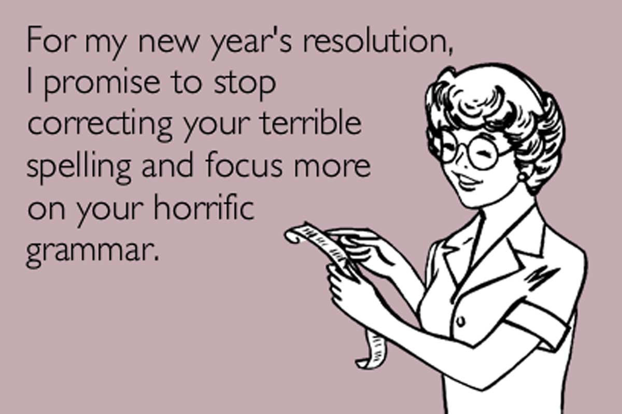

Slide 5
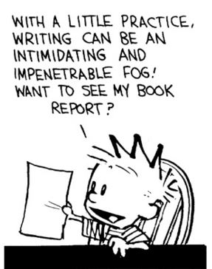

Slide 6
Review Purpose
Systematic overview of current state of “knowledge”
Identify specific grammatical features to include within final analysis

Slide 7
Review Question
What grammatical features are associated with student writing development in English between the ages of 5 and 18?

Slide 8
Definitions
“Student Writing” = any piece of extended, free-form written discourse produced by a student aged 5 -18
“Development” = any association between the grammatical features of a piece of writing and
    the biological/educational age of the writer, or
    the attainment level of that writing/its author

Slide 9
Definitions
“English” = any “Standard” version as produced by a student within Australia, Canada, New Zealand, UK, or USA.
“Grammatical Feature” = any text unit identifiable through:
    its part-of-speech
    a structure constituted through a part of speech
    its function with respect to another such structure/part-of-speech

Slide 10
Inclusion Criteria
writing of “mainstream” students (not explicitly L2, not cognitively/linguistically impaired)
empirical (primary/secondary/review)
quantitative
either developmental contrast or contrast according to register
peer-reviewed journal or professionally-edited book
post-war era (i.e. 1945 onwards)
no “interventions”

Slide 11
Coverage
6 “meta” databases
[EBSCO, JSTOR, Ovid, ProQuest SCOPUS, Web of Science]
19 “mini” databases
[Arts & Humanities Citation Index, British Education Index, Education Research Complete, Social Sciences Citation Index]
8,058 initial texts
468 final texts
658 “supplementary” texts

Slide 12
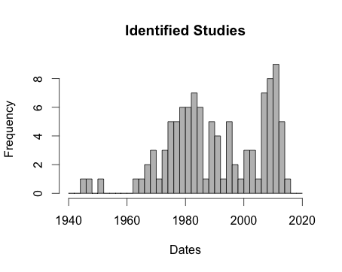
General Results

Slide 13
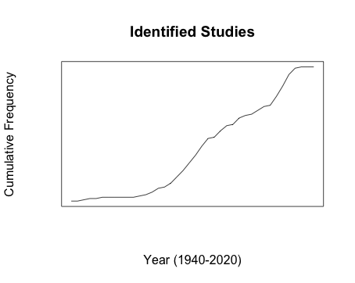
General Results
70s
mid-00s

Slide 14
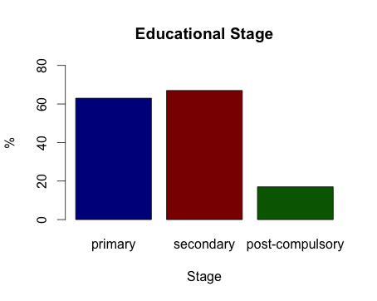
General Results

Slide 15
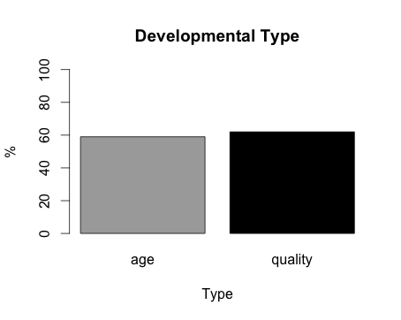
General Results

Slide 16
Provisos
Interim Findings
Corpus-based
Lack of explicit syntax operationalisations
Distinct syntax operationalisations
Norming issues
Lack of explicit register operationalisations
Register conflations
Sample quality
NOT YET COMPREHENSIVE!

Slide 17
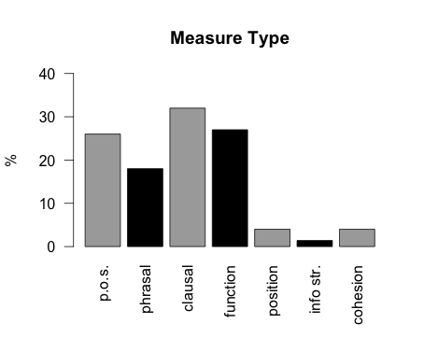
Results

Slide 18
Results
PLENTY OF INDIVIDUAL FINDINGS
PHRASE LEVEL
    NP Structure (depth):
AGE ⬆ (Ravid & Berman, 2010)
    NP Structure (type and # of modifications)
AGE ⬆ (Crossley et al. 2011; R&B, 2010)
QUAL ⬆ (Olinghouse & Wilson, 2013)

Slide 19
Results
PHRASE LEVEL
    VP Structure (# modals)
AGE ⬆, QUAL ⬆ (both Golub & Frederick, 1970)
    VP Structure (% non-finite verbs)
    AGE ⬆, QUAL ⬆ (Loban, 1976)

Slide 20
Results
CLAUSE LEVEL
    # Coordinated Clauses:
AGE ⬇ (Veal, 1974)
QUALITY ⬇ (Myhill, 2008)
    #Adverbial Clauses
AGE ⬆ (O’Donnell et al., 1967; Noyce & Christie, 1985)
    # Relative Clauses
AGE ⬆
QUALITY ⬆ (both Golub & Frederick, 1970)

Slide 21
Results
DISCOURSE “FLOW”
    # Sentences with Subject Opening
QUAL ⬇ (Myhill, 2008)
    # Sentences with Non-Finite Adverbial Clause Opening
QUAL ⬆ (Myhill, 2008)
    # Subject-Verb Inversions
QUAL ⬆ (Myhill, 2008)
    # Passives
AGE ⬆ (Hunt, 1965)

Slide 22
Results
PIECES OF A PUZZLE #1
Variation not necessarily continuous
“Continuous”:
AGE ⬆ - Passives (Hunt, 1965)
QUAL ⬇ - Coordinated Clauses (Myhill, 2008)

Slide 23
Results
Variation not necessarily continuous
“Pick ups”
NP Modification: postgrads>11>7=4 (R&B, 2010)
cf. uni>11>9 (Crossley et al, 2011)
Participial Adjectives: high>medium=low (G&F, 1970)

Slide 24
Results
Variation not necessarily continuous
“Drop Offs”
Adverbial Clauses: 7=5>3 (O’Donnell et al, 1967)
Relative Clauses: high=medium>low (G&F, 1970)

Slide 25
Results
PIECES OF A PUZZLE #2
“Shifts”
NP LENGTH: postgrads>11=7=4
NP ABSTRACTION: postgrads>11>7>4
NP MODIFICATION I: postgrads>11>7=4
NP MODIFICATION II: postgrads>11=7=4
(Ravid & Berman, 2010)

Slide 26
Results
PIECES OF A PUZZLE #3
Two Developmental Strands
Sometimes align
Relative Clauses
    QUALITY ⬆, AGE ⬆ (Golub & Frederick, 1970)
Modals
    QUALITY ⬆, AGE ⬆ (Golub & Frederick, 1970)

Slide 27
Results
PIECES OF A PUZZLE #3
Two Developmental Strands
Sometimes don’t
Sentences with Adverbial Opening
    QUALITY: Good=Average=Weak
    AGExQUALITY: Good=Average=Weak @ 10
    Good>Average>Weak @ 8
    (Myhill, 2008)

Slide 28
Results
PIECES OF A PUZZLE #3
Two Developmental Strands
Sometimes don’t
Sentences with Non-Finite Adverbial Clause Opening
    QUALITY: Good=Average=Weak
    AGExQUALITY: Good>Average>Weak @ 10
    Good=Average=Weak @ 8
    (Myhill, 2008)

Slide 29
Results
PIECES OF A PUZZLE #4
Contradictory Claims ?
the evidence from our writers indicated an approach to mastery of clause use
before an understanding and use of functionally-equivalent phrases.
- Harpin (1976)

Slide 30
Results
Contradictory Claims ?
If we think of children’s acquisition of writing skills as, in part, the replacement of the grammatical habits of conversational speech with the norms of adult writing, it seems that, at the stage represented by our child writing data, the children have already achieved much of this adaptation with respect to phrasal constructions (whether this means using more of one type or fewer of another type)
- Sampson (2003)

Slide 31
Results
Contradictory Claims → Impact of Wider Diatypic Context

Slide 32
Results
Genre:
  T-Unit Length: A>D>N (C&P, 1979)
Audience:
  Clause Length: Teacher > Friend (C&P, 1979)
Task Prompt:
  T-Unit Length: Abstract = Concrete
  Colour = Black & White
  Clause Length: Abstract > Concrete
  Colour > Black & White (G&F, 1970)

Slide 33
Results
Genre:
  T-Unit Length:
  AGE @10: A>D>N
  @6: A>N, A=D, D=N
  QUAL @ARG: Positive Relationship
  @NAR: Negative Relationship
Audience:
  Clause Length:
  AGE @10: Teacher > Friend
  @6: Teacher = Friend
  (Crowhurst, 1980; C&P, 1979)

Slide 34
Results
Genre:
  T-Unit Length:
  AGE @10: A>D>N
  @6: A>N, A=D, D=N
  QUAL @ARG: Positive Relationship
  @NAR: Negative Relationship
  AGExQUAL @12: ARG: Positive Relationship
  NAR: Negative Relationship
  @10: ARG: Positive Relationship
  NAR: No Relationship
  @6: ARG: No Relationship
  NAR: No Relationship

Slide 35
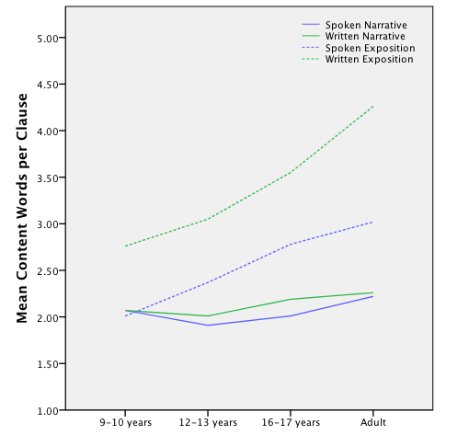
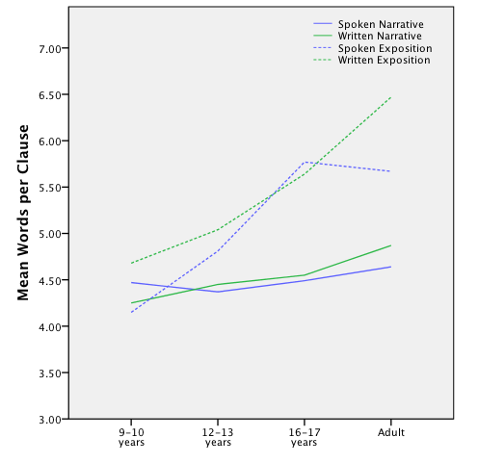
Results
Words per Clause
(Berman & Ravid, 2009)
Content Words per Clause
(Berman & Ravid, 2009)

Slide 36
Results
PIECES OF A PUZZLE #5
Systematicity?
Kagan (1980)
    Re-writing exercise
    @24.6yrs (college + high school sophmore + adults)
    6 “Dimensions”
    Dimension #6: # Prepositional Phrases (+ve)
  # “be” + “have” AUX (+ve)

Slide 37
Results
Dean & Quinlan (2010)
    Essay Writing (Descriptive, Persuasive)
    @ 4th, 6th, 8th, 10th, 12th grade
    e.g. “Spoken Style”: mental state verbs (+ve)
    conversation verbs (+ve)
    first person singular pronouns (+ve)
              noun/verb ratio (-ve)
          attributive adjectives (-ve)
    AGE: @4/6/8/10/12: Negative Association
    QUALITY: @Persuasive: Negative Association
          @Descriptive: Positive Association

Slide 38
Conclusions
Systematic ≠ Comprehensive
Keywording
A puzzle with lots of pieces
2 dimensions, interacting with wider diatypic context
How?
Why?
New structures or newly deployed structures?

Slide 39
References
Berman, R. A. & Ravid, D. (2009). Becoming a Literate Language User: Oral and Written Text Construction across Adolescence. In D. R. Olson & N. Torrance (eds.) Cambridge Handbook of Literacy (92-111). Cambridge: Cambridge University Press.
Crossley, S. A. et al. (2011). The development of writing proficiency as a function of grade level: A linguistic analysis. Written Communication 28(3), 282-311.
Crowhurst, M. (1980). Syntactic complexity and teachers’ quality ratings of narrations and arguments. Research in the Teaching of English 14(3), 223-213.
Crowhurst, M. & Piché, G. L. (1979). Audience and mode of discourse effects on syntactic complexity in writing at two grade levels. Research in the Teaching of English 13(2),101-109.
Dean, P. & Quinlan, T. (2010). What automated analyses of corpora can tell us about students’ writing skills. Journal of Writing Research 2(2), 151-177.
Golub, L. S. & Frederick, W. C. (1970). An analysis of children's writing under different stimulus conditions. Research in the Teaching of English 4(2), 168-180.
Harpin, W. (1976). The Second 'R': Writing Development in the Junior School. London: Allen & Unwin.
Hunt, K. W. (1965). Grammatical Structures Written at Three Grade Levels. Champaign, IL: NCTE.

Slide 40
References
Kagan, D. M. (1980). Syntactic complexity and cognitive style. Applied Psycholinguistics 1(1), 111-122.
Loban, W. (1976). Language development: Kindergarten through grade twelve. Urbana, IL: NCTE.
Myhill, D. A. (2008). Towards a linguistic model of sentence development in writing. Language and education 22(5), 271-288.
O’Donnell, R. C. et al. (1967). A transformational analysis of oral and written grammatical structures in the language of children in grades three, five, and seven. The Journal of Educational Research 61(1), 35-39.
Olinghouse, N. G. & Wilson, W. (2013). The relationship between vocabulary and writing quality in three genres. Reading & Writing 26(1), 45-65.
Ravid, D. & Berman, R. A. (2010). Developing noun phrase complexity at school: A text- embedded cross-linguistic analysis. First Language 30(1), 3-26.
Sampson, G. (2003). The structure of children’s writing: moving from spoken to adult written norms. In S. Granger and S. Petch-Tyson (eds.). Extending the Scope of Corpus-Based Research: New Applications (177-193). Amsterdam: Rodopi.
Veal, L. R. (1974). Syntactic measures and rated quality in the writing of young children. Studies in Language Education, Report 8. Athens, GA: University of Georgia.

Slide 41
APPENDICES

Slide 42
Eligible Databases
ELIGIBLE DATABASES | ACCESSED VIA
Arts & Humanities Citation Index | Web of Science
Australian Education Index | ProQuest
Book Citation Index | Web of Science
British Education Index | EBSCO Host
Canadian Education Index (CBCA) | ProQuest
Child Development & Adolescent Studies | EBSCO Host
Conference Proceedings Citation Index | Web of Science
Education Abstracts | EBSCO Host
Education Research Complete | EBSCO Host
e-Journals | EBSCO Host
ERIC | EBSCO Host
JSTOR | JSTOR
Linguistic & Language Behaviour Abstracts | ProQuest
PsycArticles | Ovid
PsycINFO | Ovid
Psychology and Behavioral Sciences Collection | EBSCO Host
SCOPUS | Elsevier
Social Sciences Citation Index | Web of Science

Slide 43
Search Terms I
EBSCO HOST
DATABASES | British Education Index, Child Development & Adolescent Studies, eBook Education Collection(EBSCOhost), Education Abstracts (H. W. Wilson), e-Journals, ERC, ERIC, Psychology & Behavioral Sciences Collection
LIMIT TO | English | (i.e. published in English)
SUBJECT TERMS | gramma* OR synta* OR lex* OR vocab* OR senten*
"AND" SUBJECT TERMS | writ*
"NOT" SUBJECT TERMS | second lang* OR foreign lang* OR esl OR ell OR efl OR eal OR esol OR tesol OR tefl OR english language learn* OR english as an additional language OR english as a foreign language OR english as a second language
"AND" SUBJECT TERMS | schoo* OR educat* OR studen* OR child* OR developmen* OR acquisition OR adolescen*
LIMIT TO | 1945 - 2015
LIMIT TO | scholarly (peer-reviewed journals)
SEARCHED | 31/07/2015 | 1608
OVID
DATABASES | PsycArticles, PsycINFO
LIMIT TO | English Language | (i.e. published in English)
ABSTRACT | gramma* OR synta* OR lex* OR vocab* OR senten*
"AND" ABSTRACT | writ*
"NOT" ABSTRACT | second lang* OR foreign lang* OR esl OR ell OR efl OR eal OR esol OR tesol OR tefl OR english language learn* OR english as an additional language OR english as a foreign language OR english as a second language
"AND" ABSTRACT | schoo* OR educat* OR studen* OR child* OR developmen* OR acquisition OR adolescen*
LIMIT TO | 1945 - 2015
SEARCHED | 31/07/2015 | 3291

Slide 44
Search Terms II
WEB OF SCIENCE (CORE COLLECTION)
DATABASES | Science Citation Index, Social Sciences Citation Index, Arts & Humanities Citation Index, Conference Proceedings Citation Index - Science, Conference Proceedings Citation Index - Social Science & Humanities
TOPIC | gramma* OR synta* OR lex* OR vocab* OR senten*
"AND" TOPIC | writ*
"NOT" TOPIC | second lang* OR foreign lang* OR esl OR ell OR efl OR eal OR esol OR tesol OR tefl OR english language learn* OR english as an additional language OR english as a foreign language OR english as a second language
"AND" TOPIC | schoo* OR educat* OR studen* OR child* OR developmen* OR acquisition OR adolescen*
LIMIT TO | 1945 - 2015
REFINE TO | English Language | (i.e. published in English)
RESEARCH AREAS | psychology, education educational research, linguistics, communication, behavioral sciences, sociology, social sciences and other topics
SEARCHED | 31/07/2015 | 1555
SCOPUS
DATABASES | SCOPUS
TITLE-ABS-KEY | gramma* OR synta* OR lex* OR vocab* OR senten*
"AND" TITLE-ABS-KEY | writ*
"AND" TITLE-ABS-KEY | schoo* OR educat* OR studen* OR child* OR developmen* OR acquisition OR adolescen*
"AND NOT" TITLE-ABS-KEY | "second lang*" OR "foreign lang*" OR esl OR ell OR efl OR eal OR esol OR tesol OR tefl OR "english language learn*" OR "english as an additional language" OR "english as a foreign language" OR "english as a second language"
"AND" PUBYEAR AFT | 1944
LIMIT TO | english, social sciences, psychology, humanities, article, review, book chapter, book, journals, books, book series
SEARCHED | 31/07/2015 | 2847

Slide 45
Search Terms III
PROQUEST DIALOGUE
DATABASES | Australian Education Index
ABSTRACT | gramma* OR synta* OR lex* OR vocab* OR senten*
"AND" ABSTRACT | writ*
"NOT" ABSTRACT | second lang* OR foreign lang* OR esl OR ell OR efl OR eal OR esol OR tesol OR tefl OR english language learn* OR english as an additional language OR english as a foreign language OR english as a second language
"AND" ABSTRACT | schoo* OR educat* OR studen* OR child* OR developmen* OR acquisition OR adolescen*
SEARCHED | 31/07/2015 | 419
JSTOR
DATABASES | JSTOR
ABSTRACT | gramma* OR synta* OR lex* OR vocab* OR senten*
"AND" ABSTRACT | writ*
"AND" ABSTRACT | schoo* OR educat* OR studen* OR child* OR developmen* OR acquisition OR adolescen*
NARROW BY | English Language | (i.e. published in English)
NARROW BY | articles, books, pamphlets, reviews
NARROW BY | 1945 - 2015
SEARCHED | 31/07/2015 | 699

