Slide 1
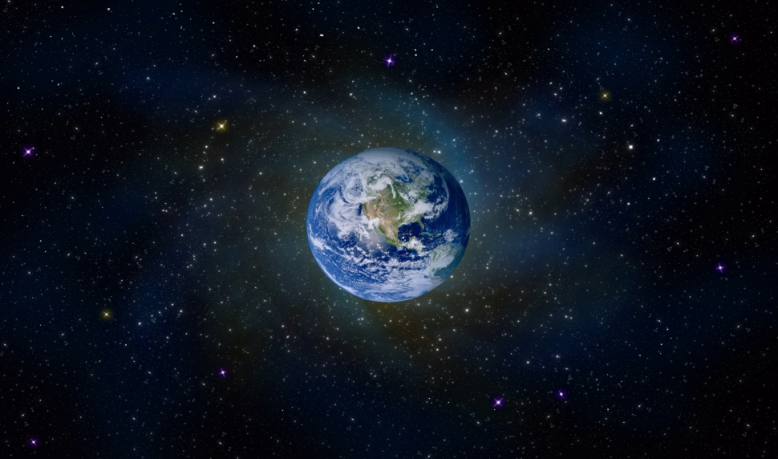
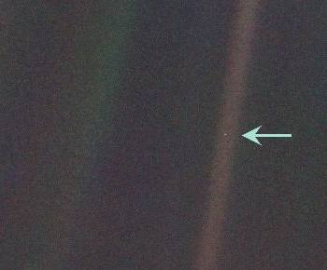
Tips for Teachers
Tasks like this that generate open-ended talk about language choices in an accessible way are really important.
After reading the descriptions, you could ask pairs of students to discuss which of the three descriptions works best for them and why.
When you take feedback, push for explanations of choices and why specific words or phrases work well.
You could then follow this with a written task.
Look at the photographs of Earth as seen from space and read the astronauts’ descriptions. Which description paints the best picture for you? Explain your choice.
A | Earth: a small, bubbly balloon hanging delicately in the nothingness of space. (Alfred Worden)
B | ...the size of a marble, the most beautiful you can imagine. That beautiful, warm, living object looked so fragile, so delicate, that if you touched it with a finger it would crumble and fall apart. (James Irwin)
C | ...a sparkling blue and white jewel, a light, delicate sky-blue sphere laced with slowly swirling veils of white, rising gradually like a small pearl in a thick sea of black mystery. (Edgar Mitchell)
TASK in pairs: Invent your own description of earth from space. You can use any of the words or sentence structures from the examples above. Share your writing with another pair and explore, what is similar and what is different about your language choices?
Notes:
Importance of tasks that generate open-ended talk about language choices in an accessible way. Read the three astronauts’ descriptions of earth seen from space.
Pairs: discuss which of the three descriptions works best for them and why.
Feedback selectively – push for explanations of choices and why specific words or phrases work well.
Collaborative writing task: invent your own description of earth from space. Support: follow the pattern used in Description A i.e. Earth: (+ own description). Use any of the words/phrases in the descriptions but in a new order. Share with another pair and discuss similarities and preferences.
Activities like this are designed to help students focus on writing choices, even if they are not able to articulate these in grammatical terms. There is scope for the teacher to put in grammatical descriptions in feedback, in order to make choices more specific – idea is to naturalise use of grammar in discussion through the use of examples – modelled on next slide.

