Slide 1
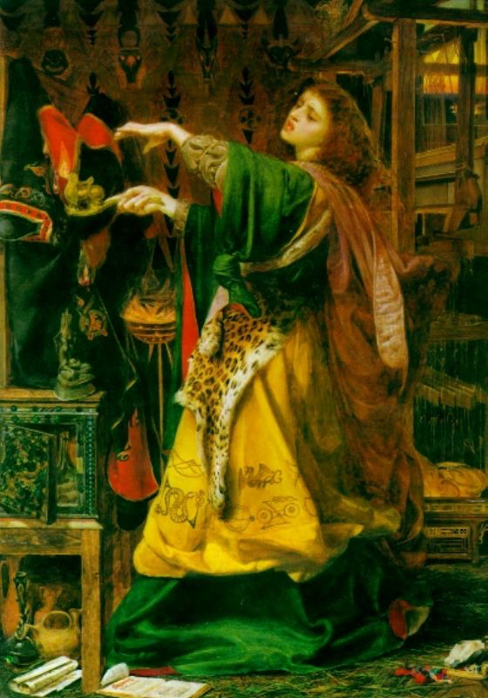
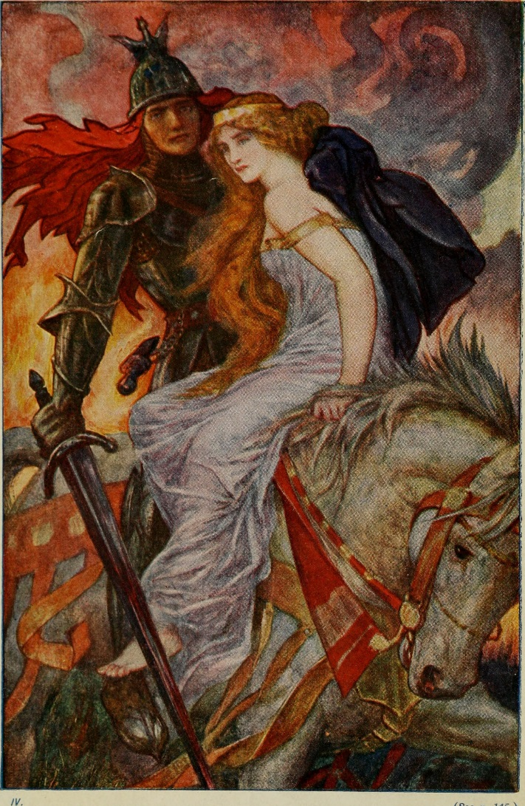
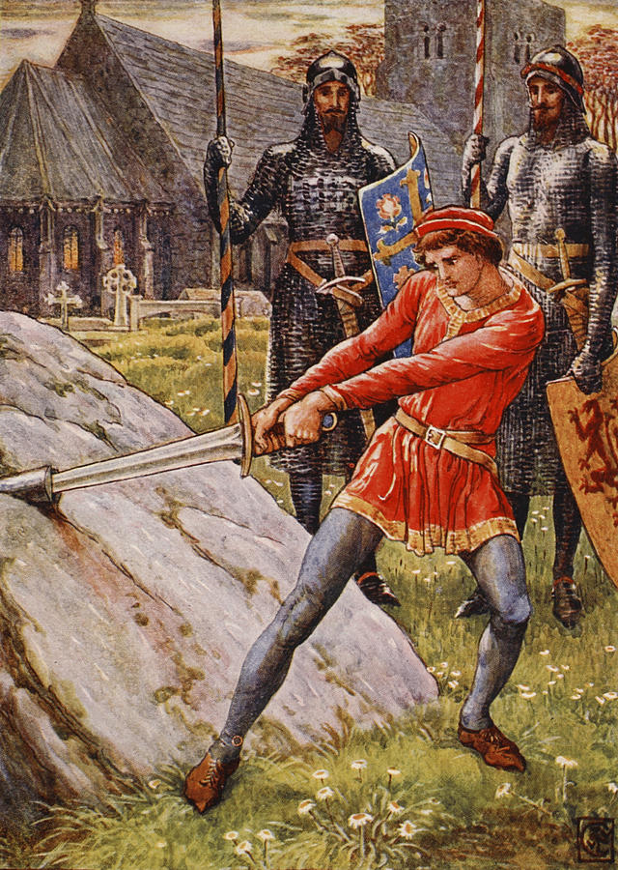
Describe your character.
Just write…
Let your pen take your imagination for a walk!

Slide 2
Exploring Detail
Go back to your ‘just write’ text and re-read it.
Look again at your descriptions and add to them, amend them, or write down different options. Think about the detail you have provided in terms of the physical description of the character and establishing a visual image (e.g. clothes or other relevant objects/settings which help with characterisation (Arthurian myth).
This is still a messy, playful, exploratory piece of writing: don’t agonise over it!

Slide 3
Noun phrases to establish character
Well-chosen noun phrases can create strong visual detail about characters:
… a lady, dark-haired and beautiful, wearing a gown of wine-red;
… the burial casket of a knight
… her fingers, long, white and dancing,
… the hood of his dark cloak,
… his face, parchment-silver and etched with age

Slide 4
Exploring Detail
Look again at your descriptions of your Arthurian character. Refine your descriptions by making a list of noun phrases to describe your character. Keep thinking about the visual detail you want to convey.
Choose one noun phrase/image that you are pleased with, and one you are less happy with, and then explain your thinking to a partner.
Tips for Teachers
This is the important bit! Here, encourage students to explain and justify their choices to each other. You could also encourage students to take it in turns to ask a question that probes choices (you could model these or have questions displayed) and which help to develop the writing further. You could then let students develop their piece into a longer description, and then allow further opportunities to discuss their work.

