Slide 1
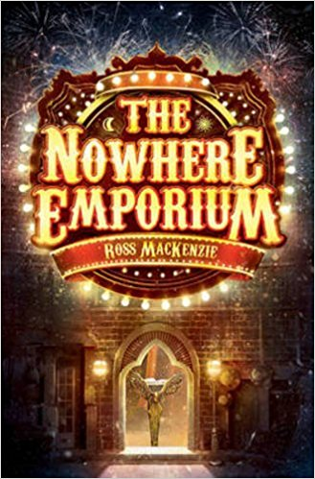
Questions about noun phrases
Look at the noun phrases that are used to
describe the Nowhere Emporium. How well do they match the picture on the front cover of
the book?
the shop from nowhere
hidden secrets
bricks the colour of midnight
bricks that shimmered and sparkled under the glow of the gas streetlamps
a golden gate so fine and intricate that some wondrous spider might have spun it
a glimmer of movement in the entranceway
the door to a world of breathtaking magic and looming danger
From the way it’s described, would you want
to go inside this shop?
What objects do you think you might find
inside? Use noun phrases to describe one of
them so we can imagine it too.
Tips for Teachers
In the example here, the questions are quite precise and encourage students to think about the effect of a particular feature – noun phrases – and to discuss their effects, and then to make predictions.
Planning questions like this in advance can be really helpful. These questions could be used to prompt whole class discussion, or, students could talk through the questions in pairs before feeding back. Remember too to think about how you might respond to students’ feedback – what follow up questions could you ask?
You could then ask students to write their own noun phrase
Notes:
Noun phrases for description, here at the start of the novel, establishing both setting and mood/atmosphere. Craft of the author is to use descriptions that will entice the reader into a particular world. The purpose of knowing about expanded noun phrases is obvious – in terms of reading, they provide essential images for us to process and build understanding of what is happening; what we might predict and speculate about; what genre we think we are reading, and so on. Connections are being made with our prior reading experience and our more general knowledge (eg what objects an ‘emporium’ might contain, and how one might differ from a mere ‘shop’). Purpose of writing task – to check understanding of the world the author is creating

