Slide 1



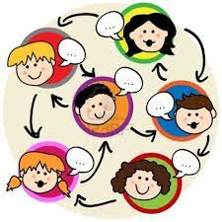
‘Metatalk for Writing’:
What’s it all about?

Slide 2
Metatalk about Writing
A team of researchers from the University of Exeter are working with a group of teachers on a project called ‘Metatalk about Writing’.
We think there should be more talking about writing (what we call ‘metatalk’) because:
Talking about writing helps us to come up with ideas for writing
Talking about writing help us to revise and improve our work
Talking about writing helps us to understand how writers make deliberate choices to create particular effects in text…

Slide 3
Your teacher is involved in the research project, and
we would like you to be involved too!
With your help, this project will help us to learn more about how and why talk can improve writing. This is important because although writing is an important skill, it’s quite a difficult thing to do! Understanding more about how to support writing will help teaching and learning in the future.
This is an exciting opportunity to be involved in a big research project; being involved is also likely to be beneficial for your learning.

Slide 4
What’s involved?
2 of my lessons will be video recorded
My written work will be collected
We also need a smaller group (2 pairs) of what we call ‘sub-sample’ students who we would like to wear a small digital recorder. Your teacher will talk to you individually about this.
The recordings we collect will be stored safely and only seen by the researchers and your teacher; your written work will be kept anonymous.

Slide 5
Consent Forms:
We need you all to read and sign a consent form, to let us know if you’re happy to be involved.
Your parents/ guardians will also be given information about the project, so you will be able to discuss it with them too.
If you are a sub-sample student, your parents will also need to sign a consent form to tell us that they are happy for you to be involved.

Slide 6
Thank you!

