Slide 1
TEACHING GRAMMAR FOR WRITING ACROSS THE CURRICULUM: DEVELOPING SUBJECT VOCABULARY
Centre for Writing Research, University of Exeter
© University of Exeter
Notes:
Key message of session:
Need for explicit teaching of vocabulary that is key to success in your subject
Grammar focus:
Noun phrases, verbs and adverbials – what they are; why they are important; how to teach them

Slide 2
Task:
Show the meaning of the word by using each one in a sentence:
weight
depression
change
suffering
effects
affects
Notes:
Point of activity is to illustrate that single words make little sense without the context of the sentence in which they are used and the context of use in a particular subject area and specific topic. This is one powerful reason why every teacher needs to teach the vocabulary associated with their subject, arranging frequent encounters with new words in different contexts, and teaching word-learning strategies for important vocabulary.

Slide 3
Answers
weight: What are the advantages and disadvantages of weight training?
depression: Explain why the weather changes with the passage of a depression.
change: Describe and explain the global responses to the threat of climate change.
suffering: “Religious people can cope with suffering better than other people.” Do you agree?
effects: Describe the likely worldwide effects of a supervolcano eruption.
affects: Describe three ways that mental preparation positively affects performance in Games.
Notes:
Highlight:
importance of context in ascertaining what a word means
the noun phrase as the prime unit of meaning – students’ understanding of how to answer these GCSE questions depends on knowing what key command words mean but circling these isn’t enough – the key nouns and noun phrases in these examples are summary labels for important concepts or phenomenon (‘suffering’ from a Christian or Buddhist perspective; ‘global responses to the threat of climate change’ – not at all the same question as ‘what is climate change’?) Stress interlinked reading and writing skills here.
Effects (noun)/affects (verb) examples have been included to draw attention to very common spelling/meaning confusion and to prominence of these terms across the curriculum. There will be a few commonly used key terms - eg practice (noun), practise (verb) - that all teachers can draw attention to. But most key vocabulary will be specific to its context of use eg ‘fatty foods’/’fatty acids’.

Slide 4
Referring closely to these examples, explain Kandinsky’s artistic style.
W
AS
S
I
L
Y
K
A
N
D
I
N
S
K
Y
Composition VII, 1913
Resonance Multicolore, 1928
White Zig-Zag, 1922
Notes:
Brief activity to illustrate the importance of appropriate subject vocabulary in ‘sounding like an expert’
List key content words that you think you will need in order to answer the question on the slide i.e. – Explain Kandinsky’s artistic style.
Focus on single nouns and noun phrases eg colour, shape, abstract expression; geometric designs – how far can you get just from general knowledge; what are you aware of needing to know in terms of vocabulary i.e. that you might also need to be actively taught by the Art department?
Are there also verbs that you might need, eg to describe processes of composition and painting style: juxtaposes, foregrounds; highlights etc?
Is there another set of evaluative words that you might need in order to express an opinion about Kandinsky’s style? Would it be appropriate to say “I like/dislike”; “I feel/think/find surprising/am moved by etc etc.
Point to make – where do students get this vocabulary from? How much is by osmosis and how much needs direct explicit teaching, built up over time. Remind of essential link between thinking and expression in all subjects – ability to ‘think like an artist’ is circumscribed by vocabulary that will facilitate such thinking.

Slide 5
Writing to explain or analyse
Explaining involves the presentation of factual information, rather than opinion, and providing reasons for how or why something happens. An explanatory piece of writing needs to help a reader to understand, and is objective, balanced and accurate. It should have authority so that your reader trusts the explanation given.
Analysing involves identifying the key parts of a topic and discussing their meaning, qualities and inter-relationships in order to be able to discuss the topic as a whole. An analytical piece of writing compares and contrasts, presents arguments and makes judgements. It should be detached and objective, rather than personal.
Notes:
Key text types common to subjects across the curriculum. As you read the descriptions, ask yourself:
what demands do these text types place on students’ vocabulary?

Slide 6
Which of these History explanations do you trust and why?
After WW1, Germany was in a great depression of their own living in poverty and with nobody to lean back on.
The Nazi party first started in a beer cellar with a bunch of men talking about politics.
At Potsdam, the second conference in these years, it was agreed to split Germany into sectors or zones.
When Kruschev began his policy of de-Stalinisation he caused problems in Hungary.
Comecon also helped Stalin and the USSR solidify power in Europe while preventing them allying with America.
Notes:
These are lower grade (first 2) and higher grade (last 3) answers from Edexcel GCSE Modern World History paper.
Highlight the differences, focusing on use of vocabulary for precision and accuracy to create an expert voice. You could pick out:
Ambiguity caused by lack of capitals – The Great Depression being referred to?
Generalisations to the point of being meaningless – ‘nobody to lean back on’
Inappropriate informality of vocabulary ‘ a bunch of men’
Last 3 examples – accurate names of historical figures and organisations; succinct noun phrases to pack in necessary information eg noun phrase in apposition (the info between the commas that directly relates to ‘Potsdam’) to quickly establish timescale of question and to explain what Potsdam refers to; accurate and precise use of terms ‘sectors or zones’
Expanded noun phrases to pinpoint important events or concepts eg Kruschev’s policy of de-Stalinisation
Verb choices for succinctness and formality and to carry historical narrative forward eg ‘solidify power’; ‘preventing them allying with’
TASK: Consider examples of writing from your students (one weaker, one stronger answer to the same question/task). Which of those answers do you most trust and why? Focus on vocabulary choices (can refer to the samples again in light of PowerPoint on teaching sentences. Don’t get distracted here by eg punctuation problems – think about how much ‘sounding like an expert’ depends on using the right vocabulary, especially nouns and verbs.

Slide 7
TEACHING SUBJECT VOCABULARY

Slide 8
Grammar provides a way of describing what writers do with language in order to be successful in a particular type of text, and particular ways of thinking. The suggestion is not to teach a raft of terminology but to be explicit about important structures and patterns of language that students can imitate.
Purpose | Text Level | Word/Sentence Level
■ What is its purpose? ■ Who is it for? ■ How will it be used? | ■ Layout ■ Structure and organisation ■ Sequence ■ Typical cohesion devices ■ Prevailing tense ■ Viewpoint (first person, third person) | ■ Active/passive voice ■ Typical sentence structure and length ■ Typical verbs ■ Typical nouns and adjectives
Notes:
Key questions for teachers:
What are the typical patterns of language that create a successful written analysis or explanation in your subject?
How can you teach these patterns of language alongside subject content?
Rest of session focuses on explicit teaching of nouns/noun phrases and verbs/adverbials.

Slide 9
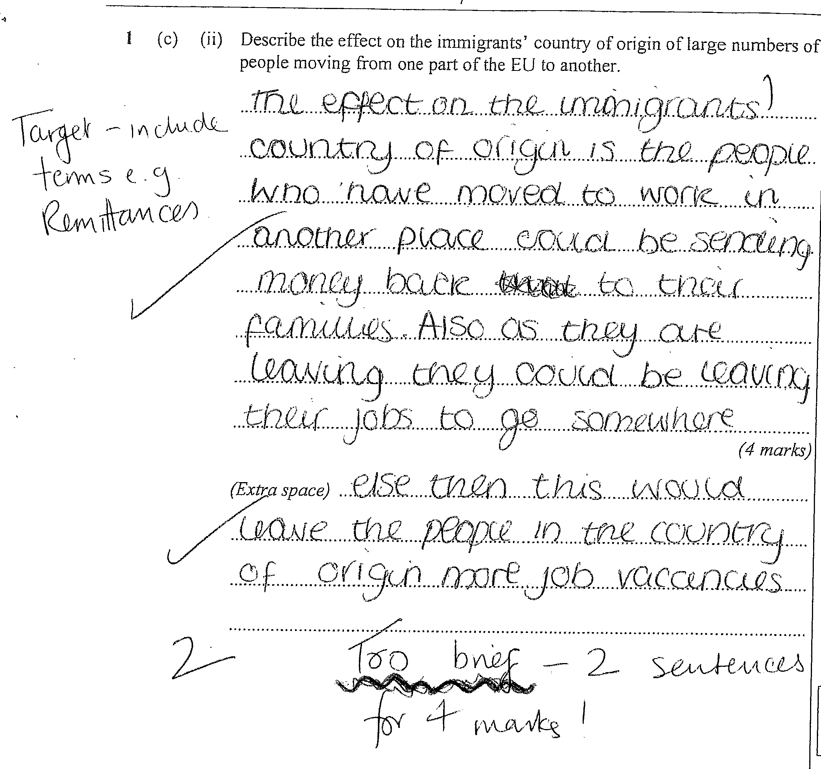
Subject vocabulary
Words are the building blocks of subject communication.
One very obvious marker of weaker writing is that it has limited vocabulary, often related to speech.
Often what is needed is vocabulary which is more formal, more precise and more typical of writing.
What is the term for ‘the people who have moved to work in another place’?
Notes:
“The effect on the immigrants’ country of origin is the people who have moved to work in another place could be sending money back to their families. Also as they are leaving they could be leaving their job to go somewhere else then this would leave the people in the country of origin more job vacancies.”
“Economic migrants” is term needed for ‘the people who have moved to work in another place’ – this immediately makes the answer more convincing.
What key terms are needed for a topic such as economic migration in the EU? Pre-teaching the key terms for a topic about to be introduced, then using them when planning and writing an answer will help reinforce the importance of key nouns and noun phrases for achieving precision and clarity. Don’t assume that students will somehow pick up this vocabulary. See slides 26 and 27 for suggestions for active teaching of vocabulary, as a reading strategy as well as for writing.

Slide 10
What would be better verb choices here?
Many classrooms already display key subject vocabulary.
These are often nouns – consider the verbs needed in your subject, as they frequently relate to higher-order thinking skills and to appropriate ways to communicate in your subject.
Notes:
Precision in choices of verbs is also important for sounding like an expert.
Topic – changes to body during 5000m race. “After 10 seconds the body will react to the running and take in more oxygen, because the heart is going faster. After 2 minutes the breathing and heart rate would go up.”
What would be better verbs for ‘the heart is going faster; the heart rate would go up’’?

Slide 11
Many students lack a vocabulary for evaluating effects and effectiveness. If this is important for your subject, how might you develop one?
Notes:
Evaluations in Drama and Food and Nutrition:
“We use physical theatre to show the Endurance (Shackleton’s expedition) crashing into the ice. We used it by using strong structure and good narration. It was successful because of the way we used the narration but unsuccessful because of the laughing which made the scene go away. Another group that worked well was Abbie’s as it was full of imagination and clear scenes.”
“Overall I believe my dish met all the criteria in a medium level, but could be improved by adding even more vegetables to get each section to a higher mark.”
Students often find it hard to name the kind of effects they are aiming for and need vocabulary support for this eg a stock of topic-specific appropriate adjectives ‘my dish would be more nutritious/healthy/nutritionally well-balanced if I added more vegetables.’

Slide 12
TEACHING SUBJECT VOCABULARY: THE NOUN PHRASE

Slide 13
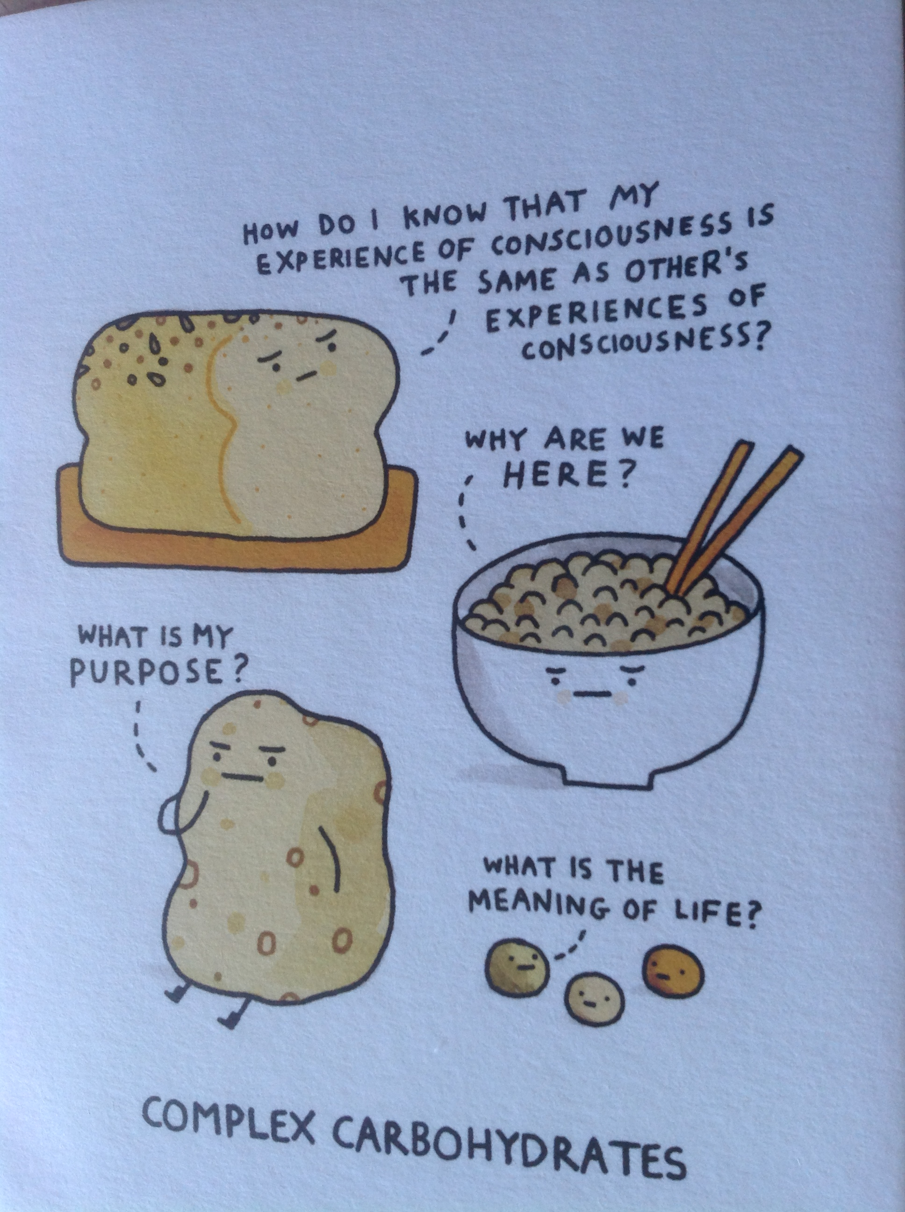
Notes:
A greetings card take on the concept of ‘complex carbohydrates’!

Slide 14
Noun phrases
ravioli
wholewheat ravioli
wholewheat ravioli with courgette flowers and ricotta
Italian-style wholewheat ravioli with courgette flowers and ricotta
gas
a colourless gas
a colourless gas, giving off a strong choking smell and soluble in water
Notes:
Noun phrases carry the bulk of information or description within a sentence and are key to locating text type and topic. Different kinds of writing often have distinctive patterns of noun phrases eg menu descriptions of food as in the first example on the slide (from a Jamie Oliver cook book).

Slide 15
TASK: How quickly can you find the single nouns and the longer noun phrases in this text? Can you sum up the topic with a noun phrase of your own?
The problem of human-caused climate change (commonly referred to as global warming) is now well known: the concentrations of 'greenhouse gases' in the atmosphere (notably carbon dioxide and methane) are now well above their pre-industrial levels, primarily due to our use of fossil fuels (coal, oil, and natural gas) but also due to deforestation and agricultural practices. As greenhouse gases accumulate in the atmosphere, more heat energy from the Earth's surface is intercepted before escaping to space, thereby causing the atmosphere to warm.
Notes:
Illustrate how a complex text (this is an A Level text) is dense with noun phrase detail.

Slide 16
The problem of human-caused climate change (commonly referred to as global warming) is now well known: the concentrations of 'greenhouse gases' in the atmosphere (notably carbon dioxide and methane) are now well above their pre-industrial levels, primarily due to our use of fossil fuels (coal, oil, and natural gas) but also due to deforestation and agricultural practices. As greenhouse gases accumulate in the atmosphere, more heat energy from the Earth's surface is intercepted before escaping to space, thereby causing the atmosphere to warm.
Notes:
Quick illustration of how much of the text is made up of nouns and expanded noun phrases. This will be true for dense texts such as this one and poses a real reading challenge. Note the number of collocations i.e. terms that consist of more than one word but that go together as a single entity – greenhouse gases, climate change, fossil fuels, heat energy. All subjects will have collocations like these as part of a central stock of subject-specific technical terms.

Slide 17
What is a noun phrase?
All the additional descriptive information attached to one ‘head’ noun.
Often this information comes before the noun eg:
a colourless gas...
a well-balanced diet...
Kandinsky’s bold and striking designs...
human-caused climate change....
Pre-modifying nouns with adjectives is the simplest way of adding descriptive detail and information. We can help students build a stock of well-chosen adjectives appropriate to a topic e.g.
strong structure and good narration a clearly-sequenced narrative
my dish met all the criteria in a medium level an economical and
nutritionally well-balanced dish

Slide 18
What is a noun phrase?
Whilst adjectives are useful, there are more sophisticated ways of adding information to nouns. Formal academic writing often modifies nouns with other nouns:
the problem of human-caused climate change
the concentrations of greenhouse gases
our use of fossil fuels
Once the war was over, the wartime camaraderie of the USA and the USSR quickly deteriorated. The success of the Superpowers’ relations was mainly due to the personal relationship of Roosevelt and Stalin.
Notes:
Example of student’s writing is taken from a high-grade GCSE History answer. Note how much of the explanation is made up of noun+of+noun constructions which allow for succinctness: These constructions are often mirrored in exam questions and will need to be explicitly taught eg Describe the key features of the impact of de-Stalinisation on Hungary.

Slide 19
What is a noun phrase?
More sophisticated writing makes more use of adding detail after the head noun (post-modification):
Kandinsky’s paintings, with their vibrant colours and chaotically-arranged shapes....
The Russian troops, advancing quickly....
The final scene, which unintentionally made the audience laugh,....
A noun phrase forms a significant ‘chunk’ of meaning within a sentence
Kandinsky’s paintings, with their vibrant colours and chaotically-arranged shapes, shocked the Establishment.
The Russian troops, advancing quickly, reached Berlin before the Allies.
The final scene, which unintentionally made the audience laugh, could be improved.
Helping students to build the noun phrase ‘chunk’ of their sentences in different
ways can strengthen their understanding and control of sentence construction.
Notes:
Noun phrase detail can be built in several different ways e.g:
Phrases starting with prepositions (with, in, at, beneath, beyond etc): congestion charges in inner city zones; the colour at the hottest part of the flame; organisms living beneath the sea bed off the coast of Japan; the design with the least environmental impact.
Clauses starting with who, which, that
Stalin, who imprisoned his opponents, ruled through fear.

Slide 20
Teaching noun phrases
Reading: scan an explanation text for noun phrases. Locating key nouns and the information attached to them will quickly tell the reader what the text is about.
Writing: Noun phrases succinctly sum up important information for the reader. They are also an important ‘grammatical chunk’ so encouraging students to use them contributes to improving clarity of sentence construction.
Topic-related vocabulary : noun phrases can be more effective than teaching single words. Noun phrases are often used in questions, and represent concepts that students need to understand.
Describe the relationship between the magnitude of earthquakes and their frequency

Slide 21
TEACHING SUBJECT VOCABULARY: VERBS AND ADVERBIALS

Slide 22
Verbs
breath rate and heart rate increase gradually
the athlete paces himself throughout the race
he needs to dispose of CO2 by breathing out
Modal verbs: can, could, will, would, shall, should, may, might, must
This could make his muscles ache but may improve the athlete’s range
of movement.
His heart and lungs will need to work harder.
Modal verbs can help students speculate and evaluate possibilities, and
connect and balance ideas.
Notes:
Examples from PE writing about effects on body of running 5000 metre race.
Remind that verbs are sometimes single words but are often in the form of a verb phrase or verb string. As with noun phrases, you might want to teach subject vocabulary in the form of key verb phrases (to dispose of; can be combined with ; is caused by etc). These will help students add detail to explanations and analyses and strengthen cause and effect connections.
Ask: How are modal verbs important to writing in your subject? They are crucial to evaluations (eg suggesting improvements to a design brief) but what about other uses such as speculating about consequences in History?

Slide 23
Adverbials
‘Adverbials’ is an overall term for single words, phrases or clauses that
give additional information about how, when or where something
happens. They can help students add detail to explanations, be more
precise, or strengthen connections between ideas.
breath rate and heart rate increase gradually
the athlete paces himself throughout the race
he needs to dispose of CO2 by breathing out
For now this could effectively make his muscles begin to ache...
Initially, his muscles may begin to ache...
Crucially....Later in the race....Eventually.....As a consequence....
Notes:
Examples are from same student’s writing about effects on body of 5000m race.
Discuss how a sentence can be improved by using a precise adverb – ‘initially’ – to replace the vaguer and clumsier ‘for now....’
Make the point that adverbials are discourse markers and can help text cohesion. More sophisticated writing will use a range of appropriate adverbials to strengthen connections between ideas (eg moreover, nevertheless, in the first place; inevitably; as a summary etc.)
See cross-curricular grammar glossary and teaching activities for more detail.

Slide 24
TASK: Write an improved version of this answer, paying attention to your use of noun phrases and verbs to convey information succinctly and precisely.
Notes:
Suggested improvement:
Economic migration within the EU can bring both advantages and disadvantages to migrants’ country of origin. One advantage is the remittances sent home by migrants to help their families. Another is the new skills they may gain which will benefit their home country when they return. The movement of large number of workers may help decrease pressure on limited jobs and resources in their country of origin, providing new opportunities for those who remain. However, disadvantages are the possibility of ‘brain drain’ if too many skilled workers leave, or gender imbalances, since it is typically men who leave home to seek employment, thus reducing the size of their country’s potential workforce.

Slide 25
PLENARY

Slide 26
Teaching subject vocabulary
Vocabulary is a very obvious key to ‘sounding like an expert’ in a subject and communicating ideas with accuracy and precision.
In the classroom:
needs to be taught in context and reinforced regularly in different contexts
needs to be taught explicitly, including word-learning strategies.
Teach students the etymology of subject words as it will support their understanding of related words eg photo-synthesis: light + putting together
Create word-webs of related words to underline relationships: eg geography; geophysical; geothermal; an ally/their allies, an alliance, to ally with, to form an alliance with; aligned against etc.
Notes:
Geoff Barton suggests that if a new term is introduced it needs to be actively reinforced and practised at least 4 times in the same lesson in order to be understood and retained.

Slide 27
Teaching subject vocabulary
Highlight key vocabulary in model texts. Consistent colour coding eg noun phrases in one colour, verbs in another, can be helpful.
Improve a section of text together, focusing on vocabulary choices and being explicit about the effect on meaning.
Entitlement vocabulary:
What words do you want all students to be able to know, use and spell correctly?
Extension vocabulary:
What words do you want your most able students to know, use and spell correctly?
Can you agree this vocabulary as a department and stage its introduction from year 7 to year 11?

Slide 28
Key teaching principles
Always link a grammar feature to its effect in the writing
Use grammatical terms but explain them through examples
Encourage discussion about language and effects
Use authentic examples from authentic texts
Use model patterns for students to imitate
Support students to design their writing by making deliberate language choices
Encourage language play, experimentation and risk taking
Notes:
Reminder of writing pedagogy within which teaching of vocabulary can be framed. The grammar is used to empower students to be explicit about what language choices can do but the emphasis is on teaching writing, not on teaching grammar.

Slide 29
Follow-on task
List the key vocabulary that students will need for a topic you will teach, in the form of nouns, noun phrases and verbs.
Plan how you will:
explicitly introduce this vocabulary;
consolidate its use during the course of the topic;
evaluate students’ success in using it.

