Slide 1





The Rights Idea? Lesson 2:
Young people’s rights when parents separate -
United Nations Convention on the Rights of the Child, Article 12
Notes:
This is the second of two lessons, ‘The Rights Idea?’ Lesson 1 introduced young people's rights under the UNCRC generally, including their right to have their voices heard under Article 12. In lesson 2 young people’s Article 12 rights are considered In the context of parental separation.

Slide 2




TEACHER SLIDE – PREPARING TO TEACH
Preparing to teach and using these slides:
The slides headed ‘teacher slides’ assist the teacher in setting up and running the lesson
Slide 12 onwards are for the pupil facing lesson
Please read the Lesson Plan 2 teaching guide for ‘The Rights Idea?’ before teaching
Have slides in presenter mode – notes are available under each slide to aid teaching
Support: and extension:
activities are suggested where appropriate (icons on bottom right corner of slides)
Resources:
Post-it notes
An ‘ask-it-basket’/ question box for pupils to ask questions confidentially
Handout for ‘Quick fire quiz’ if using
Save for the above, no additional teaching resources are needed to teach this lesson
Timing:
The lesson is designed to be taught
over 55 minutes
Notes:
This two-part lesson plan has been devised for Upper Key Stage 3 and Key Stage 4 pupils. This teaching is aimed at both PSHE and Citizenship teaching.
This slide gives an overview of the lesson. It should be read in conjunction with the Teacher Guide for ‘The Rights Idea?’ Lesson 2. Teachers are reminded to review and address any questions submitted in the anonymous ask-it-basket’/ question box, to ensure they are answering all pupils’ questions.

Slide 3
TEACHER SLIDE – PREPARING TO TEACH: PSHE
This 2-part lesson plan for upper Key Stage 3 and Key Stage 4 PSHE aims:
in lesson 1, to outline key rights under the United Nations Convention on the Rights of the Child (UNCRC) to equip pupils to be clear on their rights (KS4, R5)
in lesson 2, to discuss children’s Article 12 right to express their views on arrangements to be made if their parents separate to help pupils ‘to manage grief about changing relationships including the impact of separation [and] divorce… sources of support and how to access them.’ (Programme of Study 2020-2021: KS3, R22/ KS4, R13)
DfE Guidance on RSE states that RSE teaching should:
equip pupils to be clear on their rights and responsibilities as citizens (para 76)
be based on knowledge of pupils and their circumstances… [with] no stigmatisation of children based on their home circumstances (para 59)
and that
Teachers should be aware of common ‘adverse childhood experiences’ (such as family breakdown…) and when and how these may be affecting any of their pupils and so may be influencing how they experience these subjects (para 102)
Notes:
For PSHE, this teaching is aimed to meet the requirements of The Programme of Study for PSHE Education 2020-2021 for upper Key Stage 3 and Key Stage 4 which states that children pupils should learn:
Ways to manage grief about changing relationships including the impact of separation, divorce and bereavement; sources of support and how to access them (KS4. R13 see also KS3, R22).
In discussing young people’s Article 2 right not to be discriminated against, lesson 1 touches on the legal rights, responsibilities and protections provided by the Equality Act 2010 (Programme of Study for PSHE Education 2020-2021, KS4, R5)

Slide 4
TEACHER SLIDE – PREPARING TO TEACH: PSHE
Lesson 2 covers the following from the Programme of Study 2020-2021on forming and maintaining healthy relationships:
ways to manage grief about changing relationships including the impact of separation [and] divorce… sources of support and how to access them (KS3, R22/ KS4, R13)
strategies to access reliable, accurate and appropriate advice and support with relationships, and to assist others to access it when needed (KS4: R7)
ways to access information and support for relationships including those experiencing difficulties (KS4: R17)
the rights and protections provided within legally recognised marriages and civil partnerships and the legal status of other long-term relationships (KS4: R4)
If using the PSHE programme builder, thematic model, this fits into the Year 11 summer term programme in which pupils learn:
About different types of families and changing family structures
How to manage change, loss, grief and bereavement
[NB: Suggested for Year 11, spring term 2 if using the competencies-based model]
Notes:
The primary purpose of lesson 2 is to cover the following from the Programme of Study 2020-2021 on forming and maintaining healthy relationships:
ways to manage grief about changing relationships including the impact of separation [and] divorce… sources of support and how to access them (KS3, R22/ KS4, R13)
Within the context of accessing support for relationships with parents and the wider family following parental separation, pupils will learn:
strategies to access reliable, accurate and appropriate advice and support with relationships, and to assist others to access it when needed (KS4: R7)
ways to access information and support for relationships including those experiencing difficulties (KS4: R17)
Finally, within the context of providing young people with information (in accordance with their Article 12 rights) on the process when parents separate, pupils will learn:
the rights and protections provided within legally recognised marriages and civil partnerships and the legal status of other long-term relationships (KS4: R4)

Slide 5
TEACHER SLIDE – PREP. TO TEACH: CITIZENSHIP
This 2-part plan for upper KS3 and KS4 Citizenship meets the overarching aims of the Citizenship Programme of Study:
… to ‘develop’ (KS3) and ‘deepen’ (KS4) ‘pupils’ understanding of… the rights and responsibilities of citizens’ (page 2)
In lesson 1, by considering how some young activists are ‘getting their voices heard’ pupils will learn how to:
‘evaluate different ways that citizens can act together to solve problems and contribute to society.’ (KS4)
In lessons 1 and 2, by outlining some of key rights under the UNCRC it covers:
  local, regional and international governance and the UK’s relations with… the United Nations and wider world [and]
  human rights and international law (KS4)
  In lesson 2, by outlining the law relating to relationships and relationship breakdown it covers:
  rules, laws and the justice system… courts and tribunals (KS3)
  the legal system in the UK, (and) different sources of law (KS4)
Notes:
This slide relates to Citizenship and how the teaching meets the Citizenship Programme of Study 2013.
The lessons meet the overarching requirement of the Citizenship Programme of Study to ‘develop’ [KS3] and ‘deepen’ [KS4] ‘pupils’ understanding of… the rights and responsibilities of citizens’ (page 2).

Slide 6
TEACHER SLIDE – PREP. TO TEACH: CITIZENSHIP
The GCSE Citizenship curriculum 2015 is met as follows:
In lessons 1 and 2, by outlining some of key rights under the UNCRC it covers:
Right and responsibilities
the role of the … UNCRC
The UK and its relations with the wider world
the UK’s role and relations with the rest of… the wider world, including the UN
In lesson 2, by outlining the law on relationship breakdown it covers:
The legal system (England and Wales)
The operation of the justice system… and… civil dispute resolution
Citizenship skills – By considering the UNCRC in both lessons and young activists in lesson 1, pupils demonstrate an ability to:
understand the range of methods and approaches that can be used by governments, organisations, groups and individuals to address citizenship issues in society, including practical citizenship actions
critically evaluate the effectiveness of citizenship actions to assess progress towards the intended aims and impact for the individuals, groups and communities affected
Notes:
This slide relates to Citizenship and how the teaching meets the GCSE Citizenship curriculum 2015

Slide 7
TEACHER SLIDE – YOUNG PEOPLE’S ART 12 RIGHTS
The United Nations Convention on the Rights of the Child 1989 (UNCRC) Article 12 gives children the right to have their voices heard and their opinions listened to and taken seriously by adults. This includes the right to information, consultation and representation (if needed) when their parents separate.
This does not mean that young people make the decisions – the responsible adults (usually their parents) do, but young people have the right to have their opinions listened to. The weight placed upon those opinions will depend upon the age and maturity of the child.
The parents of approximately 280,000 young people separate each year. Research indicates that children cope better when they are consulted about arrangements for them when their parents separate and that the arrangements made are longer-lasting, yet they are seldom consulted.
Notes:
This slide gives details of young people’s Article 12 rights if their parents separate (slide 6 of lesson 1 gives details about the UNCRC generally).
This slide gives some statistics on the numbers of young people his parents separated each year and young peoples rights to be heard in the decision making following parental separation. Further details of the processes involved/ legal position when parents separate are outlined on slides 23 - 25.

Slide 8
TEACHER SLIDE – Myth-busting: MYTH 1
Myth 1: The only way to formalise a relationship is to get married.
In fact: Mixed-sex and same-sex couples can get married or enter into a civil partnership (CP). Both require a court process to legally end the relationship if it breaks down (unlike cohabitation).
Mixed-sex CP was introduced in 2019. Marriage and CPs are legal relationships, so require a legal process to end them. However parents do not need to attend court in person, this is an administrative process – it need not be adversarial i.e. it doesn’t have to be a fight.
Notes:
Slides 8 to 10 give full details of the legal position in relation to formalising relationships and ending them to inform the true or false exercise at slide 21 and myth busting exercise at slide 22.

Slide 9
TEACHER SLIDE – Myth-busting: MYTH 2
Myth 2: After a certain period together/if you have a child together, cohabiting couples have the same rights as married couples: ‘The common law marriage myth’. In fact: unlike married or CPs, cohabiting partners are not entitled to claim financial support from their former partner for themselves if they separate (although both parents must financially support their children).
Cohabitation is the fastest growing family form in England. However, many cohabitants do not realise that they do not have the same legal rights as married couples or CPs. Parents must financially support children, but not each other. Rights to the couple’s home are based on land law which, unlike family law, does not take into account contributions towards the family life leaving many ‘stay at home’ or part-time working mothers financially disadvantaged. In 2018, research by the University of Exeter showed that 46% believed that cohabiting couples form a ‘common law marriage’ when this is not the case, the so-called ‘common law marriage myth’.

Slide 10
TEACHER SLIDE – Myth-busting: MYTH 3
Myth 3: Parents must go to court to sort things out
In fact: Parents are strongly encouraged to agree finances and childcare arrangements without going to court. In the absence of safety concerns, parents are expected to work together to ensure that the children have a good ongoing relationship with both parents/regular time with each parent. Mediation is voluntary but where safety is not an issue, parents would be required to attend a meeting to find out about mediation before filing an application with the court to sort out finances or children. Children are entitled to speak to the mediator if they wish to do so. For those parents who apply to court, decisions around finances and childcare must be made in the best interests of the children. With childcare arrangements, the child's wishes and feelings will be taken into account, often by them speaking to the Family Court Adviser as Chloe and her family did (see video). If parents aren't able to put their children's needs first then the child could be separately represented within the proceedings and organisations like NYAS can provide an advocate for the child if needed.

Slide 11
TEACHER SLIDE – LESSON OUTLINE AND TIMINGS
Activity | Description | Timing
Introduction | Learning objectives and outcomes; feedback on homework task | 6 minutes
Article 12 recap | Pupils will complete the gap-fill exercise to recap on Article 12 | 2 minutes
Baseline activity | Pupils will draw a mind map of how Tom may be feeling then will consider what questions he may have and his support needs | 6 minutes
The ‘grief cycle’ | Pupils will consider the ‘grief cycle’ and how Tom’s friend Samir could support Tom | 6 minutes
The Rights Idea? video | Pupils watch The Rights Idea? video noting 3 rights young people have when parents separate | 7 minutes
Quick fire quiz | Pupils will answer quick fire quiz questions based on The Rights Idea? video | 3 minutes
True or false | True of false activity to assess pupils’ knowledge | 2 minutes
Myth busting | Pupils will consider some common misunderstandings around legal rights | 5 minutes
Divorce process | Pupils will learn about changes to the law on divorce and consider the fairness of this | 7 minutes
Sources of support | Pupils will learn about the support available to young people whose parents separate | 4 minutes
Endpoint assessment | Pupils will revisit and revise the baseline mind map as appropriate | 5 minutes
Homework/extension | Wrap up and setting homework/extension task | 2 minutes

Slide 12
GROUND RULES
We will:
not disclose personal information about ourselves or others
keep anything that others say confidential
not judge others
not put anyone on the spot and we have the right to pass
talk about ‘someone I know…’ rather than using a person’s name
comment on what is said, not who has said it
not ask personal questions or try to embarrass someone
seek help in school/encourage friends to seek help if needed
Notes:
Pupils will be discussing young people’s rights on parental separation which has the potential to be distressing for some. Teachers should refer to the Handling complex issues safely in the PSHE Classroom guide before teaching. It is important that ground rules are established to minimise the potential for distress to any pupil. If a teacher already has established ‘class ground rules’ then these can be substituted. Pupils can also be asked to add to the ground rules as appropriate.
Teachers should also:
have an ‘ask-it-basket’/ question box for pupils to ask questions confidentially
review and address any questions submitted in the anonymous ‘ask-it-basket’/ question box
work within the school’s policies on safeguarding and confidentiality
link PSHE and Citizenship education into the whole school approach to support pupil wellbeing
make pupils aware of sources of support, both inside and outside the school
explain to pupils that while confidentiality is important, if something is said or a behaviour causes concern, teachers may speak to another member of staff.

Slide 13
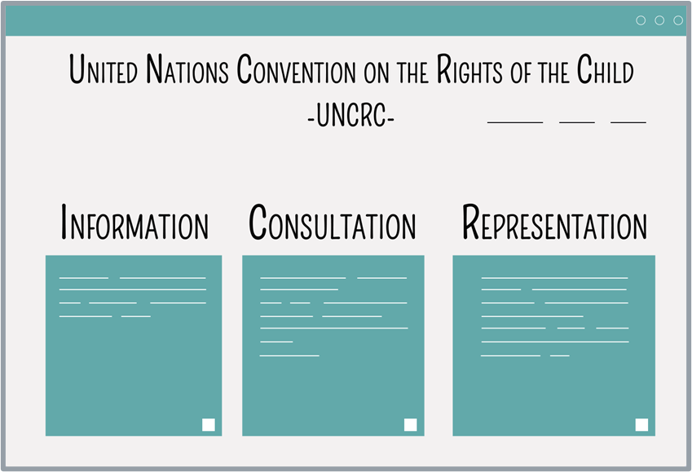
The Rights Idea – LESSON 2
Learning Objectives:
To learn about children and young people’s rights to information, consultation and (if needed) representation if parents separate under Article 12 of the United Nations Convention on the Rights of the Child (‘The UNCRC’) (including sources of support and how to access them).
To learn about the legal system in England and Wales relating to relationship breakdown
Notes:
Learning Objectives:
Run through the learning objective: To learn about children and young people’s rights to information, consultation and (if needed) representation if parents separate, under Article 12 of the United Nations Convention on the Rights of the Child (‘The UNCRC’) (including sources of support and how to access them).
To learn about the legal system in England and Wales relating to relationship breakdown

Slide 14

The Rights Idea – LESSON 2
Learning Outcomes - Pupils will be able to:
Explain young people’s rights under Article 12, UNCRC when
parents separate
Describe the range of emotions that young people may feel when
parents separate
Identify ways in which young people can be consulted if parents separate
Identify sources of support for these young people and explain how to access them
Explain the changes to the law relating to divorce and key differences between rights of married and unmarried couples on relationship breakdown in England and Wales
Notes:
Introduce the topic and run through the learning outcomes:
Pupils will be able to:
Explain young people’s rights under to Article 12, UNCRC when parents separate
Describe the range of emotions that young people may feel when parents separate
Identify ways in which young people can be consulted if parents separate
Identify sources of support for these young people and explain how to access them (see PSHE programme of study KS3, R22/ KS4, R13)
Explain the changes to the law relating to divorce and key differences between rights of married and unmarried couples on relationship breakdown in England and Wales

Slide 15
The Rights Idea: HOMEWORK TASK FEEDBACK
By today you should have:
Written about an issue that you would like to campaign about and why you think it is important
Considered what ‘right’ under the UNCRC your chosen issue addresses
As part of this task, researched prominent activists who campaign for your chosen issue and considered what actions you could take yourself to campaign on this issue in the future.
Notes:
HOMEWORK TASK from lesson 1: For homework or as an extension task, you may have asked pupils to write about an issue that they would like to campaign about and why. As part of this, they were to be asked to research prominent activists who campaign for their chosen issue and consider what actions they could take themselves to campaign on this issue in the future.
(As a reminder, as an extension activity you may have asked the pupils to consider how they might campaign for their chosen issue within their school community. As a support activity you may have given the pupils the name of a young person who is ‘getting their voice heard’).
Examples suggested for the support activity were:
Amy and Ella Meek - Set up Kids Against Plastic in 2016 when aged just 11 and 13 to campaign against the use of single use plastics (Article 6: The right to life, survival and development and Article 24: The right to healthcare as this includes the right to ‘a safe environment’).
Amika George - successfully campaigned for free sanitary products in secondary schools to end period poverty in 2017 when aged 17. She been honoured on the Time Magazine’s ‘Most Influential Teens of 2018’ list. (Article 24: The right to healthcare)
Heba Ahmed a human rights and anti-racist activist who was responsible for 15,000 people attending the Black Lives Matter protest in Manchester in June 2020 when aged 16. (Article 2: Protection from discrimination)
Jamie Windust a non-binary writer, editor, model, and public speaker. They made headlines in 2018 (when aged 21) for calling out the staff of Fantastic Beasts: The Crimes of Grindelwald for alleged misogyny, homophobia and transphobia, and in 2019 for petitioning the UK Parliament for gender-neutral passport options. (Article 2: Protection from discrimination and Article 6: The right to life, survival and development)
Shiden Tekle- in 2018 aged 18 he and three friends aged 17 recreated famous movie posters, including Titanic, Harry Potter and The Inbetweeners, with black people taking the leading roles, to put black faces in the big movies, and challenge people’s perceptions and assumptions. He set up ‘Legally Black’ whilst attending the Advocacy Academy – which trains young activists. (Article 2: Protection from discrimination)
(All of the above would also encompass Article 3 – The child’s best interests and Article 12: Getting your voice heard).
Depending on the task set, ASK one or two pupils to feedback on the issue that they would like to campaign about/prominent activists who campaign for their chosen issue etc.
N.B. Teachers have some flexibility so that if you have chosen not to set the homework/extension task you will have some additional time to cover the key activities in greater detail.

Slide 16


ARTICLE 12: UNCRC
ARTICLE 12
You have the _________ to give your ___________ and for __________ to listen, and take it __________.
Obligation, adults, opinion, seriously, judges, casually, right
Notes:
In lesson two of The Rights Idea? pupils will explore the sources of support available to them when their parents separate and how to access this support. This will be discussed as part of young people’s Article 12 right to give their opinion and for adults to listen and take it seriously. To set this up and to recap, ask pupils to use the suggested words to fill in the gaps on Article 12 above.
In slideshow mode, the word fill appears without the suggested words, with the suggested words appearing on a click to give you the option of doing the exercise as the extension task.
As a support activity consider giving pupils only the three words needed to fill the gaps.
As an extension activity consider asking pupils to complete the gap-fill without any suggested words.

Slide 17
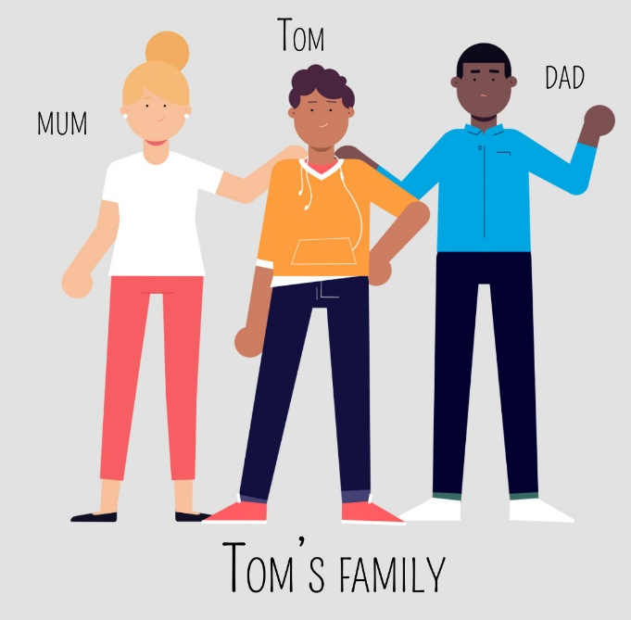
Baseline Activity – Read the scenario below
Draw a mind map with the word ‘Tom’ in the middle. Around the outside, write down:
a) how you think Tom may be feeling; b) questions you think Tom may have at this time c) support you think Tom may need and any examples you know of support that may be available to him
Tom is 13 and an only child. Two weeks ago his parents told him that they had decided to separate. This was a big surprise to Tom as his parents didn't argue much. They said that they had drifted apart and reassured Tom that they both loved him and that ‘nothing would change’ for him but hadn't really explained what that meant. There had been lots of hushed talks between his parents. Tom knew that they were talking about plans for him and felt excluded. When his dad was away, he had heard his mum crying in the bedroom, so didn't want to make her feel worse by asking questions. Tom only has a few close friends at school and their parents are still together, so he feels he doesn't have anyone to talk to. ​
Notes:
Give pupils a few minutes to read the scenario and then ask them (without conferring) to each to draw a mind map with the word ‘Tom’ in the middle. Around the outside, ask them to write down:
how you think Tom may be feeling. (Sad, hurt, angry, worried and/ or confused)
questions you think Tom may have at this time. (Is this because of something I have done? Is there any chance of you staying together? Where am I going to live? Who am I going to live with? How often will I see my other parent? Will I have to change schools? Will I be able to keep up my friendships/hobbies/time with wider family? How will things get sorted out? Will I be asked what I want? If so, by whom? Will I have to go to court?)
the support you think Tom may need and any examples you know of support that may be available to him. ( Support needed may include - good friends around him; peer support from others who've been through this; good pastoral support at school; good information online to get some of his questions answered; someone to speak to about how he's feeling; someone to speak to about what he would like to happen around arrangements for his care. Sources of support may include- pastoral support at school; friends or wider family; ChildLine or other counselling service).
Note: Do not give any further hints or tips, even if pupils ask questions. They should not share their ideas with classmates during the activity. This will give you the opportunity to see what pupils’ own beliefs and ideas are before the lesson begins.
Circulate the room as pupils complete their mind maps in order to gauge what pupils know/think/feel/believe in relation to the topic. After pupils have had 3-4 minutes or so to complete their mind maps, ask for all class feedback (using the suggested answers above to guide you}. Ask pupils not to add anything else to their mind maps during class feedback and to put these to one side as they will return to them (and these 3 questions) at the end of the lesson.

Slide 18
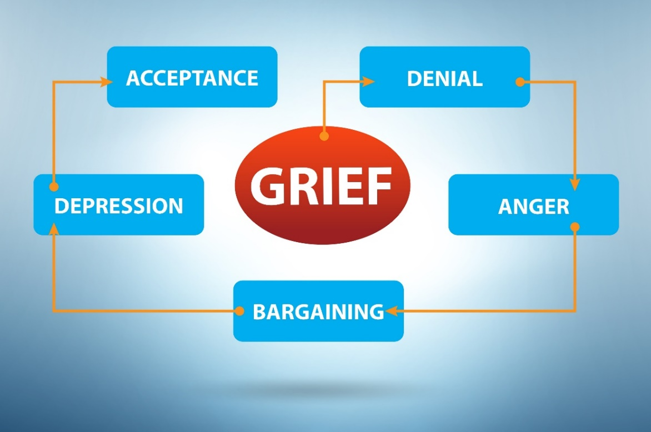
Young people’s responses to parents separating
Young people may show signs of-
1) Denial: feeling overwhelmed and bewildered
2) Anger: feeling frustrated, confused and angry
3) Depression: longing for the past/feeling sad
4) Bargaining: attempts to alter the family situation by changing their behaviour
5) Acceptance: a sense of understanding and a general desire to move forward
Notes:
Programme of Study 2020-2021 KS3, R22/ KS4, R13) requires PSHE lessons to help pupils ‘to manage grief about changing relationships including the impact of separation [and] divorce.
Here the emphasis is on the fact that parental separation can be a form of grief for children and that many go through a five stage cycle, much in the same way as they experience grief because of bereavement. The emphasis should be on normalising some of the feelings that young people may have if their parents separate such as anger or sadness. Every child’s experience is unique and will depend in part on the situation at home prior to the separation and how amicable the parents are upon separation. If the home life had been difficult the separation may be a relief. Not every child will feel all of these things or progress in a linear fashion through them.
Distancing techniques should be used, so describing how it is normal that Tom might feel hurt, sad, bewildered, angry or overwhelmed. Normalise how it is common for young people to feel that they were somehow responsible for the separation (the bargaining aspect of the grief cycle refers to attempts by young people to change their own behaviour in the hope that a parent will return home).
Split the class into 5 groups and allocate to each group a stage to focus on and provide advice about. Tell the pupils that Tom’s friend from football club, Samir wants to support Tom. Give pupils 2-3 minutes to come up with 3 top tips for Samir that could help Samir support Tom through his parents’ separation. Once pupils have had an opportunity to discuss their stage of the grief cycle (in their group) –
Ask each group to feedback what their 3 top tips would be for Samir that could help Samir support Tom through his parent’s separation. [Listen to how he's feeling, without judging and ‘be there’ for him; help him to seek out pastoral support at school; reassure him that he is not to blame for the separation and encourage him to keep up with friends, hobbies, exercise etc.]

Slide 19
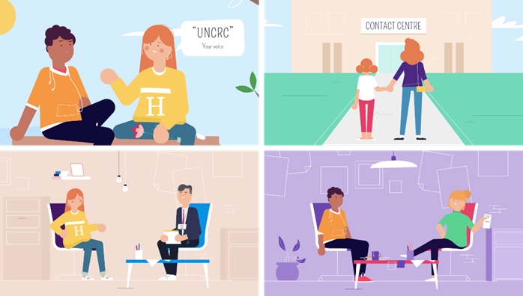


The Rights Idea– video
As you watch this video make a note of the three things that Tom discovered that young people are entitled to under the UNCRC when their parents separate.
The Rights Idea? Children and young people's rights when parents separate
Notes:
Show the class the ‘The Rights Idea?’ video asking pupils, as they watch, to make a note of and then feedback the three things that it indicates young people are entitled to under the UNCRC when their parents separate.
Press control, click on The Rights Idea? Children and young people's rights when parents separate link on the slide to play the video.
Take feedback from the class - pupils should identify that young people are entitled to: Information, consultation and (if needed representation). Emphasise that these are all voluntary- young people have the right to have their voices heard and to be consulted but equally they have the right not to be consulted if they do not wish to be.
Support activity: Consider suggesting that pupils pull out 1-2 points from the video only.
Extension activity: Consider asking pupils to pull out the different ways that Chloe said that Tom could make his voice heard – (through meeting with the mediator if his parents went to mediation; speaking to the Family Court Adviser (FCA) or sometimes the judge if his parents went to court and by having a lawyer represent him in court if needed).

Slide 20

QUICK FIRE QUIZ
1. UNHEALTHY: Attraction is important but friendship is crucial
2. UNHEALTHY: All relationships go through ups and downs
3. HEALTHY: Respectfully dealing with issues as they arise keeps relationships on track
What is the name of the person who helps parents to reach an agreement without going to court?
Where did Rosie have contact with her dad at first?
What does a Family Court Advisor do?
Do children have to go to court if their parents make an application to court?
Can children make their own application to the court?
A mediator
A contact centre
Speaks to children and reports to the court what the FCA thinks is in the children's best interests
No, the FCA tells the court the views of the children although they sometimes speak to the judge directly if they wish
Yes, if the court agrees, in rare cases they can apply and be represented separately
1. Relationship built mostly on FRIENDSHIP
2. BOTH PARTNERS SHOULD EXPECT IT TO BE PERFECT – IF IT’S NOT MOVE ON
3. CONFLICT DEALT WITH AT AN EARLY STAGE
4.
Notes:
Quick fire quiz: To consolidate learning from the video, take 3 minutes to ask the class to answer the 5 questions. To ensure that all participate, either provide a handout for pupils to complete/refer back to if they find they need the information in future (a handout is at the end of the Teacher Guide), or ask pupils to write down their answers before asking individual pupils to give their answer to a question.
In slideshow mode, each question in the left hand box is followed by an answer in the right hand box.

Slide 21
TRUE OR FALSE?
1. UNHEALTHY: Attraction is important but friendship is crucial
2. UNHEALTHY: All relationships go through ups and downs
3. HEALTHY: Respectfully dealing with issues as they arise keeps relationships on track
The only way to make a relationship legally recognised is to get married.
There are more married couples than couples who live together.
If you live together for at least two years, your rights are the same as if married.
If you live together and have a child, your rights are the same as if married.
To sort out arrangement for children after separation you must go to court.
False, since 2019 all couples have the option to enter into a civil partnership.
True. In 2019, 39% of over 16s were married and 11% were living together.
False. Cohabitants rights depend on how property is owned not time together.
False. Unmarried couples do not have rights to financial support for themselves.
False. Couples are encouraged to resolve matters without going to court.
1. Relationship built mostly on FRIENDSHIP
2. BOTH PARTNERS SHOULD EXPECT IT TO BE PERFECT – IF IT’S NOT MOVE ON
3. CONFLICT DEALT WITH AT AN EARLY STAGE
4.
Notes:
Tell pupils that Tom’s friend Samir has been helping to support Tom through his parents’ separation. It’s got Samir thinking about some of their other friends from football club whose parents aren’t married. Samir wonders what might happen if these parents split up.
True or false quiz: To set up the myth busting exercise on the next slide, run through this quick fire true or false quiz.
In slideshow mode, each question in the left hand box is followed by an answer in the right hand box.
To ensure that all pupils actively engage with the learning, ask all pupils to put their hands up or down/ thumbs up or down, depending on what they think the answer is.
For glossary of terms, see the Teacher Guide.

Slide 22

INFORMATION – MYTH BUSTING
Information on the process
Mixed-sex and same-sex couples can get married or enter into a civil partnership
(CP): both require a court process to legally end the relationship if it breaks down.
Cohabiting relationships are the fastest growing family form in England but, unlike
those who are married or in a CP, cohabitants are not entitled to claim financial support from each other if they separate (although both parents must financially support their children).
Parents are encouraged to agree child arrangements and finances without going to court if possible, but if they can’t either parent can apply to the court for an order.
Notes:
When parents separate, as the pupils have just learned, young people are entitled to information. Some of the information they are likely to want will be on the ‘sources of support’ available to them (which follow on slide 26) and details about the process itself- What will happen? How will decisions be made?
The information here is an overview only of the process with the aim of busting some common myths and misunderstandings:
That the only way to formalise a relationship is to get married.
Myths around the rights of cohabitees - ‘the common law marriage myth’
That parents must go to court to sort things out
Myth 1: The only way to formalise a relationship is to get married
In fact: Mixed-sex and same-sex couples can get married or enter into a civil partnership (CP): both require a court process to legally end the relationship if it breaks down.
Myth 2: After a certain period together/if you have a child together, cohabiting couples have the same rights as married couples: ‘The common law marriage myth’
In fact: Cohabiting relationships are the fastest growing family form in England but, unlike those who are married or in a CP, cohabitants are not entitled to claim financial support from each other if they separate (although both parents must financially support their children).
Myth 3: Parents must go to court to sort things out
In fact: Parents are strongly encouraged to agree finances and childcare arrangements without going to court wherever possible.
The teacher facing slides, at slides 6 to 8 give fuller details of the legal position in relation to formalising relationships and ending them).

Slide 23
the ‘FAULT-BASED’ law on divorce
Matrimonial Causes Act 1973: ‘Fault-based’ divorce
Applicant must show that marriage has irretrievably broken down by proving one of five facts (fault-based and separation based)
Respondent can contest the fact and if successful Applicant can only divorce after five years
Uncontested divorce can be obtained within a few months – but only if one of the fault-based facts
Notes:
In 2019, approximately 60% of the population lived in a couple, the majority were married but around one in five were cohabiting. Whilst rates of cohabitation are increasing, most parents who separate will have been married. Here, therefore, we look briefly at the process of divorce, which is set to change in autumn 2021.
Explain to pupils that different religions have different views on divorce, and those views will be respected, but this is not the focus of the lesson (ACT Citizenship Principles, Principle 1).
The person applying for the divorce is called ‘the Applicant’ and the other party is called ‘the Respondent’.
Explain to pupils that under the ‘old’ law (still in force until Autumn 2021), the Matrimonial Causes Act 1973, if a spouse wants to divorce quickly than they must prove that the other has committed adultery (had sex with a member of the opposite sex whom they are not married to) or behaved unreasonably. If the Respondent objects to the allegation then they could defend the application, but this rarely happens as it is an extremely costly process involving court hearings. If an Applicant does not wish to allege fault they would need to show that they had been separated for two years (provided the other party agreed) or five years if the other party did not agree (there is one other technical fact of two years desertion but this is rarely used). The law has been widely criticised as the requirement to ‘blame’ the other person can increase animosity. Most English speaking western countries: USA, Canada and Australia as well as much of Europe have had a no-fault divorce system for many years.
[NB, in case a pupil asks, the requirements for ending a married same-sex relationship is essentially the same as ending a mixed-sex marriage save that adultery can only be relied on if it involves sexual intercourse with a member of the opposite sex. Adultery is not a fact the party can rely on to end a civil partnership. The removal of fault, which is discussed on slide 25, removes this anomaly and the lack of a fair and even-handed approach for all couples – this is a higher level point so only cover if a pupil raises it].

Slide 24

Changes to the law on divorce
Tom thinks that the ‘fault-based’ law is outdated but Samir isn’t so sure. In pairs create two lists – one with at least 3 reasons why Tom thinks it is outdated and one with at least 3 reasons why Samir thinks it isn’t.
Notes:
Tell pupils that Tom and Samir have just learnt at school about changes happening to the divorce law. Tell pupils that Tom thinks the ‘fault-based’ law is outdated but his friend Samir isn’t so sure. In pairs, ASK pupils to create 2 lists – noting down on one list at least 3 reasons why Tom might think the law is outdated (what are the ‘cons’ of the law?), and on the other at least 3 reasons Samir might disagree (what are the ‘pros’ of the law?) ASK some of the pupils to feedback what they have put on the 2 lists.
As an extension task, consider asking pupils to consider how they think the rates of marriage, civil partnership and cohabitation might change in future – do they think the trend of increasing rates of cohabitation will continue, or will the new divorce law encourage higher rates of marriage? Might the new divorce law encourage higher rates of divorce?

Slide 25
the ‘NO-FAULT’ law on divorce
Divorce, Dissolution and Separation Act 2020
Applicant (or Applicant and Respondent on a joint application) must show that the marriage has irretrievably broken down
Respondent cannot contest the divorce
Divorce can be obtained after 26 weeks
Notes:
Now explain to the pupils why the change was felt to be needed and what the ‘new’ law sets out. Explain that wider reforms in the family justice system in recent years have focussed on reducing conflict and promoting resolution yet alleging fault can cause distress, escalate conflict, increase costs and make resolution less likely. It is hoped that moving to a no-fault system of divorce will make it less acrimonious and therefore lead to better outcomes for children.
The Divorce, Dissolution and Separation Act 2020, to be introduced in Autumn 2021, removes fault from the process. The ground for divorce remains the same – the marriage must have irretrievably broken down – but this is proved by the passage of time. The Applicant can apply for a final order 26 weeks after filing the application. There is no option to defend the divorce and the application can be made jointly. For some, it will increase the length of time it takes to get a divorce because the so called ‘quickie’ facts of adultery or unreasonable behaviour no longer apply.
Ensure, when teaching this, that you consider with pupils the ‘rights’ of the different parties affected and how sometimes rights can be in tension with each other. For example if there is a ‘right’ to divorce for all adults, without having to allege fault, if one person wants the divorce but the other doesn’t then one person’s ‘right’ to divorce will be at the expense of the other person’s ‘right to family life’ under the Human Rights Act 1998, Article 8. Equally, even if the decision to separate is mutual, this will adversely impact on the child’s ‘right to family life’. Also, divorce can lead to economic disadvantage for women as they tend to reduce their work hours to care for children so tend to be earning less than men if they have children- but rules are in place to ensure that women’s contribution to the family life and viewed as equal to financial contributions.
Remind pupils that in The Rights Idea? video we learned that Chloe, Jack and Rosie's parents made an application to court because they couldn't agree arrangements for the children. As their parents separated a couple of years ago, they would have had to have applied for a divorce under the old law and alleged fault if they wanted to obtain a divorce without waiting for at least two years if they both agreed to the divorce or five years if one objected.
Ask pupils to comment on what impact they think it may have had on the case if Chloe’s parents had divorced after the law changed and therefore ‘fault’ was not an issue:
Answer: It may have cost less. It may have made the separation less acrimonious. It may have made it easier for the parents to agree the arrangements for the children between themselves and therefore made an application to court less likely. Because it may have been more amicable, the parents may have been more open to listening to their children's views (and therefore it would have been more likely that the children’s Article 12 rights would have been upheld from the outset).

Slide 26



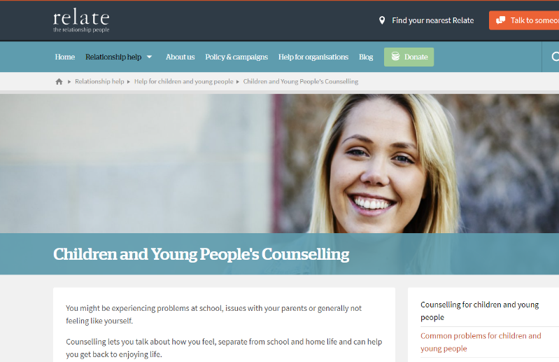
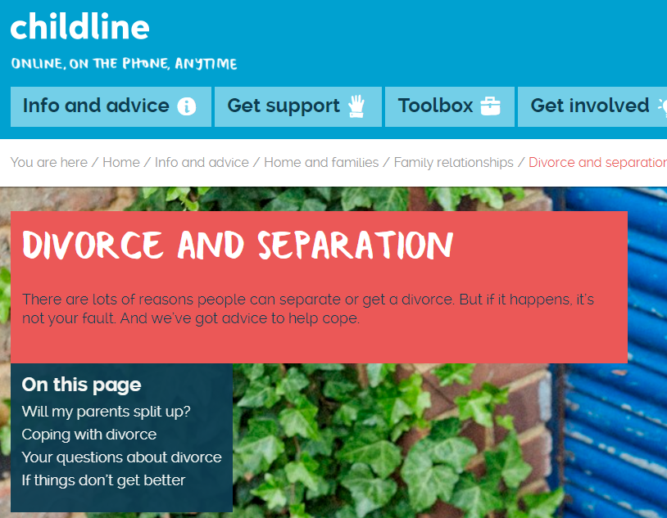
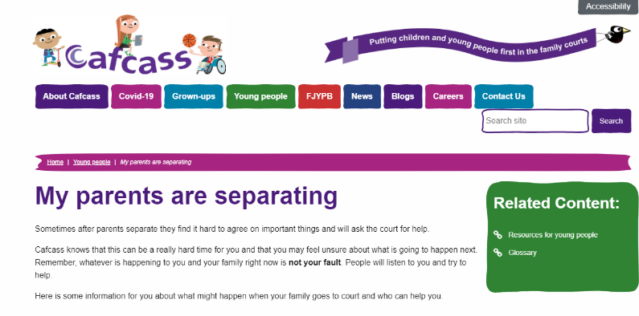
Sources of support for young people
Notes:
Remind pupils of the support available to them in school from the pastoral lead. There is also lots of information and support available to young people online including:
National Youth Advocacy Service (NYAS): NYAS provides a range of rights based services for children and young people through a network of qualified advocates. Advocates ensure that the views of children and young people are listened to, particularly in decisions which are made about them. NYAS works to ensure that young people’s Article 12 rights to information, consultation and representation are respected. It provides information to young people on its website; a free helpline and an advocate for young people. The advocate will find out what the young person’s wishes and feelings are. They will help the young person to start, change or stop something in their life. They can go with the young person to meetings, if the young person wants them to, and help them to tell people what the young person wants or speak for them if they don’t want to. The advocate will represent a child or young person in court if needed.
National Association of Child Contact Centres: NACCC runs a network of 350 contact centres which provide a safe, neutral, welcoming space for children to spend time with parents (or other people important to them, such as grandparents). Contact centres are used for children, usually up to around the age of 9, often as a stepping stone to contact away from a contact centre where parents have not been able to agree contact. The NACCC website has lots of information for children and young people to help them to understand how they may be feeling when their parents separate as well as videos and stories of other young people’s experiences of using a contact centre. Whilst contact centres are used for a younger cohort of children, this information can be useful to KS3 and KS4 pupils as they may have younger siblings/ wider family/ family friends in this younger age group.
Cafcass: Cafcass stands for Children and Family Court Advisory and Support Service. Cafcass works with children and young people in family court cases. They make sure that young people’s voices are heard and decisions are taken in their best interests. As we learned from the video, if a parent has made an application to the court about child arrangements and the judge feels that a report from Cafcass is needed to help the judge decide the case, then the FCA will speak to the parents; observe the parents with the child; speak to the child and then prepare a report for the judge recommending what they think is in the child’s best interests. The Cafcass website has lots of information for young people on the court process and resources to help young people whose parents have separated.
Relate: Relate offers counselling to young people who are experiencing difficulties in any area of life, including if parents are arguing or have separated. Counselling is available in school, at a Relate Centre, by web chat, telephone or online. Young people can expect to be helped by a supportive and non-judgmental counsellor. They can be referred by a teacher, social worker, or can ask to see a counsellor themself – what they say is confidential unless the counsellor is worried about their safety.
Childline has a huge amount of information, advice and support for young people whose parents have separated available online, by telephone or through one-to-one counselling.

Slide 27
ENDPOINT ASSESSMENT ACTIVITY
Return to the mind map you drew earlier and in a different colour add to your mind map by writing down:
Any additional words for how you think Tom might have felt when his parents told him they were separating
Any words for how you think Tom might have felt once he had learned of his rights to express his opinion and spoken to the mediator his parents saw?
Where could Tom find information and support to help him at this time and in the future (giving specific examples of organisations)?
​
Notes:
Ask the pupils to return to the mind map they drew earlier and in a different colour add to their mind map by writing down:
Any additional words for how you think Tom might have felt when his parents told him they were separating
Any words for how you think Tom might have felt once he had learned of his rights to express his opinion and spoken to the mediator his parents saw? (Words like hopeful, happier, stronger and/or empowered will hopefully be suggested. It is important to acknowledge however that he may still be feeling sad)
Where could Tom find information and support to help him at this time and in the future (giving specific examples of organisations)?
Pupils should mention:
National Youth Advocacy Service (NYAS);
National Association of Child Contact Centres (NACCC);
Cafcass
Relate
Childline

Slide 28

HOMEWORK OR EXTENSION TASK
Look at the source of support for young people whose parents have separated which the teacher allocates to your table and be ready to share some information you learned from this research about children’s rights when parents separate:
National Youth Advocacy Service: https://NYAS.net (tel: 0808 8081001)
National Association of Child Contact Centres: https://naccc.org.uk (tel: 01159 484557)
Cafcass: https://www.cafcass.gov.uk/young-people/my-parents-are-separating/ (tel: 0300 456 4000)
Childline: https://www.childline.org.uk/info-advice/home-families/family-relationships/divorce-separation/ (tel: 0800 1111)
Relate: https://www.relate.org.uk/relationship-help/help-children-and-young-people/children-and-young-peoples-counselling (tel: 03000030396)
Notes:
HOMEWORK OR EXTENSION TASK: For homework or as an extension task, allocate to each table one of the listed sources of support for young people whose parents have separated. Ask the pupils to each carry out some independent research on the source of support allocated and be ready to share some information they learned from their research about children’s rights when parents separate.
An added benefit of this homework task is that any pupil who needs these contact details for personal reasons, either for themselves or a friend, will be able to note them down without drawing attention to themselves.

Slide 29
HOMEWORK OR EXTENSION TASK
National Youth Advocacy Service: https://NYAS.net (tel: 0808 8081001)
National Association of Child Contact Centres: https://naccc.org.uk (tel: 01159 484557)
Cafcass: https://www.cafcass.gov.uk (tel: 0300 456 4000)
Childline: https://www.childline.org.uk (tel: 0800 1111)
Relate: https://www.relate.org.uk/ (tel: 03000030396)
For the service allocated to you, research:
Who is the service designed to support?
How do they support people (e.g. online, telephone, text etc.) and for what kinds of situations?
What information is available on the website about young people’s rights?
How does the service help to protect young people’s rights when parents separate?
Notes:
HOMEWORK OR EXTENSION TASK: This slide sets out the four questions that the pupil will be asked to research from one of the five organisations allocated to them. The details from the previous slide are repeated here so that a young person who wants to write down the details without drawing attention to themselves will be able to do so.

