Slide 2
Session Two Healthy, Positive Social Norms

Slide 3
Some ground rules
We will be learning and working together as a group in this programme
Some of the material we will be discussing will be sensitive and some of us will have had personal experience of the things we discuss
We will all be be respectful of personal emotions as we learn
Confidentiality
Appropriate language
Attendance
Communicating with the facilitator
Please be aware that we will be talking about sensitive issues and issues that might have affected you or people you care about. If you feel uncomfortable or upset it is fine to leave the space. Facilitators will understand and are trained to help you.

Slide 4
Where we are
Healthy & Positive Behaviour (Majority)
Unacceptable
Behaviour (Minority)
Problematic Behaviour

Slide 5
Acceptable/ majority behaviour
But from the perspective of those in the minority –
they believe they are in the majority (false consensus) and that their behaviour is not unacceptable

Slide 6
Where we need to get to
Healthy & positive majority behaviour
Unacceptable behaviour becomes SO socially proscribed (clearly defined as unacceptable) that most people stop doing it

Slide 7
Range of Behaviours
Healthy, age-appropriate, mutually respectful, safe
Mutually flirtatious, playful
Situation- or age-inappropriate or non-mutual
Harassment
Sexually abusive & violent
Adapted from Cordelia Anderson via Tabachnick, J. (2010). Making a Difference: Your role in preventing sexual violence on campus. NSRVC.org/saam
Notes:
7

Slide 8
How can we help to alter behaviour?
?

Slide 9
Not okay
Not cool
You’re better that that
This is making me uncomfortable
Don’t be an arse

Slide 10
A student’s personal experience
“I was approached by a group of male students as I was walking out of my halls of residence and they were all shouting sexual things at me and then one of them approached me, grabbed me around the waist and then started to touch my breasts and bottom. He was saying things like ‘you know you want this’ and ‘you know you're up for this’.”
NUS (2011) p13

Slide 11
Do you empathise? If this had happened to…
Your best friend
Your girlfriend
Your mother
Your sister
Your daughter

Slide 12
IMPACT (of rape, attempted rape, sexual assault, sexual harassment)
“Throughout the ordeal, I was having nightmares, was afraid to go anywhere outside of my room, had splitting headaches and was on a course of Beta blockers and antidepressants. This seriously affected my relationships further into uni and screwed up my first year exams” (Cambridge 2014 p20)
“After the attempted rape, I thought I was fine. I got with every boy, but would freak if they touched me down there. I would get drunk every night. I drew away from my friends. I got addicted to prescription drugs. I contemplated suicide. It took me a year and a half to realise I needed help.” (Cambridge 2014 p20)
“I find it difficult to go on dates with men without being wary of their intentions”
(NUS 2011 p28)
“It is playing a massive part in my life. I won’t go out alone after dark any more, which, as a part time student, is seriously affecting my studies and personal and social choices. It is also affecting me financially as I will take any possible precautions so as not to be alone in my local area in the dark. I’m taking anti-anxiety medication for the first time because of it and I feel like it’s slowly destroying me” (NUS 2011 p28)

Slide 13
A student’s personal experience
“I was approached by a group of male students as I was walking out of my halls of residence and they were all shouting sexual things at me and then one of them approached me, grabbed me around the waist and then started to touch my breasts and bottom. He was saying things like ‘you know you want this’ and ‘you know you're up for this’.”
NUS 2011 p13
Cambridge study: CUSU (Cambridge University Students' Union) (2014). Cambridge Speaks Out. Cambridge: CUSU Women's Campaign. Online at http://www.womens.cusu.cam.ac.uk/Cambridge%20Speaks%20Out%20Report%202014.pdf
NUS study: NUS (National Union of Students) (2011) (2nd Ed.). Hidden Marks. London: NUS. Online at http://www.nus.org.uk/Global/NUS_hidden_marks_report_2nd_edition_web.pdf

Slide 14
A group of students (not an individual)
All shouting sexual things at me
One of them takes it further

Slide 15
“Lad Culture”?
On Friday night at Syndicate a young female fresher passed out about 1am. Nobody moved to help her get up but four boys crowded around taking upskirt photos.
Freshers’ week at Bristol University September 2013 via Facebook
A rugby club at Oxford University has been banned from competing and had its leadership dismissed after organising a "free pussy" event, which instructed students to spike their dates' drinks.
Huffpo, 5/11/13
Aberystwyth University men's cricket club (AUMCC) social last year. The team were banned from playing and had their funding withdrawn.

Slide 16
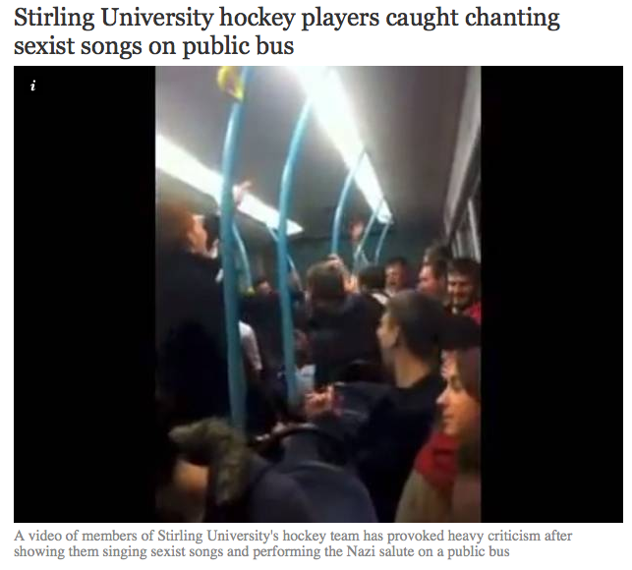
“Lad Culture”
The Independent, 6/10/2014
Government orders inquiry over violence against women at universities
The Guardian 6/9/15
Edinburgh rugby players chant rape jokes at female students
Boozed-up rugby players yelled jokes about “gang rape” at female students in the queue outside Edinburgh Students’ Union on Saturday night.
The Tab, 25/09/2014
The Times Higher Education Supplement, 8/3/2013
‘I found photos of me in pyjamas in my bed on some boys’ WhatsApp group,’ student Rosie Wilcox says. ‘They did the same to one of my friends and she wasn’t wearing anything… They thought it was really funny but she was devastated’.
The Guardian: “Campus Nightmare”, 11/10/2014
Aberystwyth University men's cricket club (AUMCC) social last year
The Independent, 15/11/2013

Slide 17
Being a “lad”
Not all men
Not “all the time”
Not “all bad”
There is pressure to conform
From Oxford Good Lads Project
http://youtu.be/PrnC9qr_gjY

Slide 18
Healthy & Positive Behaviour (Majority)
Problematic Behaviour
Unacceptable
Behaviour (Minority)

Slide 19
“We are Man”
http://www.youtube.com/watch?v=ZYhaodUPqSU

Slide 20
“But what’s the problem with a bit of harmless banter? It’s only a joke”
http://bobnational.net/record/220105/media_id/221303
Blurred Lines: The New Battle of the Sexes [television programme, online] 21:30 8/5/2014, BBC TWO, 60mins. http://bobnational.net/record/220105/media_id/221303

Slide 21
Bonding as a group
Sexual assault
Verbal harassment

Slide 22
HOMICIDE
SUICIDE
PHYSICAL EXPRESSION:
PHYSICAL/SEXUAL ASSAULT
CULTURAL MICROAGGRESSIONS (SUBTLE, INTENTIONAL OR UNINTENTIONAL): CULTURAL INVISIBILITY, SOCIAL EXCLUSION, MISPREPRESENTATION, VIOLENT PORN
VERBAL EXPRESSION:
SEXUAL HARASSMENT
MAKING SEXUAL JOKES
ATTITUDES & BELIEFS: RACISM SEXISM HOMOPHOBIA TRANSPHOBIA DISABLISM AGEISM
See handout
DISCRIMINATION
Ideas incorporated from ccasayourworld.com; McMahon & Banyard, 2012 DOI: 10.1177/1524838011426015

Slide 23
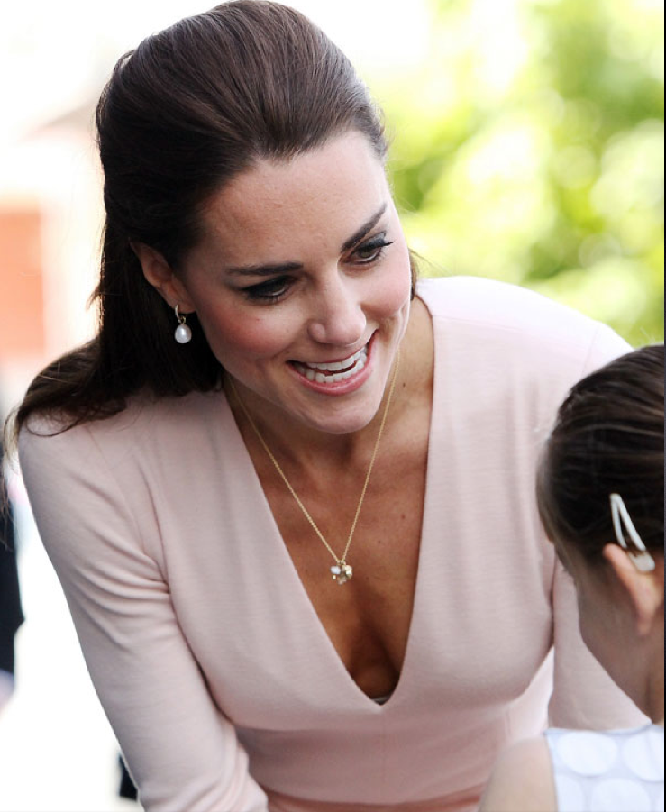
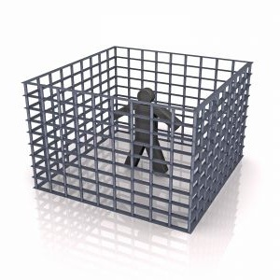

Slide 24
Being a Man?
“You have to show how masculine you are; you can’t show sensitivity – it is difficult to be different – you need to look and act a certain way”
(young man, Year 11: EVAW: A Different World is Possible, p.6)
EVAW (End Violence Against Women Coalition) (2011). A Different World Is Possible. London: EVAW.
ISBN: 978-0-9558609-3-5 Downloaded from http://www.endviolenceagainstwomen.org.uk/data/files/resources/19/a_different_world_is_possible_report_email_version.pdf

Slide 25
Being a Man?
+ risk of substance abuse
+ high-risk behaviours (proving toughness; not seeking medical help)
+ criminality
+ suicide
+ experiencing violence
+ exclusion from school & underachieving at school
+ being incarcerated in prison
(Pease, 2003, Thompson, 1995,1997)
Credit: Dr Finn Mackay

Slide 26
Social norm misperceptions among women
Healthy eating
& exercise behaviours
Illness; eating & exercise disorders
Unhealthy eating / dieting / exercise

Slide 27
Research shows:
“Men … report that they do not personally believe in many societal myths about masculinity but believe that other men do”
(Fabiano et al., 2003)
Men often underestimate the extent to which other men are uncomfortable with stereotypical (negative) masculine behaviour
(studies cited in Berkowitz, 2013)
Fabiano, P. M., Perkins, H. W., Berkowitz, A., Linkenbach, J., & Stark, C. (2003). Engaging men as social justice allies in ending violence against women: Evidence for a social norms approach. Journal of American College Health, 52(3), 105-112.
Berkowitz, A. (2013). A Grassroots’ Guide to Fostering Healthy Norms to Reduce Violence in our Communities:Social Norms Toolkit. USA: CDC. Online at http://www.alanberkowitz.com/Social_Norms_Violence_Prevention_Toolkit.pdf

Slide 28
***
!!!
***
I’m uncomfortable but I’m the only one
Don’t say stuff like that.

Slide 29
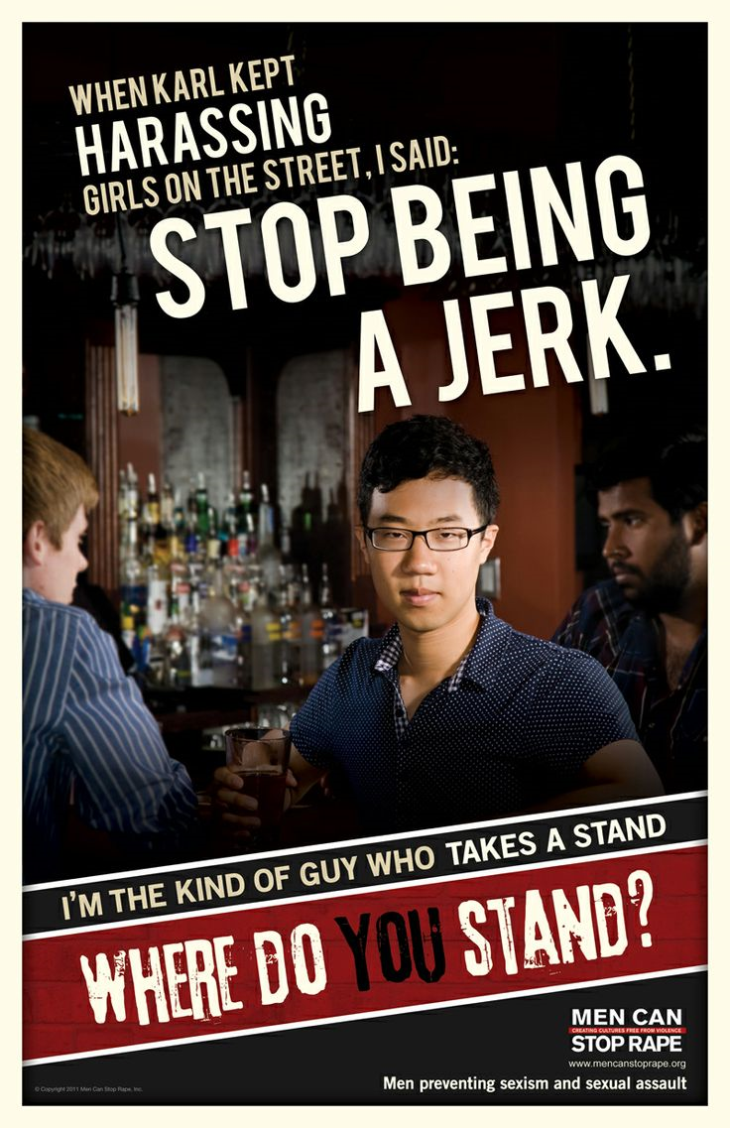

Slide 30
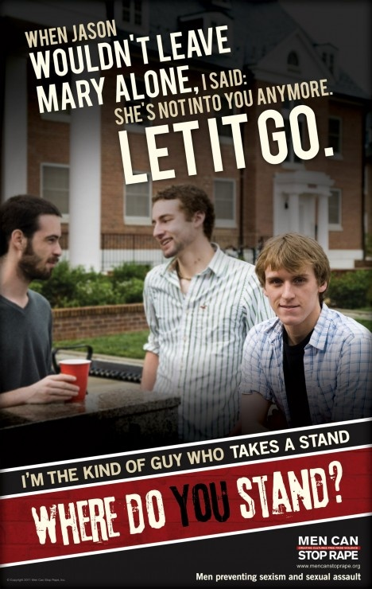

Slide 31
