Slide 1


Risk Management Cycle 2024/25

Slide 2
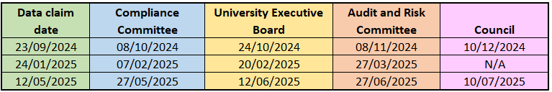
Risk Management Cycle 2024/25
Risk data will be extracted from the system on the dates in the table below. Committee review dates are shown for reference. You might be asked to update your risks in between reviewing periods by the committees who are reviewing the reports.

Slide 3
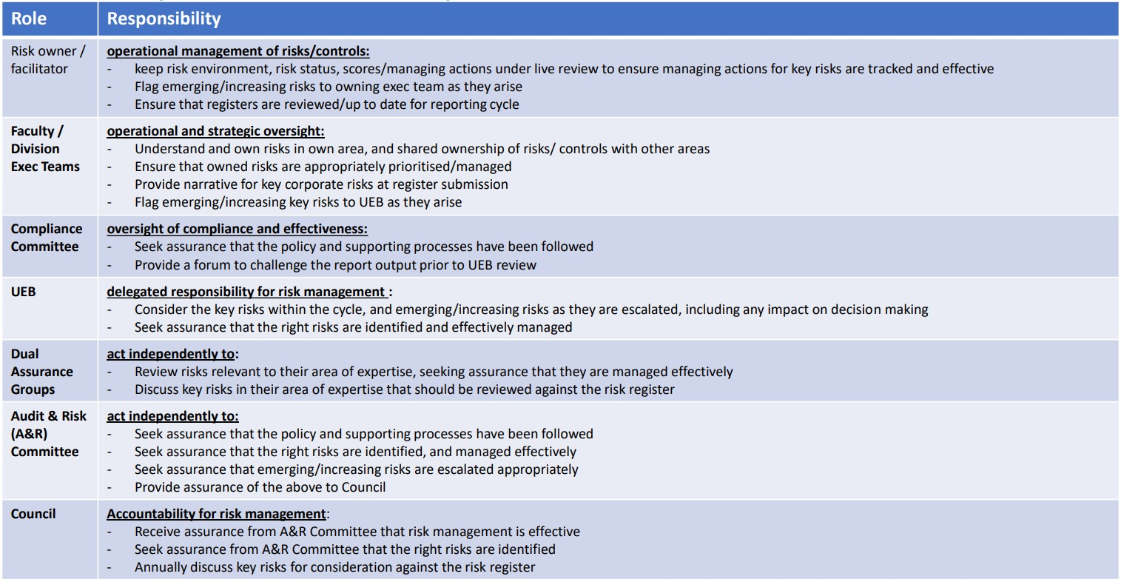
Summary of roles and responsibilities

Slide 4
If you have any questions, please contact us:
RiskManagement@exeter.ac.uk

