Slide 1
Risk Management: Risk articulation
Last updated October 2024

Slide 2
Contents
Introduction
Consider how a risk is recorded
Consider report audiences
Constructing a risk title and risk description

Slide 3
Introduction
A risk is an event that may occur, and cause harm/have impact. A risk can usually be foreseen, and action taken to reduce the harm/impact or likelihood of it happening.
Anyone at the university could identify a risk that could prevent objectives or strategic aims from being met.
All staff are responsible for managing risk, with day-to-day activity aimed at increasing the potential for meeting objectives and strategic aims.
Identified risks need to be articulated in a specific way to enable effective management strategies to be developed. This should consider how risks are recorded and reported.

Slide 4
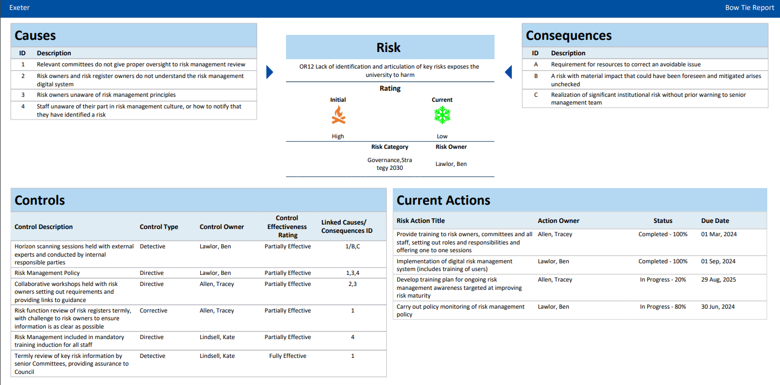
Consider how a risk is recorded
This system risk report shows:
A simple overview title
What could cause the risk to occur
What the consequence of the risk would be
4. Mitigations can then be targeted at:
The causes to try to limit the likelihood of the risk occurrence
The Consequences to limit the impact if the risk did occur

Slide 5
Consider report audiences
Risks across the university are reported to Compliance Committee, University Executive Board, Audit and Risk Committee, and Council. The risk title for risks included in the report is extracted and presented to these committees.
Committee members will not be close to all risks registered but should be able to understand the crux of the risk from the title.
This means that localised abbreviations and jargon should not be used, as only those in the area registering the risk would understand their meaning and context.

Slide 6
Constructing risk titles and descriptions
Examples of good and bad risk titles and descriptions:
Risk Title – a short, informative overview that can be understood in its own right:
Risks are not identified
Lack of identification and articulation of key risks exposes the university to harm
Risk description – more information that supports the risk title rather than repeats it:
The university does not identify risks appropriately
Key risks to the University are not identified or are not articulated to provide appropriate visibility and escalation when required. Potential realisation of a significant institutional risk without prior warning to the senior management team.

Slide 7
If you have any questions, please contact us: ​ ​ RiskManagement@exeter.ac.uk

