Slide 1
What is REF?
All Staff Open Sessions – April 2019
Professor Neil Gow, DVC R&I

Slide 2
What is REF?
Research Excellence Framework: a national assessment of research at UK universities by discipline
The university’s allocation of Quality-Related research funding is based on our REF performance
REF is an assessment of three things:
60%
RESEARCH OUTPUTS: from all staff with significant responsibilities for research
25%
IMPACT: assessment of impact case studies
.. PLUS an Institutional Environment statement – pilot, scored but not included in profile scores
Environment: an assessment a narrative statement and data
15%

Slide 3
Significant changes since REF2014
Processes for Eligibility not Selection of people
Output variability (min. 1 output, max. 5 outputs); Portability/non-portability: transitional arrangements for outputs of former staff
Output selection processes and consideration of EDI
Approach to individual circumstances is more complex

Slide 4
REF2021: Research Power
REF2021
FTE to be returned: tbc – 1,108 participated in RM18
UoAs to be returned: 25-26 (tbc) of 34
REF2014
FTE returned: 736
UoAs returned: 25 of 36
RAE2008
FTE returned: 636
UoAs returned: 31 of 67
~£17.8m per annum
2.2% of total mainstream QR
~£3.2m for Impact; 2.0% of total impact-related mainstream QR
Based on 2017-18 allocation
~£12.8m per annum
2.1% of total mainstream QR
Based on 2012-13 allocation

Slide 5
Our approach to REF2021
Openness, transparency, accountability and inclusivity – with an emphasis on collective responsibility in our REF2021 preparations.
A team approach to Exeter’s submission – an ethos that reflects the collective responsibility point. This is not an exercise of individual scrutiny; everyone contributes directly or indirectly
Celebrating our successes

Slide 6
More attention on:
OPEN ACCESS: From 1st April 2018: all journal articles and conference proceedings must be submitted in Open Research Exeter (ORE) within 3 months of acceptance
There are funds available to help with costs: www.exeter.ac.uk/research/openresearch/
Equality, Diversity and Inclusivity
Open Access
Interdisciplinary Research
Responsible Metrics
REF2021 definition of interdisciplinary research
“For the purposes of the REF, interdisciplinary research is understood to achieve outcomes (including new approaches) that could not be achieved by established disciplinary approaches alone. Interdisciplinary research features significant interaction between two or more disciplines and / or moves beyond established disciplinary foundations in applying or integrating research approaches from other disciplines.”

Slide 7
Your REF2021 to do list
Publish your best work
Register for an ORCID number
Gather supporting evidence for impact case studies (where applicable)
Support your DoRs and DoIs
Provide confidential information about your individual circumstance if required

Slide 8
Code of Practice
Code of Practice (CoP) Consultation
MARCH: initial open consultation
APRIL: CoP revised
APRIL/MAY: Further circulation for any final comment
MAY: approval of CoP
We have to consult on and produce a co-created Code of Practice. This will be submitted to Research England by 7th June 2019.
Ensure no unintended negative consequences
Reflect on initiatives/actions taken regarding EDI since REF2014
Detail the policies and processes we will use

Slide 9
Code of Practice – policies and processes
STAFF ELIGIBILITY

Slide 10
Staff who are potentially eligible for REF2021
Only staff on research-related contracts – as reported annually to HESA - can be considered for REF2021
The contract types are:
“Teaching and Research” – or Exeter’s Education and Research contract
“Research-only” – or Exeter’s Research contract

Slide 11
Definitions for eligibility
All staff with significant responsibility for research must be returned to REF2021
All staff who meet the REF2021 definition of Independent Researcher are deemed to have significant responsibility for research and must be returned to REF2021
For submission to REF, we must demonstrate that a person meets the REF2021 definition of:
Significant responsibility for research
Independent Researcher

Slide 12
Significant responsibility of research
The criteria for significant responsibility for research includes:
All staff on Education and Research (E&R) contracts are expected to have significant responsibility for research
All staff on E&R contracts will be returned to REF2021
Explicit time and resources are made available for research
Engaging actively in independent research
Independent research being an expectation of the role
1.
2.
3.
Notes:
If a university was not returning all E&R staff the onus would be no the university to demonstrate why they don’t have significant responsibility but are on a “Teaching and Research” contract and to put in place a selection process for every single member of E&R staff.

Slide 13
Independent Researcher – the REF2021 definition
The REF2021 definition of an Independent Researcher is: “an individual who undertakes self-directed research, rather than carrying out another individual’s research programme.”
This is not a judgment on a researcher’s independence of thought or ability to work independently.
The guidance includes specific qualifying criteria for all four Main Panels; with additional criteria for Panel C&D

Slide 14
Independent Researcher – qualifying criteria
For all four main panels
And, for Mains Panels C and D only
Leading or acting as principal investigator or equivalent on an externally funded research project
Holding an independently won, competitively awarded fellowship where research independence is a requirement.
Leading a research group or a substantial or specialised work package.
1.
Being named as a Co-I on an externally funded research grant/award
Having significant input into the design, conduct and interpretation of the research. (Not a standalone criterion)
4.
2.
5.
3.

Slide 15
Independent Researcher – OPEN PROCESS
Staff on Research contracts at Grade F and above invited to complete a form in July 2019 (deadline of 6th September 2019)
Forms will be available online
Eligibility Review Group will also consider eligibility in February 2020, April 2020 and July 2020
for new staff or staff who have since met the criteria.
Reviewed by the Eligibility Review Group, College Associate Deans of Research invited as observers.
Staff are notified in October 2019 if they meet the REF2021 Independent Researcher definition.

Slide 16
Independent Researcher – PRELIMINARY STAGE
before Open Stage
Directors of Research/UoAs receive lists of all staff on Research Only (Grade F and above) contracts in May 2019
Those deemed eligible at this initial stage will be informed in July 2020
All other R-only informed of Open Process
With available information, UoAs will identify those who are eligible based on Indicators 1 (PIs),2 (Fellowships) and 4 (Co-Investigators)
Where information is readily available, UoAs will identify those eligible based on Indicators 3 and 5
Associate Deans of Research will review decisions at the preliminary stage

Slide 17
Code of Practice – policies and processes
OUTPUT SELECTION

Slide 18
Approach to selecting outputs
Each UoA will have its own specific process but will draw on common approaches and principles.
Your Director of Research is your key point of contact and you should expect your UoA to explain your UoA’s process by October 2019.
The UoA will present an initial set of recommended outputs for submission to the University Research Monitoring Panel; initial list in September/October and updated list in July 2020.
Individuals with advisory or decision-making responsibilities who are conflicted will recuse themselves

Slide 19
Selection process: common principles
The common principles are:
Self-nomination of outputs (through the annual Research Monitoring exercise
Peer-review of outputs providing indicative grades
Moderation of indicative grades for Research Monitoring/REF2021
Selection panel
Communication
Adjudication where required

Slide 20
Selection process: guiding questions for UoAs
Does the set of outputs include at least one output per Category A eligible member of staff returned (excl. where the minimum output requirement has been waived)?
Is this set of outputs reflective of the highest quality outputs produced in this period?
Whilst bearing in mind the approach to an optimum quality profile, UoAs are also asked to consider :
Without damaging the quality profile, do these outputs reflect the work of the range of the Category A eligible staff, i.e. in relation to protected characteristics (where known)? Are the outputs of one group or other disproportionately represented? If so, are there appropriate ways to rebalance this within the submission?
Without damaging the quality profile, are these outputs representative of the breadth of research areas within the UoA or is one research area or other disproportionately represented? If so, are there appropriate ways to rebalance this within the submission?

Slide 21
Including outputs of former staff
REF2021 allows us to include the outputs of former staff to optimise our submission for each UoA
Outputs can be considered, and where possible staff will be informed, for:
Staff who have retired
Staff who have left
Staff who are deceased
Staff who have completed a fixed-term contract
Staff whose contract type has changed prior to the census date and who no longer have significant responsibility for research
Outputs can be considered but returned only with permission:
Staff who have taken voluntary severance
Outputs to be considered only if requested by author:
Staff subject to compulsory redundancy
Outputs will not be considered:
Staff dismissed for any other reason

Slide 22
Code of Practice – policies and processes
INDIVIDUAL CIRCUMSTANCES

Slide 23
Your circumstances matter
All staff eligible for submission to REF2021 to will be asked to complete an Individual Circumstances form in May
Completion of the form is mandatory Y/N to having circumstances to disclose
Disclosure of circumstances is voluntary
Completion of the form will allow us to collectively do the following :
Ensure that you have the right support for your research endeavours
Make the case (where appropriate) for the minimum requirement of one output to be waived
Make the case for your Unit of Assessment to submit fewer outputs

Slide 24
Types of circumstances that are recognised by REF
Only circumstances reported through this process can be considered for REF2021
Early Career Researcher started career as an independent researcher on or after 1 August 2016
Secondments or career breaks outside the HE sector
Qualifying periods of family-related leave
Junior clinical academics who have not gained a certificate of completion of training by 31 July 2020
Disability (including chronic conditions)
Ill heath, injury or mental health conditions
Constraints relating to family leave
Caring responsibilities
Gender reassignment
Other circumstances relating the protected characteristics or activities protected by employment legislation

Slide 25
Waiving the minimum requirement of one output
This can be done in the following circumstances Where the individual has not produced an output during the REF period and has:
been absent from research for an overall period of 46 months or more
experienced circumstances equivalent of a 46 month absence from research
had two or more qualifying periods of family-related leave
experienced a combination of circumstances which might have resulted in a similar impact but which would not individually meet the thresholds set

Slide 26
Registering your circumstances/the process
Confidential submission process of forms
Reviewed by the Eligibility Review Group which includes HR representation
Individual able to alert HR/Occupational Health (if they wish) to make contact
What your UoA will be told:
List of names for those with the minimum requirement waived – no further details shared
The total number of reduction which can be requested and the FTE it relates to – no further details shared, unless specifically requested by the individual

Slide 27
Reduction in total output pool
If the minimum requirement of one output is waived, the total number of outputs is automatically reduced by one per person
Your Unit of Assessment can ask for additional reductions to be taken into consideration if there are multiple individual circumstances registered which have a cumulative effect on the UoA’s ability to meet the total number of outputs required

Slide 28
Code of Practice – policies and processes
OTHER POLICIES

Slide 29
Also in the draft Code of Practice
Our Governance arrangements
Confidentiality policy
Conflict of Interest
Approach to review
Policy to support decisions between UoAs
Further (brief) opportunity to comment: we will be circulating the revised draft University of Exeter REF2021 Code of Practice to all staff

Slide 30
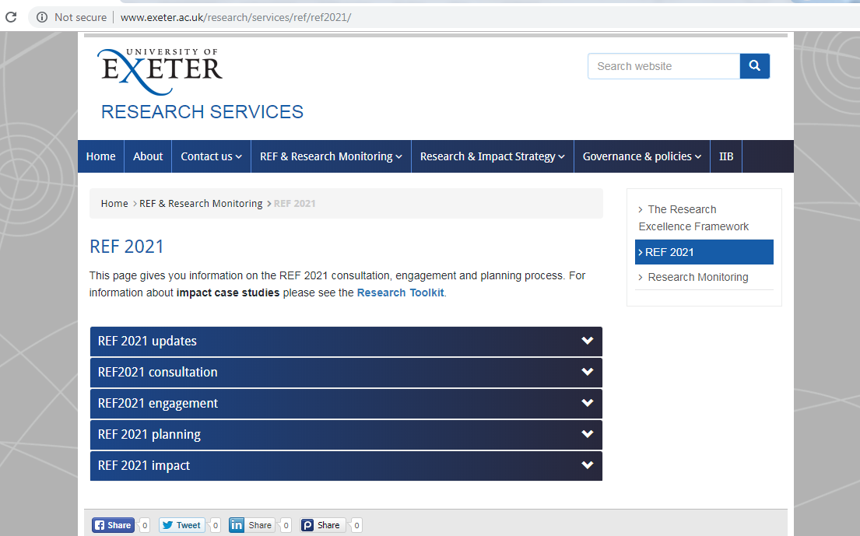
Questions?
Email: Exeter-REF-2021@Exeter.ac.uk
Website: http://www.exeter.ac.uk/research/services/ref/ref2021/

