Slide 1
Author Instructions
PLOS ONE,
PLOS Computational Biology,
PLOS Pathogens,
PLOS Neglected Tropical Diseases,
PLOS Genetics,
PLOS Digital Health (NEW!)
PLOS Climate (NEW!)
PLOS Water (NEW!)
PLOS Global Public Health (NEW!)
EXCLUDES:
PLOS Medicine
PLOS Biology
PLOS Sustainability and Transformation (NEW!)
Questions about author instructions or billing?
authorbilling@plos.org

Slide 2
Short version

Slide 3
Submissions instructions for PLOS ONE, PLOS Computational Biology, PLOS Pathogens, PLOS Neglected Tropical Diseases, PLOS Genetics, PLOS Digital Health, PLOS Water, PLOS Climate, PLOS Global Public Health
When in the Editorial Manager submission system for any of the journals above:
Login as an author.
Indicate what kind of manuscript you’re submitting. Progress-bar navigation will appear that allows you to jump to any part of the submission process.
Jump to “Additional Information” in the navigation bar →
Scroll to “Publication Fees” →
Answer with 2nd Radio Button: My institution will full or partially pay →
Select institution name from drop down
You can jump ahead or go back to any section during the submission process

Slide 4
Detailed

Slide 5
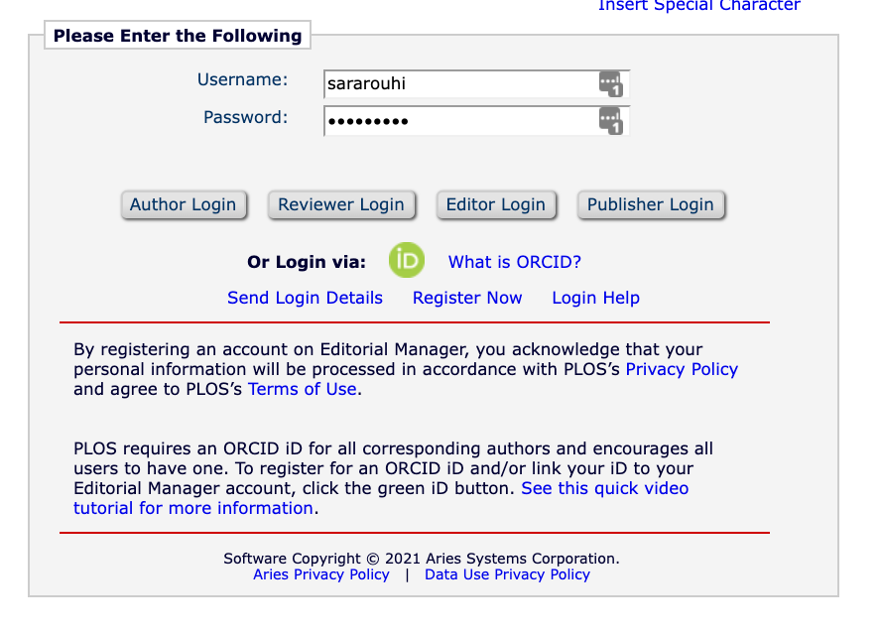
Submissions instructions for PLOS ONE, PLOS Computational Biology, PLOS Pathogens, PLOS Neglected Tropical Diseases, PLOS Genetics, PLOS Digital Health, PLOS Water, PLOS Climate, PLOS Global Public Health
When in the Editorial Manager submission system for any of the journals above:
Login as an author.
Indicate what kind of manuscript you’re submitting.
Progress-bar navigation will appear that allows you to jump to any part of the submission process.
PLOS ONE,
PLOS Computational Biology,
PLOS Pathogens,
PLOS Neglected Tropical Diseases,
PLOS Genetics,
PLOS Digital Health (NEW!)
PLOS Climate (NEW!)
PLOS Water (NEW!)
PLOS Global Public Health (NEW!)
Editorial Manager login page for PLOS ONE

Slide 6
Steps to correctly select your institution
3. Within the “Additional Information” page, scroll to “Publication Fees”
4. Select second radio button “My institution will fully or partially pay the fee…”
PLOS ONE,
PLOS Computational Biology,
PLOS Pathogens,
PLOS Neglected Tropical Diseases,
PLOS Genetics,
PLOS Digital Health (NEW!)
PLOS Climate (NEW!)
PLOS Water (NEW!)
PLOS Global Public Health (NEW!)

Slide 7
5.Select your institution from the drop down
PLOS ONE,
PLOS Computational Biology,
PLOS Pathogens,
PLOS Neglected Tropical Diseases,
PLOS Genetics,
PLOS Digital Health (NEW!)
PLOS Climate (NEW!)
PLOS Water (NEW!)
PLOS Global Public Health (NEW!)
Select your institution’s name from the drop down menu.
Once you make a selection, no further action is required. No more drop downs or text boxes will appear*.
* Except for University of California authors

Slide 8
That’s it!
Questions from authors?
authorbilling@plos.org
Questions from libraries?
institutionalaccounts@plos.org
PLOS ONE,
PLOS Computational Biology,
PLOS Pathogens,
PLOS Neglected Tropical Diseases,
PLOS Genetics,
PLOS Digital Health (NEW!)
PLOS Climate (NEW!)
PLOS Water (NEW!)
PLOS Global Public Health (NEW!)

Slide 9
https://plos.org/resources/for-institutions/institutional-account-participants/
Author eligibility or invoice questions? Authorbilling@plos.org

