Slide 1
Independent Researcher Eligibility
Professor Will Harvey, Associate Dean of Research, UEBS

Slide 2
What is REF?
Research Excellence Framework: a national assessment of research at UK universities by discipline
The university’s allocation of Quality-Related research funding is based on our REF performance
REF is an assessment of three things:
60%
RESEARCH OUTPUTS: from all staff with significant responsibilities for research
25%
IMPACT: assessment of impact case studies
.. PLUS an Institutional Environment statement – pilot, scored but not included in profile scores
Environment: an assessment a narrative statement and data
15%

Slide 3
Units of Assessment
Disciplines are listed/grouped as Units of Assessment or Sub-panels
REF2021 has 34 Units of Assessment; we will be submitting to 25-26 Units of Assessment.
Sub-panels are grouped into four Main Panels:
Main Panel A: Medicine/Life Sciences [UoA 1-6]
Main Panel B: Physicals Sciences, Engineering and Technology [UoA 7-13]
Main Panel C: Social Sciences [UoA 14 – 24]
Main Panel D: Humanities [UoA 25 – 34]

Slide 4
Significant changes since REF2014
Processes for Eligibility not Selection of people
Output variability (min. 1 output, max. 5 outputs); Portability/non-portability: transitional arrangements for outputs of former staff
Output selection processes and consideration of EDI
Approach to individual circumstances is more complex

Slide 5
Our approach to REF2021
Openness, transparency, accountability and inclusivity – with an emphasis on collective responsibility in our REF2021 preparations.
A team approach to Exeter’s submission – an ethos that reflects the collective responsibility point and recognises that everyone contributes to REF. This is not an exercise of individual scrutiny; everyone contributes directly or indirectly.
Celebrating our successes

Slide 6
What does REF2021 mean to the individual?
Helps pay our salaries/research time and contributes towards research activity costs
It enhances institutional/departmental/discipline’s reputation nationally and globally
However….
It does not directly relate to promotion, probation or recruitment
The names of people submitted will not be published

Slide 7
What does REF2021 mean for someone on a Research contract?
REF2021 recognises that some of you are in a transitional stage of your career (or have specific roles and responsibilities) and for contractual/administrative reasons you may not be eligible.
If you meet the REF definition of eligibility and you are at Exeter on the census date, you must be returned
If you leave to a different post, publications/outputs produced at Exeter, might be submitted here (specific policy applies)
Notes:
Key to stress that eligibility or ineligibility has no bearing on their role at Exeter

Slide 8
Code of Practice: our policies and processes
Our Code of Practice lists our policies on:
Independent Researcher eligibility
How outputs are selected
Selecting outputs of staff who have left
Link to the University of Exeter Code of Practice: https://www.exeter.ac.uk/research/services/ref/ref2021/

Slide 9
STAFF ELIGIBILITY

Slide 10
Staff who are potentially eligible for REF2021
Only staff on research-related contracts – as reported annually to HESA - can be considered for REF2021
The contract types are:

Slide 11
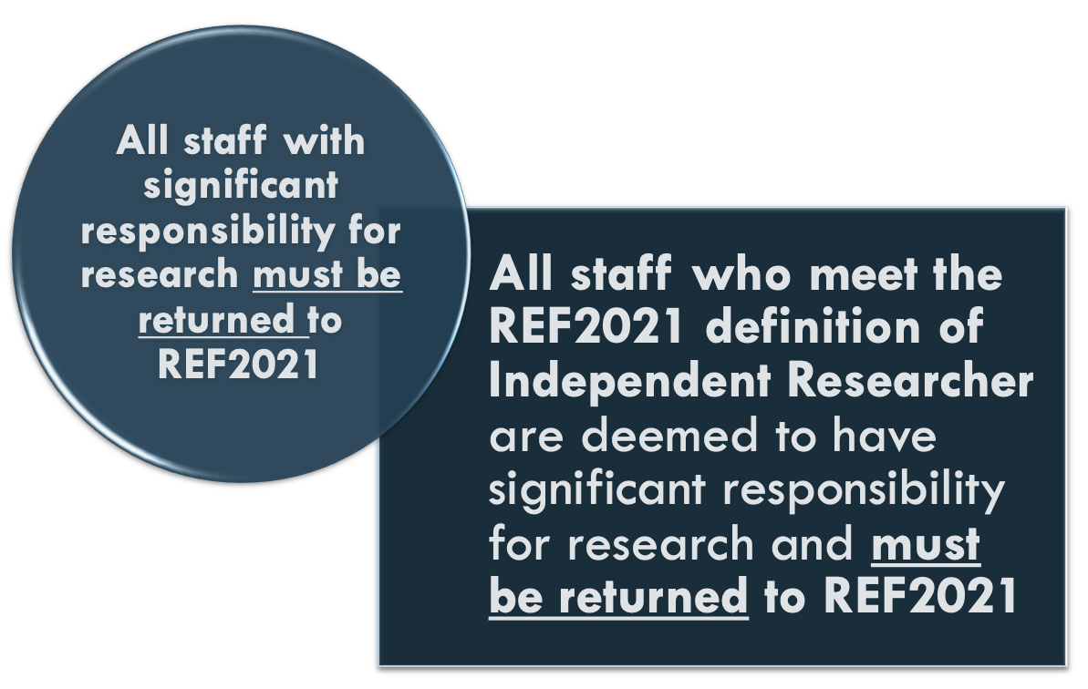
Definitions for eligibility
For submission to REF, we must demonstrate that a person meets the REF2021 definition of:
Significant responsibility for research
Independent Researcher

Slide 12
Significant responsibility of research
The criteria for significant responsibility for research includes:
All staff on Education and Research (E&R) contracts are expected to have significant responsibility for research
All staff on E&R contracts will be returned to REF2021
1.
2.
3.
Notes:
If a university was not returning all E&R staff the onus would be on the university to demonstrate why they don’t have significant responsibility but are on a “Teaching and Research” contract and to put in place a selection process for every single member of E&R staff.

Slide 13
Independent Researcher – the REF2021 definition
The REF2021 definition of an Independent Researcher is: “an individual who undertakes self-directed research, rather than carrying out another individual’s research programme.”
This is not a judgment on a researcher’s independence of thought or ability to work independently.
The guidance includes specific qualifying criteria for all four Main Panels; with additional criteria for Panel C&D

Slide 14
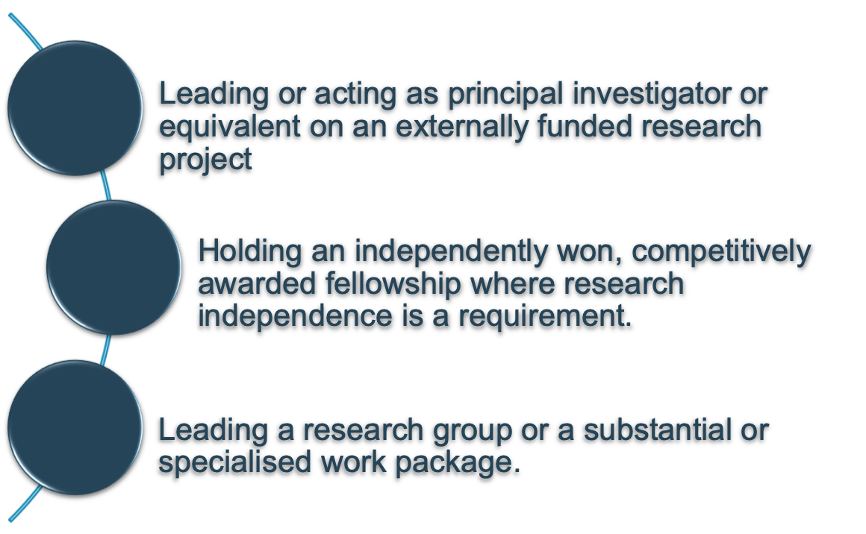
Independent Researcher – qualifying criteria
For all four main panels
And, for Mains Panels C and D only
1.
4.
2.
5.
3.

Slide 15
Independent Researcher – PRELIMINARY STAGE
Directors of Research/UoAs have reviewed lists of all staff on Research Only (Grade F and above) contracts in May 2019 based on information held within University records (mainly grants information)
Staff who meet the REF2021 definition will be notified that they are eligible
All other staff on Research contracts (Grade F and above) will be invited to the Open Process

Slide 16
INDEPENDENT RESEARCHER OPEN PROCESS

Slide 17
What is the Open Process for?
Allows us all to ensure that we haven’t missed anyone who is eligible
It allows individuals to:
give further information about how they some of the indicators;
Provide information on grants held at previous posts that Exeter is unaware of;
Explanation/further information of how you meet the indicators.
Your Director of Research is your key point of contact within your UoA – do discuss this with them or your line manager or Head of Department

Slide 18
Open Process timetable
Staff on Research contracts at Grade F and above invited to complete a form in July 2019 (deadline early September 2019)
Form reviewed by the Eligibility Review Group; College Associate Deans of Research invited as observers.
Staff are notified in October 2019 if they meet the REF2021 Independent Researcher definition.
Eligibility Review Group will also consider eligibility in February 2020, April 2020 and July 2020
The forms will be available online until July 2020 for new staff or staff who have since met the criteria.

Slide 19
The Independent Research form
Asks new staff for details of research grants and/or staff about research grants held at previous universities as PI (or as Co-I for Panel C or D units of assessment)
Details of competitive research fellowships
A brief explanation of how you meet:
Indicator 3: Leading a research group or a substantial or specialised work package
Indicator 5: Having a significant input into the design, conduct and interpretation of the research (Panel C and Panel D only)

Slide 20
If you meet the REF2021 eligibility, your REF2021 to-do list
Publish your best work
Be compliant with the REF2021 and University Open Access Policy
Register for an ORCID number
Gather supporting evidence for impact case studies (where applicable)
Support your DoRs and DoIs
Provide confidential information about your individual circumstance if required

Slide 21
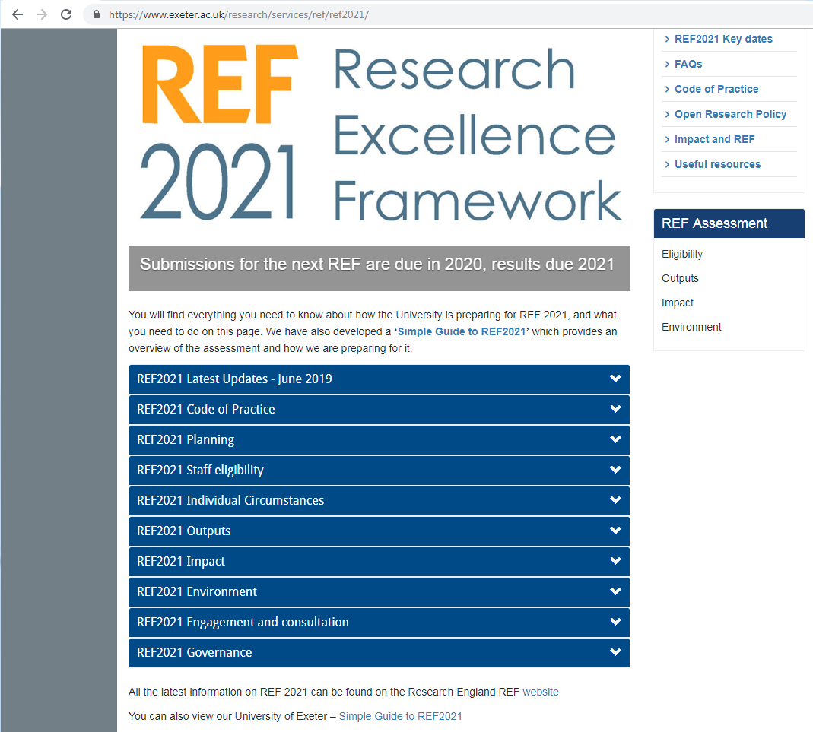
Questions?
Email: Exeter-REF-2021@Exeter.ac.uk
Website: http://www.exeter.ac.uk/research/services/ref/ref2021/

